Slide 1
[Modeling of hydroacoustic propagation based on
the normal mode-parabolic equation method]
[De Nan]
[P1.3-526]
Designated area for External Participants to insert their Logo and/or Affiliation
Please remove this text and the dashed outline after placing your Logo

Slide 2
[Modeling of hydroacoustic propagation based on the normal mode-parabolic equation method]
[De Nan ,nan.de@ndc.org.cn]
P1.3-526
In view of the low accuracy of the far-field modeling of underwater explosion sound propagation, the normal mode-parabolic equation method is used to carry out the modeling of hydroacoustic propagation to optimize the ability of far-field propagation simulation. This method combines the advantages of the normal mode model method and the parabolic equation method, adopts local normal mode analysis in the vertical direction, and uses the parabolic equation method to solve the normal mode amplitude equation in the horizontal direction. This method can be used to simulate the sound propagation loss of underwater explosions, and combined with the sound velocity profile, the theoretical travel time of sound propagation can be calculated. This method solves the problem that the high frequency situation is hard to calculate with the parabolic equation method, and the algorithm is able to extended to three-dimensional simulation.
ABSTRACT

Slide 3
[Modeling of hydroacoustic propagation based on the normal mode-parabolic equation method]
[De Nan ,nan.de@ndc.org.cn]
P1.3-526
Monitoring and analysis of global underwater explosions is an important task of the NDC. For the forward simulation of underwater sound propagation, the normal mode method has clear physical interpretationc, however it is only suitable for waveguides with constant environmental parameters in the horizontal direction, while the parabolic equation method can easily deal with the depth-related sound speed, terrain and distance. The normal mode method has the limitation of the modal order, and it is difficult to guarantee the calculation accuracy for the propagation problems with thousands of modalities such as deep sea and far field. The advantages of the two methods can be combined, and the initial field constructed by the normal wave solution can be recursed using the parabolic equation method to obtain the full-space sound field.
INTRODUCTION

Slide 4
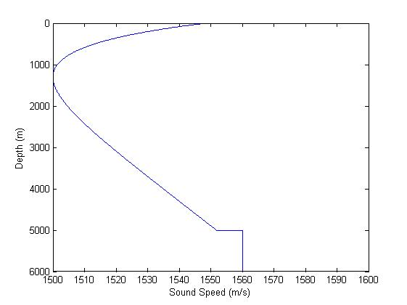
[Modeling of hydroacoustic propagation based on the normal mode-parabolic equation method]
[De Nan ,nan.de@ndc.org.cn]
P1.3-526
Based on the normal mode method, this research directly solves the eigen equation in the complex number domain, and considers the contribution of the imaginary part of the eigenvalue to the eigen equation. In addition, for the linearly segmented sound velocity profile, the analytical expressions of the phase integral and its derivative are derived directly. Solve in the real number domain to improve the calculation efficiency.
METHODS

Slide 5
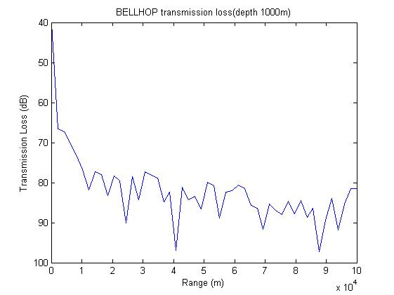
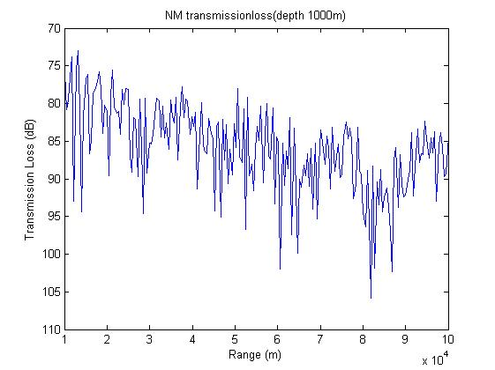
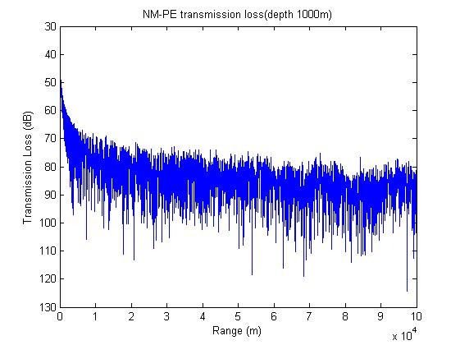
[Modeling of hydroacoustic propagation based on the normal mode-parabolic equation method]
[De Nan ,nan.de@ndc.org.cn]
P1.3-526
The Munk sound velocity model is used to simulate the transmission loss of the three methods. The propagation distance is 100km, the ocean depth is 5000m, the sound source depth is 800m, and the propagation loss at 1km is detected.
RESULTS
Bellhop method takes 9.3s, NM method takes 43.5s, NM-PE method takes 22.1s.

Slide 6
[Modeling of hydroacoustic propagation based on the normal mode-parabolic equation method]
[De Nan ,nan.de@ndc.org.cn]
P1.3-526
Through the above comparison, it can be found that the NM-PE method can improve the calculation efficiency while ensuring the calculation accuracy, and perform accurate propagation loss simulation calculations. More work will be carried out in the future, using more data to test the method.
CONCLUSIONS
Thanks for listening

