Slide 1


Yield Estimation of the Aug 4, 2020 Beirut Explosion Using Seismic and Shockwave Data
Chandan K. Saikia, Petru Negraru, Jon Creasey,
and Mark T. Woods
Air Force Technical Applications Center
Patrick Space Force Base, PSFB, FL 32952, USA
Acknowledgements: MSgt. Natasha Matoon and Michael Mecham of AFTAC and Dr. Samuel Rigby for providing the blast-wave data used in this study.
Disclaimer: Views in this presentation are those of the authors and do not represent the official position or policy of the United States Government and CTBTO.

Slide 2
Beirut Explosion – Shockwave and Seismic Data
Killed at least 207 people, injured 7500, caused property damage equivalent of US$27 billion and made about 300,000 people homeless.
Generated both blast and seismic wave data where seismic signal is pronounced in the frequency band 2 -7 Hz.
Hydro-acoustic phases well recorded by regional OBS stations in Cypress
Provided motivation to investigate both shockwave and seismic data to estimate a possible range of yield and analyze the consistency in the estimates.

Slide 3
Topics
Blast wave Data
Seismic Wave – Signal Characteristics
Shock Wave Analysis
Seismic Data Analysis: (i) spectral characteristics, (ii) possible corner (f_{c}), (iii) m_{b} values
Estimate seismic yields
Summary
m_{b}: IDC: 3.2 ± 0.3 - 1 obs
GFK: 3.5 - 16 obs
USGS: 3.3
m_{b}tmp: IDC : 3.4 ± 0.2 - 4 obs

Slide 4
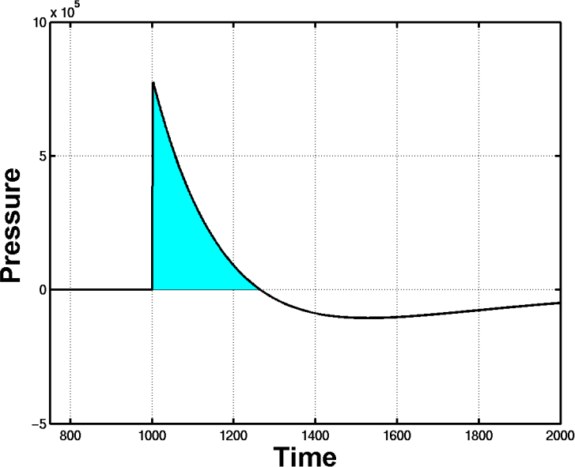
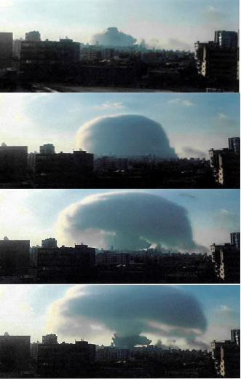
Impulse Formation of blastwaves at a Site
overpressure
Schematic
impulse
duration
Blastwave parameters:
(i) Impulse,
(ii) duration and
(iii) overpressure
arrival time (T):
shockwave velocity (R/T)
Distance(m) Travel Time (s)
665.58 1.37
951.73 2.04
1380.93 3.40
1809.11 4.50
2899.25 7.60
10043.51 28.00
Special thanks to Msgt Matoon and Mr. Mecham of AFTAC for the accomplishment of this task.

Slide 5
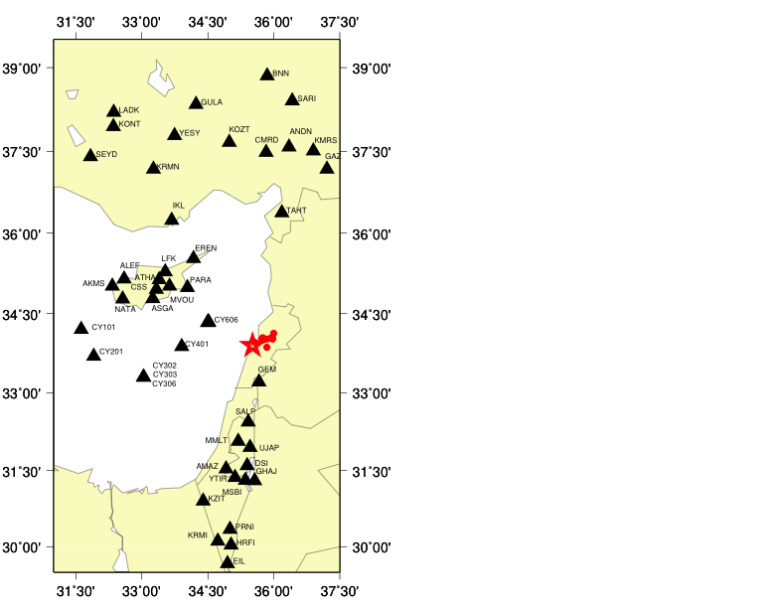
Beirut Explosion – Seismic Data
Downloaded waveforms from open stations archived at IRIS Data Management Center (DMC) and were corrected for the instrument responses.
Majority waveforms exhibit useful signals in a frequency band ranging from 2 to 7 Hz.
Stations: CY101 CY201, CY302, CY303, CY306, CY401,CY606, EREN, PARA, and MVOU towards Cypress displayed arrival of the hydro-acoustic waves (~1.5km/sec)
P waves travel to all stations with a speed of about 6.5 km/sec.
Beirut Explosion
Nearby Earthquakes
Event locations are from NEIC

Slide 6
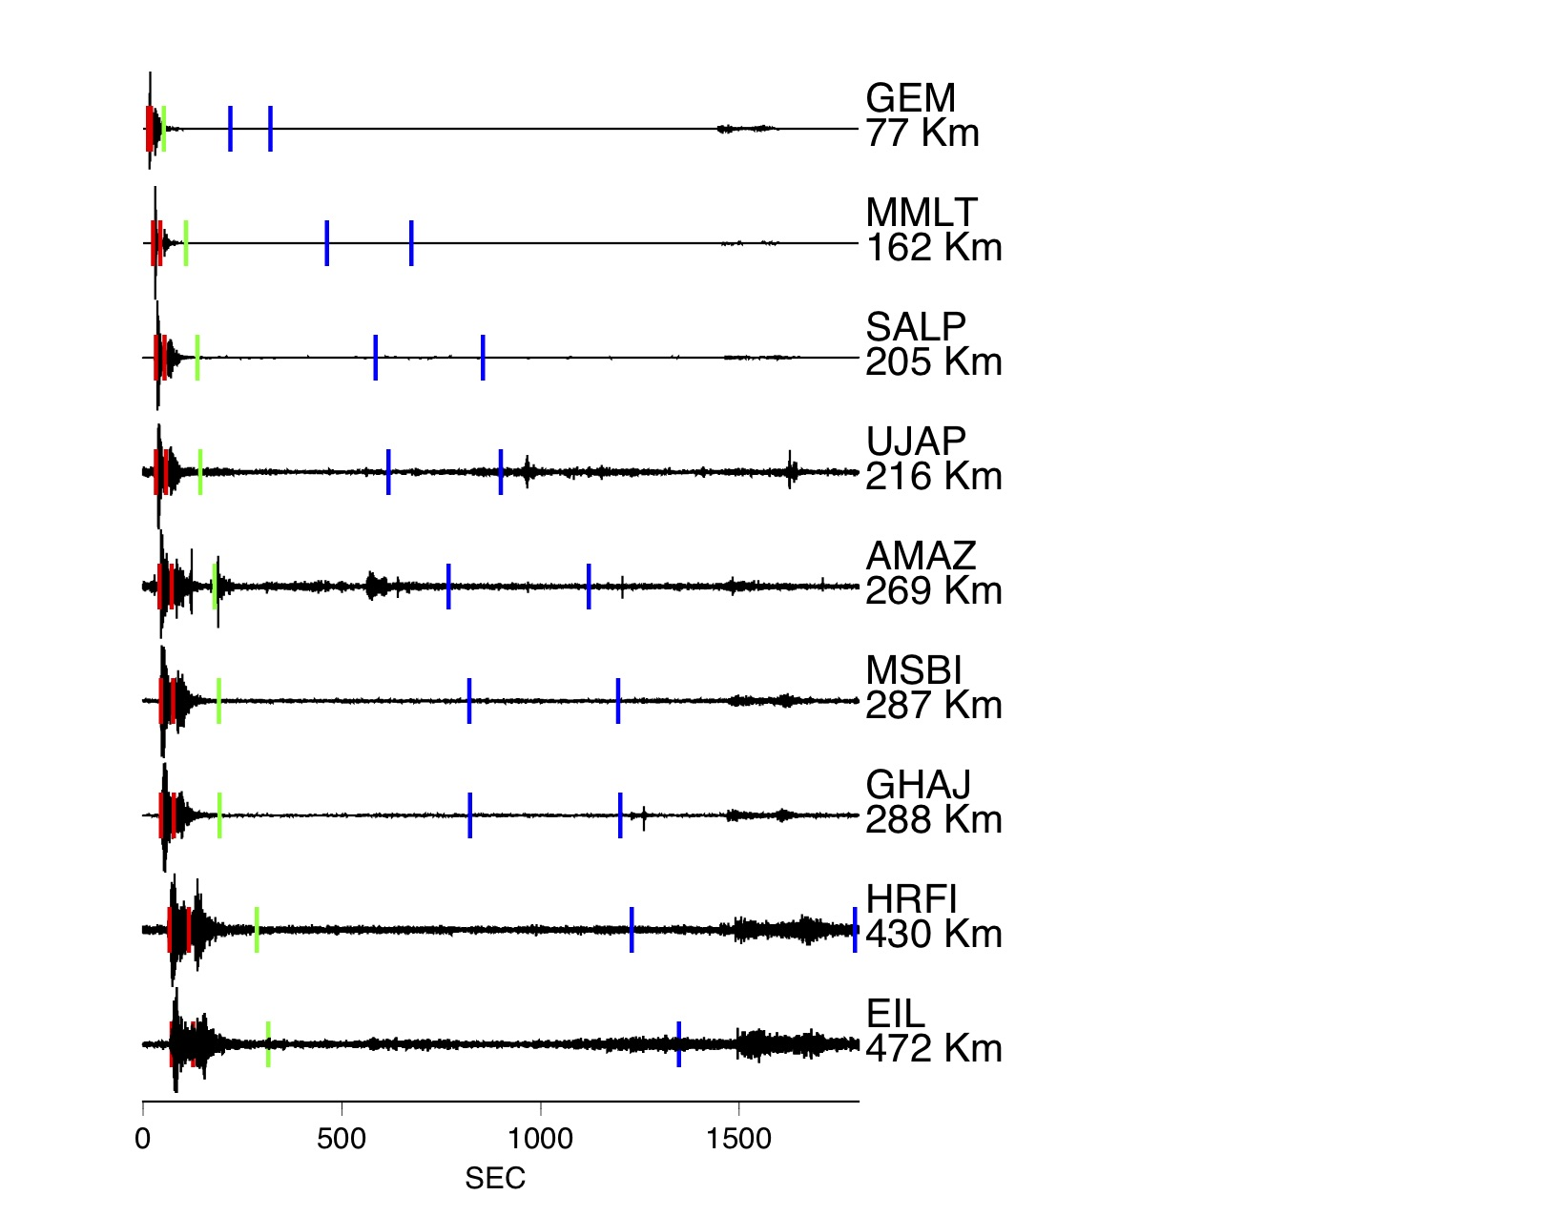
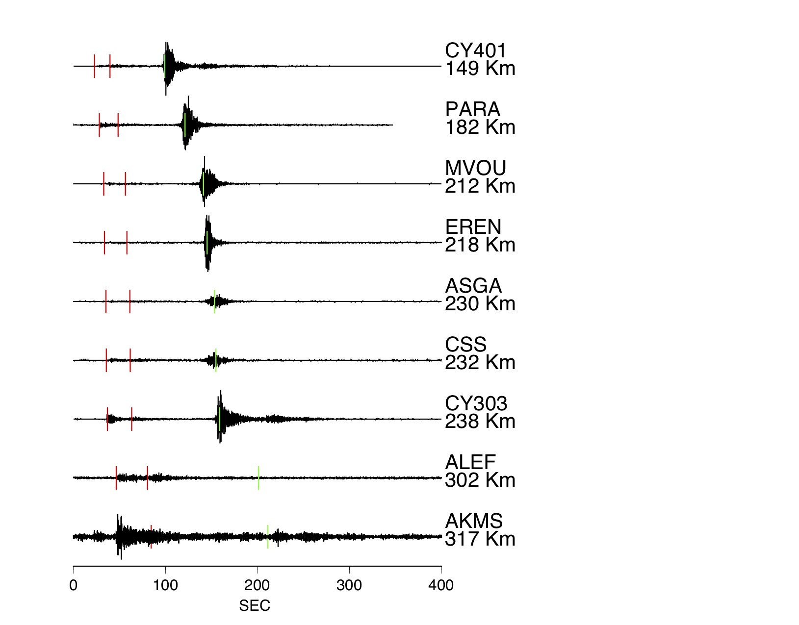
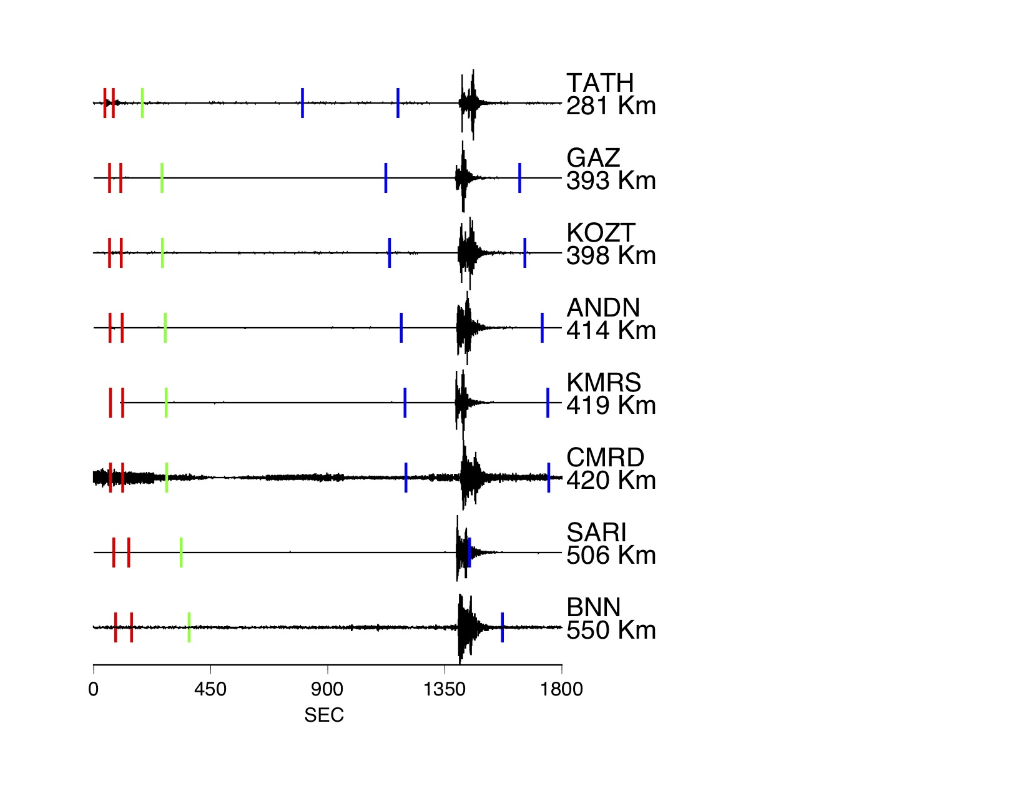
Waveforms – Instrument Corrected
Stations to South
Stations to Cypress
Stations to North
Hydro-acoustic
Regional earthquake
t₃
t₁
t₁
t₂
t₁
t₄
t₅
t₃
t₄
t₅
t₃
t₄
t₅
t₁ – 6.5 km/sec t₄ – 350m/sec
t₂ – 3.757 km/sec t₅ – 240m/sec
t₃ - 1.5 km/sec
waves arriving around t₃ marker are hydro-acoustic/T phases and those within the t₄ and t₅ markers will be infrasound unless arriving from an interfering event.

Slide 7
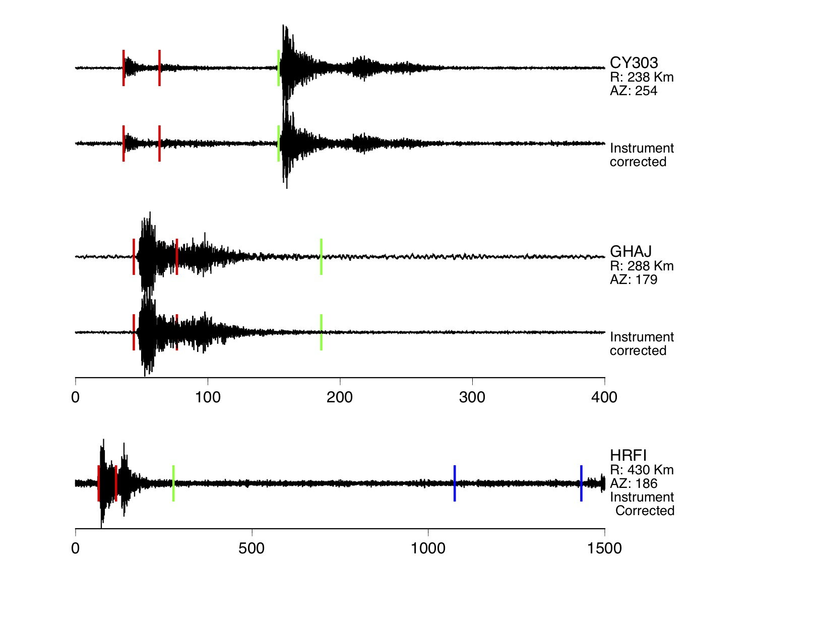
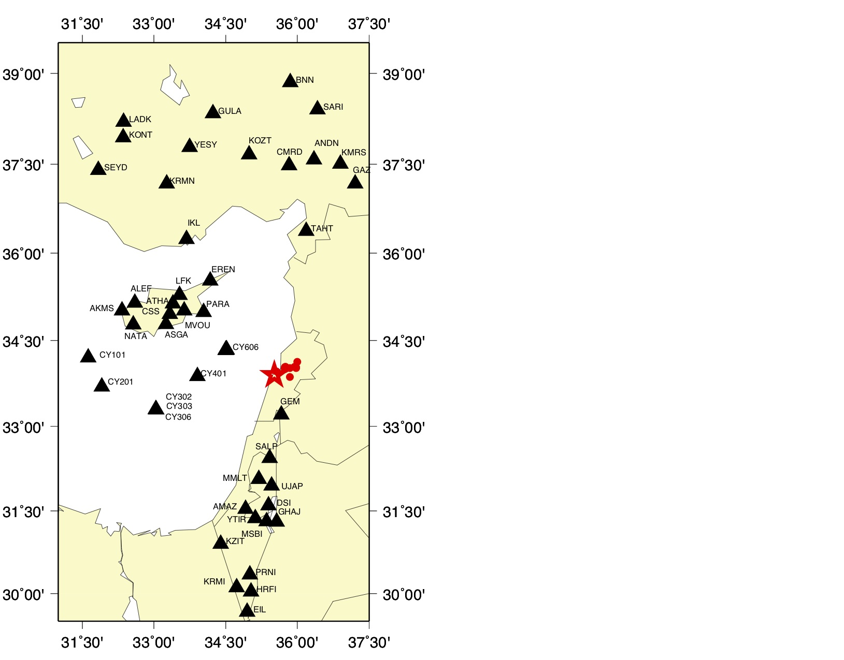
Beirut Explosion Data Comparison (Velocity)
t₁
t₂
hydro acoustic
Cypress
t₃
south
Infrasound
south
t₄
t₅

Slide 8
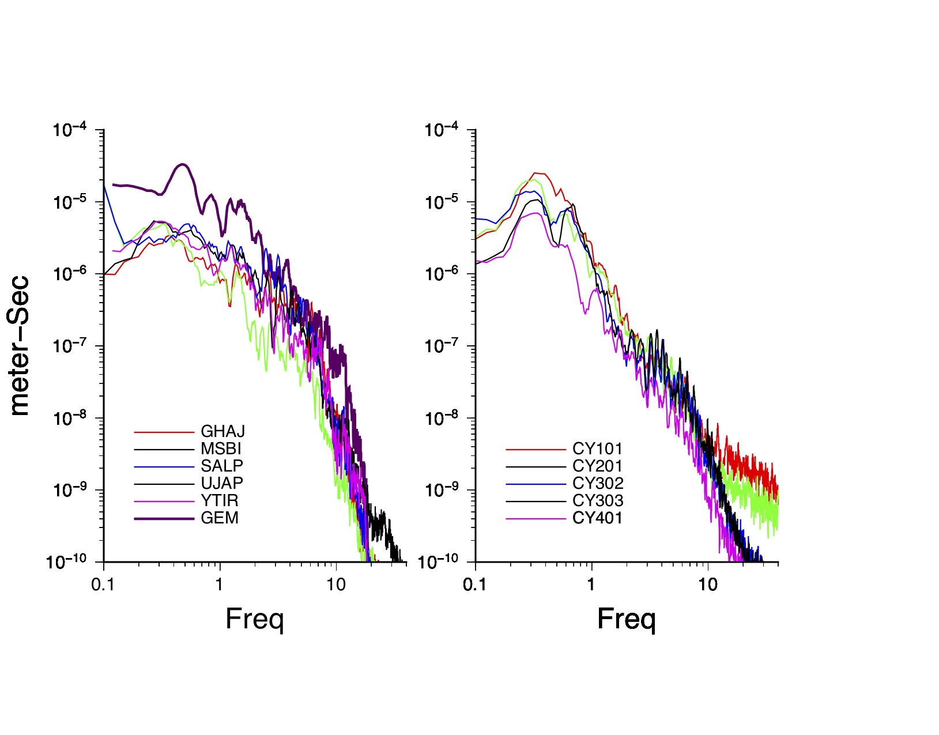
Beirut Explosion – Displacement P-Wave Spectra
Extracted P-wave window starting at 10 seconds before the t₁ marker and ending at 20 seconds after.
Noise window had the same time length.
Tapered, transformed to the frequency domain, noise spectra subtracted from signal spectra, and the corrected spectra has a 3-point smoothing.
Spectra normalized to 2 km (geometrical correction)
NOISE-CORRECTED SPECTRA
Stations to South
Stations to Cypress
??
??

Slide 9
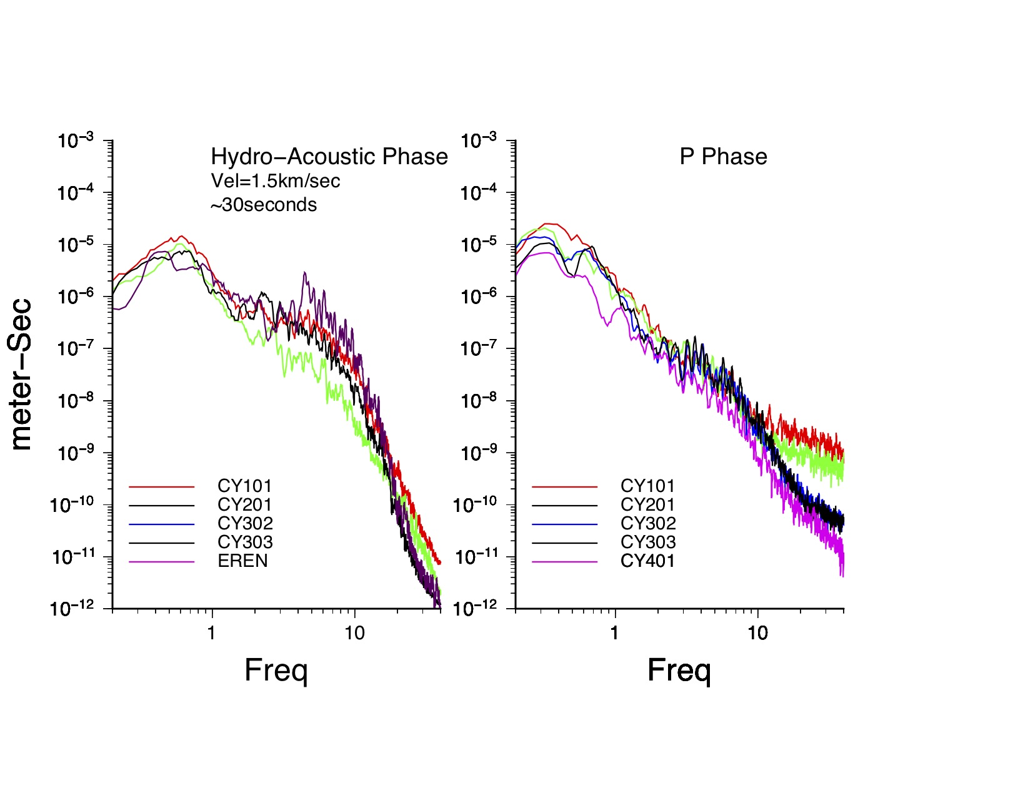
Characteristic of Hydro Acoustic vs. P wave
Spectra for Stations to Cypress

Slide 10
Blast Wave Analysis – Yield of Beirut Explosion
To determine yield using blast data, we used the empirical scaling relationship (Koper et al.,2007) which relates scaled shockwave velocity to scaled distance.
Used two data sets: we presented the first data set earlier and used scaling relations to fit data. We also assigned 90% confidence limit to calculate possible upper and lower limits for the estimated yield value.
Augmented this data by adding additional data from Rigby et al. (2002). These authors used a different scaling relation that was developed based on shockwave data from experiments using hemisphere of TNT between 1 and 400,000 Kg (Kingary and Bulmash, 1984).
Kingery, C.N. and G. Blumash (1984), Air blast parameters from TNT spherical air burst and hemispherical surface burst, Tech Rept, ARBPL-TR-02555, U Army BRL, APG, MD , USA.
Koper K. D., T. C.Wallace, R. E Reinkeand J.A. Leverette (2002): Empirical scaling laws for truck bomb explosions based on seismic and acoustic data, Bull. Seis. Soc. Am., vol92, no2., pp527-542
Rigby, S.E. et al. (2020). Preliminary yield estimation of the 2020 Beirut explosion Using video footage from social media, Shock Waves, https://doi.org/10.1007/s00193-00970-z

Slide 11
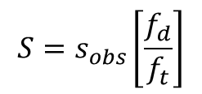
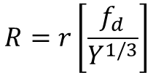
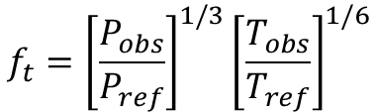
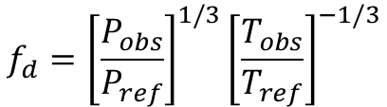


Scaling of Distance vs. Shockwave Velocity
Scaled shockwave velocity ( S ):
$$S=s_{obs}\left[\frac{f_{d}}{f_{t}}\right]$$
$$R=r\left[\frac{f_{d}}{Y^{1/3}}\right]$$
Scaled Distance ( R ):
where the s_{obs} and r are the shockwave velocity and distance Y is the yield of the explosive and f_{d} and f_{t} are constants expressed in terms of pressure and temperature as follows:
$$f_{d}={\left[\frac{P_{obs}}{P_{ref}}\right]}^{1/3}{\left[\frac{T_{obs}}{T_{ref}}\right]}^{−1/3}$$
$$f_{t}={\left[\frac{P_{obs}}{P_{ref}}\right]}^{1/3}{\left[\frac{T_{obs}}{T_{ref}}\right]}^{1/6}$$
$$\frac{P_{obs}}{P_{ref}}≈1$$
$$\frac{T_{obs}}{T_{ref}}=\frac{303.15K}{288.15K}=1.0521$$
BE detonated at the surface at sea-level and so
Bibliography: Koper K. D., T. C.Wallace, R. E Reinkeand J.A. Leverette (2002): Empirical scaling laws for truck bomb explosions based on seismic and acoustic data, Bull. Seis. Soc. Am., vol92, no2., pp527-542

Slide 12
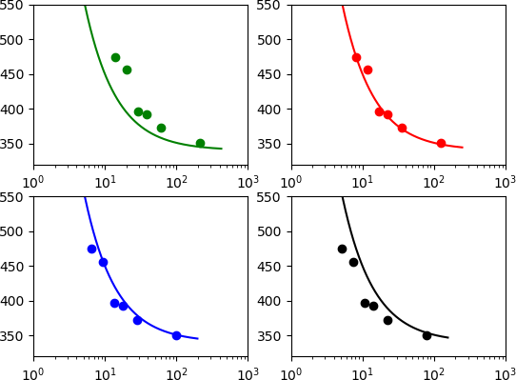
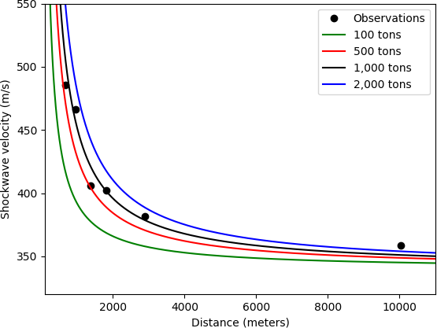
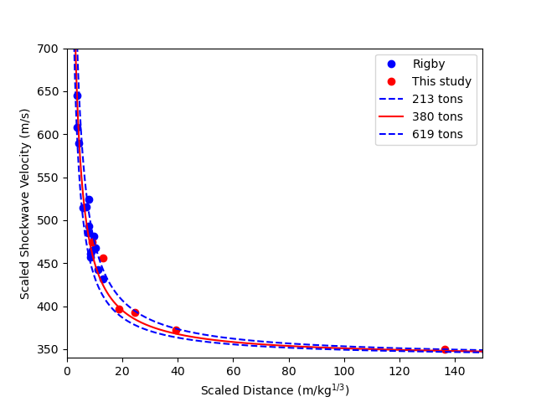
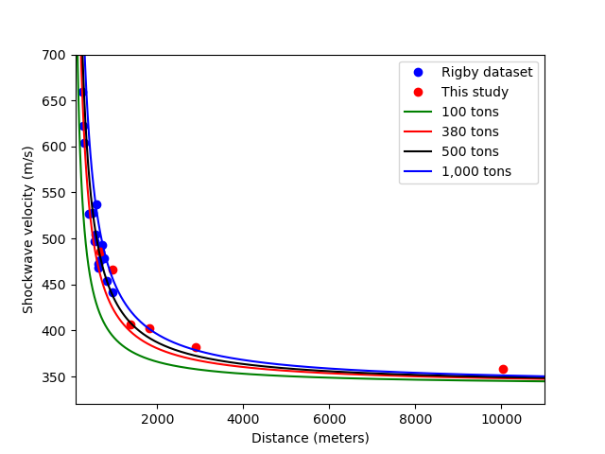
Results: Yield for Best Fit
100 tons
500 tons
Close-in blast data from Rigby et al. (2020) suggest that Beirut explosion is consistent with a low yield ~ about 600 tons for its best value with an upper limit of 1.1 Kt.
When our dataset is augmented by Rigby et al. dataset, the analysis yields 380 tons as the best estimate, with its 90% confidence limit from 213 to 619 tons as shown in the lower right panel.
Scaled shockwave velocity (m/s)
S = 1100R⁻¹ + 340
1,000 tons
2,000 tons
Scaled distance (m/kg^{1/3})
distance (m/kg^{1/3})

Slide 13
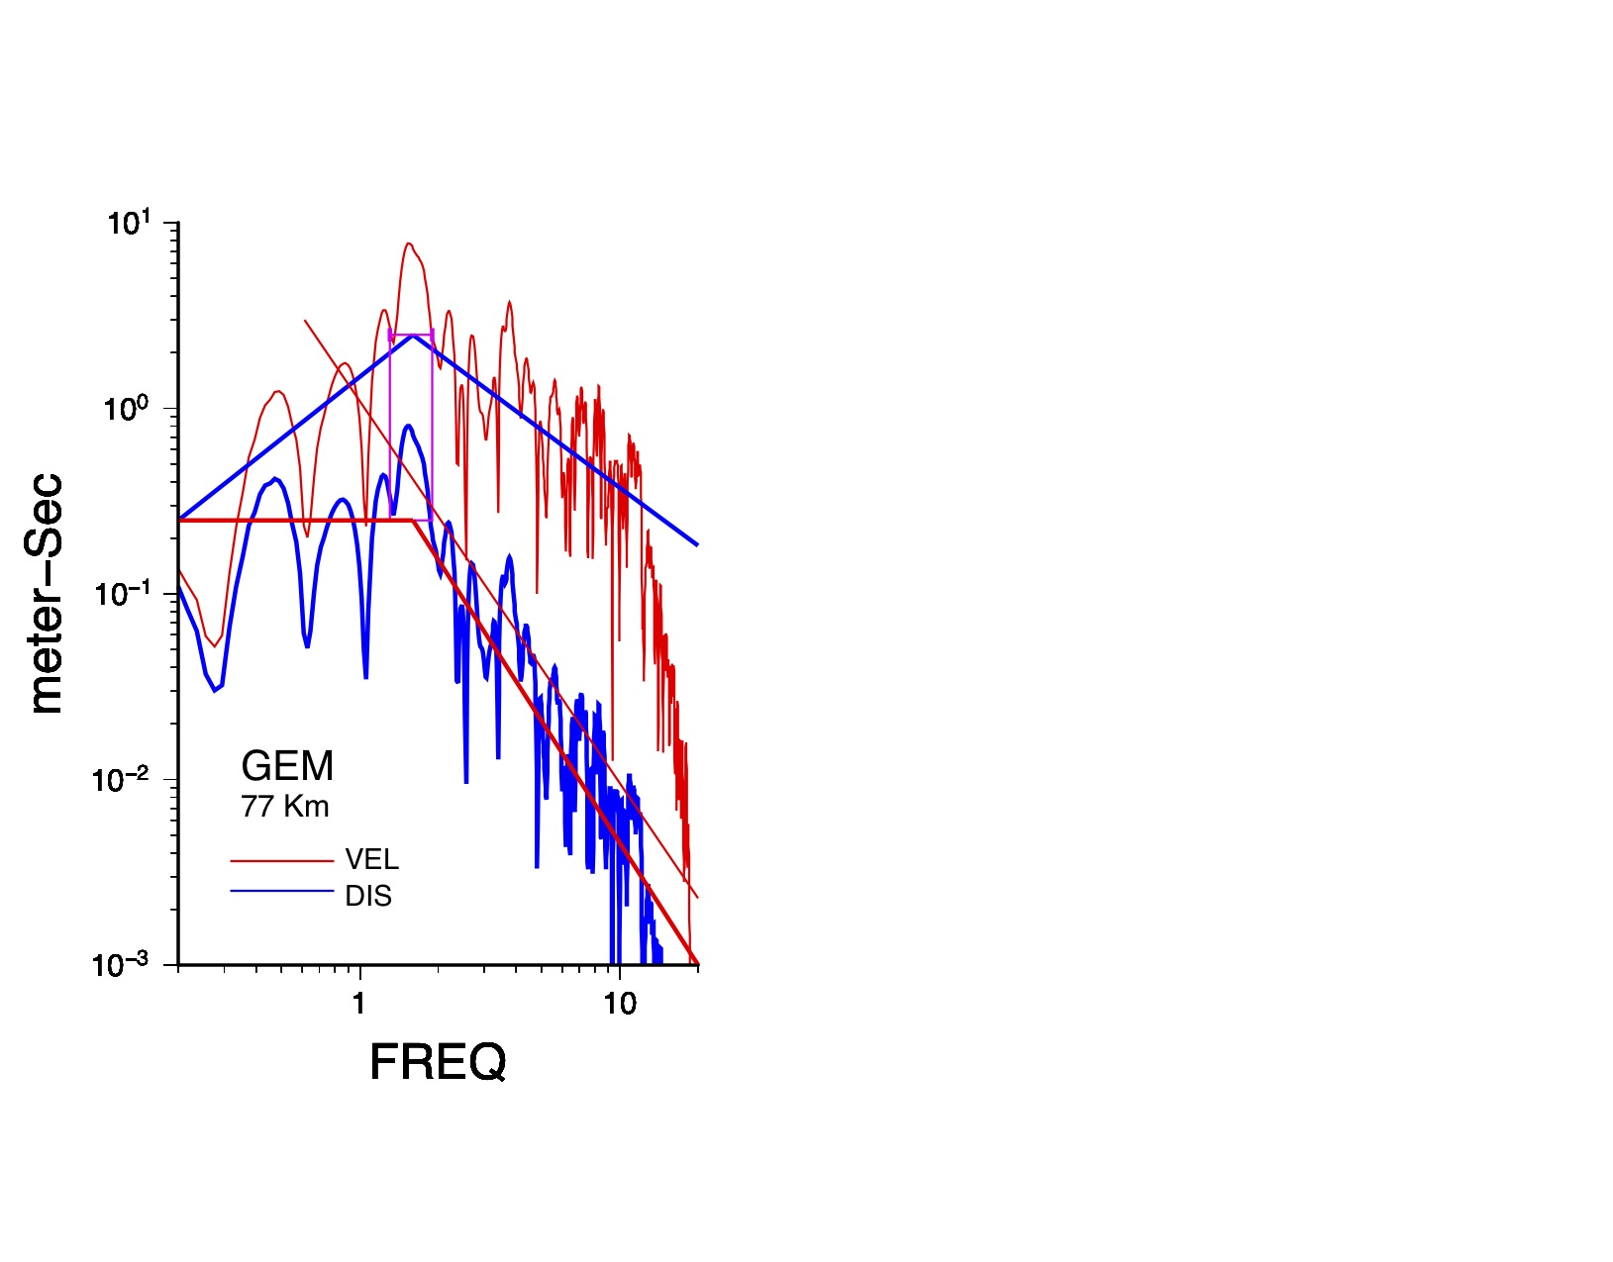
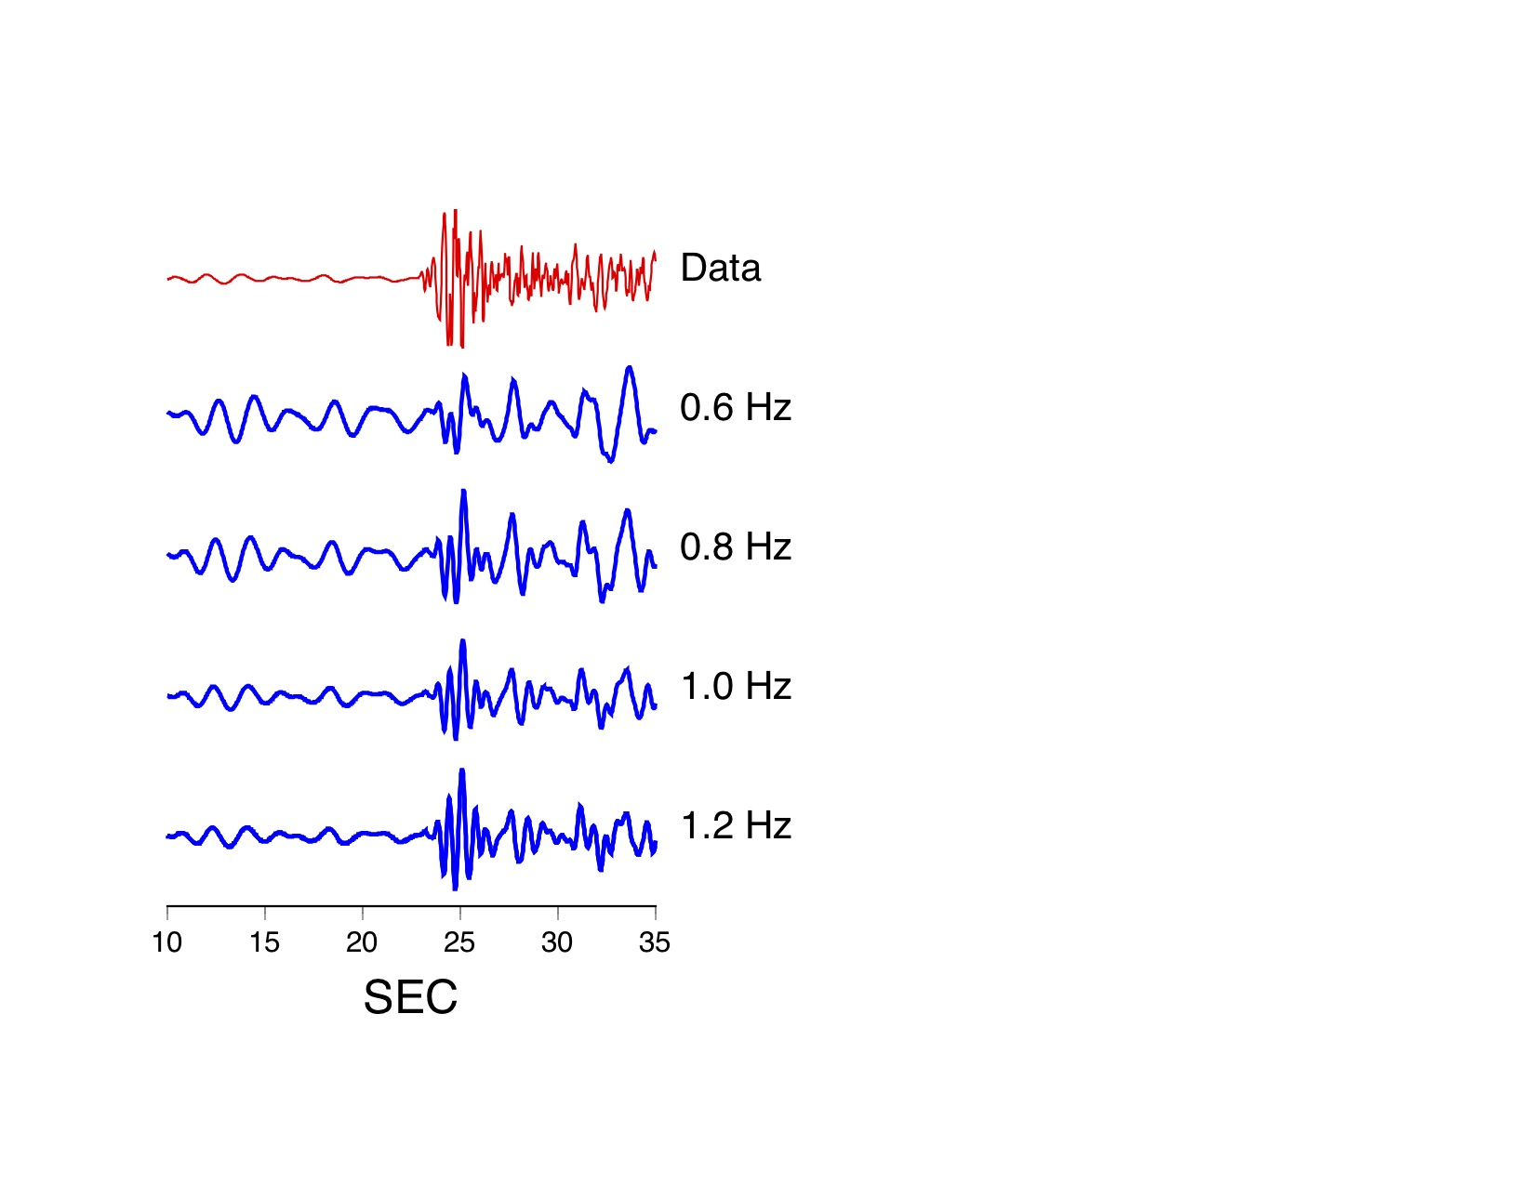

Source Corner (f_{c}) vs. Yield (Y) - Beirut Explosion
Spectral Analysis of GEM Waveform
Surface focused
GEM spectra has a decay
Corner (f_{c}) is around 1.6 Hz (1.3-1.9Hz)
Relate f_{c} to the possible yield
Low-Passed
f_{c} estimated using waveforms from two TARANTULA chemical explosions at locations within 1 meter in (X,Y): one at 0.6 meters above the ground and the other at 0.6 meters below, at common stations located 3.5 and 4.6km away suggests
f_{c} estimates are similar
Next, use Mueller-Murphy Source Function (MMSF) to relate f_{c} and Y with emplacement conditions adopted from Bassinoy et al. (2018).
$$ω^{−2}$$

Slide 14
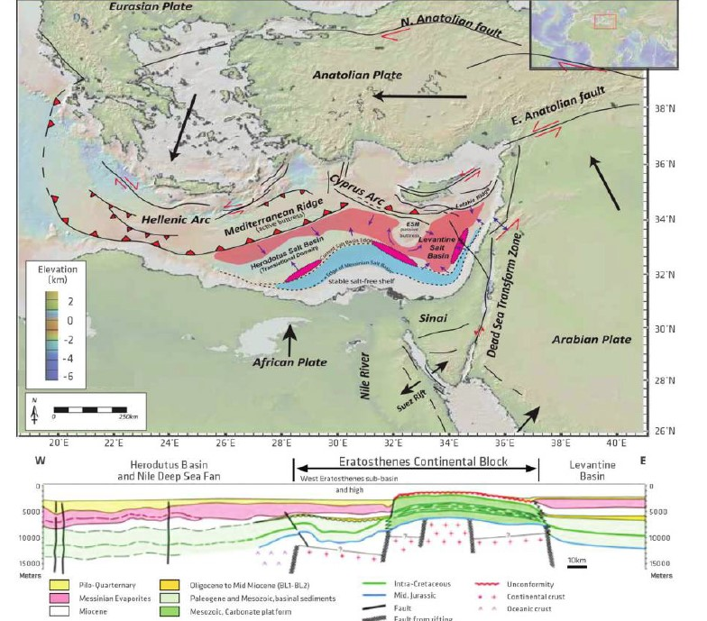
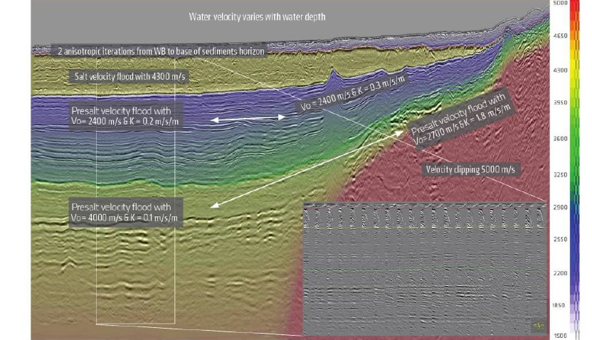
Geologic Perspective of Beirut Explosion Site
Taken from: El-Bessinoy, A., J. Kumar and T. Martin (2018). Velocity model building in the major basins of the eastern Mediterranean sea for imaging regional prospectivity, https://doi.org/10.1190/tle37005519.1
The explosion occurred in the Mesozoic carbonate platform at the location of the red star where some information on the possible velocities is available from an imaging study that was conducted towards the hydrocarbon prospectivity in the eastern Mediterranean ( El-Bassiony et al., 2018). The carbonate buildups shows a relatively high velocity of about 5000 m/s with a 3.5 m/s/s of gradient.

Slide 15
Relate f_{c} vs. Y and m_{b} vs. Y
Spectral analysis suggests that the corner frequency (f_{c}) of the Beirut explosion is about 1.6 Hz and its value may vary between 1.3 – 1.9 Hz.
We used MMSF which has a dependence on the depth of burial (H) and source corner frequency (f_{c}). Beirut explosion is a surface focused explosion.
We solved for the yield iteratively using the constraint that for a chosen yield so that the depth of burial (H) satisfies the scaling law H=122.0/[Y^{1/3}] so that the resulting corner frequency matches the target f_{c} estimated from the recorder data. Without this “rule of thumb”, H can be quite arbitrary. We don’t use the spectral level because of lack of knowledge of the surface–to-ground coupling of seismic waves.
Above constraint produced a chemical yield of 1.7 Kt for a f_{c} of 1.6 Hz. The lower and upper limits of f_{c} correspond to 1.1 and 2.4 Kt, respectively. These yield estimates become small for shallow depths.
Used Bowers et al. (2001) m_{b} vs. Y formula: m_{b}=4.25 + 0.75 log₁₀(Y) to calculate yield. Depending upon which published m_{b} value is chosen, its yield would vary from 8 (m_{b}=2.9) to 68 (m_{b}=3.6) tons for chemical. Hence, for the seismic yield to be consistent with the blast wave yield, some level of a correction factor is necessary..

Slide 16
Summary
  Blast-wave analysis produced 380 tons TNT equivalent yield with a minimum misfit. An analysis with the 90% confidence limit produced a probable range of yield between 213 and 619 tons of TNT equivalent. Uncertainty attributed to observed yield estimate is expected to account for the possible distance and/or the arrival time errors in the blast wave data.
  The empirical scaled shockwave vs. scaled distance produced lower values than the values published in Rigby et al. (2021).
  Over pressure analysis conducted at AFTAC by other colleagues indicated that yield is 350 tons.
  Yield estimates based on the seismic data using the m_{b} vs. log₁₀(Y) are in the range of 8-68 tons (chemical) lower than the blast-wave estimates, which may be due to the inefficient transmission of the shockwave from the air to ground because of the surroundings during the Beirut explosion. Corrections have been proposed in literatures to represent the inefficient surface to ground coupling of seismic waves. Additional data is needed to determine the coupling for low vs. moderate sized explosions.
  Based on the assumption that the MMSF f_{c} vs. Y scaling and scaled depth of burial are applicable, the yield estimate varies between 1.1 Kt to 2.4 Kt. We did not use the spectral level along with the source corner because we are still analyzing to firm up our coupling analysis between the surface and contained explosions.
  Seismic data provided two measurable parameters: f_{c} and m_{b}. Yields estimated using these two parameters are different. Hence we need to continue further investigation using other explosion data to resolve this difference.

