Slide 1
Data-based kernel density equations for probability distributions of CTBT-relevant radioxenon isotopes at IMS stations in normal background from nuclear facilities and as simulated from underground nuclear explosions
M. Kalinowski, B. Liu
IDC/CTBTO, Vienna, Austria
P2.1-486

Slide 2
Introduction 1/2
P2.1-486
For the International Monitoring System (IMS) to be effective, it is vital that nuclear explosion signals can be distinguished from natural and man-made radioactivity in the atmosphere.
The International Data Centre (IDC) of the Comprehensive Nuclear-Test-Ban Treaty Organization (CTBTO) applies standard event screening criteria, with the objective of characterizing, highlighting, and thereby screening out, events considered to be consistent with natural phenomena or non-nuclear explosive, man-made phenomena.
Global radioactivity monitoring for the verification of the Comprehensive Nuclear-Test-Ban Treaty (CTBT) includes the four xenon isotopes ^{131m}Xe, ¹³³Xe, ^{133m}Xe and ¹³⁵Xe. These four isotopes are serving as important indicators of nuclear explosions.
INTRODUCTION

Slide 3
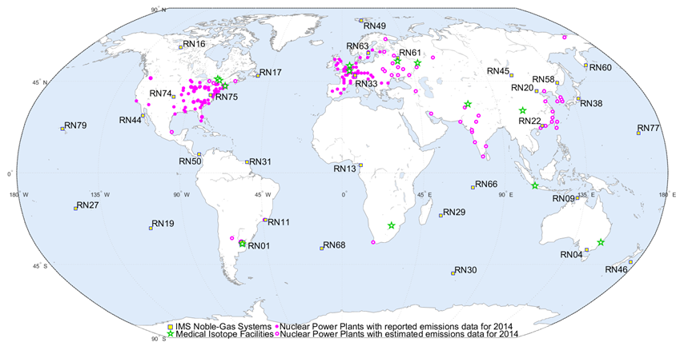
Introduction 2/2
P2.1-486
The objective of this study is to apply the kernel density (KD) approach to generate and investigate probability distributions of isotopic ratios for radioxenon releases from certain types of sources.
The goal is to create probability density functions that could be applied with a Bayesian method to determine the probability whether an IMS observation can be explained by known sources or could possibly be caused by a nuclear explosion.
INTRODUCTION

Slide 4
Methods
P2.1-486
Kernel Density Estimation (KDE)
Using a univariate kernel density estimator
  Python module: Statsmodels Version 0.11.1
  Estimator: statsmodels.nonparametric.KDEUnivariate
Optimizing parameters for each distribution
  According to the ranges of day releases or isotopic ratios
  Bandwidth
  Number of bins
  Linear or Log10 scale
Results in 2D arrays, i.e. a matrix with two columns, the first one is the KDE.support vector with 512 points
  KDE.density (density values at the 512 points)
  KDE.CDF (cumulative density function values at the 512 points)
METHODS

Slide 5
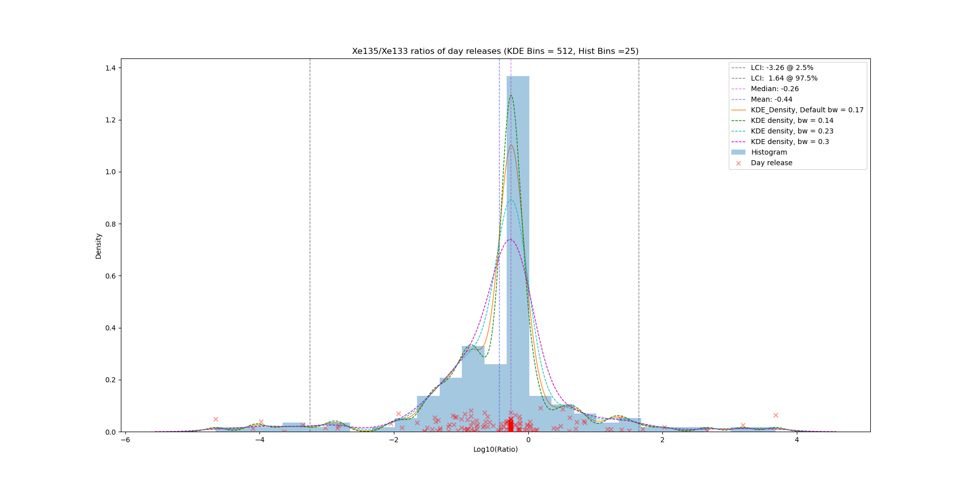
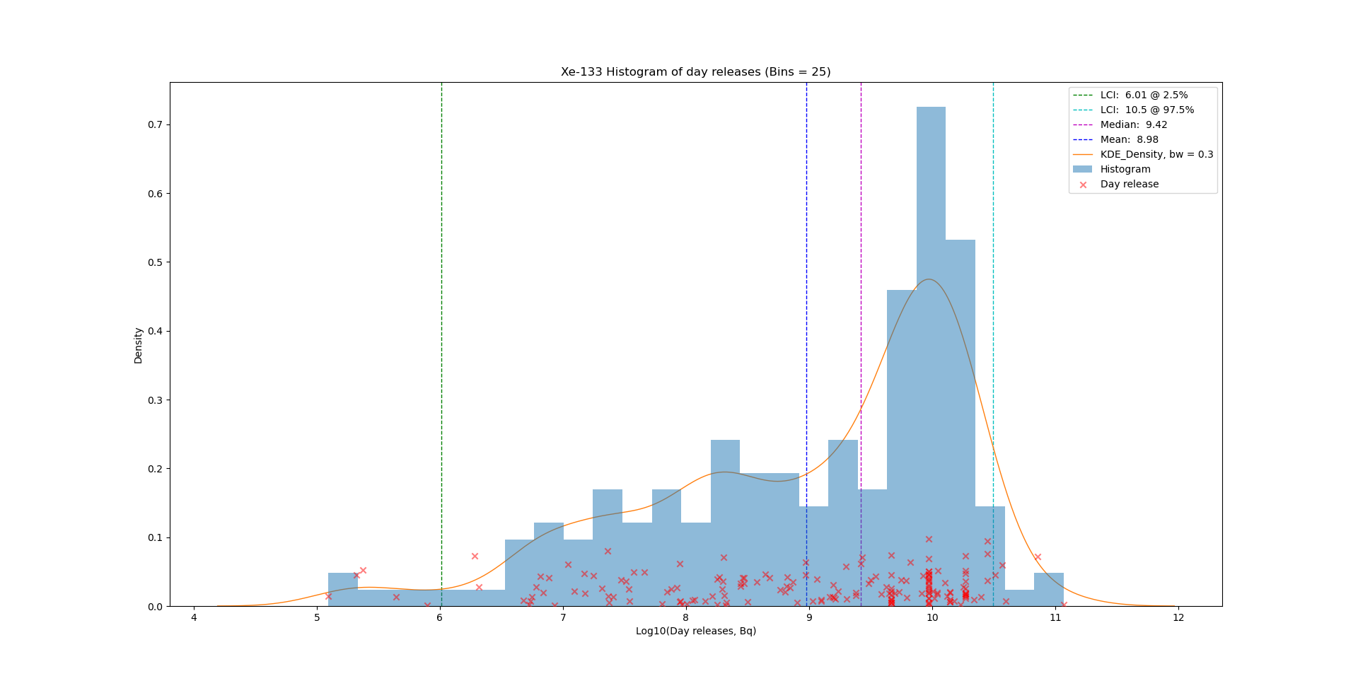
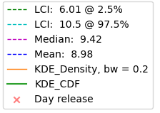
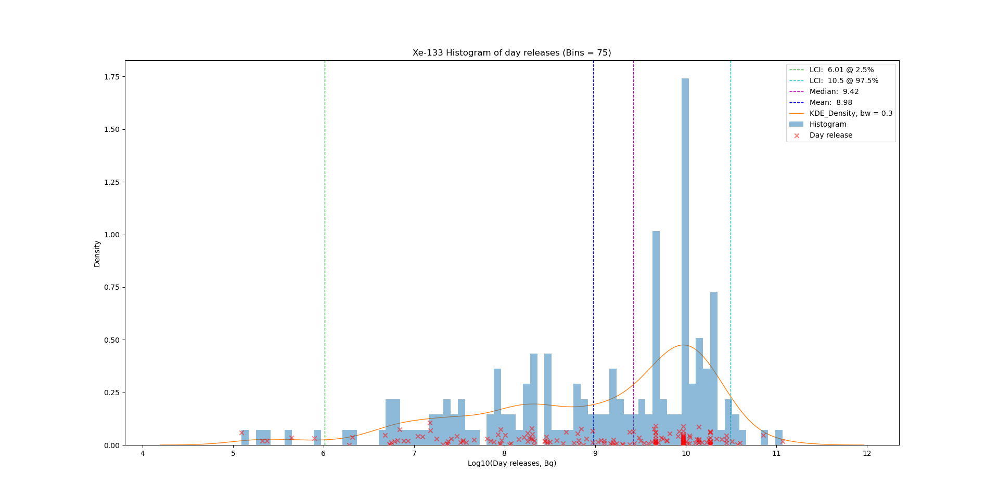
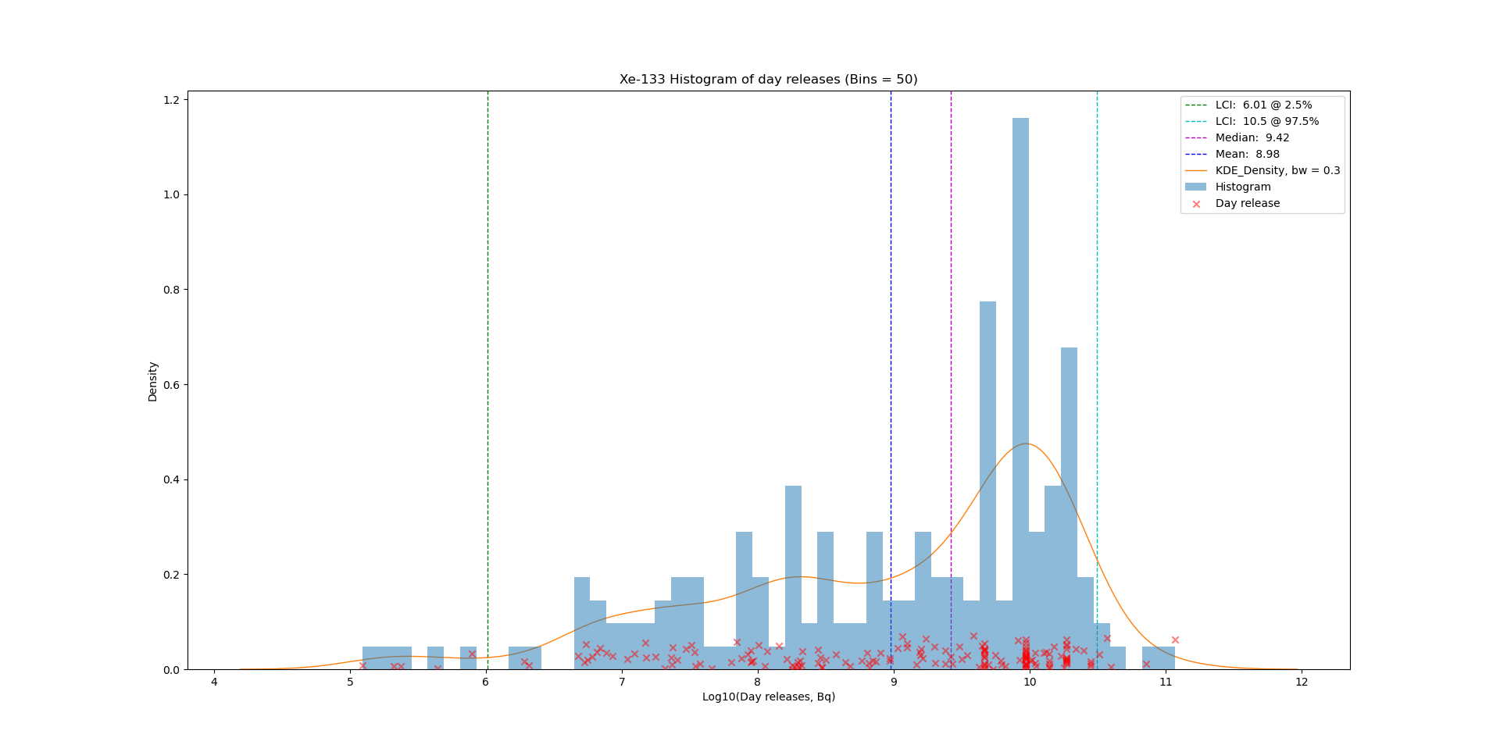
Results
P2.1-486
Optimization parameters for each distribution
KDE Bandwidth is optimized for each distribution, example in top left plot.
Bin number of histogram is selected as 25 fitting the KDE curve best.
Xe135/Xe133
bw: 0.14, 0.17, 0.23, 0.3
Xe-133 Hist
25 bins
RESULTS
Xe-133 Hist
75 bins
Xe-133 Hist
50 bins
Scatter: Y values are arbitrary for displaying.
Limits of the coverage interval is estimated for the original data

Slide 6
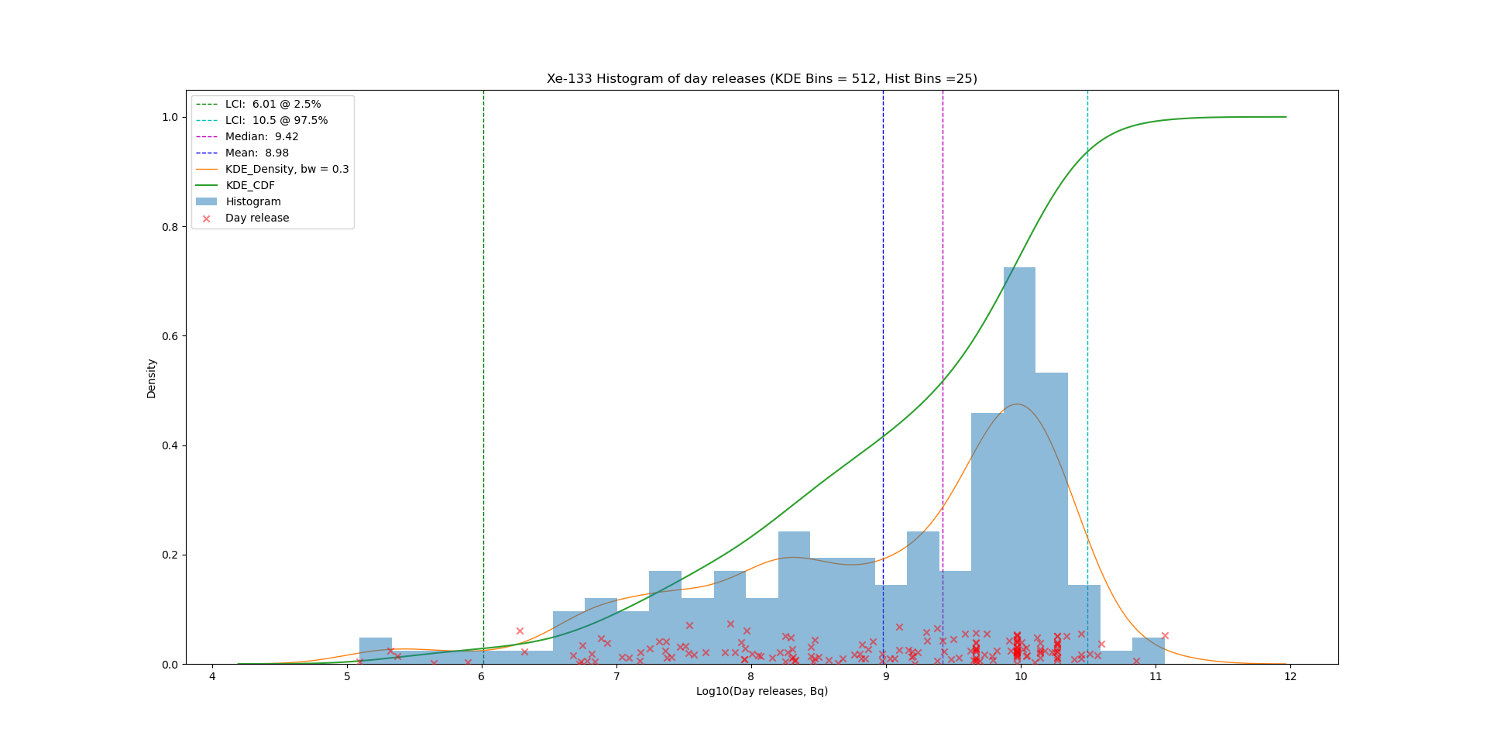
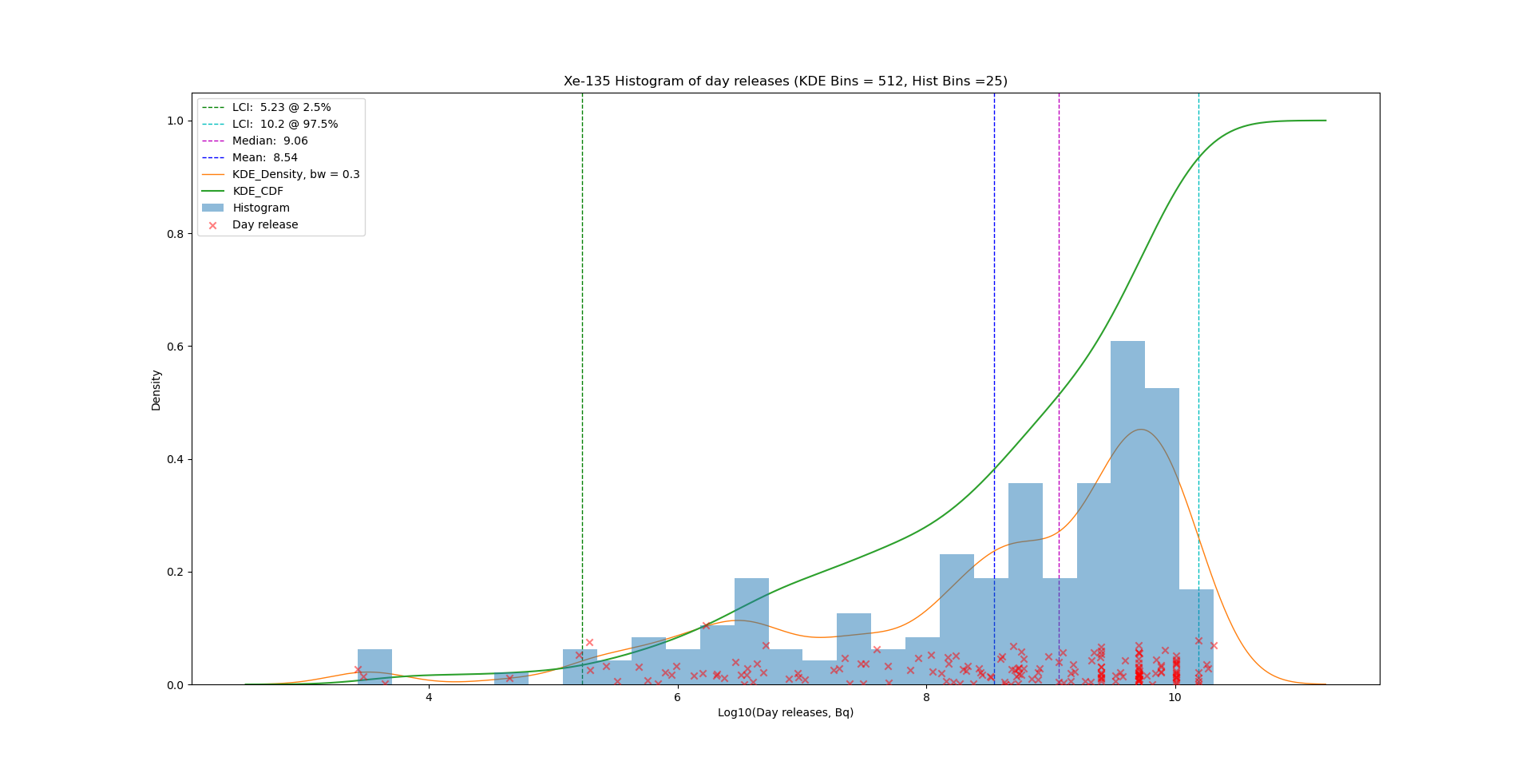
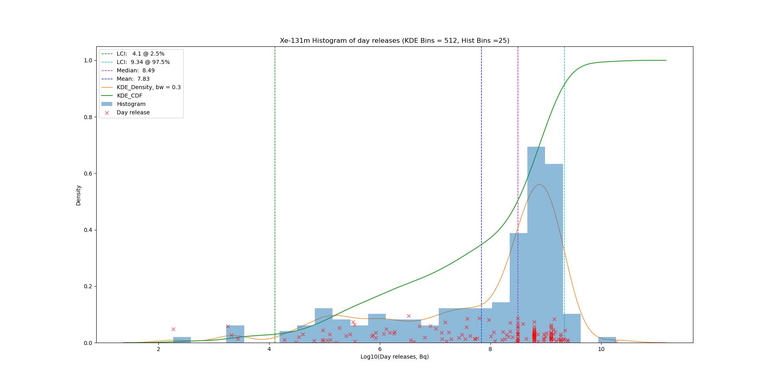
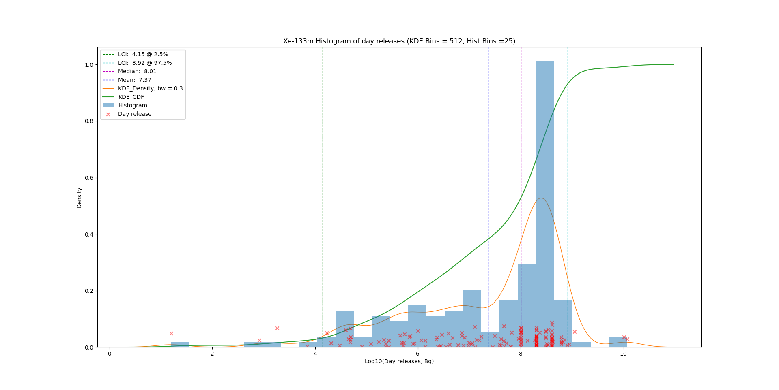
Results
P2.1-486
Distributions of activity concentrations of NPP day releases
In 2014, there were 385 nuclear power plants (NPPs) at 174 sites in operation. Reported data are available from 227 NPPs (59%).
Xe-133
Xe-135
Xe-133
RESULTS
Xe-131m
Xe-133m

Slide 7
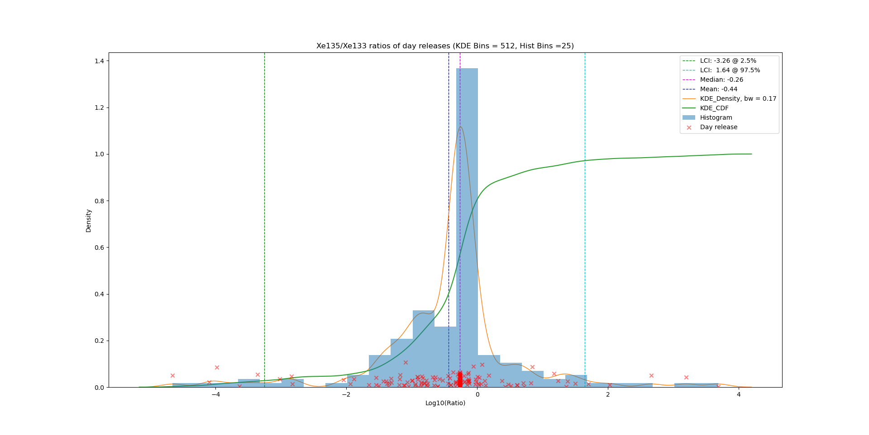
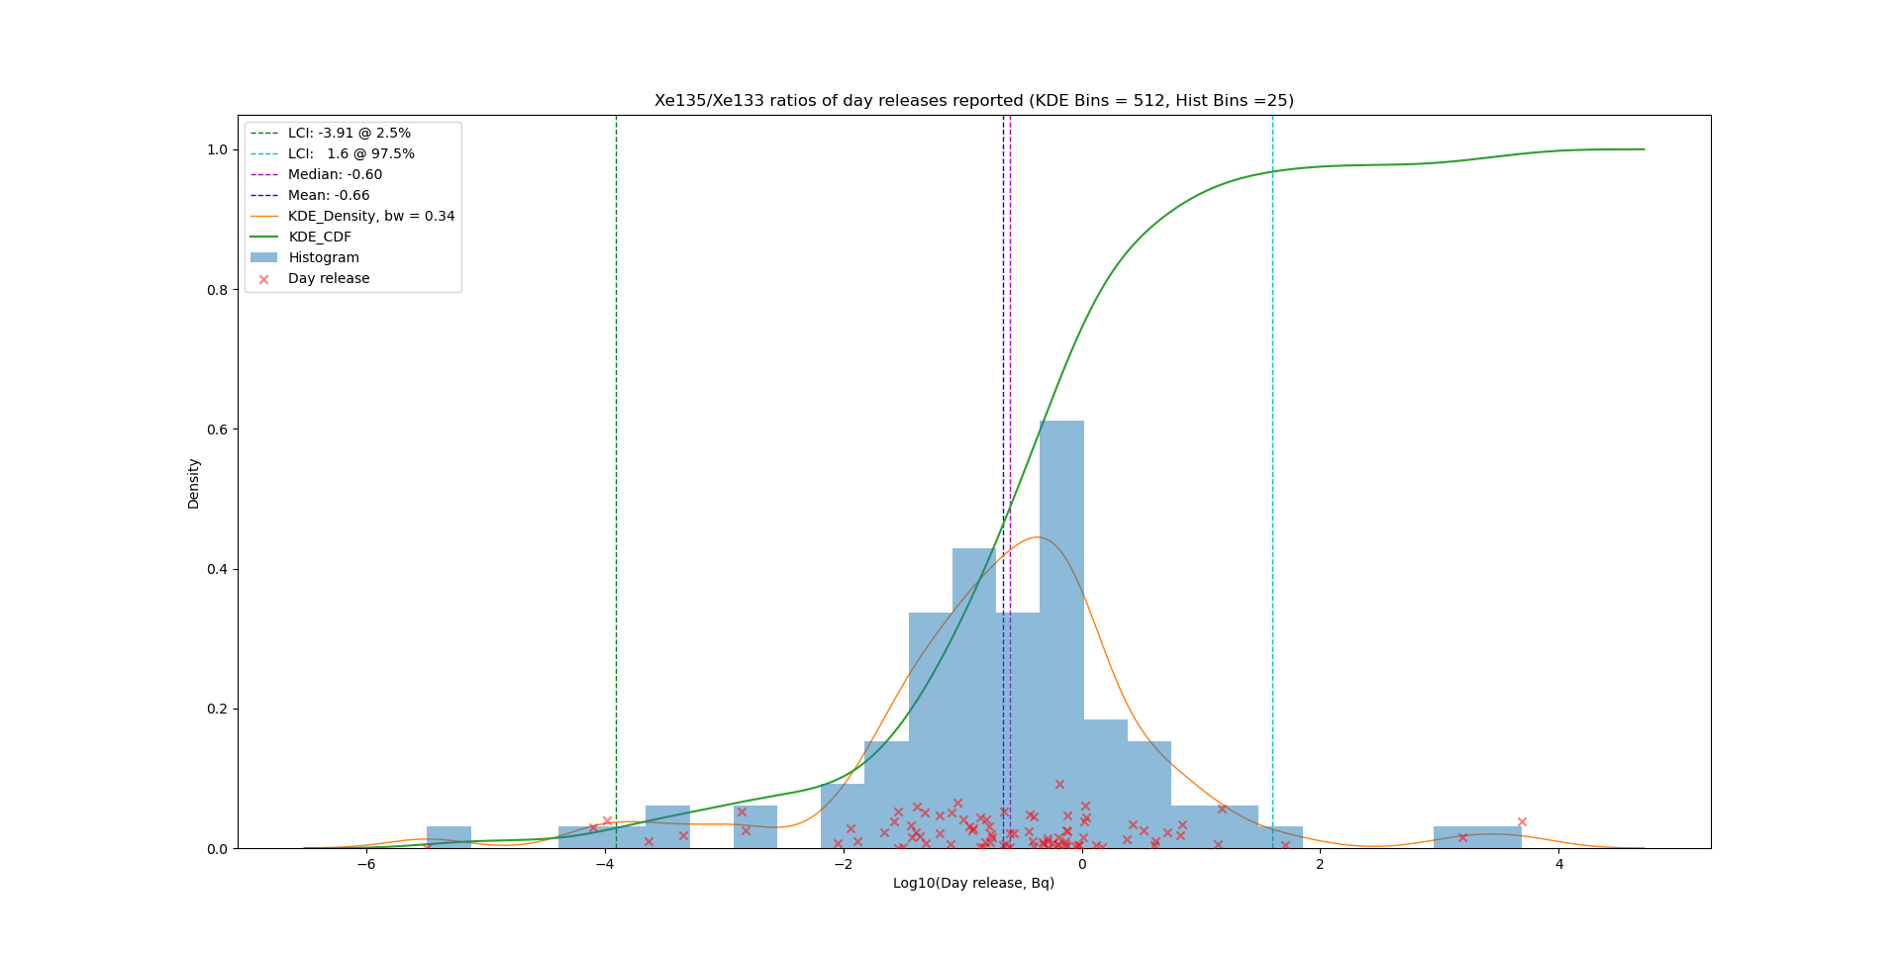
Results
P2.1-486
NPP results
Distributions of isotopic ratios for the reported data only
Comparison of Ratios of Xe135 to Xe133
RESULTS
Reported and estimated
Reported only
The estimated data apply a standard ratio, resulting in a high histogram bar.
The reported data alone have a smoother distribution.

Slide 8
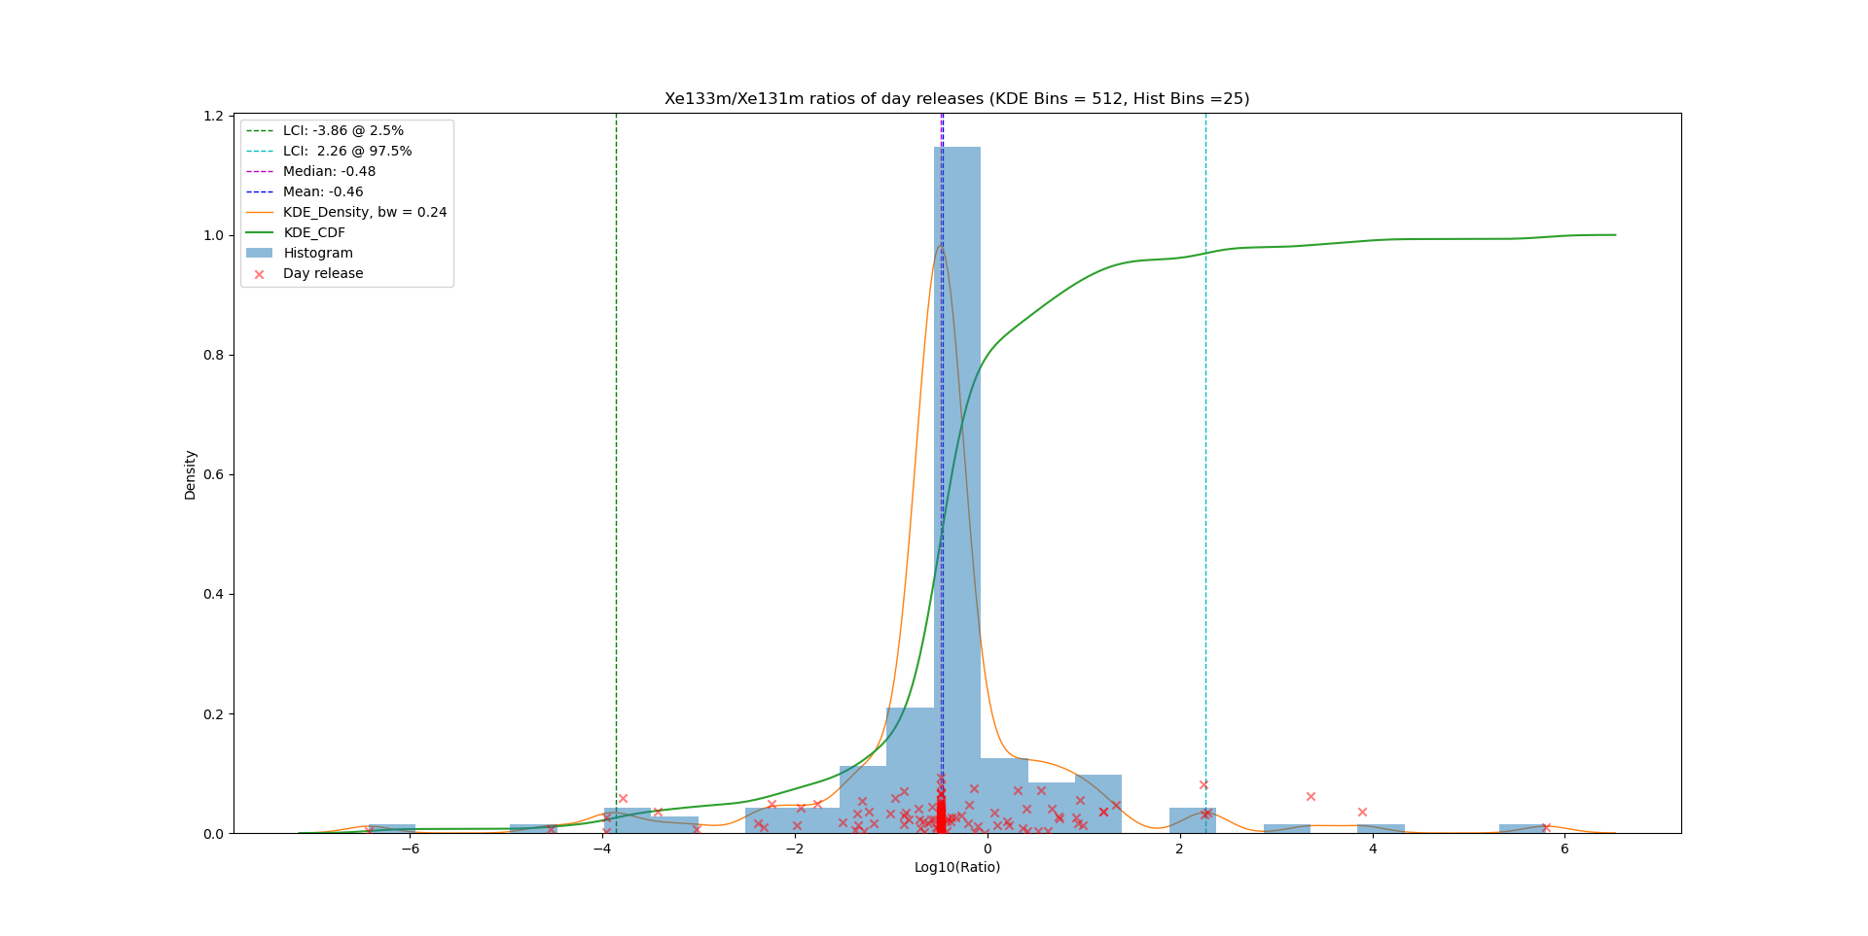
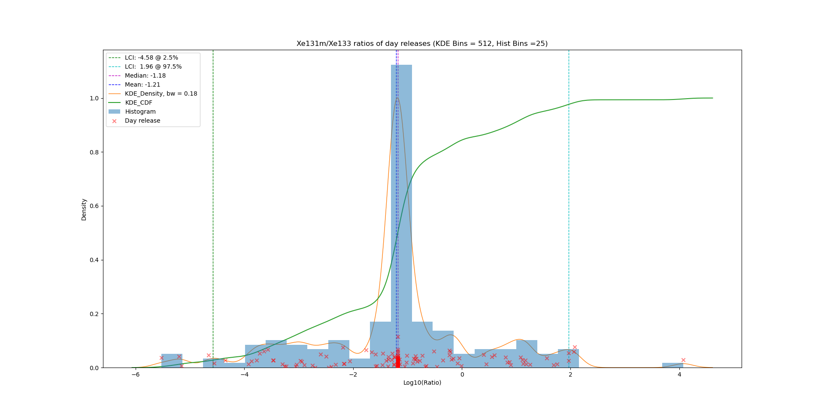
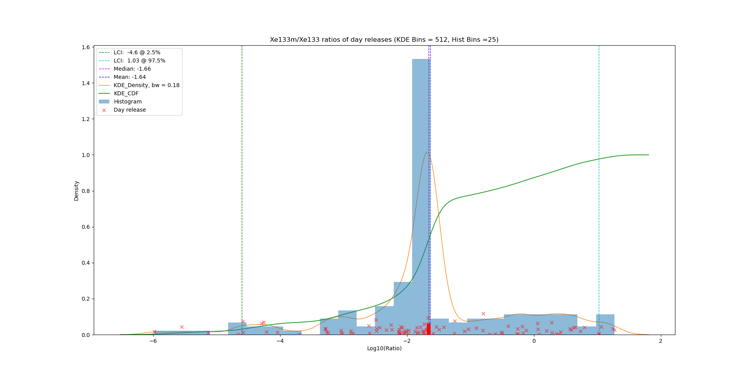
Results
P2.1-486
NPP results
Distributions of isotopic ratios for the reported and estimated data.
Xe135/Xe133
Xe133m/Xe131m
RESULTS
Xe-131m/Xe-133
Xe131m/Xe133
Xe133m/Xe133
8

Slide 9
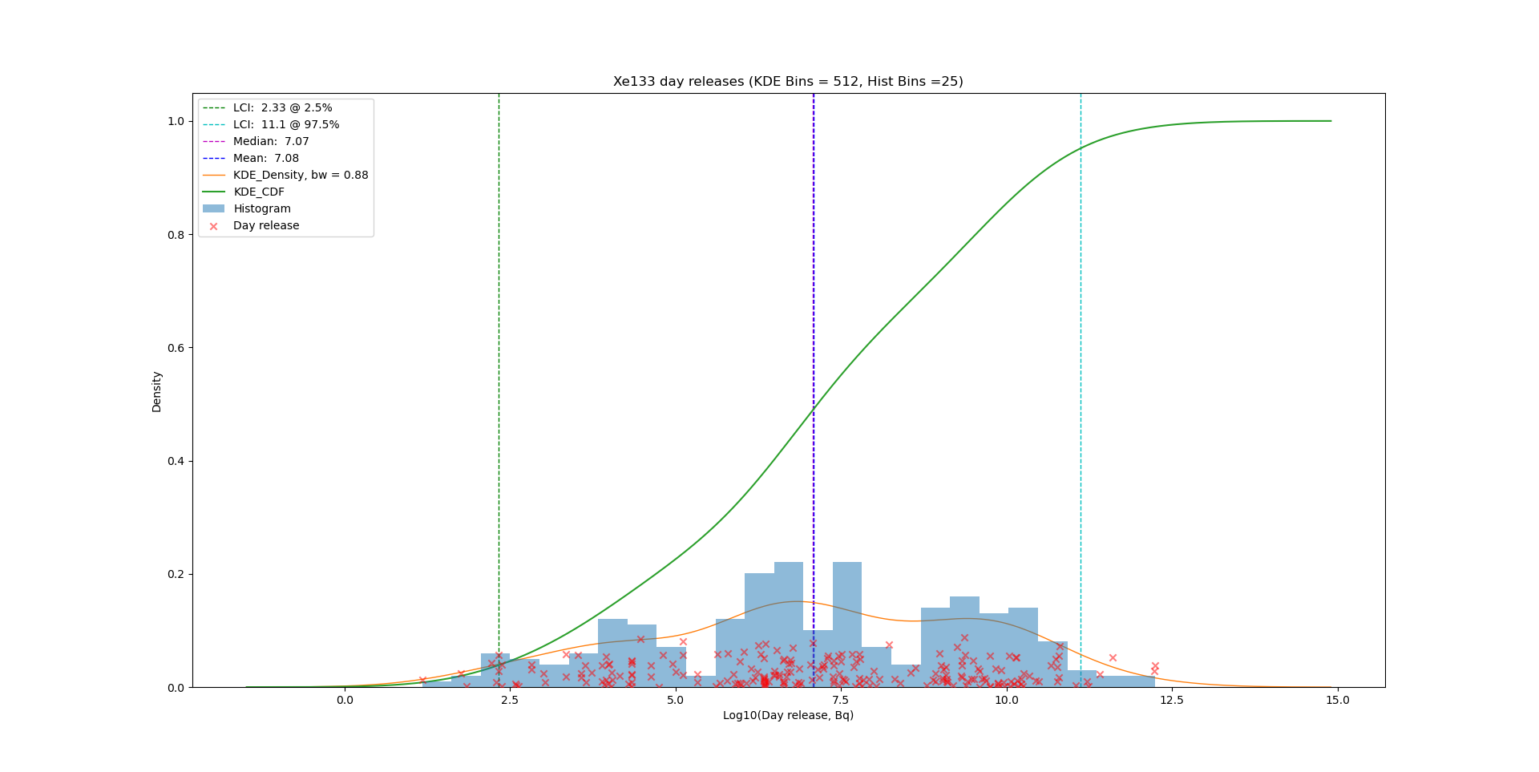



Results
P2.1-486
NRR results
Distributions of NRR day releases: Radioxenon emissions for the global fleet of research reactors is estimated by Kalinowski/Tayyebi (2019).
Xe-133
Xe-135
RESULTS
Xe-131m
Xe-133m

Slide 10
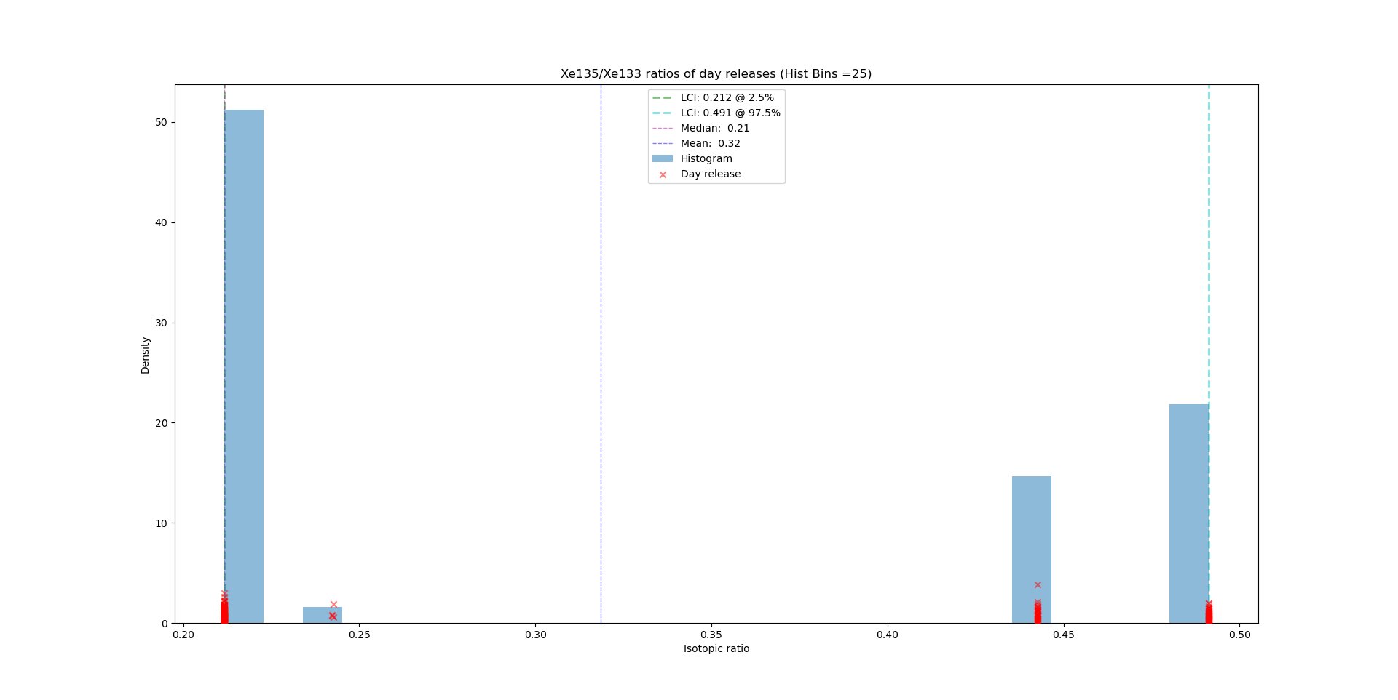
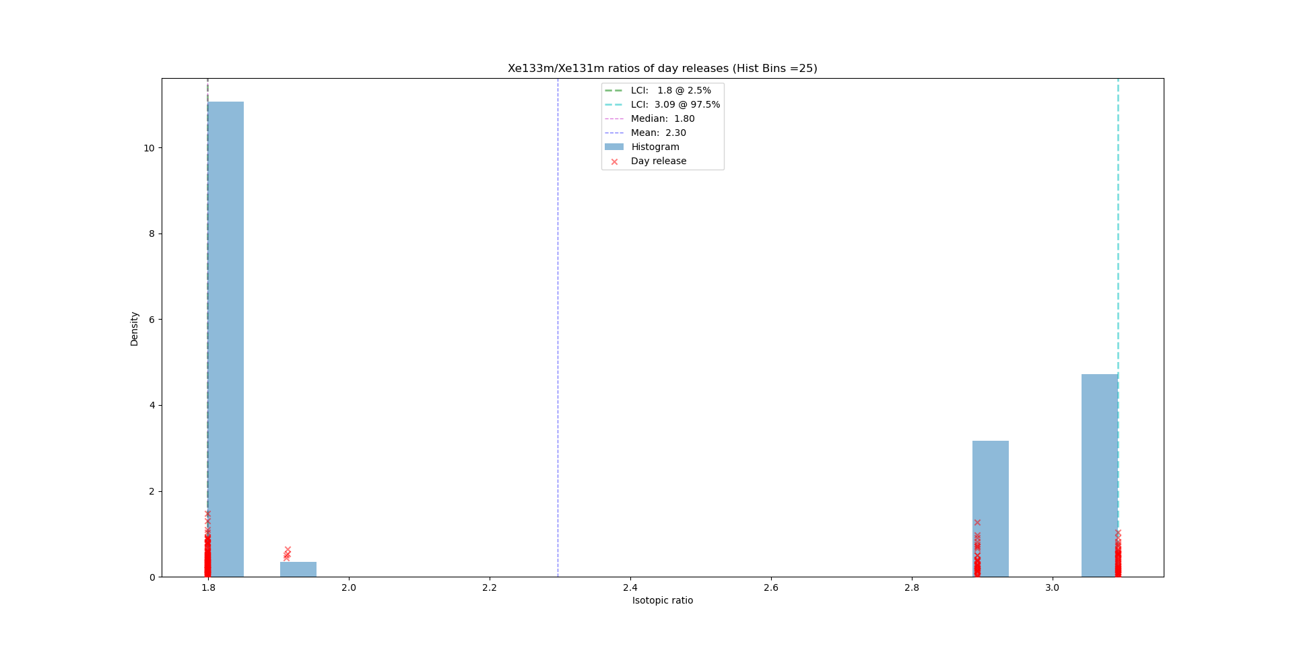
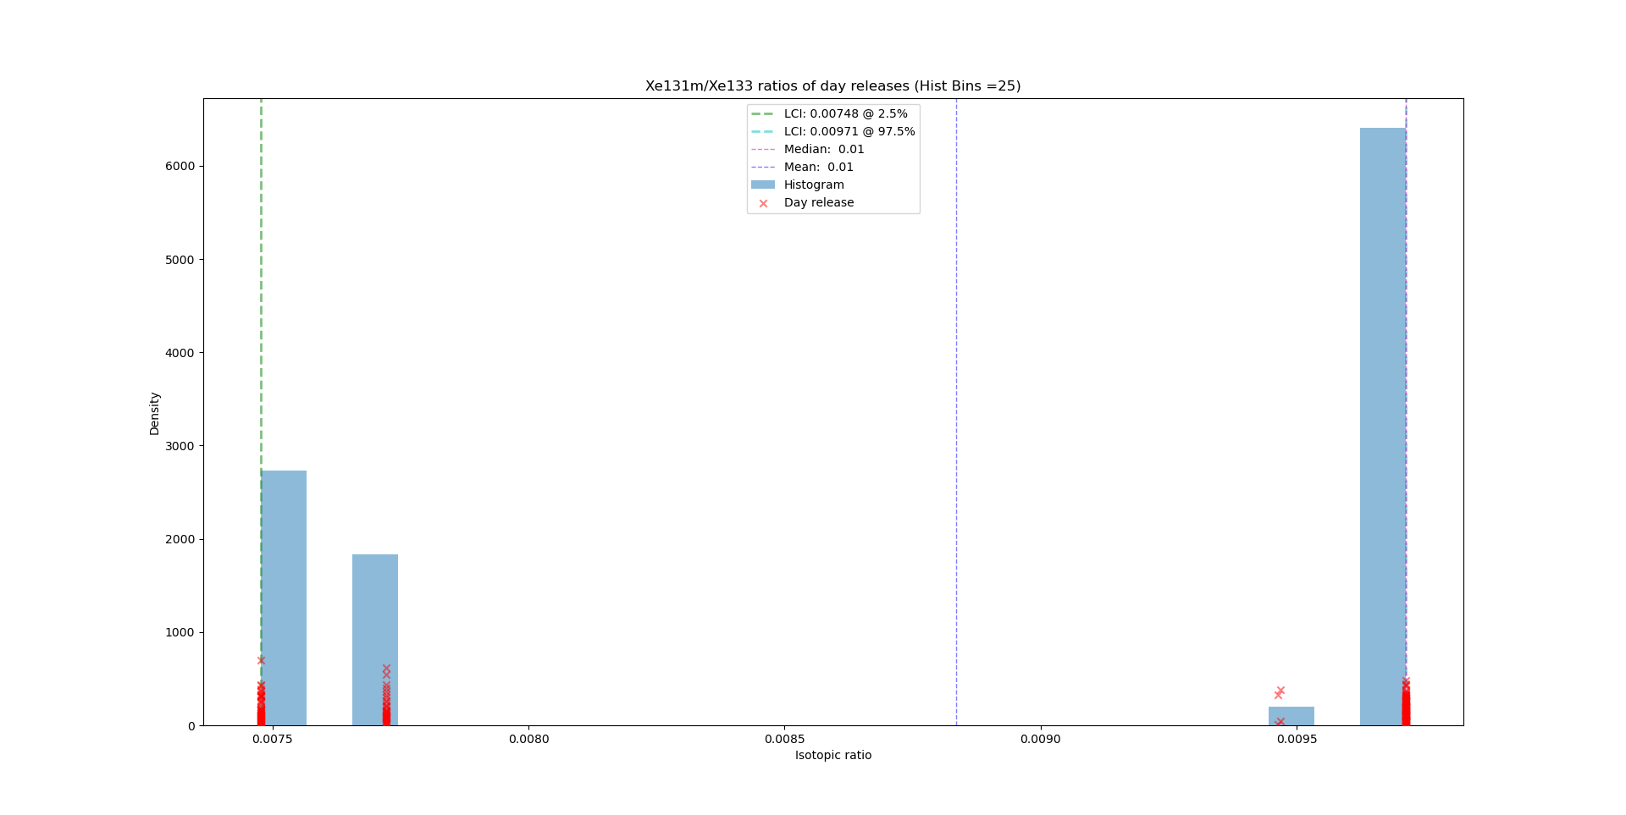

Results
P2.1-486
NRR results
Distributions of isotopic ratios.
Very few reported data are available. Estimated data apply a standard ratio for certain reactor types (pool, TRIGA, others), resulting in few histogram bars. No KDE applied.
Xe-135/Xe-133
Xe-133m/Xe-131m
RESULTS
Xe-133m/Xe-133
Xe-131m/Xe-133

Slide 11
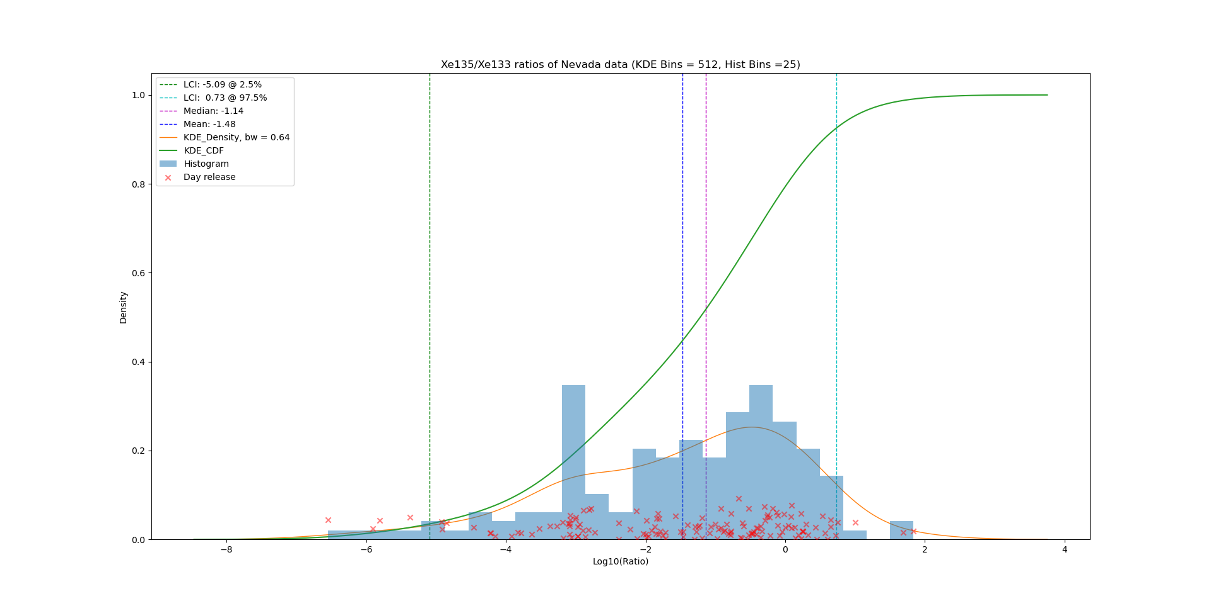
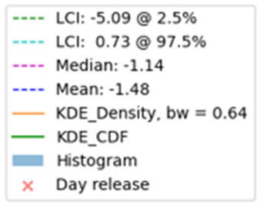
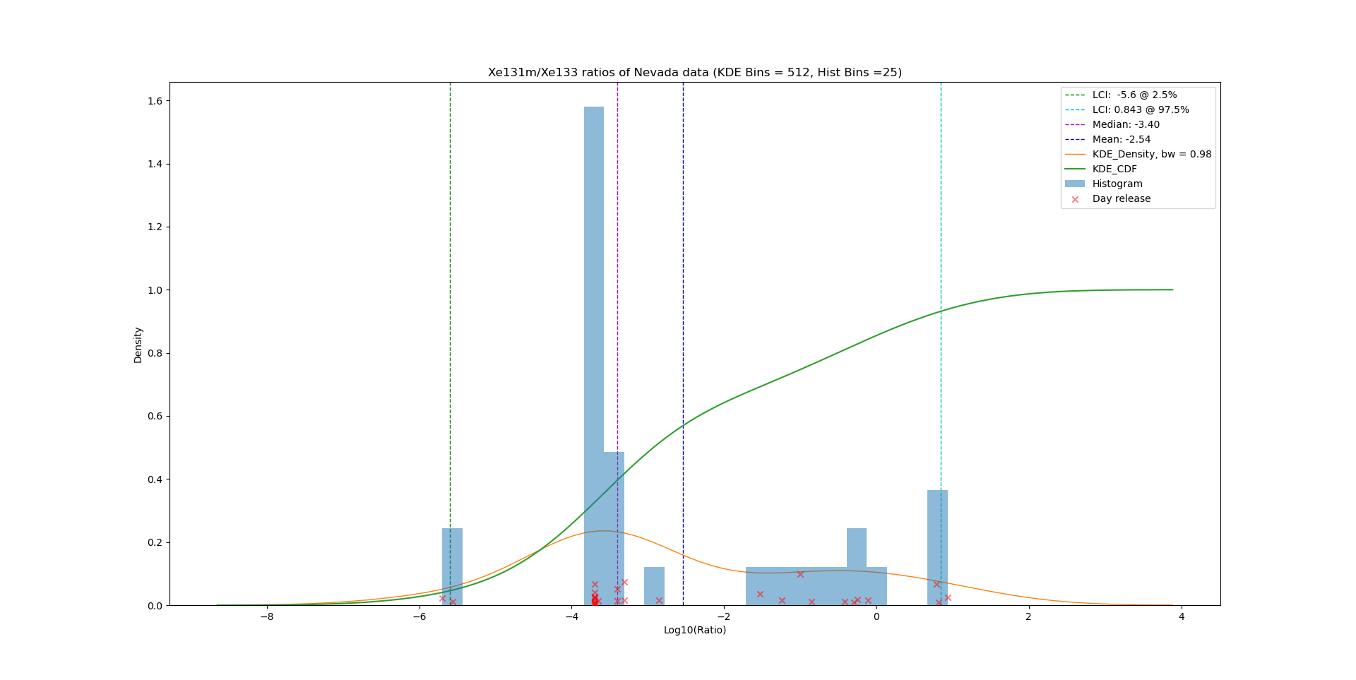
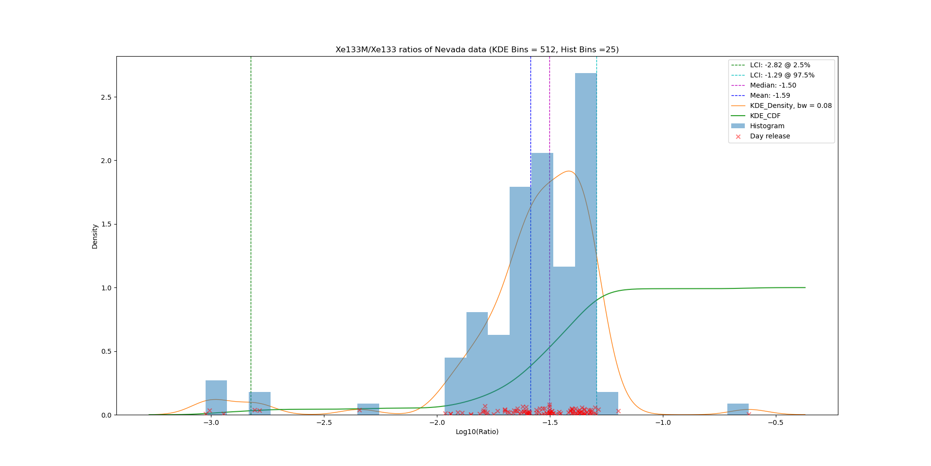
Results
P2.1-486
Results of nuclear testing at Nevada
Distributions of isotopic ratios in (Kalinowski et al 2011).
Xe135/Xe133
RESULTS
Xe131m/Xe133
Xe133m/Xe133
11

Slide 12
Summary
P2.1-486
KD estimations for nuclear facility releases are derived from the data set of the radioxenon emission inventory of all nuclear power plants and all nuclear research reactors in the calendar year 2014.
For both reactor type sources and nuclear explosion sources, the KD estimations can be linked with isotopic ratio calculations that connect the sources and IMS stations as receiver.
CONCLUSIONS

Slide 13
References
P2.1-486
Martin B. Kalinowski, Halit Tatlisu (2020) Global radioxenon emission inventory from nuclear power plants for the calendar year 2014. Pure and Applied Geophysics. https://doi.org/10.1007/s00024-020-02579-w.
Kalinowski, M.B.; P. Tayyebi, M. Lechermann, H. Tatlisu (2021): Global radioxenon emission inventory from nuclear research reactors. Accepted by Pure and Applied Geophysics, in print.
Kalinowski, M.B., 2011. Characterisation of prompt and delayed atmospheric radioactivity releases from underground nuclear tests at Nevada as a function of release time. Journal of Environmental Radioactivity. 102 (9), 824-836. doi:10.1016/j.jenvrad.2011.05.006.
REFERENCES

