Slide 1


Connecting underground nuclear explosion gas-release ranges as aggregated from a set of scenarios with IMS radioxenon observations for evaluating isotopic activity ratios as indicators of a nuclear test
Martin Kalinowski¹, Boxue LIU¹, Yunwei Sun², Charles R. Carrigan³, Steven Kreek² and Tarabay Antoun²
¹IDC/CTBTO, Vienna, Austria; ²LLNL, USA; ³M.H. Chew & Assoc./LLNL, USA
P2.1-601
LLNL-POST-823157
The views expressed here do not necessarily reflect the views of the United States Government, the United States Department of Energy,
the National Nuclear Security Administration or the Lawrence Livermore National Laboratory.

Slide 2
Introduction
P2.1-601
Isotopic activity ratios of radioxenon measured in IMS noble gas samples are routinely obtained that might indicate a gas release from an underground nuclear test, although caused by atmospheric emissions from nuclear facilities.
This presentation treats nuclear explosions as the source. The method presented here combines the two ends (source and receptor) for comparing radioxenon isotopes and their activity ratios for a possible match.
A robust method is required that tests the isotopic activity ratios of samples against prepared information aggregated from a comprehensive set of all relevant release scenarios that could possibly explain given ratios.
INTRODUCTION

Slide 3
Introduction
P2.1-601
The source is the radioisotope generation by a nuclear explosion, the receptor is the observation in IMS samples. Mathematical modelling is used to create the relationship between source and receptor. The ratios in the IMS sample are reconstructed as a function of the time of release into the atmosphere and the sampling time.
Recent research results on the source mechanisms including in-growth and decay, cavity-melt fractionation and seepage of cavity gases are used to develop best-estimate input source terms as well as minimum and maximum activity ratio boundaries as a function of time.
The output is a score for the consistency of the observation with the boundaries of all possible nuclear explosion signals.
INTRODUCTION

Slide 4
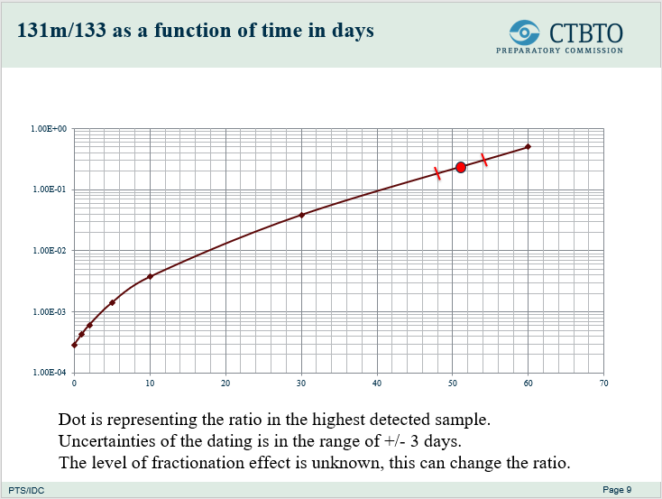
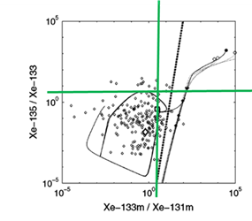
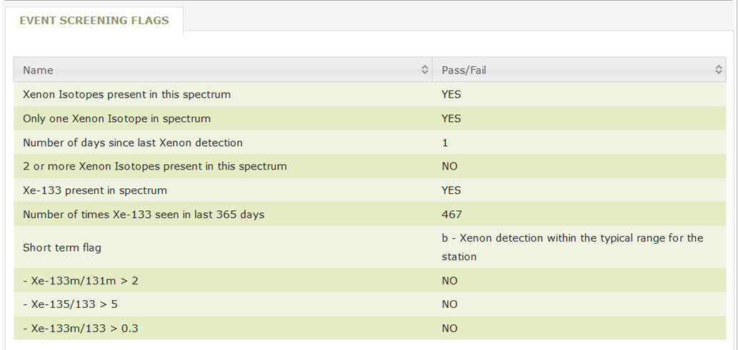
Initial implementation in IDC operations
P2.1-601
Isotopic ratio thresholds:
Screening flags in IDC products for each RN sample
Flag thresholds apply only to a rapid venting scenario
Ad-hoc expert analysis:
Case of DPRK announced test in 2013
Only one specific scenario of full in-growth assumed, no fractionation.
MOTIVATION
Motivation for this presentation:
Why not making comprehensive information available for enhanced methods?

Slide 5
Radioxenon Isotopic Ratios
from Source to Sample
P2.1-601
Use case | Source type | Pre-release processes | Predetermined source term | Event source hypothesis | Atmospheric transport | Plume passing over station | Sample processing | Measurement result
 | Pre-need |  |  |  | post-need
IMS observations consistent with known sources? | Nuclear facility (NPP, NRR, MIPF) |  | PDF for continuous or puff releases for each facility or type | Probability distribution of reconstructed source term as f(x,y,t) | SRS fields from backward ATM | Concentration at collection stop | Concentration profile turns into an activity at collection stop | Activity at acquisition start
IMS observations consistent with hypothesis of a nuclear test | Under-ground nuclear test | Cavity model, cavity-to-surface transport | Envelope for ensemble of multi-scenario releases as f(t) with t ranging from 0 to a cutoff time
What kind of observations could a suspected nuclear test cause? |  |  |  | Envelope of constrained ensemble | SRS fields from backward ATM or dilution factors from forward ATM | Predicted concentrations vs. concentration at collection stop
CONCEPT
Yellow boxes: new and addressed here

Slide 6
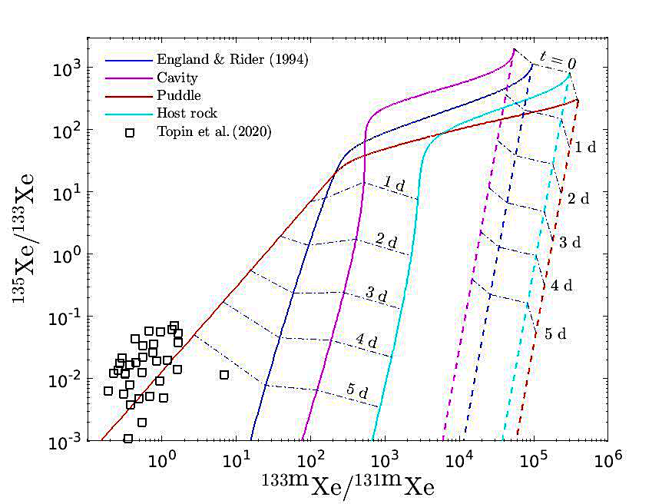
An Example of A Staged UNE Screening Approach
P2.1-601
Post-Detonation Input
(see next slide)
Post-Detonation Input
(from IDC products)
Event source identity hypothesis testing
CONCEPT
Predicted Range: Possible Isotopic Composition of
Atmospheric Source Term
IDC analysis of IMS sample with multiple NG isotopes
(post-need)
UNE Cavity-Melt
Isotopic Evolution Scenario Library
(Pre-need)
Cavity-To-Surface
Transport Scenario
Library Transfer Functions
(Pre-need)
T
Atmospheric
Transport Scenario Transfer Functions
(Post-need)
T
T
Sampling – Analysis
Transfer Functions
(Post-need)
T
Example for Isotopic Ratios
of Sample, Decay Corrected
with Error Bars
Post-Detonation Input Constrains Predicted Range of Isotopic Compositions

Slide 7
Using Available Input
to Constrain Source Term Envelope
P2.1-601
Limiting range of relevant scenarios in pre-need library:
Cavity-melt isotopic evolution: Input such as location (geology) and seismicity can be used to limit range of isotopic evolution in cavity scenarios used to provide input for transfer functions.
Cavity-to-surface transport: Input such as nuclear yield, zero-time, geology, and detonation depth can limit range of scenarios considered for predicting range of input for atmospheric transport transfer functions.
Constraining range of relevant post-need simulations:
Atmospheric release: Input such as local/regional weather observations and seismic zero time.
Output: Constrained envelope of predicted isotopic compositions of sampled event
CONCEPT

Slide 8

















Schematic Time Series from Nuclear Explosion to Sample Measurements
P2.1-601
Procedures of isotopic ratio analysis by using transfer functions and ATM simulations
Forward: Activities released into atmosphere are derived from UNE scenarios.
Backward: Released activities can be estimated by activities measured in samples.
Explosion → Release
ATM simulations
$$t_{t}=t_{2}−t_{1}$$
Sampling
$$t_{c}$$
Processing→ Measurement
$$t_{p}=t_{3}−t_{2}$$
Activities collected in a sample
METHODS
$$t=0$$
$$t_{1}$$
$$t_{2}$$
$$t_{3}$$
t, the elapsed time relative to the explosion time
$$A\left(0\right)$$
$$A\left(t_{1}\right)$$
$$M(t_{t})$$
$$C\left(t_{2}\right)$$
$$A_{s}\left(t_{2}\right)$$
$$A_{s}\left(t_{3}\right)$$
Yields, Fractionating
Linear ATM
Constant Concentration
Activity measured
Activities released into atmosphere
$$A\left(t_{2}\right)=\frac{C\left(t_{2}\right)}{M(t_{t})}$$
$$C\left(t_{2}\right)=\frac{A_{s}\left(t_{2}\right)}{V_{s}}\frac{λt_{c}}{1−e^{−λt_{c}}}$$
$$A_{s}\left(t_{2}\right)=A_{s}(t_{3}) e^{λ_{1}t_{p}}$$
$$A\left(t_{1}\right)=A(t_{2}) e^{λ_{1}t_{t}}$$
Transfer functions

Slide 9
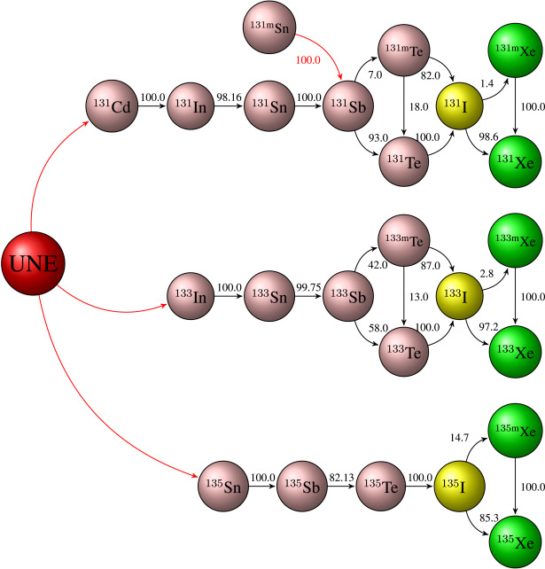
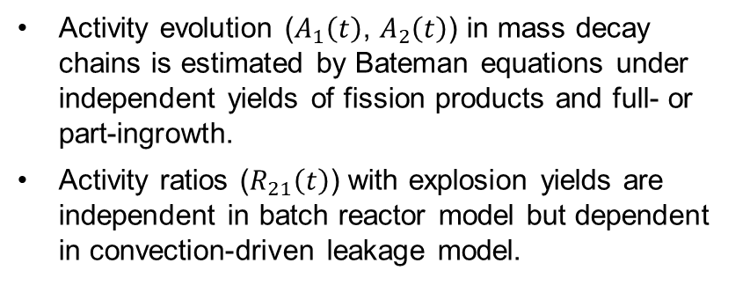

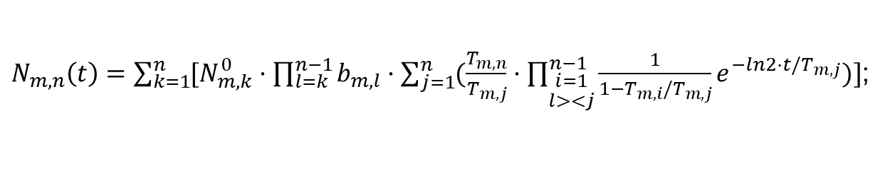
Activities released from nuclear explosion
P2.1-601
Activity evolution ($A_{1}\left(t\right)$, $A_{2}\left(t\right)$) in mass decay chains is estimated by Bateman equations under independent yields of fission products and full- or part-ingrowth.
Activity ratios ($R_{21}\left(t\right)$) with explosion yields are independent in batch reactor model but dependent in convection-driven leakage model.
METHODS
$R_{21}\left(t\right)=\frac{A_{2}\left(t\right)}{A_{1}\left(t\right)}$;
$N_{m,n}\left(t\right)=\sum_{k=1}^{n}{[N_{m,k}^{0}·\prod_{l=k}^{n−1}{b_{m,l}}·\sum_{j=1}^{n}{(\frac{T_{m,n}}{T_{m,j}}·\prod_{\begin{aligned}i=1 \\ l><j\end{aligned}}^{n−1}{\frac{1}{1−T_{m,i}/T_{m,j}}e^{−ln2·t/T_{m,j}}})}]}$;

Slide 10
The new realistic model relating the physical evolution of the cavity to isotopic evolution
P2.1-601
Improved source-term model* couples cavity physical evolution with isotopic evolution.
Initial redistribution of radionuclide inventory begins during cavity expansion as shock melting and vaporization occur. (a)
Vapor phase contains refractory precursors which potentially “rain out” into melt in order of condensation temperature depending on cooling time scale. (b)
As cavity pressure decreases, cooler cavity roof debris falls through vapor phase and into melt capturing additional refractories. (c)
Continuing collapse of the cavity roof occurs forming a “chimney” with gas phase distributed among roof debris. (d)
a
b
Cavity
METHODS
Melt
Source: Illustration taken from Schwartz et al. (1984).
c
d
* Carrigan et al. Cavity-melt partitioning of refractory radionuclides and implications for detecting underground nuclear explosions. J. Env. Radioactivity, 219, 2020. Open Access

Slide 11
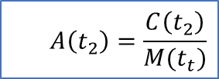

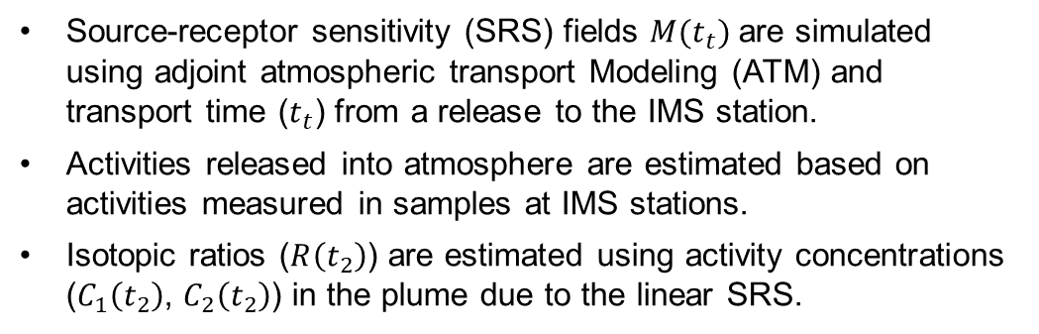

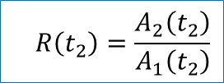
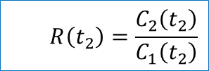
Activity concentrations in the plume
P2.1-601
Source-receptor sensitivity (SRS) fields $M(t_{t})$ are simulated using adjoint atmospheric transport Modeling (ATM) and transport time ($t_{t}$) from a release to the IMS station.
Activities released into atmosphere are estimated based on activities measured in samples at IMS stations.
Isotopic ratios ($R\left(t_{2}\right)$) are estimated using activity concentrations ($C_{1}\left(t_{2}\right)$, $C_{2}\left(t_{2}\right)$) in the plume due to the linear SRS.
$$A\left(t_{2}\right)=\frac{C\left(t_{2}\right)}{M(t_{t})}$$
$$R\left(t_{2}\right)=\frac{A_{2}\left(t_{2}\right)}{A_{1}\left(t_{2}\right)}$$
METHODS
Linear SRS
$$M(t_{t})$$
$$R\left(t_{2}\right)=\frac{C_{2}\left(t_{2}\right)}{C_{1}\left(t_{2}\right)}$$
Simplest case: independent decay
$$R\left(t_{2}\right)=R\left(t_{1}\right)e^{−(λ_{2}−λ_{1})t_{t}}$$

Slide 12
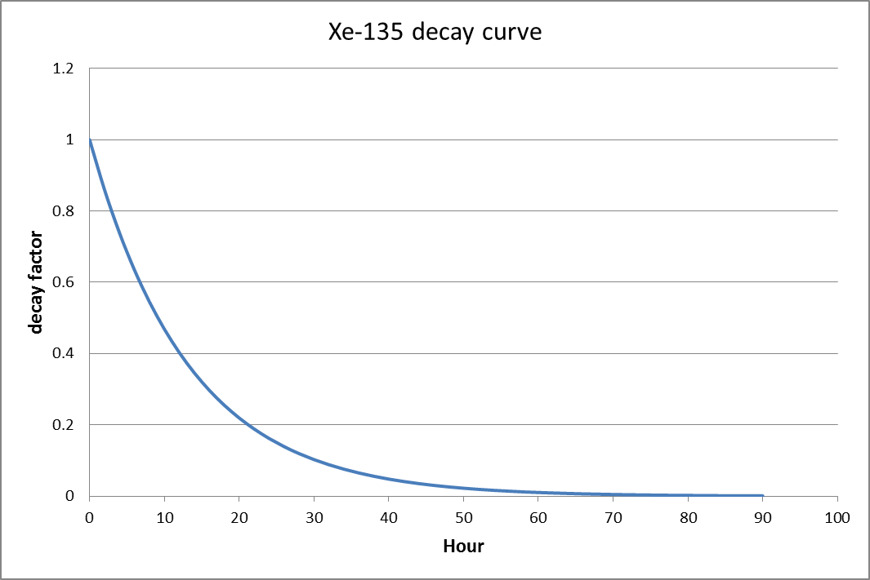
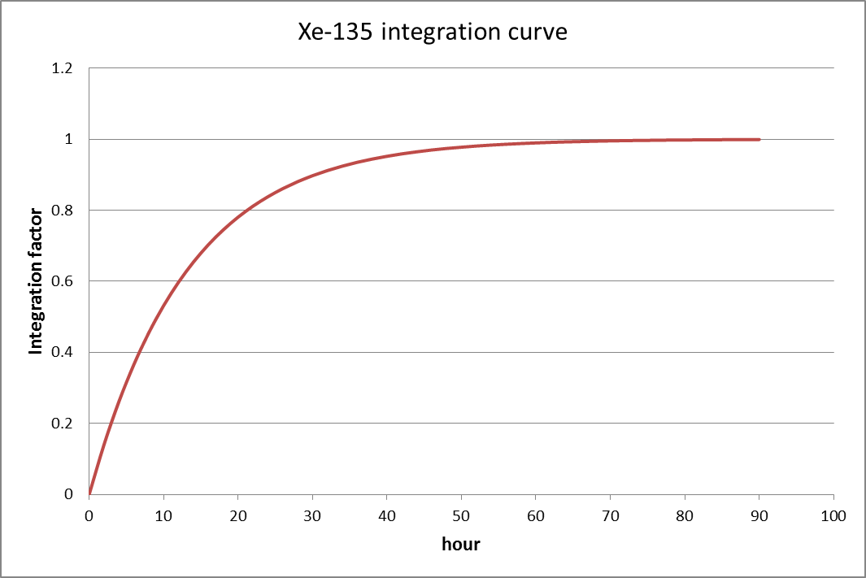
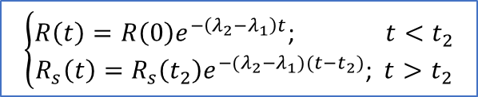
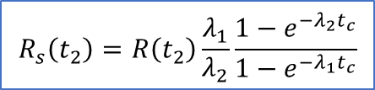
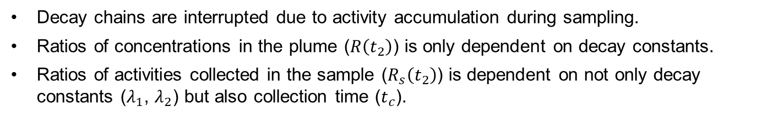
Activities collected in a sample
P2.1-601
Decay chains are interrupted due to activity accumulation during sampling.
Ratios of concentrations in the plume ($R\left(t_{2}\right)$) is only dependent on decay constants.
Ratios of activities collected in the sample ($R_{s}\left(t_{2}\right)$) is dependent on not only decay constants ($λ_{1}$, $λ_{2}$) but also collection time ($t_{c}$).
During
Sampling
$$R_{s}\left(t_{2}\right)=R\left(t_{2}\right)\frac{λ_{1}}{λ_{2}}\frac{1−e^{−λ_{2}t_{c}}}{1−e^{−λ_{1}t_{c}}}$$
METHODS
+
Before and
after sampling
$$\left\{\begin{aligned}R\left(t\right)=R\left(0\right)e^{−\left(λ_{2}−λ_{1}\right)t}\text{; }t<t_{2} \\ R_{s}\left(t\right)=R_{s}\left(t_{2}\right)e^{−(λ_{2}−λ_{1})(t−t_{2})}\text{; }t>t_{2}\end{aligned}\right.$$

Slide 13
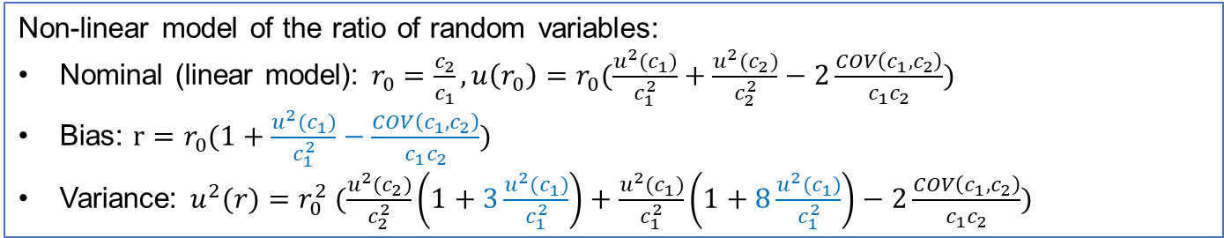
Estimation of isotopic ratios in measurements
P2.1-601
Isotopic ratios and associated uncertainties are dependent on not only concentrations but also their uncertainties and covariances.
Ratios of two random variables can be estimated by high-order Taylor terms due to the non-linear model, and are dependent on uncertainties of the denominators.
For low level samples, it is better to use the Monte-Carlo method estimating isotopic ratios and their uncertainties based on activities measured in the sample or associated peak counts directly.
METHODS
Non-linear model of the ratio of random variables:
Nominal (linear model): $r_{0}=\frac{c_{2}}{c_{1}},u\left(r_{0}\right)=r_{0}(\frac{u^{2}(c_{1})}{c_{1}^{2}}+\frac{u^{2}(c_{2})}{c_{2}^{2}}−2\frac{COV\left(c_{1},c_{2}\right)}{c_{1}c_{2}})$
Bias: $r=r_{0}(1+\frac{u^{2}(c_{1})}{c_{1}^{2}}−\frac{COV\left(c_{1},c_{2}\right)}{c_{1}c_{2}})$
Variance: $u^{2}(r)=r_{0}^{2} (\frac{u^{2}(c_{2})}{c_{2}^{2}}\left(1+3\frac{u^{2}(c_{1})}{c_{1}^{2}}\right)+\frac{u^{2}(c_{1})}{c_{1}^{2}}\left(1+8\frac{u^{2}(c_{1})}{c_{1}^{2}}\right)−2\frac{COV\left(c_{1},c_{2}\right)}{c_{1}c_{2}})$
Notes:
ATM simulations are performed in two steps, adjoint modelling and post-processing.

Slide 14
Time-invariant source discrimination based on radioxenon isotopic ratio relationship for early releases from nuclear explosion
P2.1-601
The full ingrowth from precursors is included until released at the given time, 1, 2,…, 10 days.
Classical approach: All isotope ratio relations found left of the screening line can be screened out, i.e., the related samples are not relevant for CTBT verification purposes.
Instead, the new approach uses the boundary of the relevant part of the constrained nuclear test domain, taking into account the uncertainties.
The simulation curves for nuclear explosion scenarios remain in the right half of the screening line.
RESULTS
M. B. Kalinowski and Y.-Y. Liao (2012): Isotopic Characterization of Radioiodine and Radioxenon in Releases from Underground Nuclear Explosions with Various Degrees of Fractionation. Pure and Applied Geophysics, https://doi.org/10.1007/s00024-012-0580-7.

Slide 15
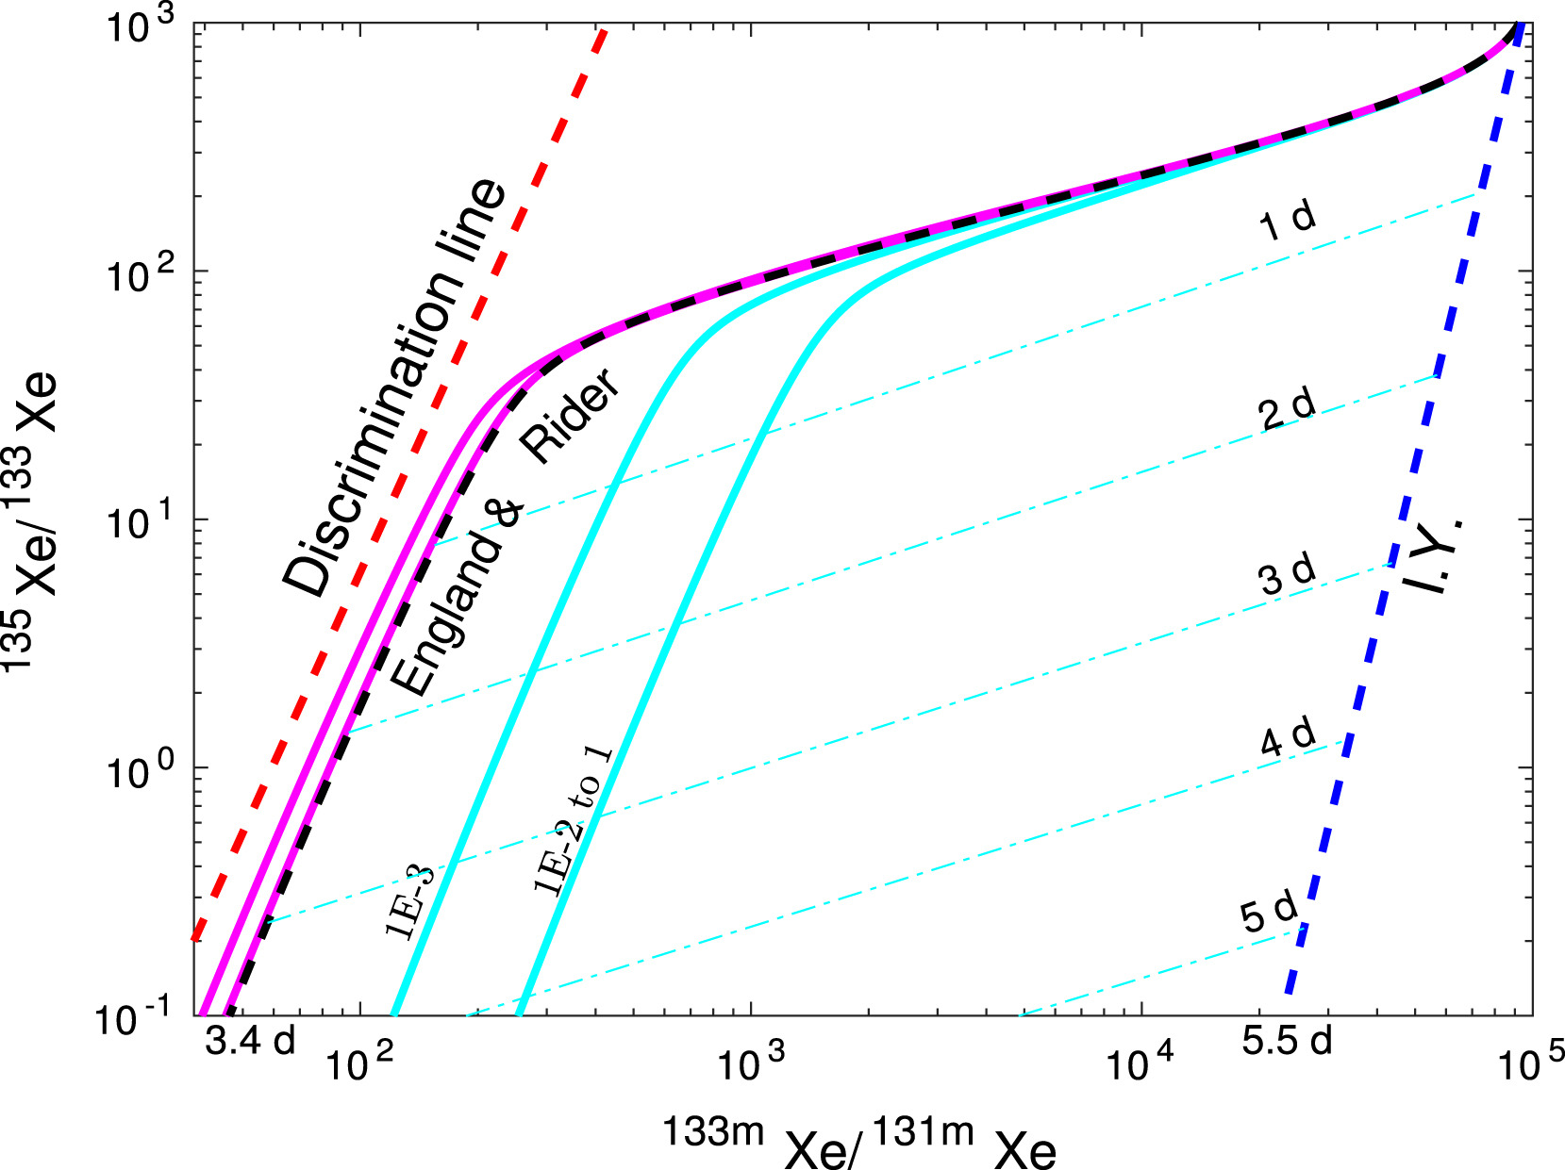
Isotopic Source-Term Scenarios Use Improved Models Of Cavity Gas Evolution
P2.1-601
An improved source-term model relates physical evolution with isotopic evolution of the radioactive inventory in the post-detonation cavity.
Increasing rate of loss or “rainout” of refractories to melt zone moves cyan curves progressively closer to independent yield line.
Including early-time partitioning of refractory precursors into the cavity melt zone (cyan lines) causes displacement of isotopic ratio curves closer to the discrimination line but still within the nuclear explosion domain.
Additional information about time of the event, further constrains the space of isotopic ratios that are consistent with the hypothetical nuclear test.
RESULTS
Carrigan et al. Cavity-melt partitioning of refractory radionuclides and implications for detecting underground nuclear explosions. J. Env. Radioactivity, 219, 2020.

Slide 16
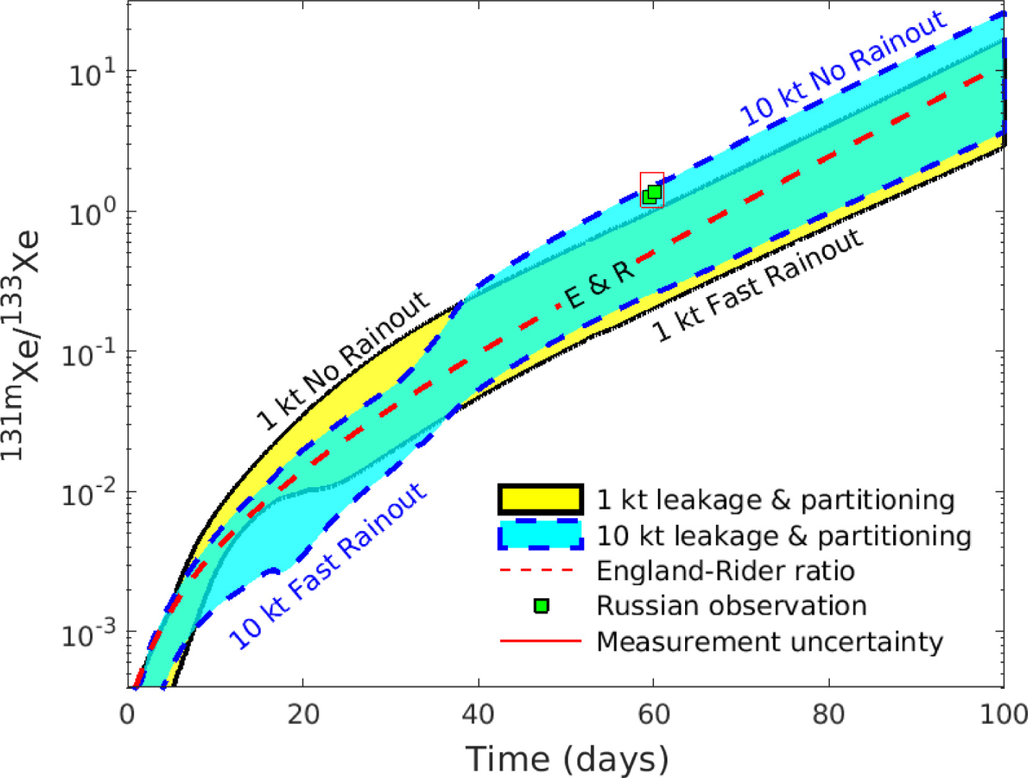
Long-Term Isotopic Evolution Of DPRK 2013 Simulated With Limited Inputs
P2.1-601
Long-term evolution of isotopic ratios is estimated by the new model for assumptions about the underground nuclear explosion.
See example of late time observations of Xe-131m/Xe-133 at RUX58 associated with the nuclear test announced by DPRK in 2013. This is within the combined boundary of isotopic ratios under different scenarios, represented by yellow, blue and green.
RESULTS
Carrigan et al. Cavity-melt partitioning of refractory radionuclides and implications for detecting underground nuclear explosions. J. Env. Radioactivity, 219, 2020.

Slide 17
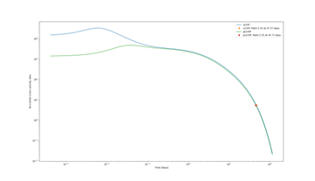
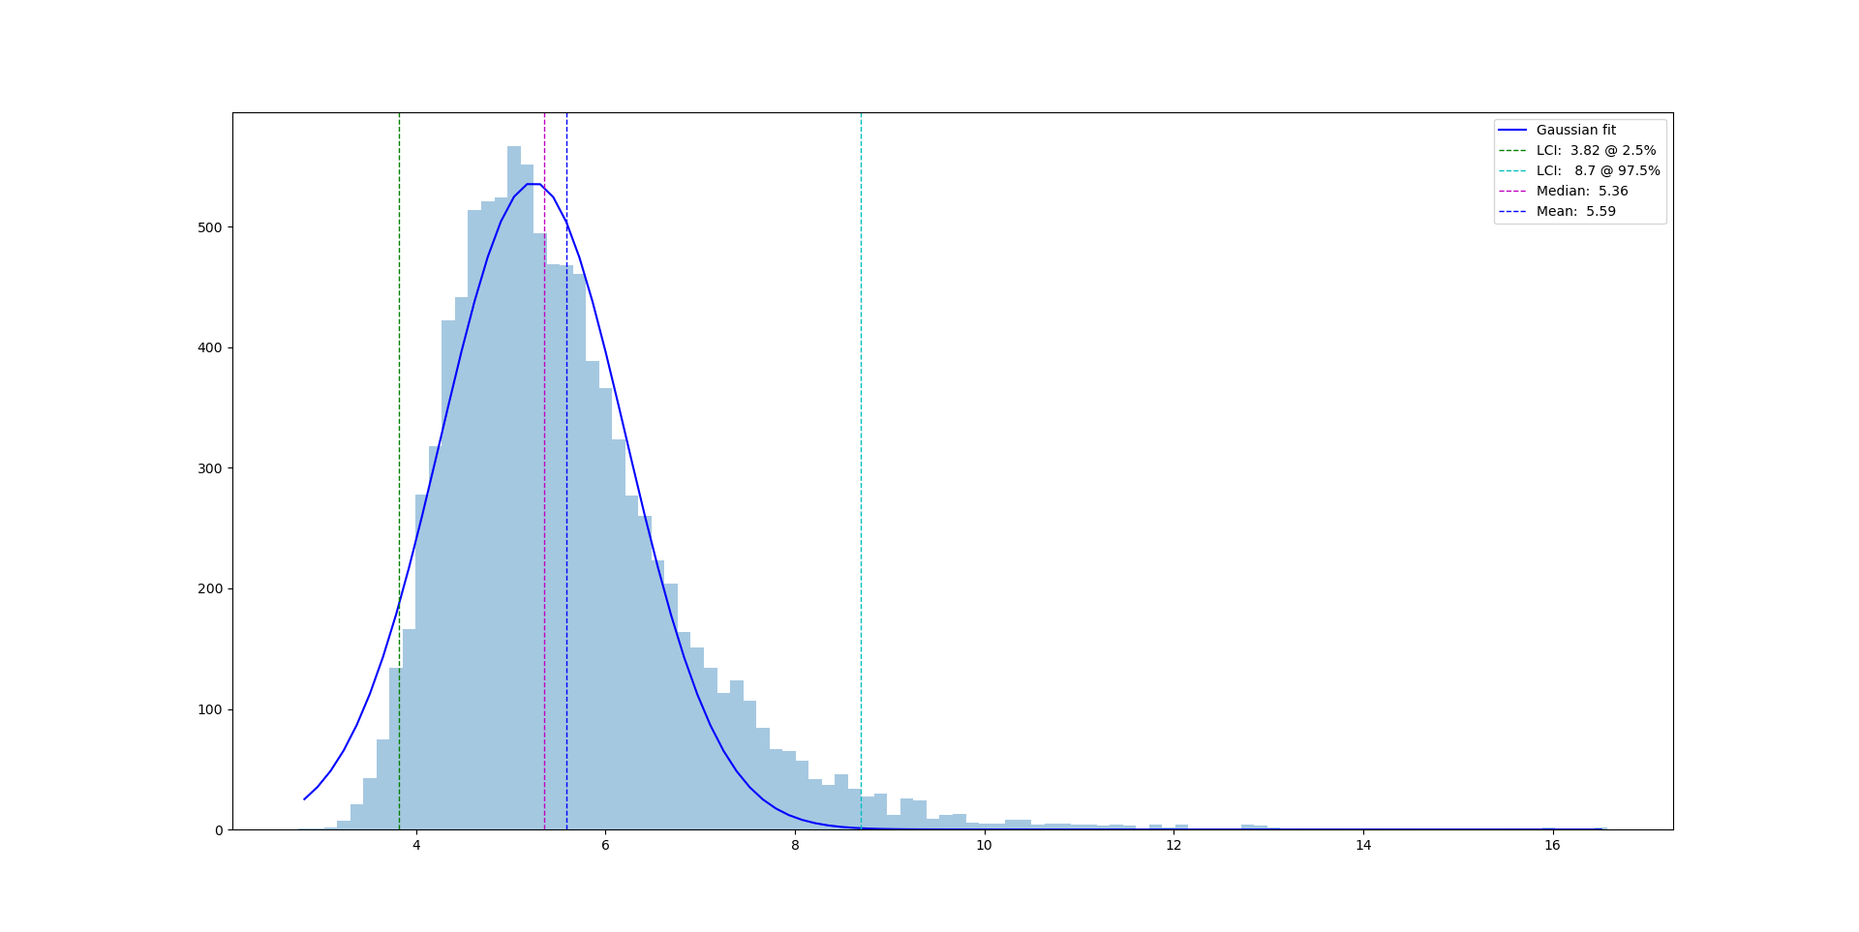
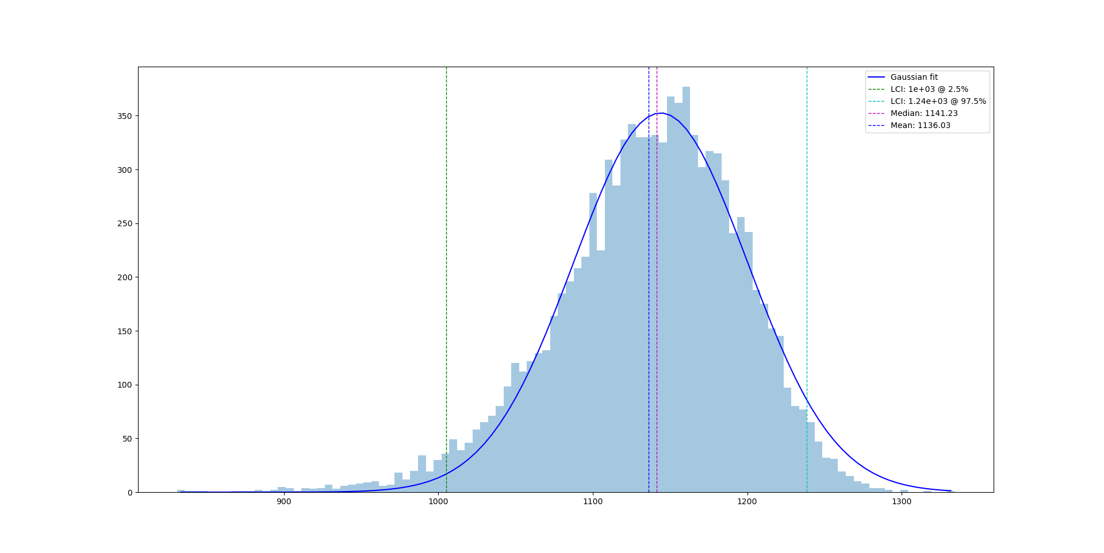

Explosion time estimation of DPRK2013
P2.1-601
The sample at JPX38 at 19:00 on 8 April 2013 (the stop of collection)
  Xe-133: 3.05±0.14; Xe-131m: 0.57±0.11 (mBq/m³);
  Gaussian distributions of concentrations were used simply.
The explosion time was estimated by the Monte-Carlo method.
  47.3 days with limits of the coverage interval (41.7, 51.7) for U235 full-ingrowth model.
  The estimation could be improved further by more detailed activity evolution models.
RESULTS
Numeric solution of
explosion time with two boundaries for scenarios.
Distribution of explosion times
Nominal: 47.6 days
Mean: 47.3 days
$$R\left(t_{2}\right)=\frac{C_{133}\left(t_{2}\right)}{C_{131m}\left(t_{2}\right)}$$
+

Slide 18
Conclusions 1/2
P2.1-601
Conclusions
The concept for an enhanced approach is presented here that improves radionuclide screening and nuclear explosion hypothesis testing.
Pre-need libraries of scenarios for source term evolution are generated from a new method coupling isotopic evolution of the gas-phase radioactive inventory to realistic physical models of cavity evolution.
The input data will be aggregated to determine the envelope of isotopic ratios associated with underground nuclear explosions.
In post-need applications, this envelope can be constrained with the aid of available observational data.
CONCLUSIONS

Slide 19
Conclusions 2/2
P2.1-601
Conclusions (contd.)
Estimates of the composition of prompt releases will be less affected by uncertainty in parameters controlling cavity-evolution and gas leakage than late-time releases as represented by the DPRK 2013 detection.
Using isotopic analysis of the sample and related atmospheric transport simulations, the isotopic ratios at the source can be reconstructed as a function of time and geographic location. With additional information this can be further constrained.
For screening purposes, the reconstructed source ratios are compared with the envelope of possible isotopic ratios to provide a probabilistic estimate that the observations are associated with a UNE. For Expert Technical Analysis of a specific event, this comparison can be used to assist States Signatories in testing the hypothesis of an UNE being the source.
CONCLUSIONS

