Slide 1
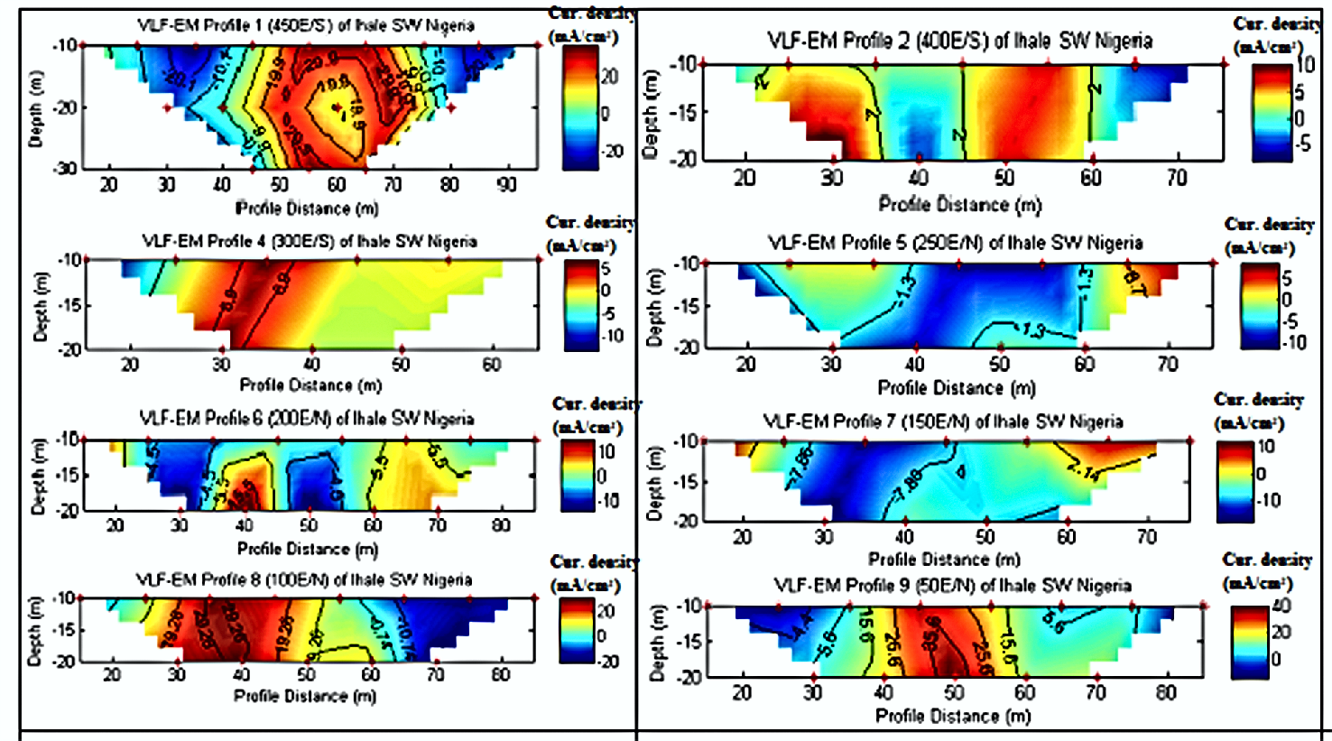
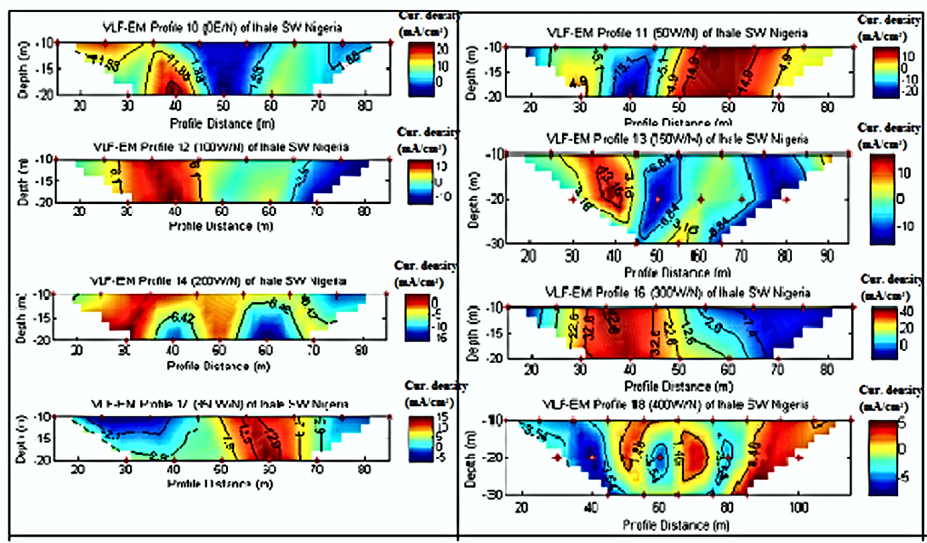
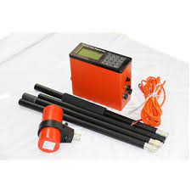
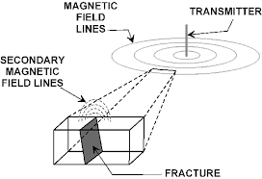
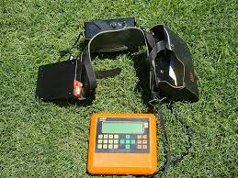
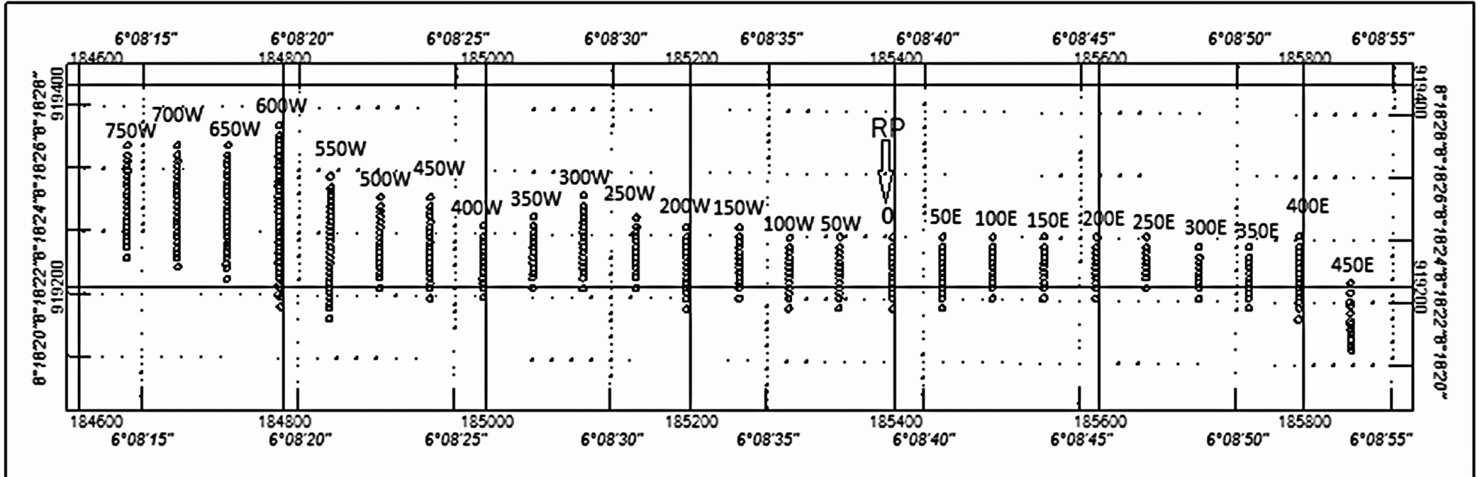
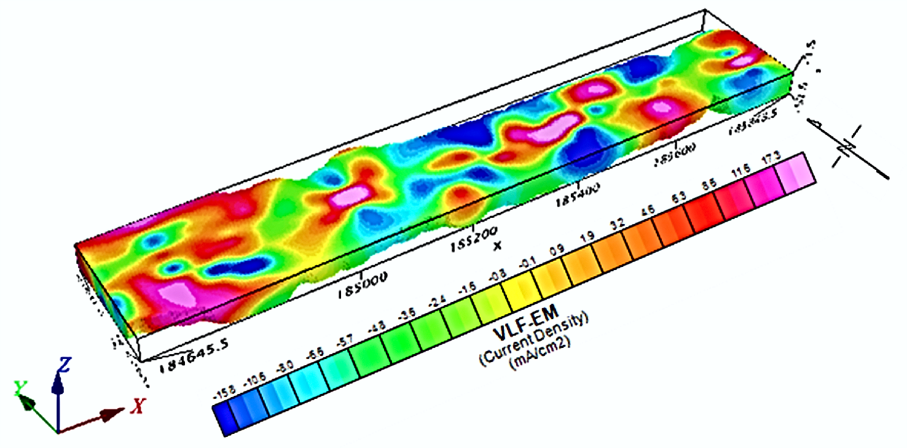
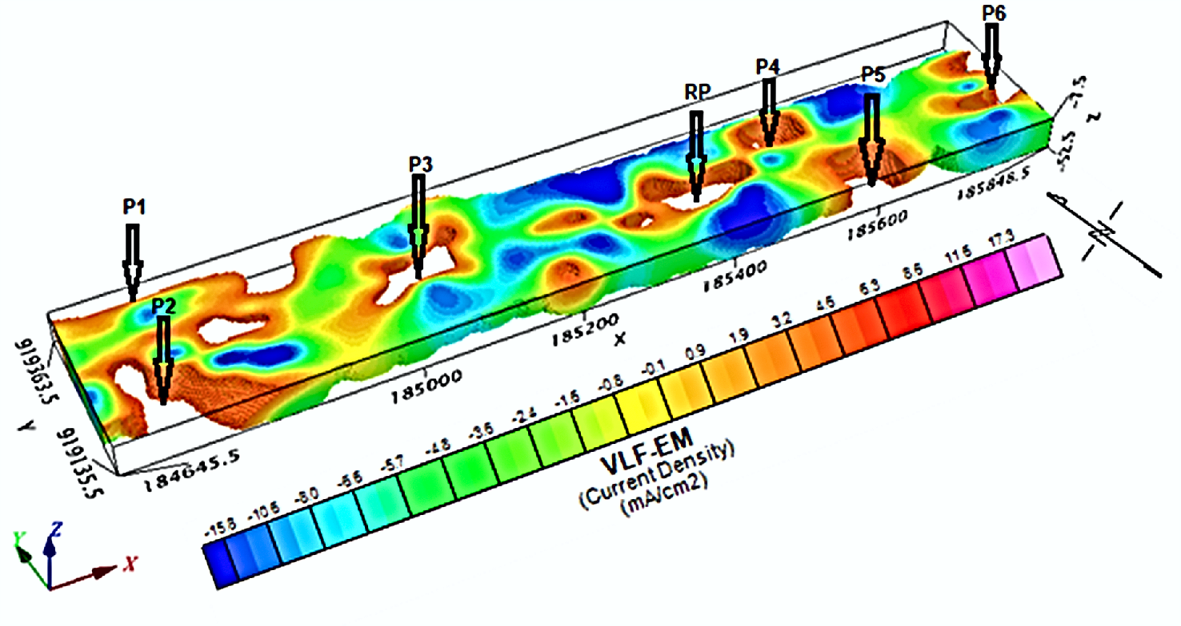
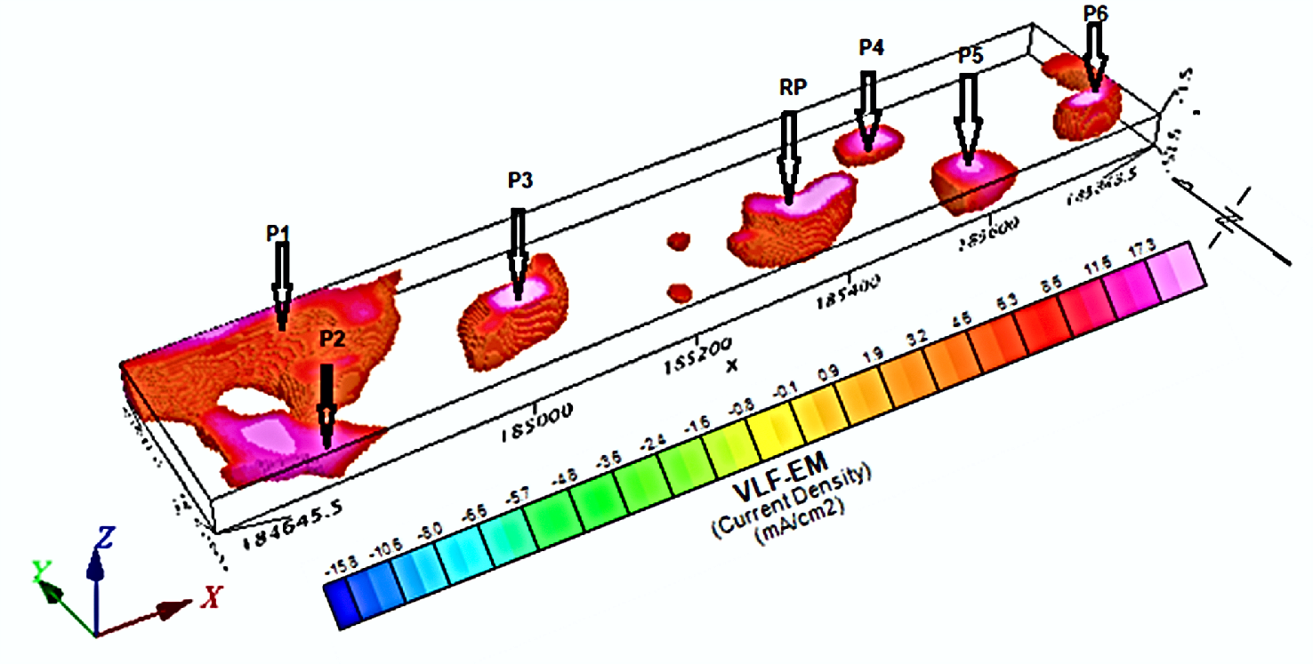
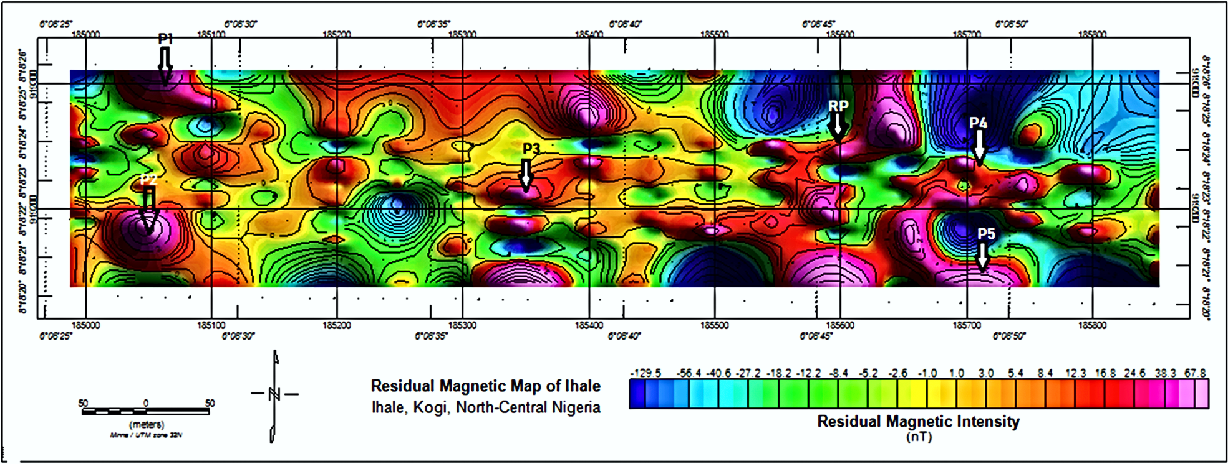
Combined Ground Magnetic and Very Low Frequency Electromagnetic (VLF-EM) Investigations for Gold Exploration around Ihale in Bunnu-Kabba Area of Kogi, north-central Nigeria
Olawale Olakunle Osinowo & Michael Oluwaseyi Falufosi
Department of Geology, University of Ibadan, Ibadan, Nigeria
Introduction
The all time high demand and the rising price of gold as a precious metal has engendered the rush for gold in Ihale and environ in Bunnu – Kabba area of Kogi, north-central Nigeria, where due to the dearth of geological and geophysical subsurface data, exploitation of the precious resource has been left in the hands low skilled artisanal miners.
Methodology
Magnetic and Very Low Electromagnetic (VLF-EM) geophysical techniques were integrated to probe the subsurface. Ground magnetic measurements were taken using proton-precession magnetometer which measured the Total Magnetic Intensity data (TMI) in nanotesla (nT). ABEM WADI VLF-EM meter was employed to measure terrain conductivity by determining the ratio of the real (Re) to the imaginary (Im) components of the propagating time varying low frequency (15-25 Hz) primary (Hp) and secondary (Hs) EM fields (Ogilvy and Lee, 1991).
VLF-EM
2D VLF-EM current density imaged the subsurface in terms of current density distribution and probed up to 40 m. The 2D plots identified some regions of low and high current density values. High values delineate regions of relatively high conductivity that could be attributed to the occurrence of fractured zones and pegmatite veins, while region with low current density values indicate resistive zones within the basement rocks having little or no fractures.
3D display of VLF-EM current density obtained by combining all the VLF-EM results presents the current density distribution along the three orthogonal (x, y, z) directions indicating the variation of the subsurface current density along N-S, E-W as well as variation with depth, up to 52.2 m depth.
Prominent regions of high and low VLF-EM derived current density (– 16 to 20) are visible on the 3D subsurface model. Isosurface data clipping at 18.5 current density cut-off value identified seven (7) zones of high current density (≥ 18.5) including the one that coincide with the mineralized pegmatite vein upon which the reference profile was established (arrow).
Data Acquisition
Twenty five (25) Magnetic and VLE-EM profiles, each, which run N – S of the study area were established east and west of the reference middle profile at 50 m inter profile interval. The reference profile was established on a known gold mineralized vein. Nine (9) profiles were established east (50E to 450 E) of the reference profile, while fifteen (15) profiles (50W to 750W) were occupied west of the reference profile. The profile range in length from 70 to 125 m and measurements were taken at 5 m station interval.
Data Processing
The resultant TMI data were filtered to remove out ranged, especially high frequency cultural noise. Low pass Guassian filter was applied to remove the regional and ambient field effects. The residual magnetic data were further reduced to pole at low latitude to simply anomalies and make magnetic anomalies lie symmetrically over the causative sources (Keating and Zerbo, 1996).
The VLF-EM data were subjected to Fraser (1969) filtering to generate the filtered equivalent of the raw real and the imaginary components. The filtered data were subsequently subjected to Karous and Hjelt (1977) filtering using the VLFPROS MATLAB (Sundararajan et al., 2006) to transform the measured in-phase component into current densities at constant depths (McNeill and Labson, 1991).
Conclusion
This study highlights the importance of carefully planned ground magnetic and VLF - EM surveys for the purpose of identifying the occurrence of base metals within the subsurface. The applied subsurface imaging techniques also demonstrate the efficacy of geophysical techniques for delineating subsurface structures as well as buried base metals which could be natural or artificial.
References
Karous, M. R. and Hjelt, S. E., 1977. Determination of apparent current density from VLF measurements: Report. Department of Geophysics, University of Oulu, Finland, Contribution 89. 19pp.
Keating, P., and L. Zerbo, 1996. An improved technique for reduction to the pole at low latitudes. Geophysics. 61: 131-137.
McNeill, J.D., Labson, V., 1991. Geological mapping using VLF radio fields. In: Nabighian, M.N. (Ed.), Electromagnetic Methods in Applied Geophysics, vol. 2. Society of Exploration Geophysicists, Tulsa, OK., 521-640.
Ogilvy, R.D., Lee, A.C., 1991. Interpretation of VLF-EM inphase data using current density pseudosections. Geophysical Prospecting 39: 567-580.
Sundararajan, N., Rameshbabu, V., Prasad, N.S. and Srinivas, Y., 2006. VLFPROS- A MATLAB code for processing of VLF-EM data. Computers & Geosciences 32: 1806-1813.
Results
Magnetic
Five (5) zones of relatively high magnetic intensity (45 nT to 68 nT) and dominantly trending NE-SW and E-W directions, were delineated, and they present magnetic signatures similar to that of the reference mineralized vein.

