Slide 1
OSI Hybrid Power Integration for Base of Operations
Alana Campbell, Mohamed Ali Nasri
P2.2-230

Slide 2
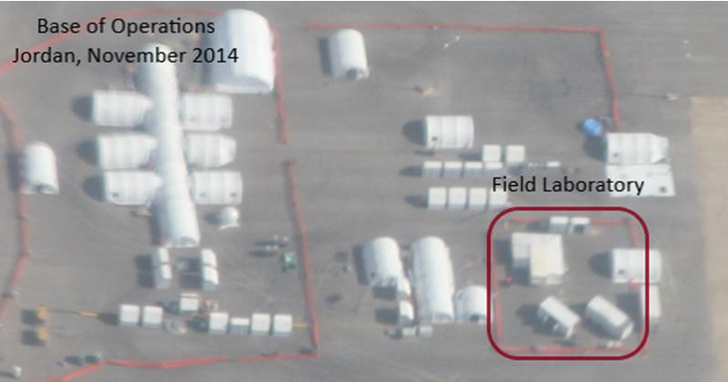
OSI Base of Operations Hybrid Power System
Alana Campbell, Mohamed Ali Nasri, OSI EP
P2.2-230
Stable and reliable electricity is critical for a functional OSI. The integration of solar power into the OSI field power distribution is an opportunity to enhance flexibility in the field and harness renewable energy at the Base of Operations and to deployed field equipment.

Slide 3
OSI Base of Operations Hybrid Power System
Alana Campbell, Mohamed Ali Nasri, OSI EP
P2.2-230
One challenge of On-Site Inspection (T2.2) is preparing for deployment to unknown locations with unknown resources. A critical element of a functional Base of Operations is stable and reliable electricity. The current diesel generators and UPS system has been enhanced with a hybrid power system that adds the ability to accept power from other generation sources, such as solar. An increased battery bank allows for more quiet time without the diesel generators reducing fuel usage and CO2 production.
Compact, foldable 100w solar panels have been designed to fit the air transportation containers connecting to inverter hubs that assist the hybrid power unit to supply power to the BOO. Excess energy is stored in battery banks for later use and the design of the system allows for immediate use of solar power anywhere alone the distribution network. The smart controller and control screen allow for efficient management of available power, auto-starting generators as a last resort if required.
Deployable solar units for smaller field equipment such as samplers or pumps complement smaller fuel generators, and small solar mats and converters that clip directly to existing battery terminals provide trickle charge to remotely deployed field equipment (such as SAMs) during sunlight hours.
ABSTRACT

Slide 4
OSI Base of Operations Hybrid Power System
Alana Campbell, Mohamed Ali Nasri, OSI EP
P2.2-230
After entry into force of the CTBT, OSIs may be carried out in various environmental conditions and locations worldwide with a maximum duration of up to 130 days.
These operations require stable electrical power supply at the Base of Operations (BOO) and in the field for technical equipment. In addition to diesel generator sets, integrated alternative energy has been introduced to reduce the fuel footprint and increase efficiency.
OSI worked with Renovagen UK who developed tailor-made solar mats for the air transportation containers at the BOO and small field solar power generation units for remotely used equipment.
INTRODUCTION

Slide 5
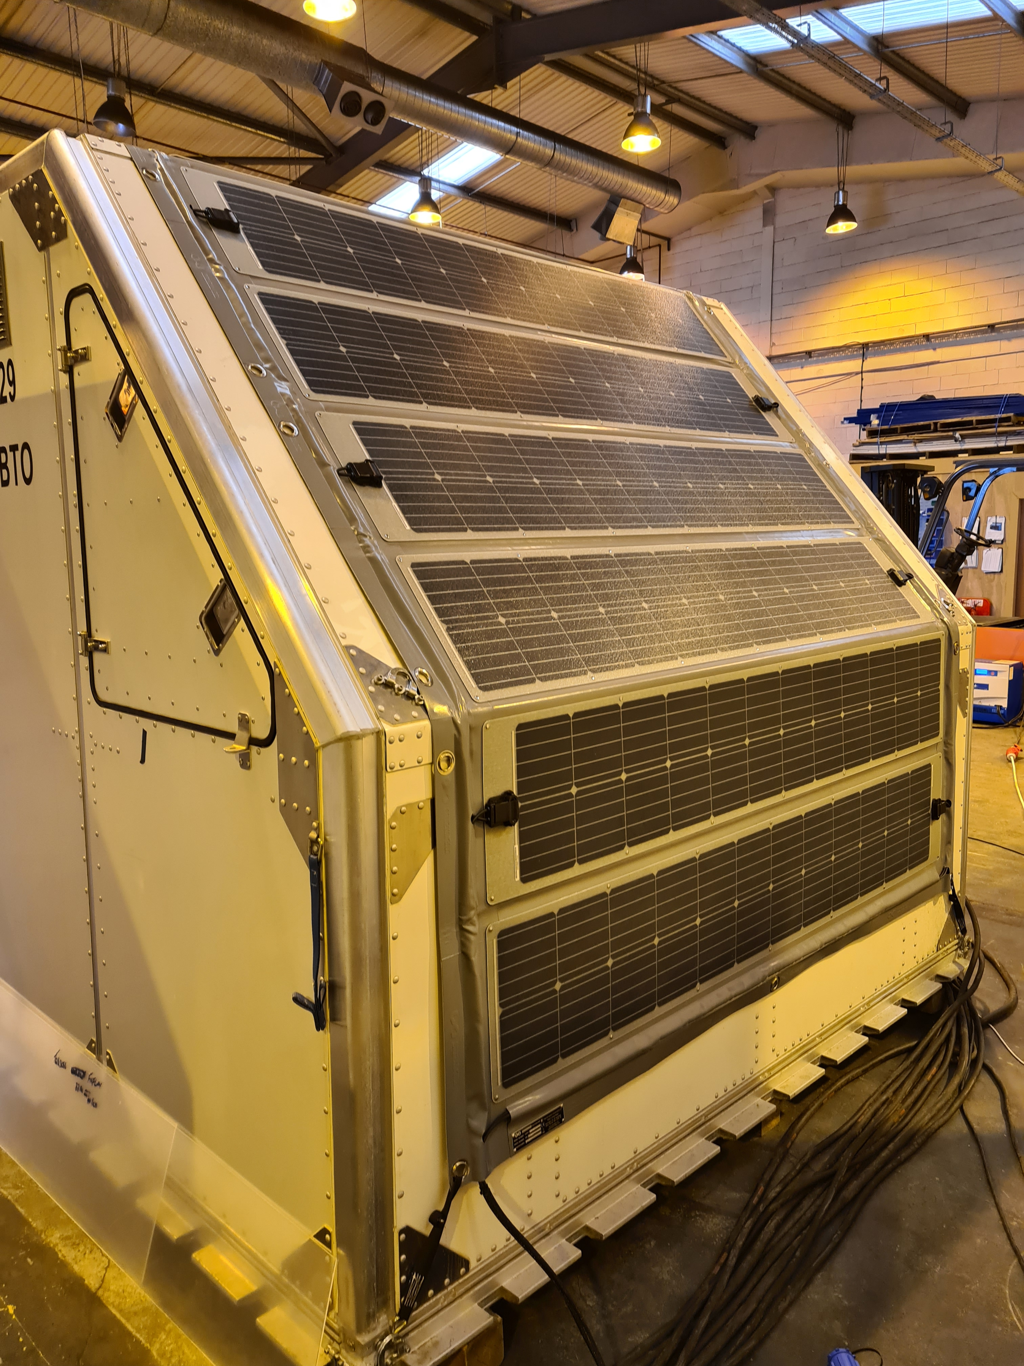
OSI Base of Operations Hybrid Power System
Alana Campbell, Mohamed Ali Nasri, OSI EP
P2.2-230
BOO Solar Mats and Inverters
The BOO establishment includes the OSI deployable transportation and field containers as a part of the storage and working areas. Bespoke solar mats have been designed to integrate into the diesel-powered electricity generation.
The electricity generated by these will be used first in the smart system run by the Hybrid Power Unit. Lightening protection included.
Ground mount inverter hubs connect at any point in the power grid.
920W power output per solar mat.
METHODS

Slide 6
OSI Base of Operations Hybrid Power System
Alana Campbell, Mohamed Ali Nasri, OSI EP
P2.2-230
Local (remote) Power Supply
Hybrid power can be produced in the field to support remote equipment for example, a water sample pump.
Local power supply has an energy hub 5kWh Lithium with two 0.92kWp solar mats.
METHODS
Small Equipment remote Power Supply
Solar panels folding to the size of a briefcase to attach directly to a car battery to support the SAMS equipment operating remotely. This is designed to reduce the swapping out for re-charging at the BOO.

Slide 7
OSI Base of Operations Hybrid Power System
Alana Campbell, Mohamed Ali Nasri, OSI EP
P2.2-230
Initial testing of the hybrid power equipment has had positive results, but it is yet to be run with a full electricity draw in a field situation.
Further tests are planned of longer duration, and it is expected there will be lower diesel consumption once the full field electricity system is operational.
Remote field equipment should be self-sufficient for longer periods between re-charging and will buy time for Technical Staff during an OSI.
RESULTS

Slide 8
OSI Base of Operations Hybrid Power System
Alana Campbell, Mohamed Ali Nasri, OSI EP
P2.2-230
The full potential of this system will be realized in an operational field environment and OSI is hopeful that over the long term the integrated solar power will reduce diesel consumption, and therefore relieve pressure on the resupply system and deliver a better environmental footprint.
CONCLUSIONS

