Slide 1

Improving environmental radioactivity monitoring
by the use of shielded portable HPGe detector
Rizzo, S. Salvi, H. Mubashir, F. Cicconi, C. Telloli, A. Ubaldini,
E. Manzi, P. Lombadi, E. Marrocchino, C. Vaccaro
Poster No. 2.2-387

Slide 2
Improving environmental radioactivity monitoring
by the use of shielded portable HPGe detector
A. Rizzo, S. Salvi, H. Mubashir, F. Cicconi, C. Telloli, A. Ubaldini, E. Marrocchino, C. Vaccaro
P2.2-387
The ENEA Traceability Laboratory in Bologna utilizes a portable HPGe gamma spectrometer TransSPEC-DX-100T for in situ monitoring campaigns and to evaluate the possible presence of radioisotopes in the environment (e.g. waste assay measurements, emergency response, nuclear safeguards inspection).
In order to use the instrument to its full capacity and potential, a transportable shielding has been designed and built-in collaboration with the University of Ferrara, taking into account a good balance between transportability and performance of the system. The results of a monitoring campaign with and without shielding will be shown and the need to include shielding in the draft list of auxiliary equipment will be discussed.
ABSTRACT

Slide 3
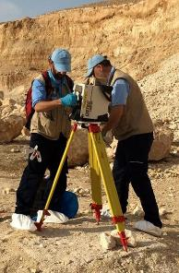
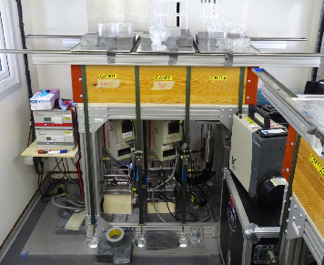

Improving environmental radioactivity monitoring
by the use of shielded portable HPGe detector
A. Rizzo, S. Salvi, H. Mubashir, F. Cicconi, C. Telloli, A. Ubaldini, E. Marrocchino, C. Vaccaro
P2.2-387
The gamma monitoring technique is allowed to be used during an On-Site Inspection by the Treaty.
The specific instrumentation to be used has to be included in the draft list of the equipment for OSI.
During an On Site Inspection we can have two different situations for the use of portable gamma spectrometer, one ordinary and one extraordinary:
Detection of anomaly above and on the surface during in field activities (ordinary)
Failure of the gamma spectrometer in the on site radionuclide laboratory (extraordinary)
INTRODUCTION
!

Slide 4
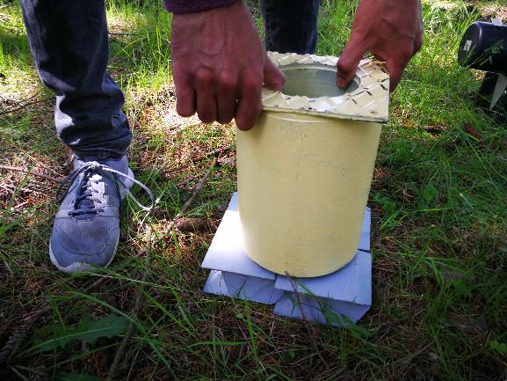
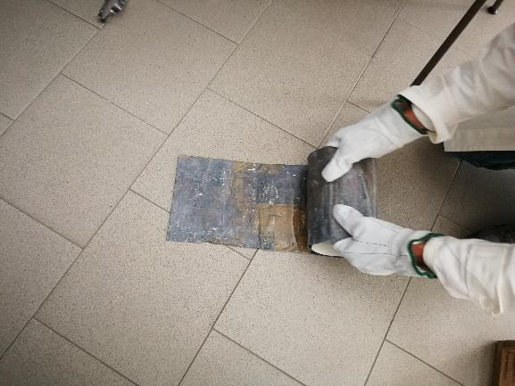
Improving environmental radioactivity monitoring
by the use of shielded portable HPGe detector
A. Rizzo, S. Salvi, H. Mubashir, F. Cicconi, C. Telloli, A. Ubaldini, E. Marrocchino, C. Vaccaro
P2.2-387
METHODS
A
Heavier but still transportable
B
Lighter and completely portable
Two different shielding devices

Slide 5
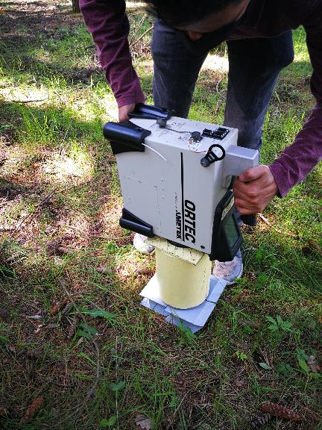
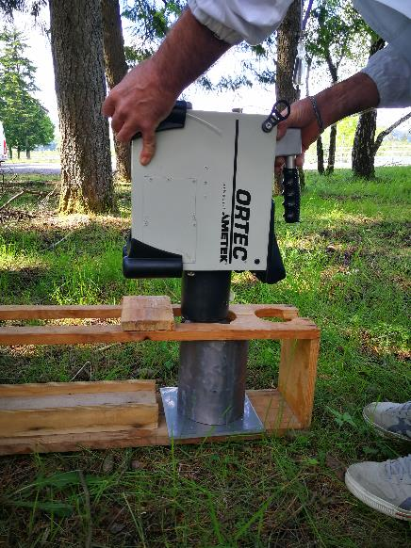
Improving environmental radioactivity monitoring
by the use of shielded portable HPGe detector
A. Rizzo, S. Salvi, H. Mubashir, F. Cicconi, C. Telloli, A. Ubaldini, E. Marrocchino, C. Vaccaro
P2.2-387
METHODS
B
A

Slide 6
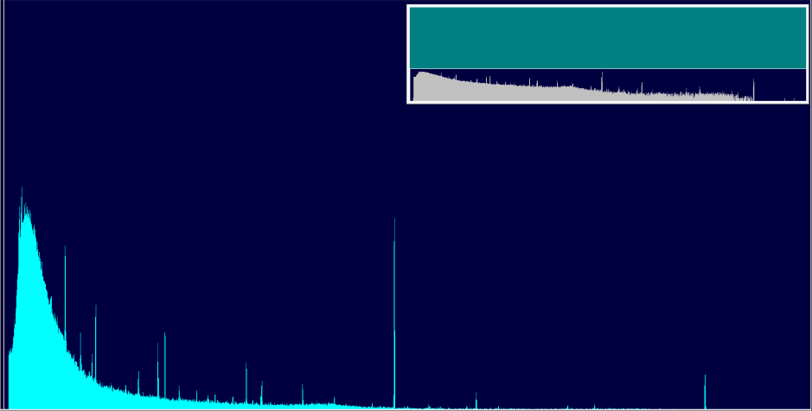
Improving environmental radioactivity monitoring
by the use of shielded portable HPGe detector
A. Rizzo, S. Salvi, H. Mubashir, F. Cicconi, C. Telloli, A. Ubaldini, E. Marrocchino, C. Vaccaro
P2.2-387
Background measurement with no Shielding
RESULTS
Peak | At 1456 Kev
Background | 144 counts
Gross Area | 6526 counts
Net Area | 6426 counts
Gross/Net Count Rate | 3.63/3.52 cps
Average Background Above/Below Peak | 7/3.33

Slide 7
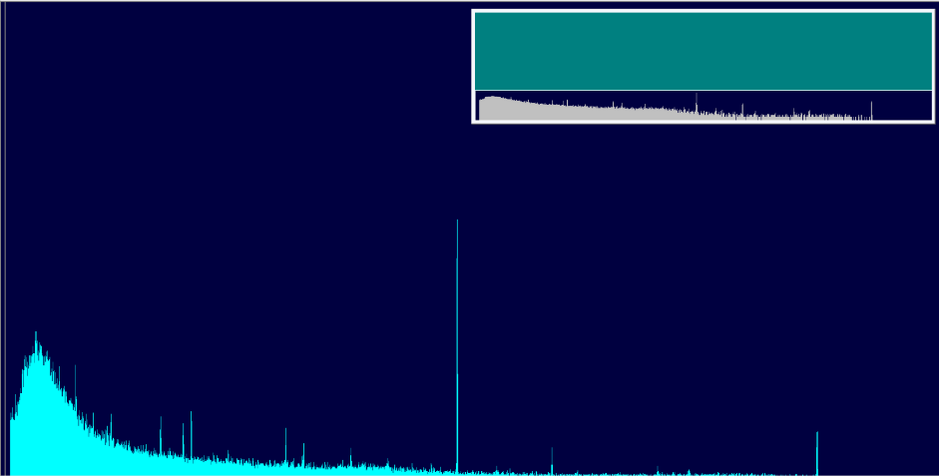

Improving environmental radioactivity monitoring
by the use of shielded portable HPGe detector
A. Rizzo, S. Salvi, H. Mubashir, F. Cicconi, C. Telloli, A. Ubaldini, E. Marrocchino, C. Vaccaro
P2.2-387
Background measurement with Heavy Shielding (A)
RESULTS
Peak | At 1456 Kev
Background | 50 counts
Gross Area | 1807 counts
Net Area | 1736 counts
Gross/Net Count Rate | 1.00/0.96 cps
Average Background Above/Below Peak | 2.33/1.66 cps

Slide 8


Improving environmental radioactivity monitoring
by the use of shielded portable HPGe detector
A. Rizzo, S. Salvi, H. Mubashir, F. Cicconi, C. Telloli, A. Ubaldini, E. Marrocchino, C. Vaccaro
P2.2-387
Background measurement with Light Shielding (B)
RESULTS
Peak | At 1456 Kev
Background | 126 counts
Gross Area | 4781 counts
Net Area | 4698 counts
Gross/Net Count Rate | 2.66/2.57 cps
Average Background Above/Below Peak | 5.66/2 cps

Slide 9
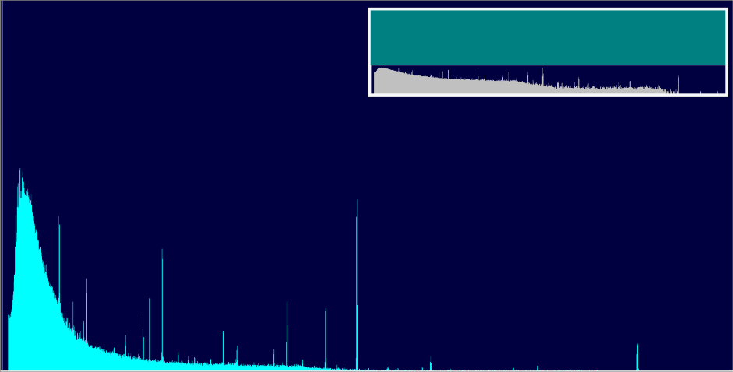
Improving environmental radioactivity monitoring
by the use of shielded portable HPGe detector
A. Rizzo, S. Salvi, H. Mubashir, F. Cicconi, C. Telloli, A. Ubaldini, E. Marrocchino, C. Vaccaro
P2.2-387
Measurement of Multigamma Source with no Shielding
RESULTS
CS-137 | At 659.3 Kev
Background | 756.4 counts
Gross Area | 4425 counts
Net Area | 3375 counts
Gross/Net Count Rate | 2.46/1.80 cps
Average Background Above/Below Peak | 46/44 cps

Slide 10
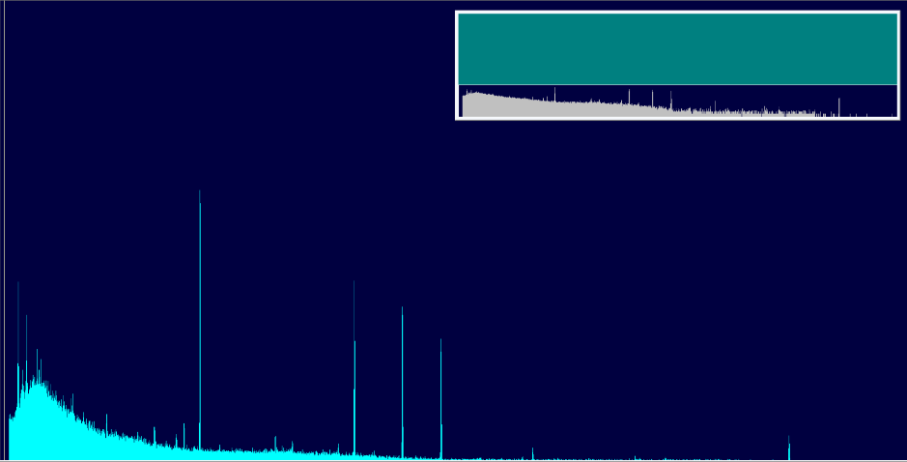

Improving environmental radioactivity monitoring
by the use of shielded portable HPGe detector
A. Rizzo, S. Salvi, H. Mubashir, F. Cicconi, C. Telloli, A. Ubaldini, E. Marrocchino, C. Vaccaro
P2.2-387
Measurement of Multigamma Source with Heavy Shielding (A)
RESULTS
CS-137 | At 659.2 Kev
Background | 456 counts
Gross Area | 3626 counts
Net Area | 3208 counts
Gross/Net Count Rate | 2.01/1.75 cps
Average Background Above/Below Peak | 18.33/21.33 cps

Slide 11
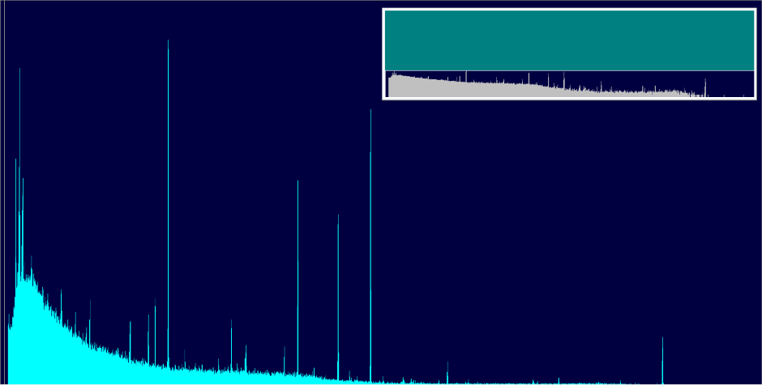
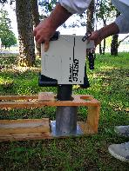
Improving environmental radioactivity monitoring
by the use of shielded portable HPGe detector
A. Rizzo, S. Salvi, H. Mubashir, F. Cicconi, C. Telloli, A. Ubaldini, E. Marrocchino, C. Vaccaro
P2.2-387
Measurement of Multigamma Source with Light Shielding (B)
RESULTS
CS-137 | At 659.2 Kev
Background | 669 counts
Gross Area | 5515 counts
Net Area | 4624 counts
Gross/Net Count Rate | 3.06/2.53 cps
Average Background Above/Below Peak | 39/37 cps

Slide 12
Improving environmental radioactivity monitoring
by the use of shielded portable HPGe detector
A. Rizzo, S. Salvi, H. Mubashir, F. Cicconi, C. Telloli, A. Ubaldini, E. Marrocchino, C. Vaccaro
P2.2-387
Two different shielding devices has been fabricated and tested, one heavier but still transportable (A) and one lighter portable (B).
Their use lowers the total count of the background and allows better determination of gamma spectra lines.
The portable shielding can also provide a backup strategy in case of failure of the laboratory systems.
Similar devices could be taken into consideration in the auxiliary equipment list for On Site radionuclide techniques.
CONCLUSIONS

