Slide 1
Radioactive Signs at the Near-Portal Sites of Tunnels
after Underground Nuclear Tests at Semipalatinsk Test Site
Yuri V. Dubasov
P2.2-313

Slide 2
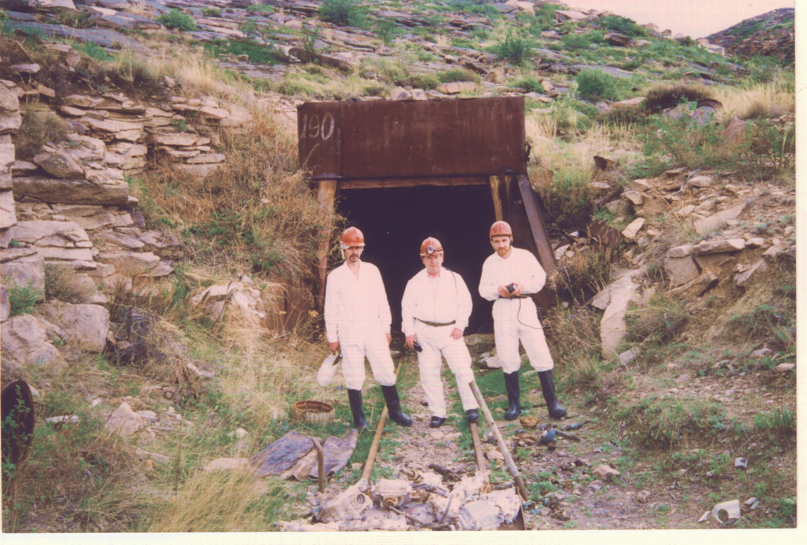
Radioactive signs at the near-portal sites of tunnels after underground nuclear tests at Semipalatinsk Test Site
Yuri Dubasov , Khlopin Radium Institute, yuri.dubasov@gmail.com
P2.2-313
About half of the underground nuclear tests showed signs of radioactive contamination.

Slide 3
Table 1. Brief characteristics of surveyed tunnels
Table 1. Brief characteristics of surveyed tunnels
Table 1. Brief characteristics of surveyed tunnels
Radioactive signs at the near-portal sites of tunnels after underground nuclear tests at Semipalatinsk Test Site
Yuri Dubasov , Khlopin Radium Institute, yuri.dubasov@gmail.com
P2.2-313
Brief characteristics of surveyed tunnels
№ № | Test | Date | Yield, kt | №№ | Test | Date | Yield, kt.
1 | V-1 | 11.10.61 | 1 | 21 | 701 701 R | 26.03.78. 06.05.79 | 0,001 – 20х2 0,001 – 20х3
2 | А-1 А-1Sh | 02.02.62 29.07.65 | 0,001 - 20 0,001 – 20 | 22 | 204 204-R 204-RR | 22.04.78 23.10.80 05.12.80 | 0,001 – 20х3 0,001 – 20х2 0,001 – 20х2
3 | А А Repeat* | 04.02.65 11.05.65 | 0,001 - 20 0,001 – 20 | 23 | 104 | 28.07.78 | 20 – 150 0,001 -20х4
4 | 11 11R | 20.03.66 28.05.67 | 100 0,001 – 20х2 charge** | 24 | 181 | 10.04.80 | 0,001 -20х2
5 | 13 13R | 19.10.66 02.09.67 | 20 -150 0,001 - 20 | 25 | 173 | 22.05.80 | 0,001 – 20х3
6 | 14 14R | 03.12.66 23.08.82 | 0,001 – 20х2 0,001- 20 | 26 | 184 | 14.08.81“ | 0,001 – 20х3
7 | 19 19R | 25.03.67 04.04.69 | 0,001 – 20х2 0,001 -20 | 27 | 177 | 30.03.83 | 0,001 – 20
8 | 506 506 R | 15.07.67 30.10.69 | 0,001 -20 0,001 - 20 | 28 | 180 | 29.11.83 | 0,001 – 20х2
9 | 18 18 R | 04.08.67 27.11.77 | 0,001 – 20х2 0,001 - 20 | 29 | 208 | 03.04.87“ | 0,001 – 20х3
10 | 810 | 07.01.68 | 0.001 – 20 | 30 | 138 | 06.06.87 | 0,001- 20
11 | 504 504 R | 23.05.68 29.10.68 | <0,001 0,001 -20 | 31 | Е-2 | 29.09.68 | 60
12 | 802 802 R | 29.01.70 21.12.79 | 0,001 -20х3 0,001- 20 | 32 | 511 | 27.11.69 | 0,001 – 20
13 | 710 | 04.07.69 | 0,001 – 20х2 | 33 | 502 | 06.09.70 | 0,001 – 20
14 | 503 | 11.09.69 | 0,001 – 20х2 | 34 | 110 110 R | 07.06.72 28.02.74 | 0,001 – 20 0,001 – 20
15 | 148/1 | 09.04.71 | 0,23 | 35 | 113 | 16.02.73 | 20 – 150
16 | 609 609 R | 30.12.71. 10.04.76. | 20 - 150 0.001 - 20 | 36 | 604 604 R | 13.12.75 25.04.77 | 0,001 – 20 0,001 – 20
17 | 176 176 R | 16.05.74 24.06.83 | 0,001 - 20 0,001 - 20 | 37 | 143 | 30.10.76 | 0,001 – 20
18 | 148/5 | 16.12.74. | 3,8 | 38 | 128 | 18.10.79 | 0,001 – 20х2
19 | 101 101 R | 11.03.75 21.04.76 | 0,001 - 20 0,001 - 20 | 39 | 127 | 25.06.80 | 0,001 – 20
20 | 165 | 08.06.75. | 0,001 - 20 | 40 | 139 | 17.02.89 | 0,001 – 20
With the aim of excluding the possibility of repeated use (demilitariza-tion) of the Test Complex at the Degelen Mountain on the Former Semipalatinsk Test Site and to ensure the non-prolifera-ion of nuclear technologies, three countries - the Republic of Kazakhstan, the Russian Federation, and the USA recognized it expedient to perform complete closure work at all used tunnel portals. In 1996 -1997 , the Khlopin Radium Institute conducted a survey of 40 near-portal sites of the tunnels before their final closure.
INTRODUCTION

Slide 4
At the Semipalatinsk test site (STS) of the Soviet Union, 209 underground nuclear tests were co by the re
At the Semipalatinsk test
At the Semipalatinsk test
[Radioactive signs at the near-portal sites of tunnels after underground nuclear tests at Semipalatinsk Test Site
Yuri Dubasov , Khlopin Radium Institute, yuri.dubasov@gmail.com
[
P2.2-313
At the Semipalatinsk test site (STS) of the Soviet Union, 209 underground nuclear tests were conducted in horizontal mine workings - tunnels. About 40% of the tests were accompanied by the releases of radioactive noble gases (RNG) of various intensities. In 1996, the Khlopin Radium Institute conducted a survey at the former STS of about 40 near-portal sites of the tunnels before their final closure. During the site of tunnels survey, the radiation background was measured, gamma spectra were recorded at the sites, and rock samples were sampling for radiochemical analyses. The report will present data on contamination of the surveyed sites of tunnels with radionuclides such ¹³⁷Cs, ⁹⁰Sr and others, and compare them with data on radiation characterization during nuclear tests (the release of RNG) in these tunnels.
ABSTRACT

Slide 5
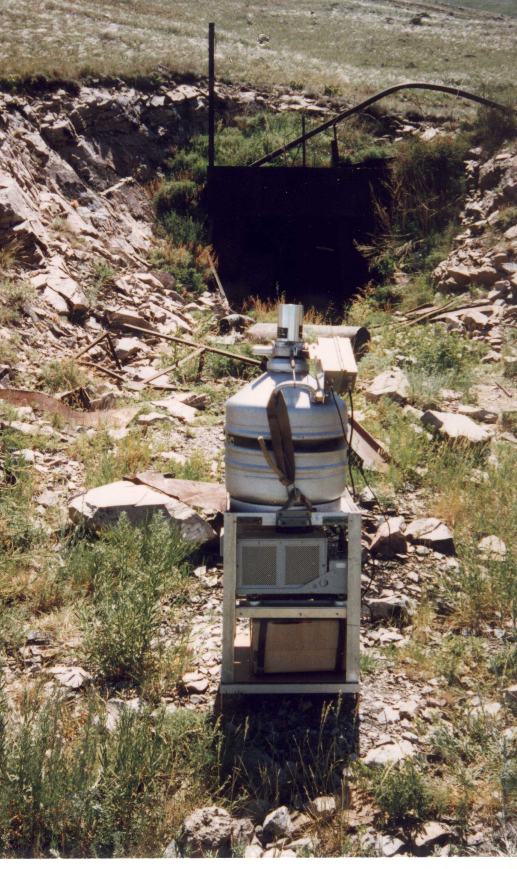
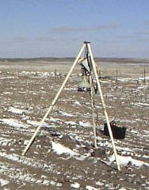
[. Radioactive signs at the near-portal sites of tunnels after underground nuclear tests at Semipalatinsk Test Site
Yuri Dubasov , Khlopin Radium Institute, yuri.dubasov@gmail.com
P2.2-313X
The survey consisted of measuring radiation levels ( dose rate) and beta-particle fluxes at the estuary site near the installed GPS marker, with the help of two Ge(Li) - spectrometers and a CsI-scintillation spectrometer "SKIF" gamma –spectra were recorded.
Soil samples were taken for radiochemical analysis. Soil (ground) was sampled at portal rock faces within the coverage of Ge (Li) spectrometer. Samples were taken at three points by a cylindrical sampler 90 mm in diameter at the depth of 10-15 cm; three samples were combined in one.
METHODS

Slide 6
Radioactive signs at the near-portal sites of tunnels after underground nuclear tests at Semipalatinsk Test Site
Yuri Dubasov , Khlopin Radium Institute, yuri.dubasov@gmail.com
P2.2-313
Of the 40 tunnels surveyed, 16 tunnels had elevated levels of radiation and ¹³⁷Cs contamination at the near-portal sites.
On the near-portal sites of the tunnels A-1, 11, 14, 506, 810, 50/ hour, the flux density of β-particles 4500 parts / cm² min, the concentration of ¹³⁷Cs was 160 kBq/kg. The ratio of ¹³⁷Cs/⁹⁰Sr for the rock from the near-portal sites of the tunnels 511 and 502 were 80 and 300, respectively, which indicates a late outflow of gases through the stemming complex.
Of the 40 tunnels surveyed, the dose rate for 25 tunnels at the near-portal sites at near the GPS marker does not exceed 0.3 mSv / h. The lowest values for surface contamination of ¹³⁷Cs (2 Bq / kg) were recorded for the tunnels E-2, 113, and 604.
A spot with a high content of ²⁴¹Am was found at the near –portal site tunnel 139. There was significant ²⁴¹Am contamination at a site near the portal where fire had been used to burn the insulation off of copper cable recovered from the tunnel, by “metal collectors”.
RESULTS

Slide 7
Thus, the survey of the near-portal sites of forty tunnels of the former Semipalatinsk test site, in which nuclear tests were conducted in the
Radioactive signs at the near-portal sites of tunnels after underground nuclear tests at Semipalatinsk Test Site
Yuri Dubasov , Khlopin Radium Institute, yuri.dubasov@gmail.com
P22-.313
Thus, the survey of the near-portal sites of forty tunnels at the former Semipalatinsk test site, in which nuclear tests were conducted in the period from 1961 to 1987, showed that for 20 tunnels, signs of radioactive contamination of various intensity remain, mainly due to ¹³⁷Cs -the product of the decay of ¹³⁷Xe, which released through the cracks formed in the stemming complex.
CONCLUSIONS

