Slide 1
An Integrated Study of Seismic and Infrasound for Detecting Non-Tectonic Earthquake in Indonesia
Aldilla Damayanti Purnama Ratri, Yusuf Hadi Perdana
Poster No. P2.3-591
Indonesian Agency for Meteorology, Climatology and Geophysics (BMKG), Jakarta, Indonesia

Slide 2
An Integrated Study of Seismic and Infrasound for Detecting Non-Tectonic Earthquake in Indonesia
Aldilla Damayanti Purnama Ratri, Yusuf Hadi Perdana
Indonesian Agency for Meteorology, Climatology and Geophysics (BMKG), Jakarta, Indonesia
aldilla.damayanti@bmkg.go.id
P2.3-591
ABSTRACT
INTRODUCTION
METHODS
RESULTS
CONCLUSIONS
OUTLINES

Slide 3
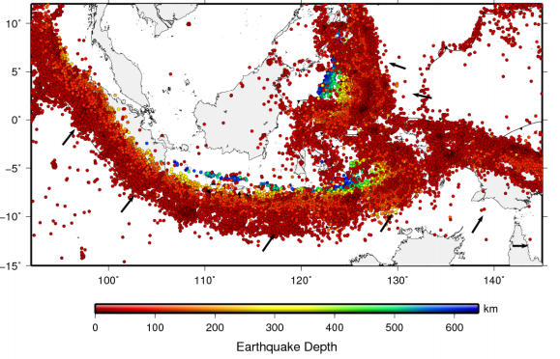
An Integrated Study of Seismic and Infrasound for Detecting Non-Tectonic Earthquake in Indonesia
Aldilla Damayanti Purnama Ratri, Yusuf Hadi Perdana
Indonesian Agency for Meteorology, Climatology and Geophysics (BMKG), Jakarta, Indonesia
aldilla.damayanti@bmkg.go.id
P2.3-591
Indonesia is the prone area of earthquakes, not only tectonic earthquakes but also non-tectonic earthquakes, therefore needed to validate these earthquakes, whether caused by tectonic or non-tectonic activity. Tectonic and Non-tectonic earthquakes have different frequencies. Non-tectonic earthquakes are dominated at low frequency and well detected by infrasound measurement, because Infrasound is acoustic wave with very low frequency less than 20 Hz (~0.01 – 20 Hz).
ABSTRACT
Distribution of Seismicity in Indonesia from 1907 to 2016 (Source: National Center of Earthquake Studies (PuSGeN), 2017

Slide 4
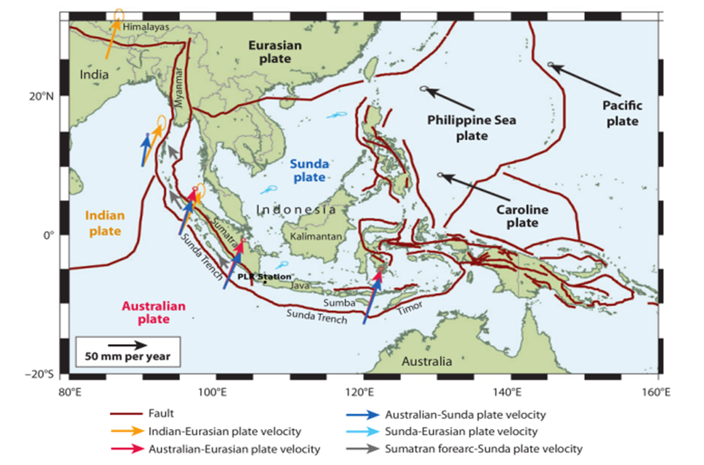
An Integrated Study of Seismic and Infrasound for Detecting Non-Tectonic Earthquake in Indonesia
Aldilla Damayanti Purnama Ratri, Yusuf Hadi Perdana
Indonesian Agency for Meteorology, Climatology and Geophysics (BMKG), Jakarta, Indonesia
aldilla.damayanti@bmkg.go.id
P2.3-591
Indonesia is in a unique geotectonic position.
Lies on two continental plates and two oceanic plates.
Sits on the ring of fire.
Prone to earthquakes, not only Tectonic Earthquakes but also Non-Tectonic Earthquakes.
A more systematic analysis of detection Non-Tectonic Earthquakes is needed by integrating parameters, such as seismic and infrasound.
INTRODUCTION
Tectonic Setting of Indonesia (Mc.Caffrey, 2009)

Slide 5
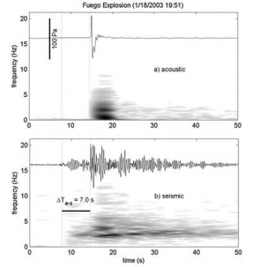
An Integrated Study of Seismic and Infrasound for Detecting Non-Tectonic Earthquake in Indonesia
Aldilla Damayanti Purnama Ratri, Yusuf Hadi Perdana
Indonesian Agency for Meteorology, Climatology and Geophysics (BMKG), Jakarta, Indonesia
aldilla.damayanti@bmkg.go.id
P2.3-591
Tectonic and Non-Tectonic Earthquakes have different frequencies → Seismic and Infrasound waves.
Seismic and Infrasound measurement is a good combination to detect and validate Non-Tectonic earthquakes.
By studying these parameters, in short term goals we want to know specific characteristic of non-tectonic earthquakes, and for long term goals we want to use infrasound as a parameter for earthquake precursor which help us to give early warning to the society.
INTRODUCTION
Infrasound and Seismic Trace at Fuego Explosion (Johnson, et al, 2004)

Slide 6
An Integrated Study of Seismic and Infrasound for Detecting Non-Tectonic Earthquake in Indonesia
Aldilla Damayanti Purnama Ratri, Yusuf Hadi Perdana
Indonesian Agency for Meteorology, Climatology and Geophysics (BMKG), Jakarta, Indonesia
aldilla.damayanti@bmkg.go.id
P2.3-591
The Progressive Multi-Channel Correlation (PMCC) method is based on sequential study of windowed signals (Cansi, 1995). The PMCC from DTK-GPMCC application in the NDC-in-a-box package is applied to the raw differential pressure recordings at each of the IMS infrasound arrays’ micro-barometers to derive advanced data parameters like back azimuth, apparent velocity and frequency content of coherent signals thereby associated to different events.
Processing with the PMCC technique is performed consecutively in 11 frequency ranges, ranging from 0.07 to 4.0 Hz, covering the entire spectrum of interest for the detection of infrasound signals. The duration of the processing window depends inversely on the frequency band.
The first processing stage produces elemental detections, called PMCC pixels, which meet a correlation and consistency criteria. The next step is grouping individual detection pixels that have similar signal attributes: time, frequency, back-azimuth, and horizontal speed. Groups of neighboring pixels constitute an "infrasonic family“ (Neri, et al. Sixteenth International Congress of the Brazilian Geophysical)
Signals can be associated to a certain source by applying cross bearing techniques on the back-azimuth directions of two or more arrays. The seismic or acoustic origin as well as the propagation of signals can be identified by the apparent velocity and frequency content of the recordings.
METHODS

Slide 7
An Integrated Study of Seismic and Infrasound for Detecting Non-Tectonic Earthquake in Indonesia
Aldilla Damayanti Purnama Ratri, Yusuf Hadi Perdana
Indonesian Agency for Meteorology, Climatology and Geophysics (BMKG), Jakarta, Indonesia
aldilla.damayanti@bmkg.go.id
P2.3-591
Coherence Method. An approach for detecting and locating technique which use coherent of P- and S-waves arrivals at different stations for assumed 3D grid of potential source locations (Matos et al. 2016; Lopez-Comino et al. 2017; Adinolfi et al. 2019).
The steps of the processing (Adinolfi, et al. 2020) :
Pre-Processing. Selected windowed data, Continuous waveforms are filtered in the certain frequency band and cut in 20 min long time windows with 20% of overlap, which in turn are used to compute characteristic functions (CFs).
Earthquake detection with S-wave Image Function Contribution (IFC) by applying threshold criterion.
Earthquakes’ location with P- and S-waves IFCs
Discrimination between real and false detections. Threshold and approximately criterion.
Magnitude estimation.
METHODS

Slide 8
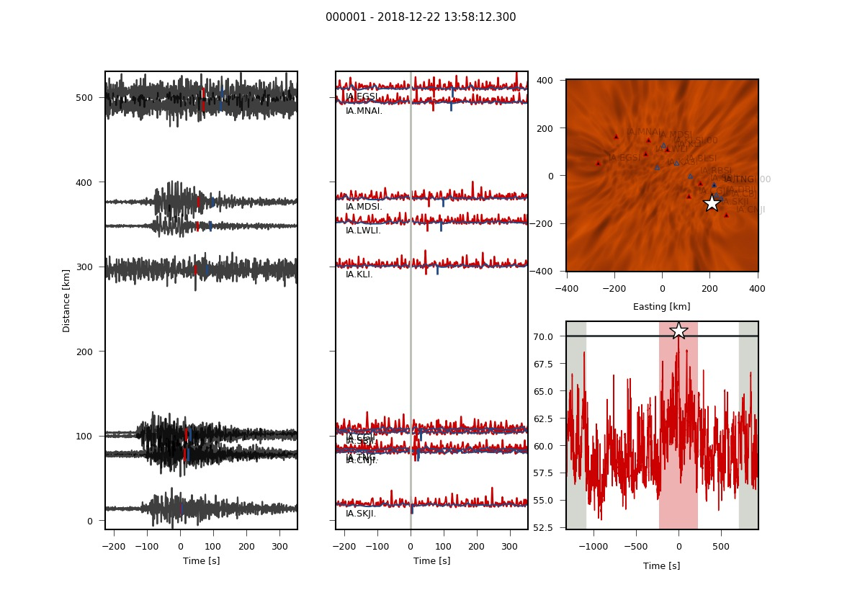
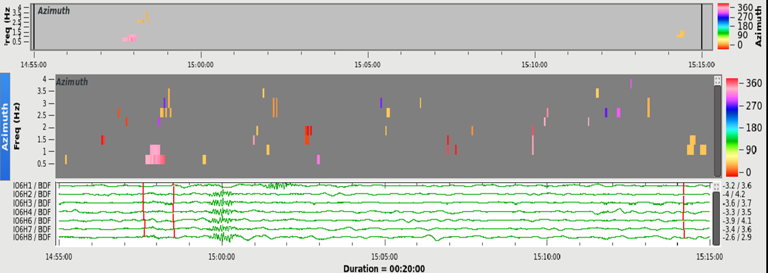
An Integrated Study of Seismic and Infrasound for Detecting Non-Tectonic Earthquake in Indonesia
Aldilla Damayanti Purnama Ratri, Yusuf Hadi Perdana
Indonesian Agency for Meteorology, Climatology and Geophysics (BMKG), Jakarta, Indonesia
aldilla.damayanti@bmkg.go.id
P2.3-591
Anak Krakatau Event Dec 22nd, 2018
RESULTS
PMCC detection using I06AU Infrasound data on Dec 22nd, 2018
Coherence Method detection using 6 seismic sensors data on Dec 22nd, 2018

Slide 9
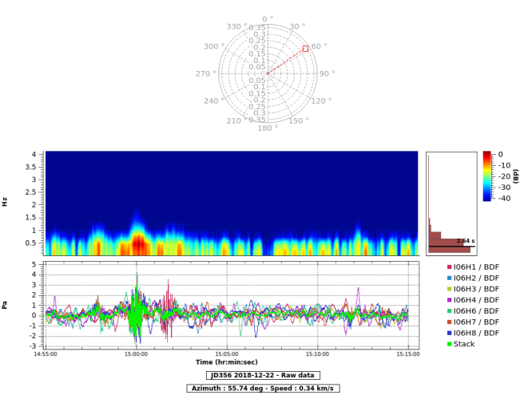
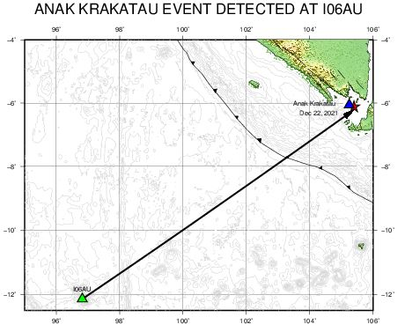
An Integrated Study of Seismic and Infrasound for Detecting Non-Tectonic Earthquake in Indonesia
Aldilla Damayanti Purnama Ratri, Yusuf Hadi Perdana
Indonesian Agency for Meteorology, Climatology and Geophysics (BMKG), Jakarta, Indonesia
aldilla.damayanti@bmkg.go.id
P2.3-591
RESULTS
Polar plot associated to the PMCC detection using I06AU
Earthquake Epicenter detected by infrasound data
Earthquake Epicenter detected by seismic data

Slide 10
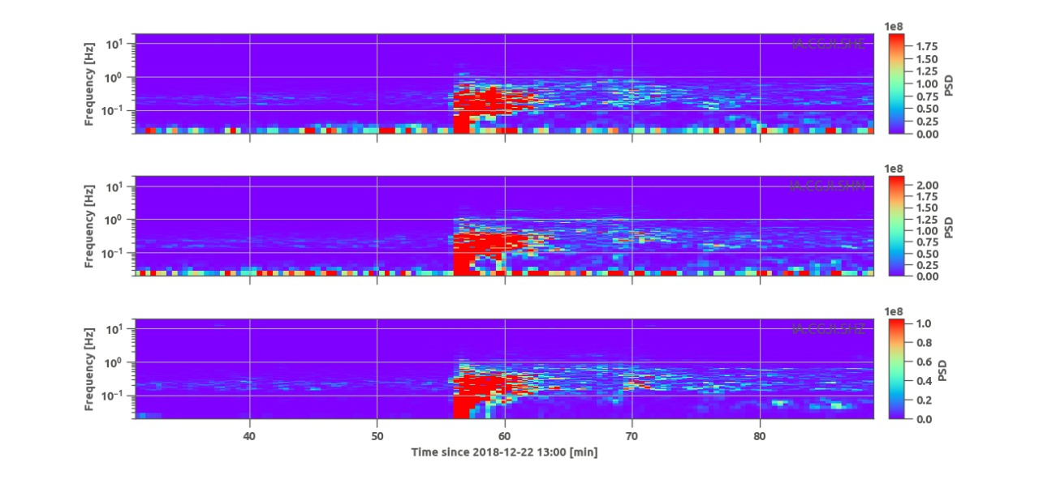
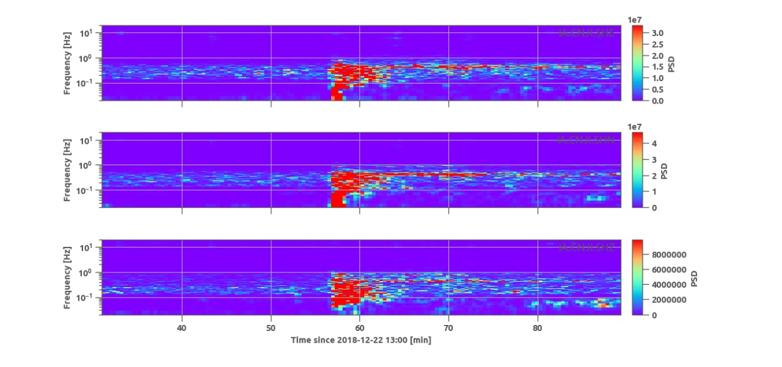
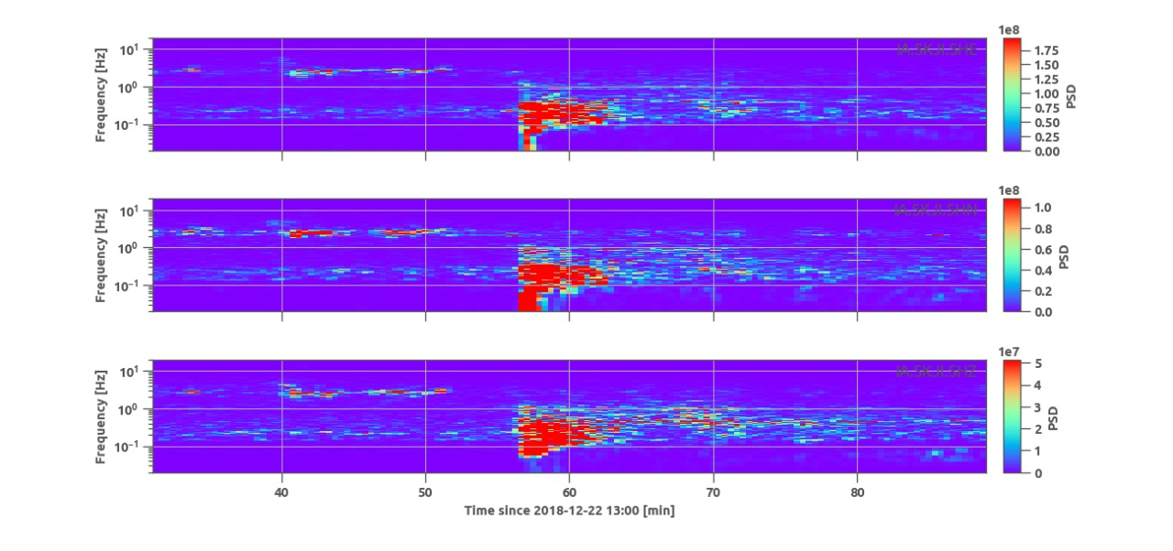
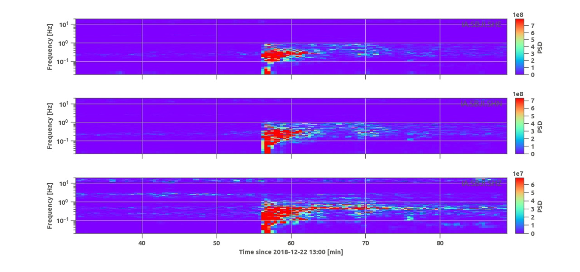
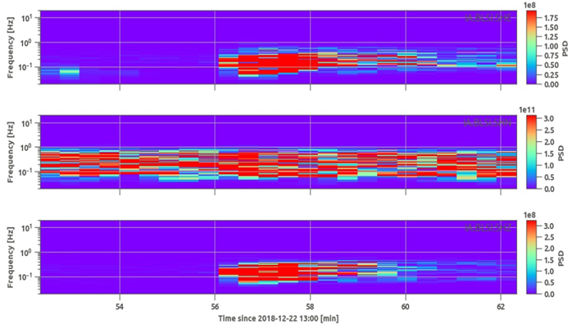
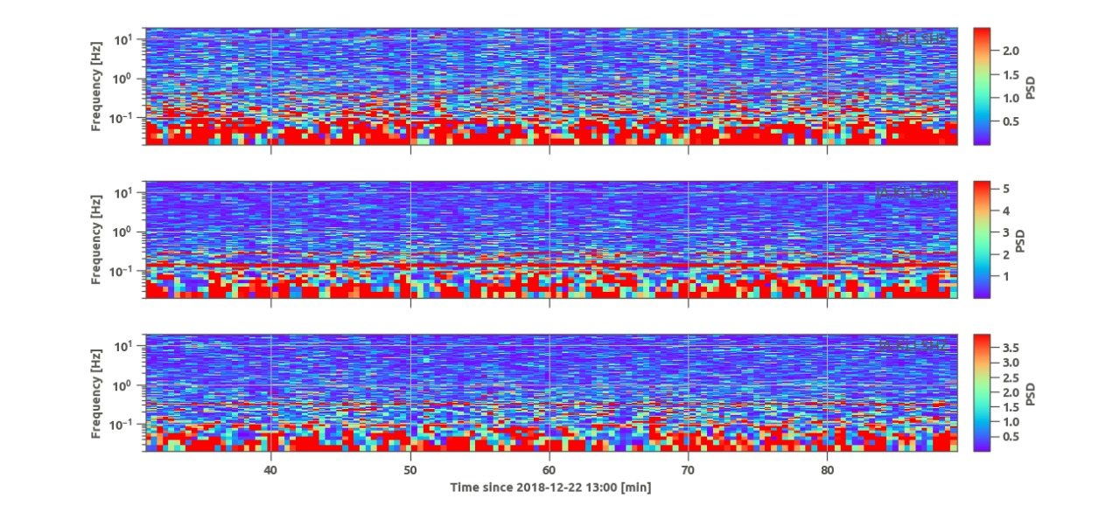
An Integrated Study of Seismic and Infrasound for Detecting Non-Tectonic Earthquake in Indonesia
Aldilla Damayanti Purnama Ratri, Yusuf Hadi Perdana
Indonesian Agency for Meteorology, Climatology and Geophysics (BMKG), Jakarta, Indonesia
aldilla.damayanti@bmkg.go.id
P2.3-591
RESULTS
Display of seismic sensors in surrounding area

Slide 11
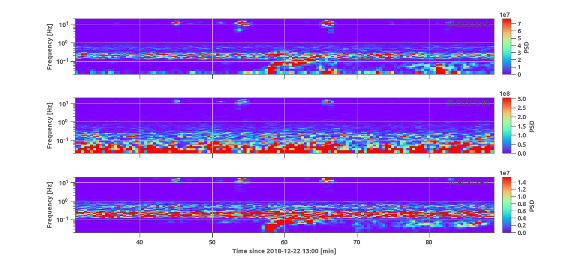
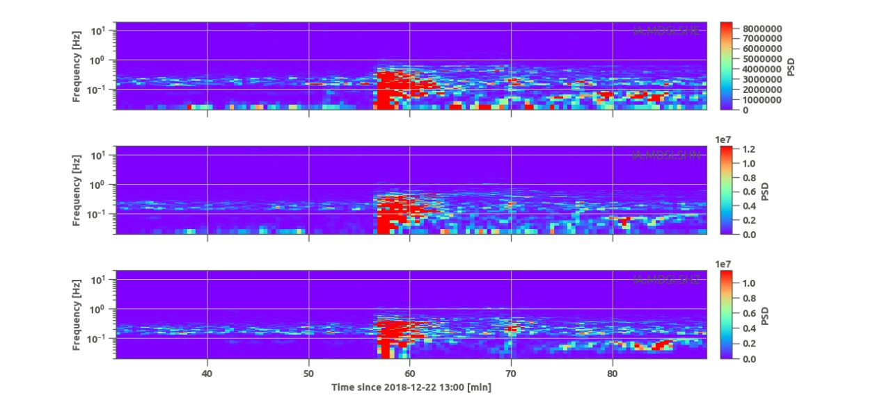
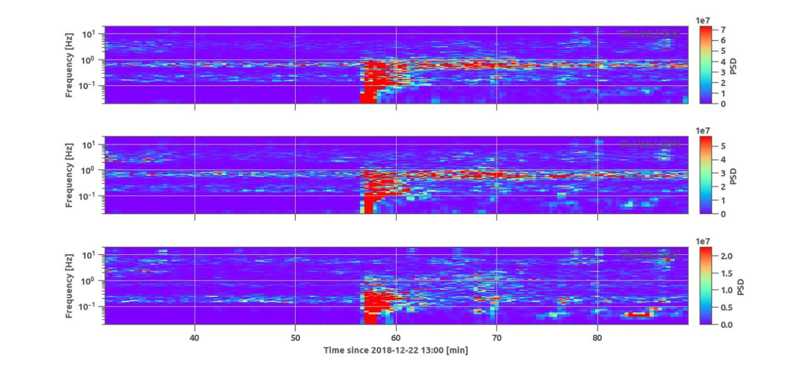
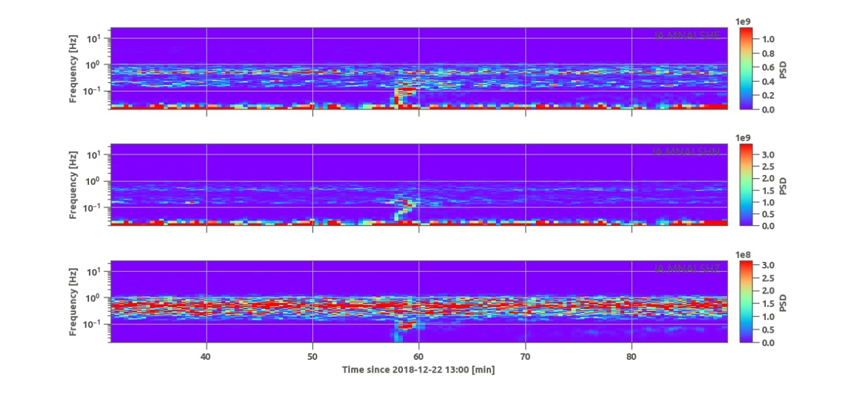
An Integrated Study of Seismic and Infrasound for Detecting Non-Tectonic Earthquake in Indonesia
Aldilla Damayanti Purnama Ratri, Yusuf Hadi Perdana
Indonesian Agency for Meteorology, Climatology and Geophysics (BMKG), Jakarta, Indonesia
aldilla.damayanti@bmkg.go.id
P2.3-591
RESULTS
Display of seismic sensors in surrounding area

Slide 12
An Integrated Study of Seismic and Infrasound for Detecting Non-Tectonic Earthquake in Indonesia
Aldilla Damayanti Purnama Ratri, Yusuf Hadi Perdana
Indonesian Agency for Meteorology, Climatology and Geophysics (BMKG), Jakarta, Indonesia
aldilla.damayanti@bmkg.go.id
P2.3-591
On Dec 22nd, 2018 there was an event in surrounding areas of Anak Krakatau Mountain recorded by seismic and infrasound sensors.
Not all seismic sensors can detect that event clearly but this event well detected by infrasound sensor.
Infrasound sensor detected the event with back azimuth 55.74◦ from the I06AU sensor and has low frequency, less than 1 Hz.
These results are similar to seismic sensors which detect this event and also get a similar frequency with infrasound measurement, less than 1 Hz.
Both parameters detect the same event with have similar frequency and can be concluded that event on Dec 22nd, 2018 caused by Anak Krakatau activity and assumed as Non-Tectonic Earthquake.
Seismic is a powerful parameter in terms of Tectonic and Non-Tectonic Earthquake monitoring. Infrasound in particular is as an important complement to understand and ensure the Non-Tectonic Earthquake.
Infrasound complements seismic monitoring in its capability to robustly detect and characterize surface activity.
CONCLUSIONS

Slide 13
An Integrated Study of Seismic and Infrasound for Detecting Non-Tectonic Earthquake in Indonesia
Aldilla Damayanti Purnama Ratri, Yusuf Hadi Perdana
Indonesian Agency for Meteorology, Climatology and Geophysics (BMKG), Jakarta, Indonesia
aldilla.damayanti@bmkg.go.id
P2.3-591
Adinolfi GM, Cesca S, Picozzi M, Heimann S, Zollo A. 2019. Detection of weak seismic sequences based on arrival time coherence and empiric network detectability: an application at a near fault observatory. Geophys J Int 218(3):2054–2065. https://doi.org/10.1093/gji/ggz248.
Adinolfi GM, et al. 2020. An application of coherence-based method for earthquake detection and microseismic monitoring (Irpinia fault system, Southern Italy). Journal of Seismology. http://doi.org/10.1007/s10950-020-09914-7
Cansi Y. 1995. An automatic seismic event processing for detection and location: the PMCC method. Geophysical Research Letters, Vol. 22 No.9. Pages 1021-1024. doi: 10.1029/95gl00468.
Johnson, et al. 2004. Eruptions observed with infrasound, Geophysical Research Letters, Vol. 31, L14604. doi: 10.1029/2004GL020020.
López-Comino JA, Cesca S, Heimann S, Grigoli F, Milkereit C,Dahm T, Zang A (2017) Characterization of hydraulic fractures growth during the Äspö hard rock laboratory experiment (Sweden). Rock Mech Rock Eng 50(11):2985–3001.https://doi.org/10.1007/s00603-017-1285-0
Matos C, Heimann S, Grigoli F, Cesca S, & Custódio S (2016) Seismicity of a slow deforming environment: Alentejo, South Portugal. In EGU General Assembly Conference Abstracts(Vol. 18, p. 278)
Mc.Caffrey, 2009. The Tectonic Framework of the Sumatran Subduction Zone. Article in Annual Review of Earth and Planetary Science.
National Earthquake Research Center (PUSGEN), 2017, Indonesia Earthquake Sources and Hazard Maps, Research Center of Ministry for Public Work.
Neri, et al. Detections and interpretation of Infrasounds signals recorded by infrasounds stations in South America. Sixteenth International Congress of the Brazilian Geophysical)
REFERENCES

Slide 14

An Integrated Study of Seismic and Infrasound for Detecting Non-Tectonic Earthquake in Indonesia
Aldilla Damayanti Purnama Ratri, Yusuf Hadi Perdana
Indonesian Agency for Meteorology, Climatology and Geophysics (BMKG), Jakarta, Indonesia
aldilla.damayanti@bmkg.go.id
P2.3-591

