Slide 1

Discrimination of quarry blasts using a complex of seismic and
infrasound data in Kazakhstan
Alexandr Smirnov, Natalya Mikhailova, Aidyn Mukambaev
P2.3-116
Institute of Geophysical Research, Almaty, Kazakhstan

Slide 2
Discrimination of quarry blasts using a complex of seismic and
infrasound data in Kazakhstan
Alexandr Smirnov, Smirnoff@kndc.kz, Natalia Mikhailova, mikhailova@kndc.kz, Aidyn Mukambaev, mukambayev@kndc.kz, IGR, Kazakhstan
P2.3-116
The monitoring system of NNC RK comprises five seismic arrays, eight 3-component stations, and three infrasound arrays. Every year, the network in Central Asia registers and processes some 20,000 seismic events. Among the total bulk of such processed events, about 5,000 events are blasts of different characters. Mainly, they are industrial quarry blasts. The technique has been developed and technology has been generated for recognition of the character of the event based on the set of seismic and infrasound data, which can also increase the accuracy of blast localization significantly on account of reliable reference to the specific quarry. For twelve quarries, template seismic waveforms have been produced. It has been shown that a record of the Lg phase at every quarry at a specific station has a specific form; notably, record forms of this phase from different blasts registered by the same station at the same component for the same quarry are very similar. This feature is used as a
criterion for recognition. This technique has been tested with data from the Aqbastau quarry. The findings of this research proved that this method is feasible and highly efficient.
ABSTRACT

Slide 3
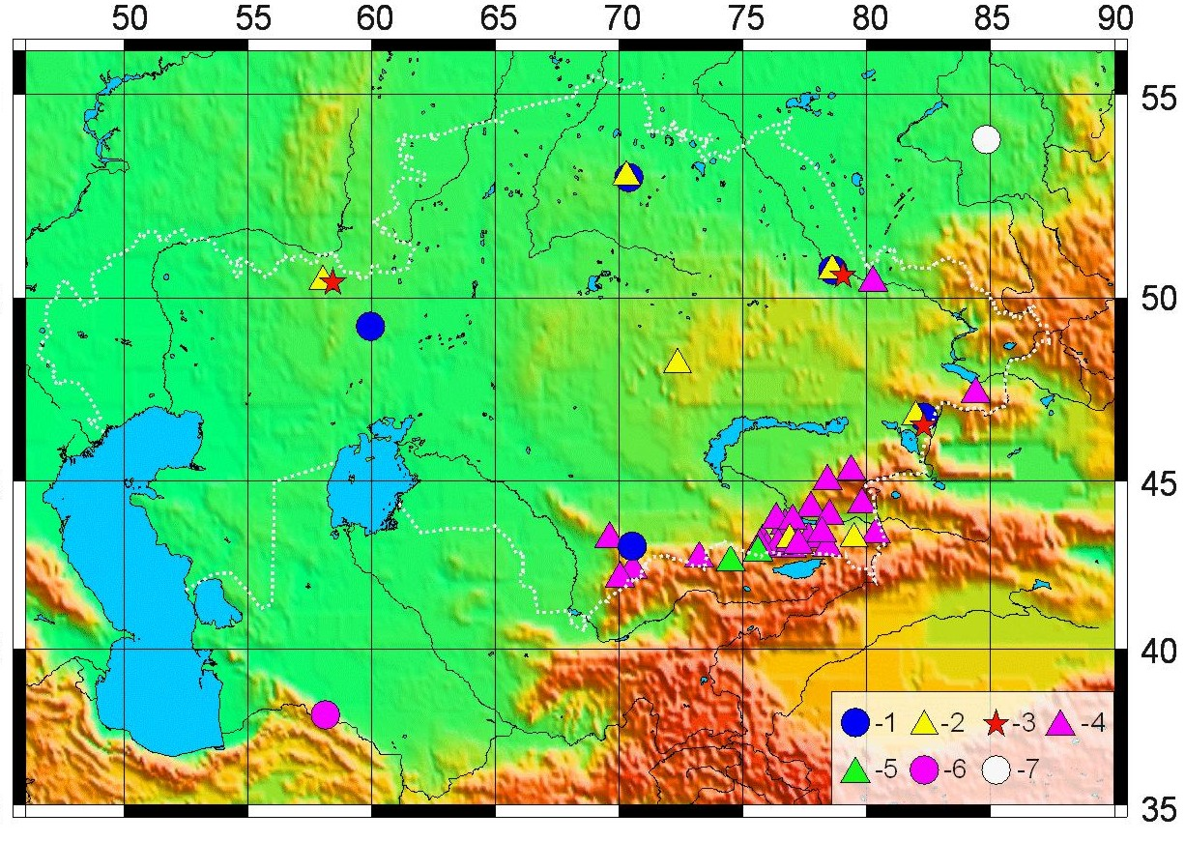
Discrimination of quarry blasts using a complex of seismic and
infrasound data in Kazakhstan
Alexandr Smirnov, Smirnoff@kndc.kz, Natalia Mikhailova, mikhailova@kndc.kz, Aidyn Mukambaev, mukambayev@kndc.kz, IGR, Kazakhstan
P2.3-116
The network of stations whose data is used for processing and compiling bulletins in the KNDC
Annually, stations that send data to KNDC record ~20000 seismic events. ~5000 of them are explosions of different nature, mostly quarry blasts. These explosions are provided with the full compact of the processing, they are included in the seismic event bulletins.
motivation
1 − seismic arrays IGR; 2 − 3C stations IGR
3 − infrasound arrays IGR; 4 − seismic station SEME MES RK;
5 − seismic stations IS KR; 6 – seismic array Alibek, Turkmenistan;
7 − seismic and infrasound arrays Zalesovo, Russia

Slide 4
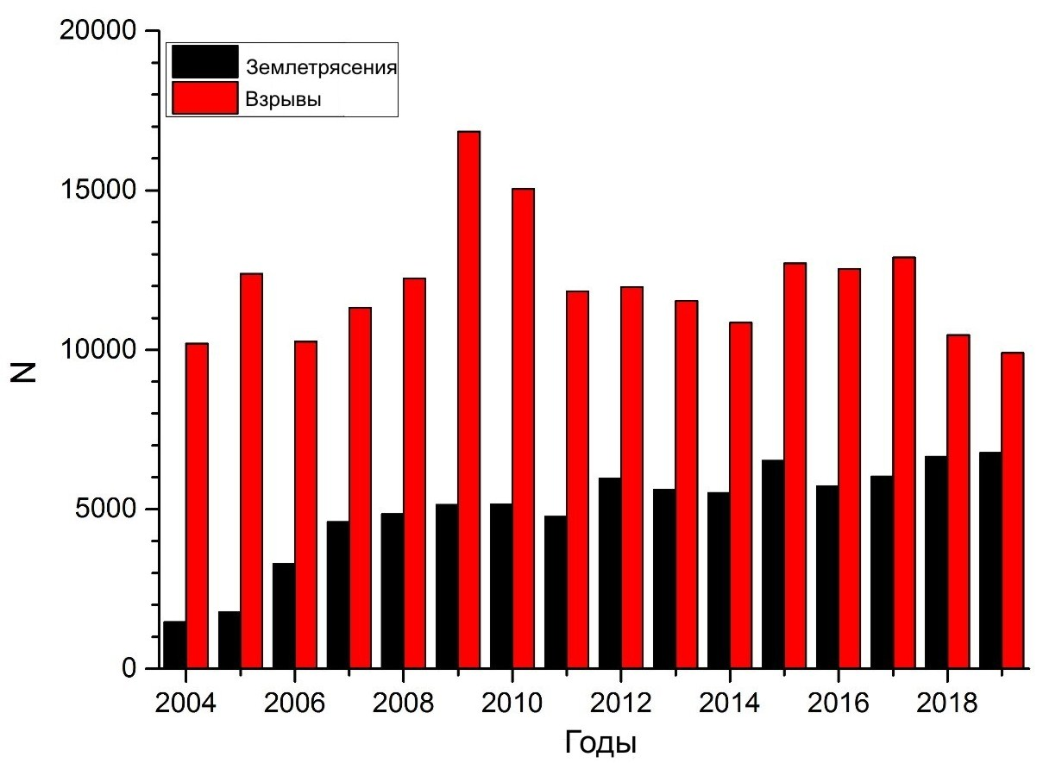
Discrimination of quarry blasts using a complex of seismic and
infrasound data in Kazakhstan
Alexandr Smirnov, Smirnoff@kndc.kz, Natalia Mikhailova, mikhailova@kndc.kz, Aidyn Mukambaev, mukambayev@kndc.kz, IGR, Kazakhstan
P2.3-116
Explosions
Earthquakes
Partition of the explosions in the total number of processed seismic events has been steadily growing in recent years.
It is very important to identify explosions in seismic bulletins and label them accordingly.
motivation
Years
Balance of the number of earthquakes and explosions in bulletins KNDC in 2004 – 2019

Slide 5
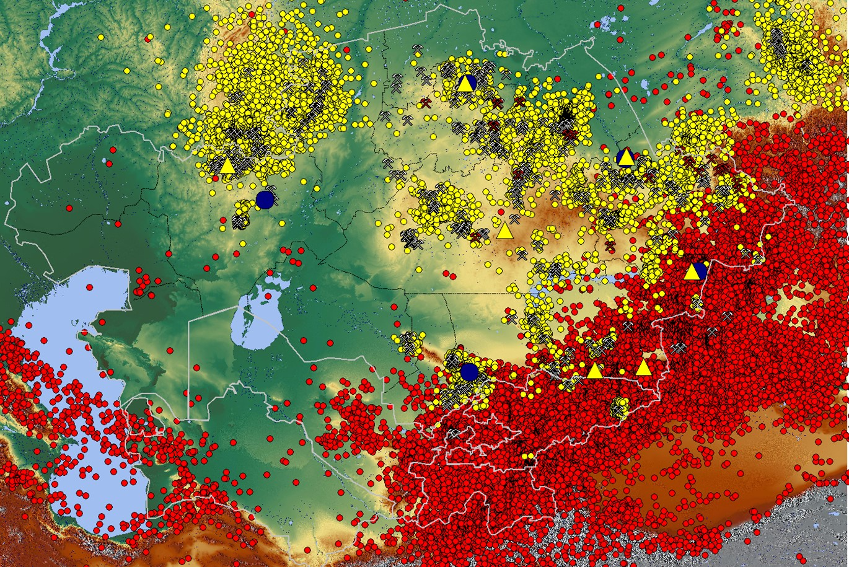
Discrimination of quarry blasts using a complex of seismic and
infrasound data in Kazakhstan
Alexandr Smirnov, Smirnoff@kndc.kz, Natalia Mikhailova, mikhailova@kndc.kz, Aidyn Mukambaev, mukambayev@kndc.kz, IGR, Kazakhstan
P2.3-116
A large number of events with epicenters close to well-known quarries are explosions. But, there are known cases when earthquakes occur near the quarries, even quite strong ones, which at the first stage of processing were mistakenly considered as explosions. For example, these are the Karaganda earthquake in 2014, the Ekibastuz earthquake in 2019, and others. Recognizing, and sometimes proving the nature of the source, is not an easy task, but it is very important for the evaluation of seismic hazard assessment as the estimate is done based on earthquake catalogs.
motivation
Map of epicenters of earthquakes and explosions for 10 years. Red circles are earthquakes, yellow ones are explosions

Slide 6
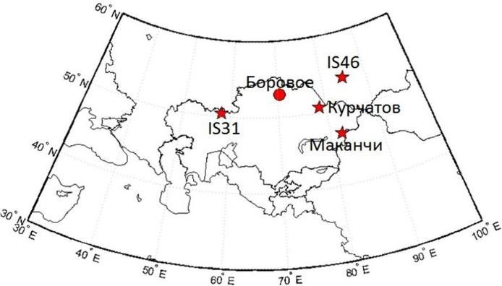
Discrimination of quarry blasts using a complex of seismic and
infrasound data in Kazakhstan
Alexandr Smirnov, Smirnoff@kndc.kz, Natalia Mikhailova, mikhailova@kndc.kz, Aidyn Mukambaev, mukambayev@kndc.kz, IGR, Kazakhstan
P2.3-116
Three infrasound stations are currently operating as part of the IGR monitoring network: Aktyubinsk (IS31), 2001, part of the international monitoring system (IMS CTBTO); Kurchatov (KURIS), 2010, rebuilt near the previously operating infrasound station; Makanchi (MKIAR), 2016, built under an agreement with the Air Force Technical Applications Center (AFTAC, USA). KNDC also receives real-time data from the Zalesovo infrasound array (IS46) located in Russia, which is the CTBTO IMS station.
Infrasound stations also register a large number of quarry explosions.
The discrimination method described in this work based on a fusion of the seismic and infrasonic data.
METHODS
Location of infrasound stations in Kazakhstan and the Russian station Zalesovo (marked by the asterisks). The circle shows the Borovoye station that is decommissioned for modernization.

Slide 7
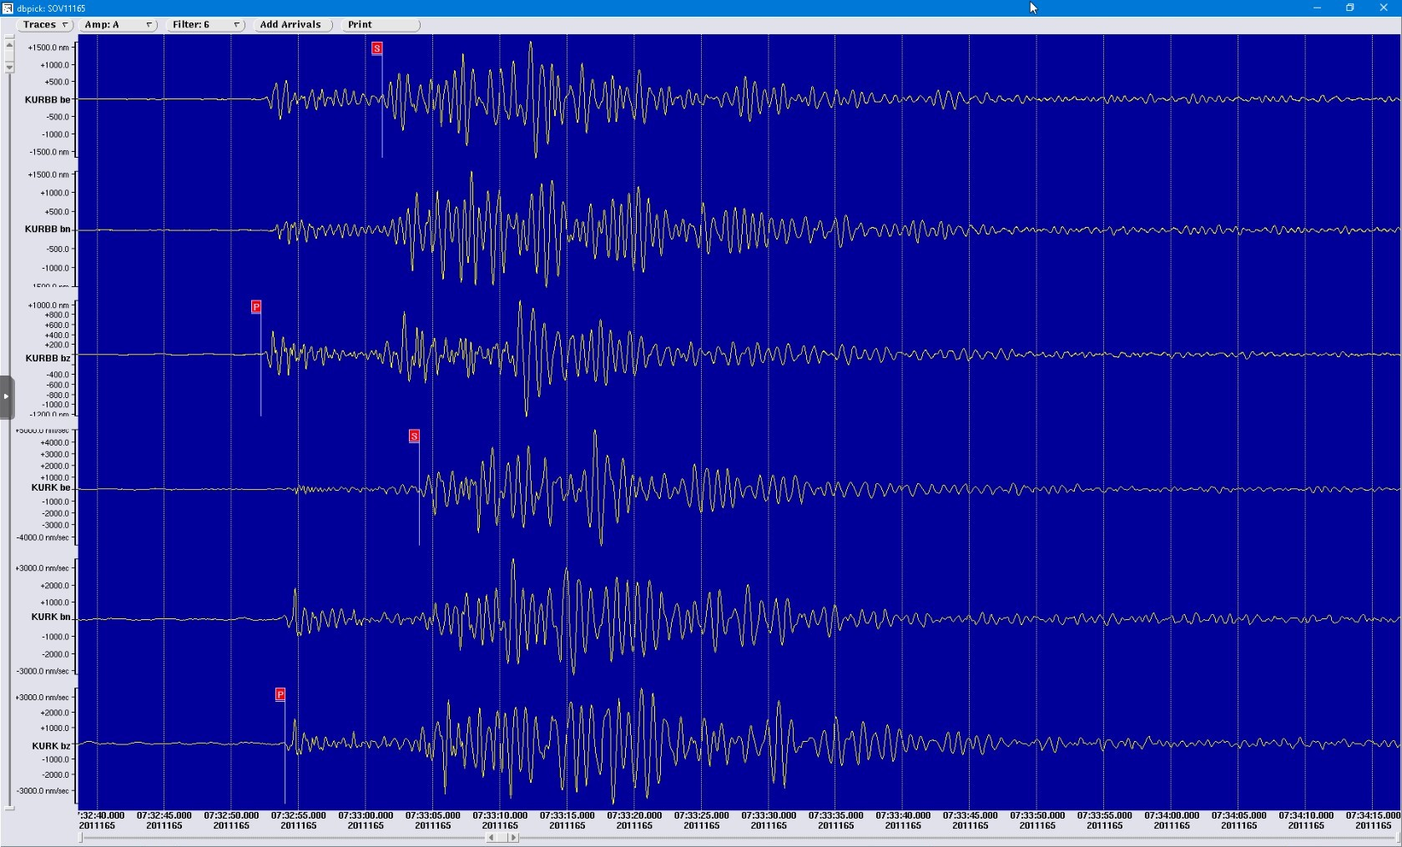
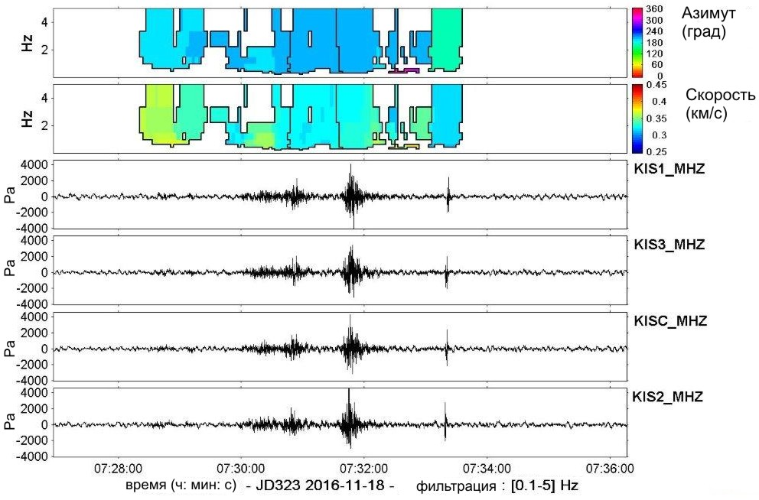
Discrimination of quarry blasts using a complex of seismic and
infrasound data in Kazakhstan
Alexandr Smirnov, Smirnoff@kndc.kz, Natalia Mikhailova, mikhailova@kndc.kz, Aidyn Mukambaev, mukambayev@kndc.kz, IGR, Kazakhstan
P2.3-116
METHODS
An example of registering of signals from an explosion at the Karazhyra quarry (Semipalatinsk Test Site) 14/06/2011 by seismic stations KURBB and KURK (left) and infrasound station KURIS (right, the four bottom panels correspond to the four elements of the group)

Slide 8
Discrimination of quarry blasts using a complex of seismic and
infrasound data in Kazakhstan
Alexandr Smirnov, Smirnoff@kndc.kz, Natalia Mikhailova, mikhailova@kndc.kz, Aidyn Mukambaev, mukambayev@kndc.kz, IGR, Kazakhstan
P2.3-116
Discrimination technique:
In order to determine if a new recorded event is an explosion within one of the previously studied quarries, the following steps should be taken:
- a database of reference records is being created - waveforms for a number of quarries. These are seismic records of explosions in well-defined quarries;
- a seismic bulletin is created based on the data of seismic stations for a certain period of time;
- a comparison of the new current seismic records with the reference form of the record for the same station is carried out. The comparison is carried out by finding the cross-correlation function (CCF) of the reference form and the current records of the corresponding station channel. The calculation is performed using GeoTool software.
- a bulletin of infrasound detections based on data from infrasound stations is being created;
- an association of events from the seismic bulletin, the candidate event set, and the infrasonic bulletin is carried out.
METHODS

Slide 9
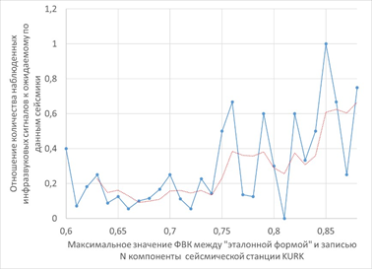
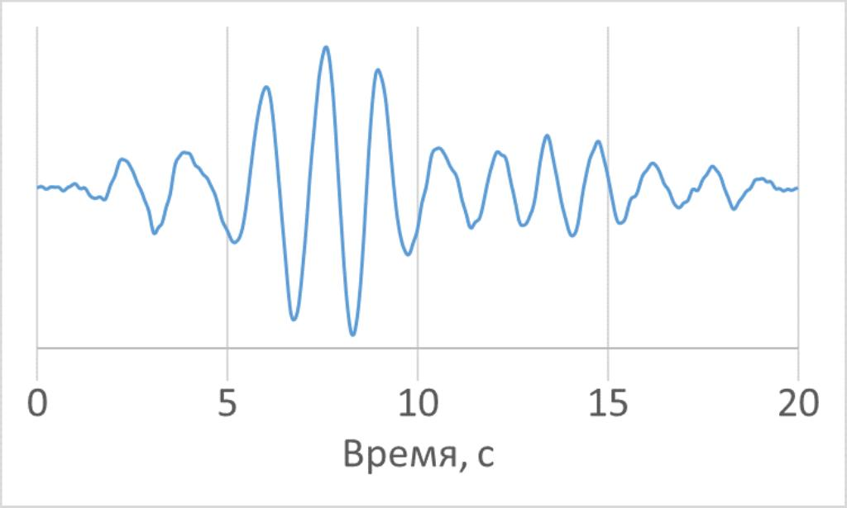
Discrimination of quarry blasts using a complex of seismic and
infrasound data in Kazakhstan
Alexandr Smirnov, Smirnoff@kndc.kz, Natalia Mikhailova, mikhailova@kndc.kz, Aidyn Mukambaev, mukambayev@kndc.kz, IGR, Kazakhstan
P2.3-116
The technique was tested on seismic events near the Akbastau quarry in the East Kazakhstan region, recorded by the KURK seismic station (N-S component)
The ratio of the number of observed infrasonic signals to that expected in accordance with seismic data
METHODS
"Reference waveform" of phase Lg of records of explosions in the Akbastau quarry, as recorded by the KURK station obtained using the GISMO software package
Maximum of the cross-correlation function between the candidate signal waveform and the reference waveform, seismic station KURK
Dependence of a percentage of correct infrasound phase predictions on the correlation between candidate seismic events and the reference waveform

Slide 10
Discrimination of quarry blasts using a complex of seismic and
infrasound data in Kazakhstan
Alexandr Smirnov, Smirnoff@kndc.kz, Natalia Mikhailova, mikhailova@kndc.kz, Aidyn Mukambaev, mukambayev@kndc.kz, IGR, Kazakhstan
P2.3-116
The testing of the technique showed its efficiency. The empirical predictive threshold value of the cross-correlation function (CCF) maximum between the candidate event and the reference waveform was found to be 0.75. Starting from such a value of the CCF maximum, the discrimination can be considered reliable. Application of the technology to the waveforms for the period under study made it possible to detect 74 events that are highly likely to be explosions in the Akbastau quarry. Of these, 31 events were already included in the seismic bulletin based on the regular processing technique. It was possible to establish with high accuracy the location of the epicenters of these explosions.
RESULTS

Slide 11
Discrimination of quarry blasts using a complex of seismic and
infrasound data in Kazakhstan
Alexandr Smirnov, Smirnoff@kndc.kz, Natalia Mikhailova, mikhailova@kndc.kz, Aidyn Mukambaev, mukambayev@kndc.kz, IGR, Kazakhstan
P2.3-116
The new technique for recognizing the nature of events based on a fusion of seismic and infrasonic data makes it possible to obtain reference waveforms for active quarries of Kazakhstan using the data of the IGR monitoring system. Using this data, it is possible to recognize the belonging of the detected event to the class of explosions and to localize its epicenter with high accuracy.
In the future, it is prospective to continue testing the approach for other quarries and to study its applicability to explosions in large open-pit mines.
CONCLUSIONS

