Slide 1
Stromboli volcano eruption 2019-07-03 and atmospheric influence on the detection capability on the infrasound stations
Abdelouaheb AGREBI, Gerard RAMBOLAMANANA, Andry RAMANANTSOA, Eddy RASOLOMANANA
Poster No. P2.3-630
CTBTO for CTBT Science and Technology

Slide 2
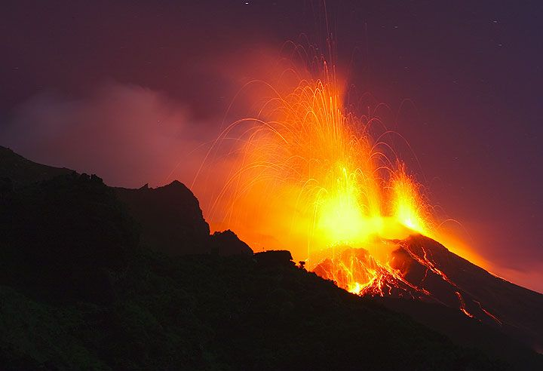
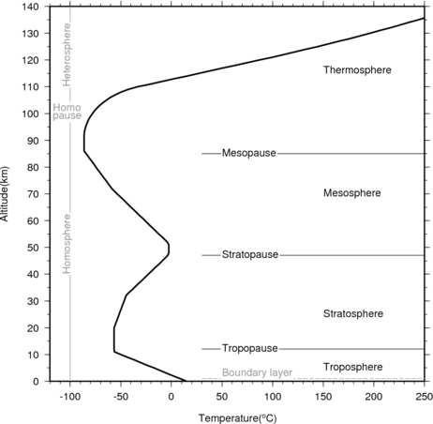
Stromboli volcano eruption 2019-07-03 and atmospheric influence on the detection capability on the infrasound stations
Abdelouaheb AGREBI, Researcher, CTBTO for CTBT Science and Technology
P2.3-630
In this paper we will focus on one of the most violent eruptions of Stromboli volcano which is one of the most active volcanoes in Italy and on the earth, occurred on 03 July 2019, using data from four IMS Infrasound stations situated in different distance from the Stromboli volcano to observe the detection capability of the Infrasound network in the International Monitoring System and the influence of Zonal wind on the infrasound stations detectability as the infrasound propagate in different layer of the atmosphere and depends also on the wind field.
ABSTRACT

Slide 3
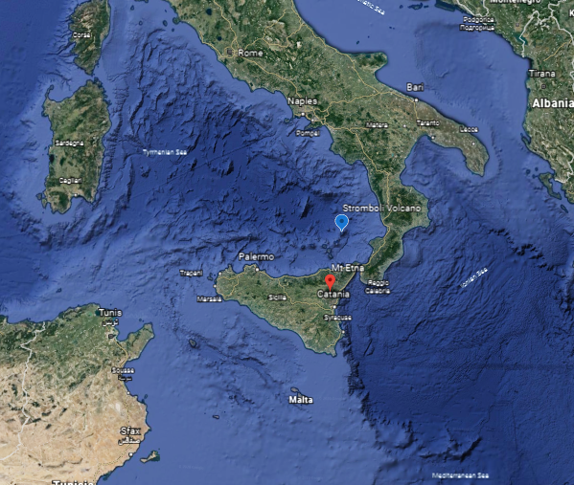
Stromboli volcano eruption 2019-07-03 and atmospheric influence on the detection capability on the infrasound stations
Abdelouaheb AGREBI, Researcher, CTBTO for CTBT Science and Technology
P2.3-630
Stromboli forms the North-eastern-most of the Aeolian islands. Its base begins over 1000 meters below the surface of the Tyrrhenian Sea and it rises to an elevation of 924 meters above sea level.
Periodically, Stromboli's eruptive style transitions and vents near the summit produce lava flows that are funnelled by the Sciara del Fuoco to the sea; the most recent of these occurred in 2002, 2003, 2007, 2013, 2014 and 2019.
Facts About Stromboli
Location: | Aeolian Islands, Italy
Coordinates: | 38°.789 N, 15°.213 E
Elevation: | 924 m (3,031 ft)
Volcano Type: | Stratovolcano
Nearby Volcanoes: | Etna Vesuvius
INTRODUCTION

Slide 4
Stromboli volcano eruption 2019-07-03 and atmospheric influence on the detection capability on the infrasound stations
Abdelouaheb AGREBI, Researcher, CTBTO for CTBT Science and Technology
P2.3-630
Infrasound data from Four IMS infrasound stations : I48TN in Tunisia, I26DE in Germany, I37NO in Norway and the I42PT in Portugal is used in this study.
2019-07-03 data from the IMS stations is processed using the DTK_GPMCC software and Geotool from the NDC-in-A-Box Package.
The National Data Centre in Madagascar provided the Raytracer software used to perform the raytracing.
METHODS

Slide 5
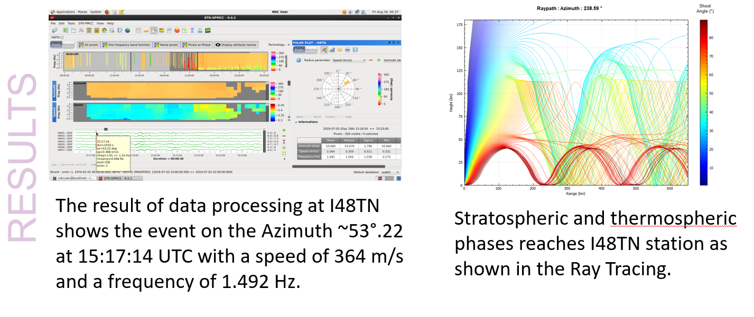
Stromboli volcano eruption 2019-07-03 and atmospheric influence on the detection capability on the infrasound stations
Abdelouaheb AGREBI, Researcher, CTBTO for CTBT Science and Technology
P2.3-630
RESULTS

Slide 6
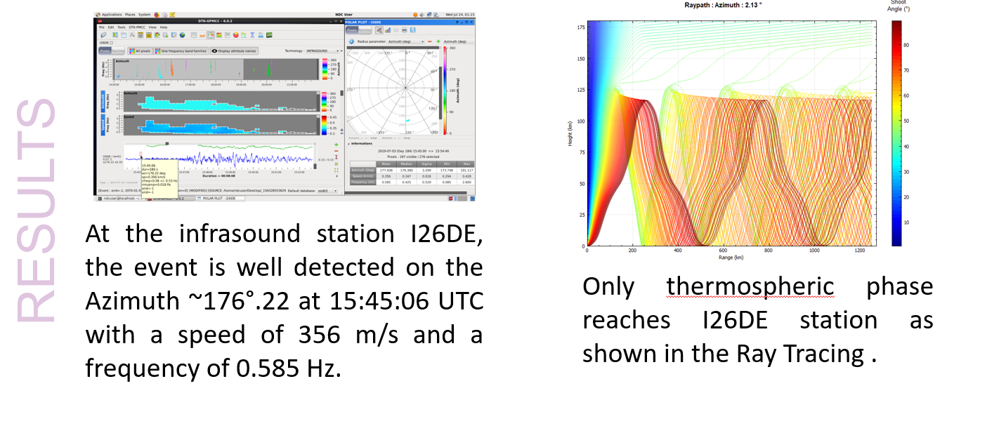
Stromboli volcano eruption 2019-07-03 and atmospheric influence on the detection capability on the infrasound stations
Abdelouaheb AGREBI, Researcher, CTBTO for CTBT Science and Technology
P2.3-630
RESULTS

Slide 7
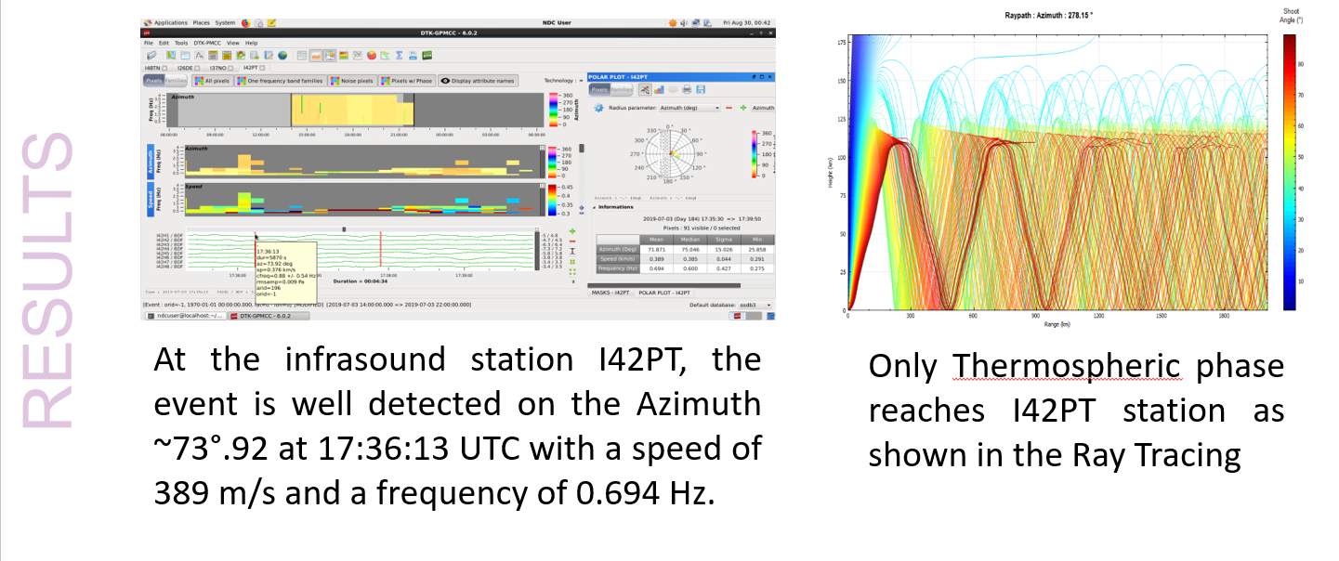
Stromboli volcano eruption 2019-07-03 and atmospheric influence on the detection capability on the infrasound stations
Abdelouaheb AGREBI, Researcher, CTBTO for CTBT Science and Technology
P2.3-630
RESULTS

Slide 8
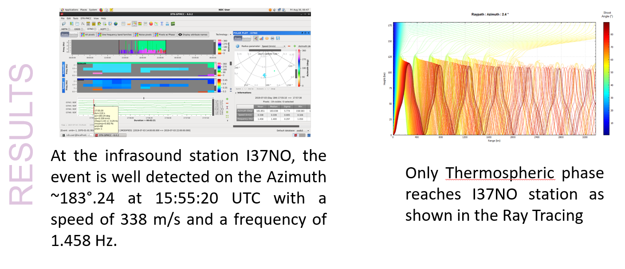
Stromboli volcano eruption 2019-07-03 and atmospheric influence on the detection capability on the infrasound stations
Abdelouaheb AGREBI, Researcher, CTBTO for CTBT Science and Technology
P2.3-630
RESULTS

Slide 9
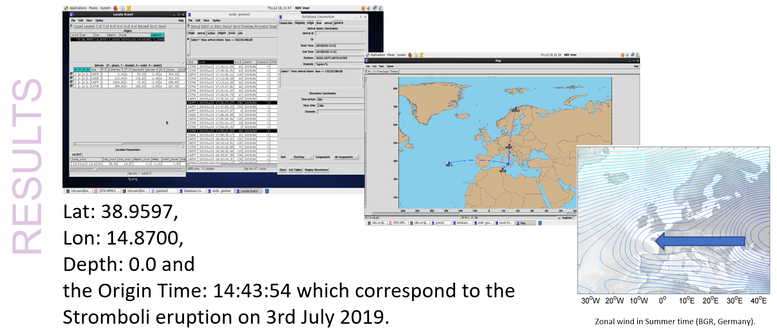
Stromboli volcano eruption 2019-07-03 and atmospheric influence on the detection capability on the infrasound stations
Abdelouaheb AGREBI, Researcher, CTBTO for CTBT Science and Technology
P2.3-630
RESULTS

Slide 10
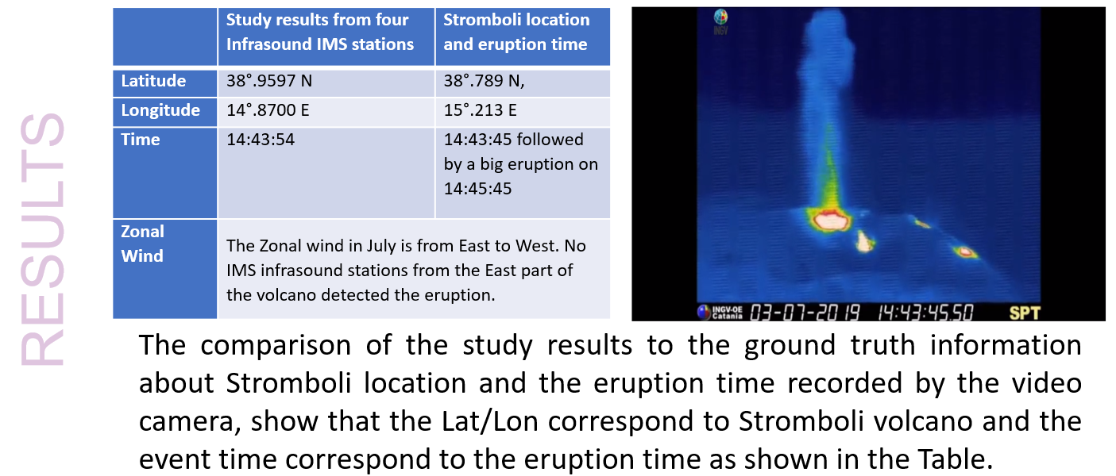
Stromboli volcano eruption 2019-07-03 and atmospheric influence on the detection capability on the infrasound stations
Abdelouaheb AGREBI, Researcher, CTBTO for CTBT Science and Technology
P2.3-630
RESULTS

Slide 11
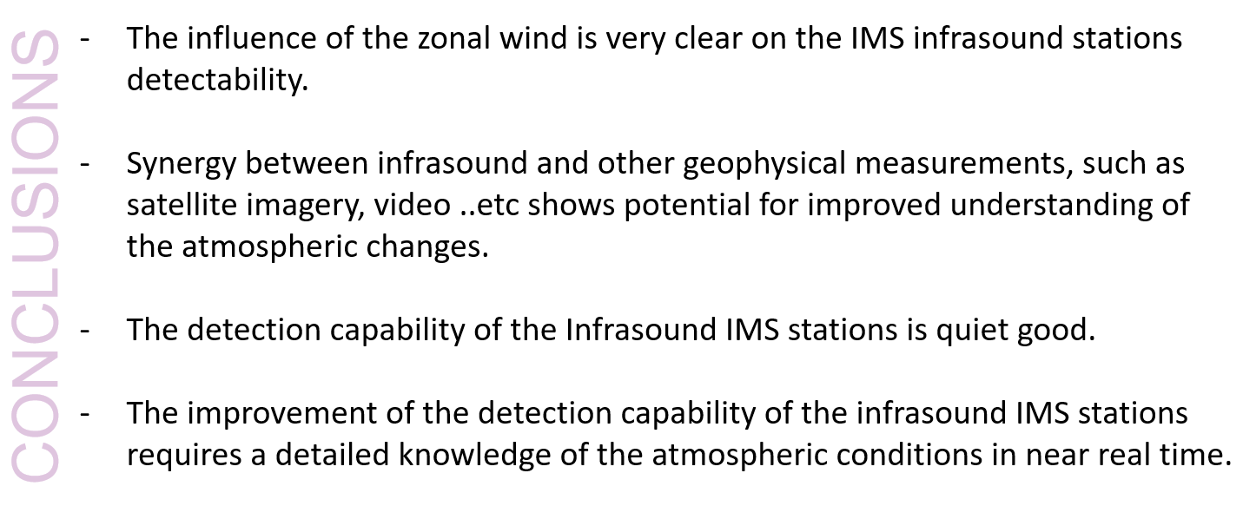
Stromboli volcano eruption 2019-07-03 and atmospheric influence on the detection capability on the infrasound stations
Abdelouaheb AGREBI, Researcher, CTBTO for CTBT Science and Technology
P2.3-630
CONCLUSIONS

