Slide 1
Understanding m_{b} Variations: The Implications of a
Global International Monitoring System
Jessica Keeble and Neil Selby
Poster P2.3-240
AWE Blacknest, Brimpton, RG7 4RS, United Kingdom

Slide 2

Understanding m_{b} Variations: The Implications of a Global International Monitoring System
Jessica Keeble & Neil Selby. jess@blacknest.gov.uk. AWE Blacknest, Brimpton, RG7 4RS, UK.
P2.3-240
When complete, the International Monitoring System (IMS) will include 170 seismometer stations. These stations consist of various seismometer types, and are located in a range of geological and tectonic settings. The data recorded can be used to determine the body-wave magnitude (m_{b}) of a seismic event, which is used in the m_{b}:M_{s} event screening criterion applied at the International Data Centre (IDC). Event screening being the rejection of the null hypothesis that an event is a single point underground explosion. Initial development of the m_{b} magnitude scale (and the m_{b}:M_{s} criterion) was mainly based on body-wave data recorded by standard short-period instruments. Today, the IMS consists of a range of short-period and broadband instruments with a variety of responses.
Our work seeks to understand the implications of varying instrumentation and the potential impact on the mb values measured, as well as investigating the effect of variations in attenuation (quantified by t*). Initial results suggest that a combination of these variables has the potential to affect the consistency of event mb magnitudes using the current IDC m_{b} measurement method. We consider alternative methods which could prove more robust.
UK Ministry of Defence © Crown Owned Copyright 2021/AWE
ABSTRACT

Slide 3
Understanding m_{b} Variations: The Implications of a Global International Monitoring System
Jessica Keeble & Neil Selby. jess@blacknest.gov.uk. AWE Blacknest, Brimpton, RG7 4RS, UK.
P2.3-240
RATIONALE
OVERVIEW
Attenuation and lithology are known to affect the intercept of the m_{b}-log yield relationship. However, the effect on the slope (a) is less clear.
Factors investigated in this study may have an effect on the m_{b} : M_{s} relationship, as the slope of this relationship may not be consistent in all settings.
The m_{b}: M_{s} event screening criterion applied at the International Data Centre (IDC) forms an integral part of event characterisation and as such, the body-wave magnitude (m_{b}) measurement is critical.
By modelling historic explosions, we show that attenuation (t*) and lithology variation substantially impact m_{b} measurements by changing the slope of the m_{b}-log yield relationship.
We show the impact of different instrument responses on m_{b} measurements alone is subtle, but for specific lithology and t* combinations the effect is compounded. The response itself is well characterised and within analysts’ control, therefore it may be appropriate to improve m_{b} measurement techniques.
INTRODUCTION
UK Ministry of Defence © Crown Owned Copyright 2021/AWE

Slide 4
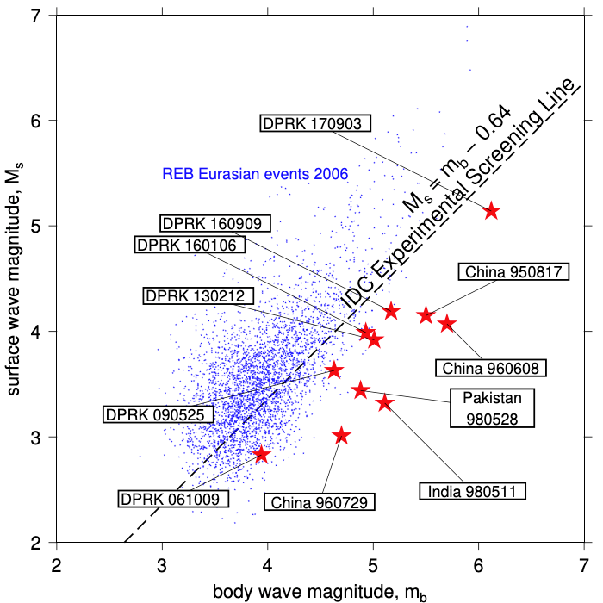
Understanding m_{b} Variations: The Implications of a Global International Monitoring System
Jessica Keeble & Neil Selby. jess@blacknest.gov.uk. AWE Blacknest, Brimpton, RG7 4RS, UK.
P2.3-240
P2.3-240
The IDC experimental m_{b}:M_{s} screening line is the revised relationship proposed by Selby et al. 2012 (Fig. 1).
For tests which fall close to the screening line, a small change in the m_{b} could result in a change of source characterisation.
The m_{b}: M_{s} event screening criterion is applied globally. By showing the impact of varying t*, lithology and instrument response, we investigate whether optimal event screening may require regional criteria.
INTRODUCTION
Figure 1. Red stars - m_{b} and M_{s} magnitudes for selected underground test explosions. Blue dots - Eurasian earthquakes from the Reviewed Event Bulletin.
UK Ministry of Defence © Crown Owned Copyright 2021/AWE

Slide 5
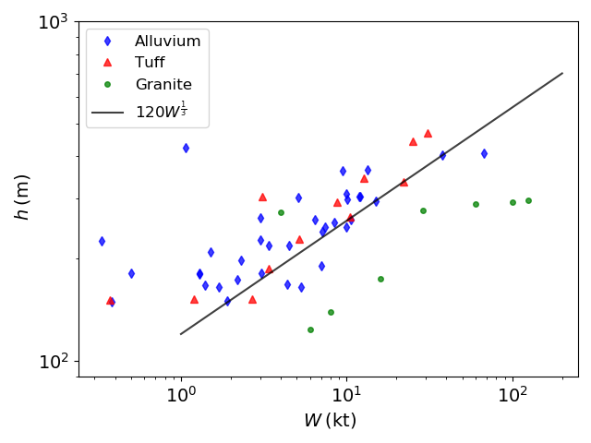

Understanding m_{b} Variations: The Implications of a Global International Monitoring System
Jessica Keeble & Neil Selby. jess@blacknest.gov.uk. AWE Blacknest, Brimpton, RG7 4RS, UK.
P2.3-240
The teleseismic direct P wavelet for selected explosions with published yield and depth, is modelled using Mueller Murphy 1971 (MM71) moment-rate function, a nominal elastic pP, and a t* operator (Marshall et al., 1992 and Springer, 2002).
49 tests were modelled from the Yucca Flat area at NNSS, in both tuff and alluvium lithology. 8 tests were modelled from Degelen Mountain (granite).
There are a mixture of over-buried and underburied tests used as inputs to the modelling process (Fig. 2).
DATA
Figure 2. The yield (W):depth(h) relationship of tests modelled. Tests carried out at: NNSS in blue (alluvium) and red (tuff) ; Degelen in green (granite). Black line: $h=120W^{\frac{1}{3}}$ (1).
UK Ministry of Defence © Crown Owned Copyright 2021/AWE

Slide 6
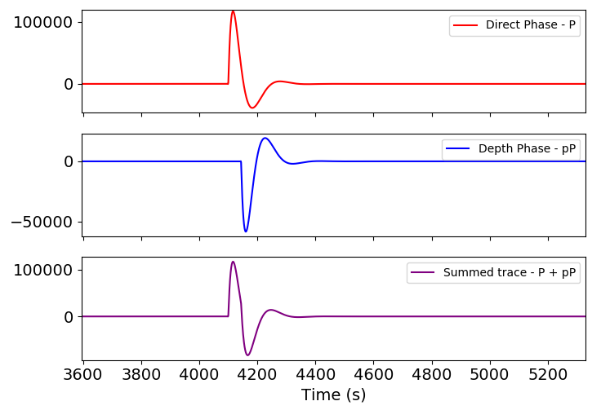
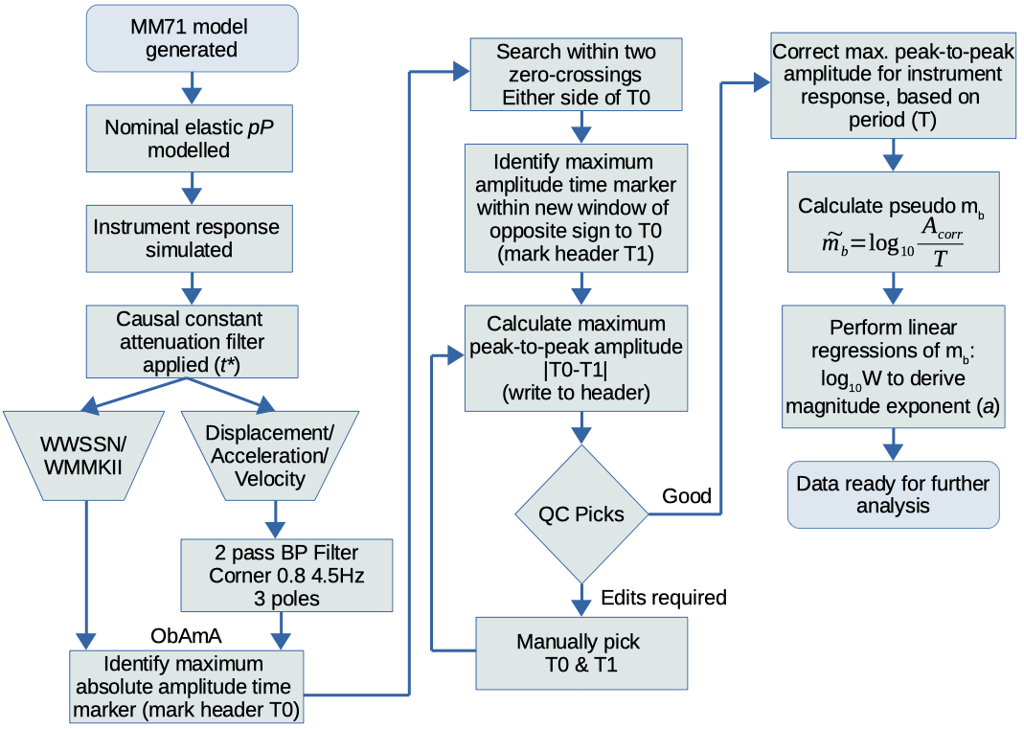
Understanding m_{b} Variations: The Implications of a Global International Monitoring System
Jessica Keeble & Neil Selby. jess@blacknest.gov.uk. AWE Blacknest, Brimpton, RG7 4RS, UK.
P2.3-240
PSEUDO-m_{b} CALCULATION
Figure 3. Direct phase (P), depth phase (pP) and resulting summed waveform. Granite lithology, 29kt yield, 278m depth, reflection coefficient 0.5.
We model a nominal elastic pP phase. We do not model the complex non-linear surface effects (caused by the spall zone) of an explosive source (Fig. 3).
For consistency with historical m_{b} magnitude measurement techniques, the “traditional” WWSSN and Willmore mk II instruments remain unfiltered
*
*
Figure 4. Processing steps. ObAmA is the Obspy Amplitude Analysis tool developed by Green (pers. comm.) which makes automatic m_{b} measurements.
UK Ministry of Defence © Crown Owned Copyright 2021/AWE

Slide 7
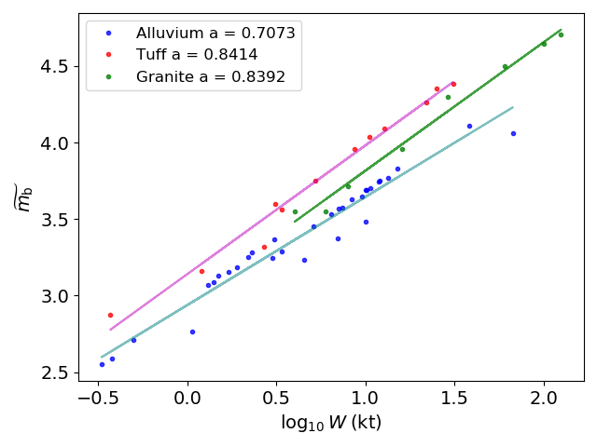


Understanding m_{b} Variations: The Implications of a Global International Monitoring System
Jessica Keeble & Neil Selby. jess@blacknest.gov.uk. AWE Blacknest, Brimpton, RG7 4RS, UK.
P2.3-240
Since the m_{b} calculation does not account for geometric spreading, we refer to pseudo- m_{b} ($\tilde{m_{b}}$).
The effect of t*, lithology and instrument response on m_{b} is analysed by performing a linear regression to estimate a from the following :
$\tilde{m_{b}}=a\log_{10}{W}+c$ (2)
We determine how varying t*, lithology and instrument response affects the slope of this relationship, a.
This study does not model c.
PSEUDO-m_{b} CALCULATION
Figure 5. Example log₁₀W : $\tilde{m_{b}}$comparison, WWSSN instrument response simulated, t* 0.4s. NNSS results are shown in blue (alluvium) and red (tuff), Degelen mountain is shown green (granite).
UK Ministry of Defence © Crown Owned Copyright 2021/AWE

Slide 8
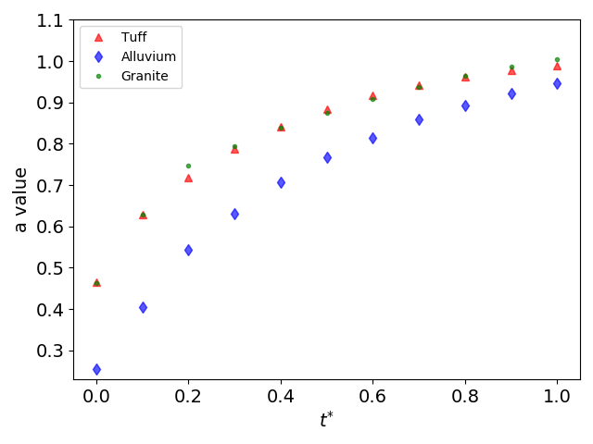
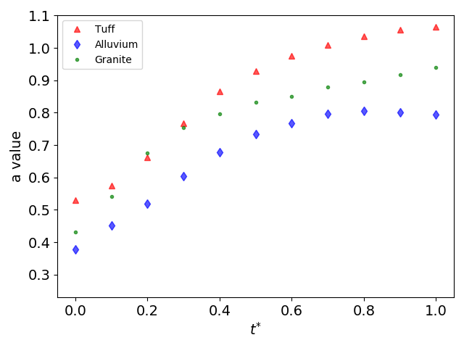
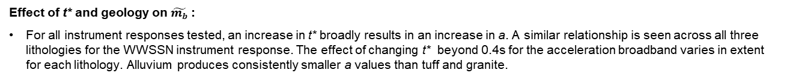
Understanding m_{b} Variations: The Implications of a Global International Monitoring System
Jessica Keeble & Neil Selby. jess@blacknest.gov.uk. AWE Blacknest, Brimpton, RG7 4RS, UK.
P2.3-240
Effect of t* and geology on $\tilde{m_{b}}$:
For all instrument responses tested, an increase in t* broadly results in an increase in a. A similar relationship is seen across all three lithologies for the WWSSN instrument response. The effect of changing t* beyond 0.4s for the acceleration broadband varies in extent for each lithology. Alluvium produces consistently smaller a values than tuff and granite.
WWSSN
Acceleration broadband
RESULTS
(a)
(b)
Figure 6. The effect of t* on each lithology – tuff (red triangle), alluvium (blue diamond) and granite (green dot), for the WWSSN response (a) and acceleration broadband result (b). In both examples, increasing t* increases the resulting a (except beyond t*=0.8s in (b)). In the WWSSN example (a) the effect of increasing t* on a is similar across all three lithologies tested. The alluvium lithology produces consistently smaller a than the tuff and granite. Dependent on which instrument response and t* values is used, the tuff and granite produce similar a values however figure (b) shows this is not the case for t*<0.1s and >=0.4s.
UK Ministry of Defence © Crown Owned Copyright 2021/AWE

Slide 9
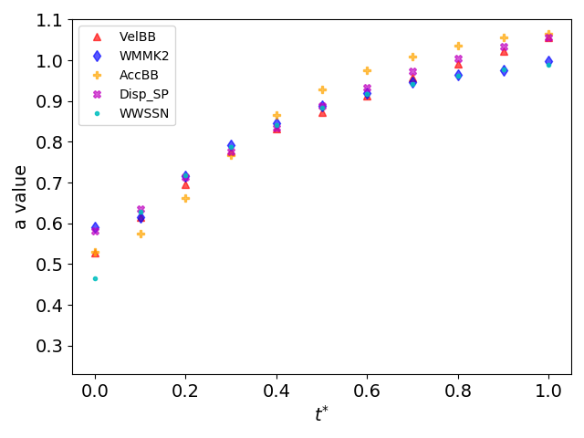
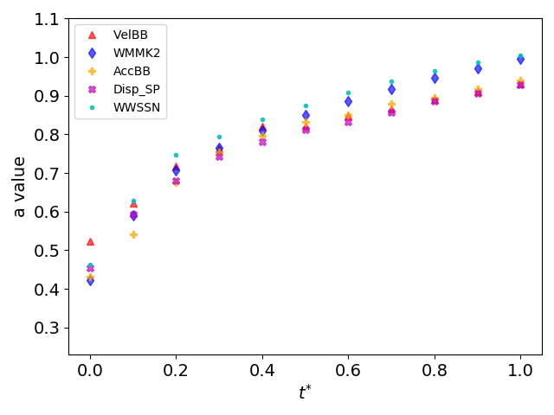
Understanding m_{b} Variations: The Implications of a Global International Monitoring System
Jessica Keeble & Neil Selby. jess@blacknest.gov.uk. AWE Blacknest, Brimpton, RG7 4RS, UK.
P2.3-240
Effect of instrument response on $\tilde{m_{b}}$:
Instrument response comparisons show small but notable variation in a (and therefore m_{b} ). There is not a consistent relationship across all three lithologies, with the acceleration broadband instrument producing the largest a in the tuff and smallest a in the granite.
Tuff
Granite
RESULTS
(a)
(b)
Figure 7. Instrument response comparison for each t* value tested for each lithology, NNSS tuff (a), and Degelen granite (b). In (a) and (b) at t*=0.4s the velocity broadband (red triangle) produces the smallest a ( tuff=0.8327 and alluvium=0.6349). In the tuff, the acceleration broadband (yellow cross) results in the largest a (0.8651). The WWSSN (solid cyan circle) produces the largest a in granite (0.7464 when t*=0.2s in granite).
UK Ministry of Defence © Crown Owned Copyright 2021/AWE

Slide 10
Understanding m_{b} Variations: The Implications of a Global International Monitoring System
Jessica Keeble & Neil Selby. jess@blacknest.gov.uk. AWE Blacknest, Brimpton, RG7 4RS, UK.
P2.3-240
FINDINGS
The variation of slope a in m_{b}-log yield relationship may also affect m_{b}:M_{s} relationship.
Both t* and lithology have a significant impact on the slope of the m_{b}-log yield relationship, a.
The instrument response of the seismometer producing the data has a more subtle effect on a, but for certain t* and lithology combinations, the effect is compounded.
IMPLICATIONS
Underground nuclear explosions which lay close to the m_{b}:M_{s} discriminant line may be affected by these variations, leading to incorrect classification of events.
The m_{b}:M_{s} screening criteria is currently applied globally, this work suggests it may be more appropriate to derive regional discriminants.
The instrument response affects station m_{b} estimates in IDC provisional operations, investigation is required in using common instrument response for m_{b} calculations.
CONCLUSIONS
UK Ministry of Defence © Crown Owned Copyright 2021/AWE

Slide 11
Understanding m_{b} Variations: The Implications of a Global International Monitoring System
Jessica Keeble & Neil Selby. jess@blacknest.gov.uk. AWE Blacknest, Brimpton, RG7 4RS, UK.
P2.3-240
Consider the effect of varying t* with frequency.
Understand the implications of using nominally modelled depth phases through incorporating increasing complexity.
Determine alternative m_{b} measurement technique which considers variation in instrument response.
Collate datasets used for previously published work to allow accurate comparisons between results.
FUTURE WORK
References: Douglas, A. (1987). Differences in upper mantle attenuation between the Nevada and Shagan River Test sites: Can the effects be seen in P-wave seismograms? Bulletin of the Seismological Society of America, 77(1), 270–276.
Douglas, A. (2013). Forensic Seismology and Nuclear Test Bans, Cambridge University Press.
Marshall, P. D., Porter, D., & Peachell, P., 1992. Analysis of seismograms from nuclear explosions of known yield at Degelen Mountain and Konystan in East Kazakhstan, USSR, AWE Report 2/92
Mueller, R. A et al (1971). Seismic characteristics of underground nuclear detonations: Part i. Seismic spectrum scaling, Bull. Seism. Soc. Am., 61(6), p1675–1692.
Murphy, J. R. et al (1971b). Seismic characteristics of underground nuclear detonations: Part ii. elastic energy and magnitude determinations, Bull. Seism. Soc. Am., 61(6), 1693–1704.
Murphy, J. R., (1996). Types of seismic events and their source descriptions, in Monitoring a Comprehensive Test Ban Treaty, pp. 225–245, Springer.
Peacock, S. et al (2017). Joint maximum-likelihood magnitudes of presumed underground nuclear test explosions, Geophysical Journal International, 210(2), 621–644.
Selby, N. D. et al. (2012). m_{b}:Ms Event Screening Revisited. Bull. Seism. Soc. Am. 102(1), pg 88-97.
Springer, D. et al (2002). Seismic source summary for all US below-surface nuclear explosions, Bull. Seism. Soc. Am., 92(5), 1806–1840.
UK Ministry of Defence © Crown Owned Copyright 2021/AWE

