Slide 1
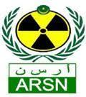

Statistical study of the Cs-137 detections at RN43 station
Mohamed Mahmoud Mounja¹, Claudia Sanguigni²; Antonietta Rizzo²; Giuseppe Ottaviano²
¹Mauritania National Authority of Radiation, Safety and Nuclear Security (ARSN), Nouakchott, Mauritania
²Italian National Agency for New Technologies, Energy and Sustainable Economic Development (ENEA), Italy
O2.4-406

Slide 2
Statistical study of the Cs-137 detections at RN43 station
M. M. Mounja¹, C. Sanguigni²; A. Rizzo²; g. Ottaviano²
¹Mauritania National Authority of Radiation, Safety and Nuclear Security (ARSN), Nouakchott, Mauritania
²Italian National Agency for New Technologies, Energy and Sustainable Economic Development (ENEA), Italy]
O2.4-406
This work is the result of a joint collaboration between the Italian and the Mauritanian National Data Centers.
The historical analysis of the occurrence of relevant radionuclides at RN43 over the past ten years showed that the main contributor was Cs-137, causing several level 3 and level 4.
A descriptive statistical analysis of the Cs-137 occurrence was performed and two types of parametric process control methods were applied: the “Shewhart Control Chart” and the “Exponentially Weighted Moving Average (EWMA) Control Chart”.
The results of both methods were then analyzed in order to reveal seasonality, possible sources of Cs-137 and correlation with atmospheric phenomena.
ABSTRACT

Slide 3
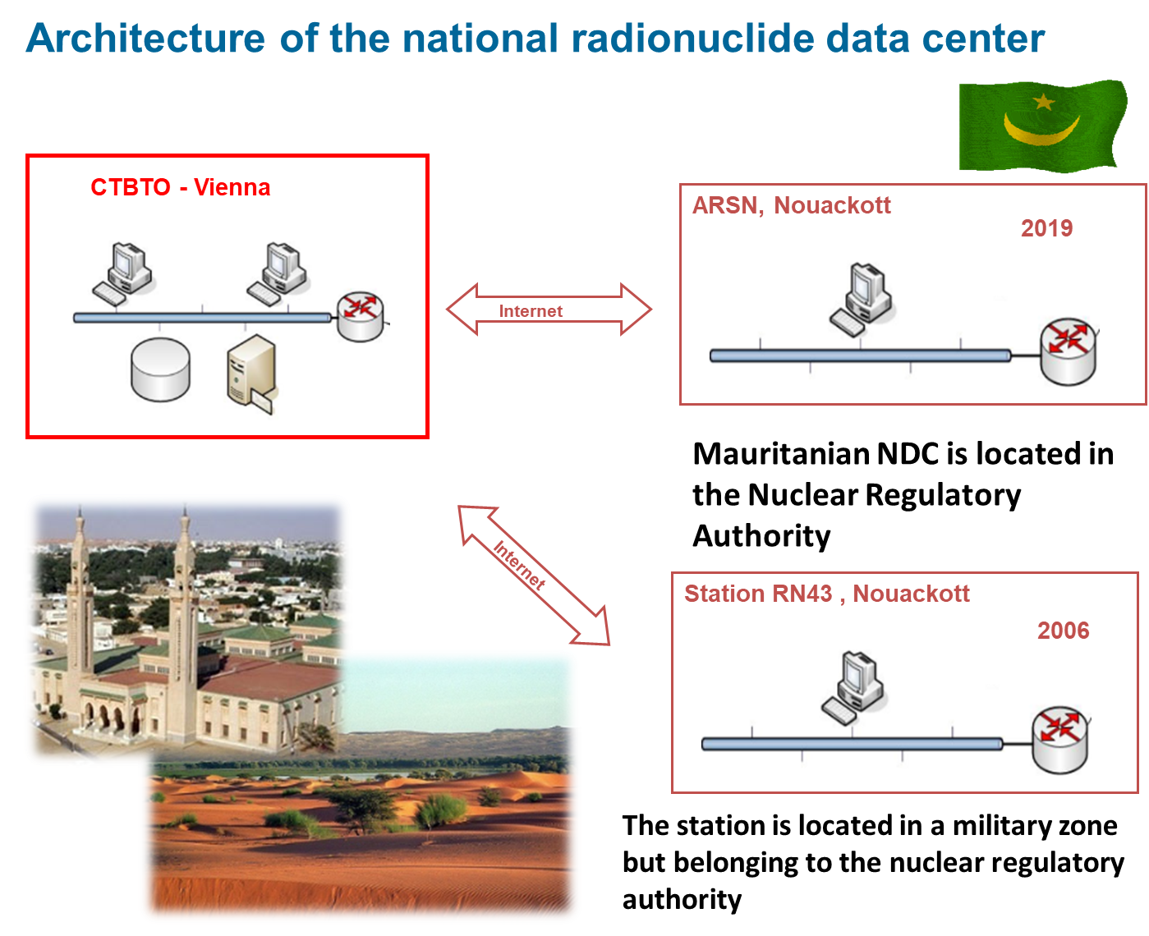

Statistical study of the Cs-137 detections at RN43 station
M. M. Mounja¹, C. Sanguigni²; A. Rizzo²; g. Ottaviano²
¹Mauritania National Authority of Radiation, Safety and Nuclear Security (ARSN), Nouakchott, Mauritania
²Italian National Agency for New Technologies, Energy and Sustainable Economic Development (ENEA), Italy]
O2.4-406
INTRODUCTION

Slide 4
Statistical study of the Cs-137 detections at RN43 station
M. M. Mounja¹, C. Sanguigni²; A. Rizzo²; g. Ottaviano²
¹Mauritania National Authority of Radiation, Safety and Nuclear Security (ARSN), Nouakchott, Mauritania
²Italian National Agency for New Technologies, Energy and Sustainable Economic Development (ENEA), Italy]
O2.4-406
Atmospheric Optical Depth is the coefficient of attenuation of solar radiation by atmosphere, so it’s an indirect measurement of the presence of dust and haze in the atmosphere.
INTRODUCTION
Ref. M. E. Emetere, G.A. Adeyemi “Dataset on aerosol loading and deposition over Nouakchott-Mauritania
Data in brief, 19, 2291-2296 (2018) https://doi.org/10.1016/j.dib.2018.07.018

Slide 5
Statistical study of the Cs-137 detections at RN43 station
M. M. Mounja¹, C. Sanguigni²; A. Rizzo²; g. Ottaviano²
¹Mauritania National Authority of Radiation, Safety and Nuclear Security (ARSN), Nouakchott, Mauritania
²Italian National Agency for New Technologies, Energy and Sustainable Economic Development (ENEA), Italy]
O2.4-406
Atmospheric Aerosol Loading is the suspensions of solids and/or liquid particles in the air that we breathe, as dust, smoke and haze, measured by the mass concentration of aerosol particles or by an optical measure.
INTRODUCTION
Ref. M. E. Emetere, G.A. Adeyemi “Dataset on aerosol loading and deposition over Nouakchott-Mauritania
Data in brief, 19, 2291-2296 (2018) https://doi.org/10.1016/j.dib.2018.07.018

Slide 6
Statistical study of the Cs-137 detections at RN43 station
M. M. Mounja¹, C. Sanguigni²; A. Rizzo²; g. Ottaviano²
¹Mauritania National Authority of Radiation, Safety and Nuclear Security (ARSN), Nouakchott, Mauritania
²Italian National Agency for New Technologies, Energy and Sustainable Economic Development (ENEA), Italy]
O2.4-406
O2.4-406
INTRODUCTION

Slide 7
Statistical study of the Cs-137 detections at RN43 station
M. M. Mounja¹, C. Sanguigni²; A. Rizzo²; g. Ottaviano²
¹Mauritania National Authority of Radiation, Safety and Nuclear Security (ARSN), Nouakchott, Mauritania
²Italian National Agency for New Technologies, Energy and Sustainable Economic Development (ENEA), Italy]
O2.4-406
INTRODUCTION

Slide 8
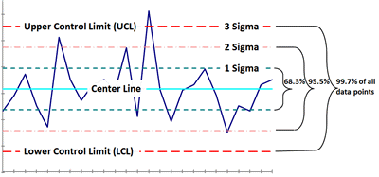
Statistical study of the Cs-137 detections at RN43 station
M. M. Mounja¹, C. Sanguigni²; A. Rizzo²; g. Ottaviano²
¹Mauritania National Authority of Radiation, Safety and Nuclear Security (ARSN), Nouakchott, Mauritania
²Italian National Agency for New Technologies, Energy and Sustainable Economic Development (ENEA), Italy]
O2.4-406
Shewhart Control Chart
METHODS

Slide 9
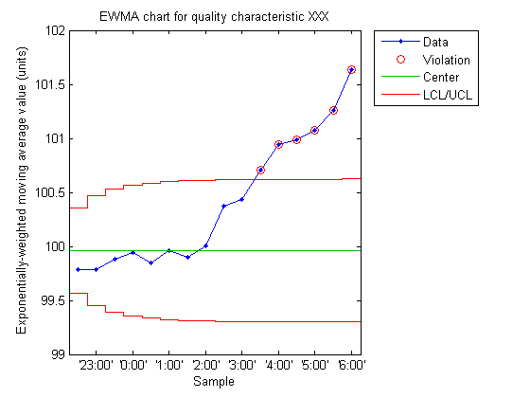
Statistical study of the Cs-137 detections at RN43 station
M. M. Mounja¹, C. Sanguigni²; A. Rizzo²; g. Ottaviano²
¹Mauritania National Authority of Radiation, Safety and Nuclear Security (ARSN), Nouakchott, Mauritania
²Italian National Agency for New Technologies, Energy and Sustainable Economic Development (ENEA), Italy]
O2.4-406
EWMA Control Chart
METHODS

Slide 10
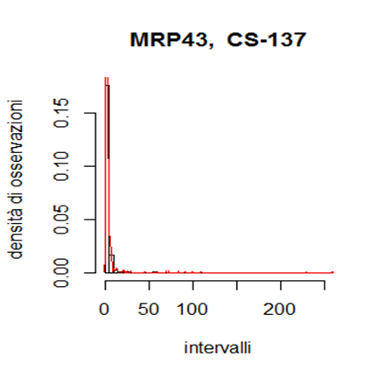
Statistical study of the Cs-137 detections at RN43 station
M. M. Mounja¹, C. Sanguigni²; A. Rizzo²; g. Ottaviano²
¹Mauritania National Authority of Radiation, Safety and Nuclear Security (ARSN), Nouakchott, Mauritania
²Italian National Agency for New Technologies, Energy and Sustainable Economic Development (ENEA), Italy]
O2.4-406
The distribution of Cs-137 is not a normal distribution but it exhibits asymmetry
Density of observations
METHODS
intervals

Slide 11
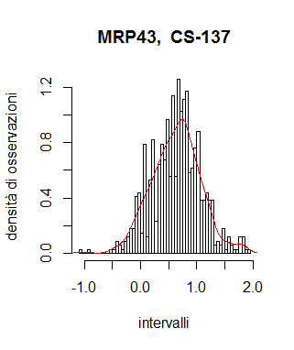
Statistical study of the Cs-137 detections at RN43 station
M. M. Mounja¹, C. Sanguigni²; A. Rizzo²; g. Ottaviano²
¹Mauritania National Authority of Radiation, Safety and Nuclear Security (ARSN), Nouakchott, Mauritania
²Italian National Agency for New Technologies, Energy and Sustainable Economic Development (ENEA), Italy]
O2.4-406
Cs-137 distribution graph (2008-2018) after Box-Cox transformation
Density of observations
METHODS
intervals

Slide 12
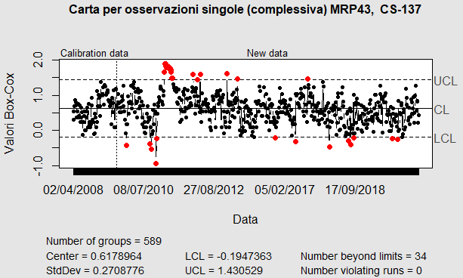
Statistical study of the Cs-137 detections at RN43 station
M. M. Mounja¹, C. Sanguigni²; A. Rizzo²; g. Ottaviano²
¹Mauritania National Authority of Radiation, Safety and Nuclear Security (ARSN), Nouakchott, Mauritania
²Italian National Agency for New Technologies, Energy and Sustainable Economic Development (ENEA), Italy]
O2.4-406
Fukushima events
Shewhart Control Chart
applied to the measurements of Cs-137 at RN43 (2008-2019)
RESULTS

Slide 13
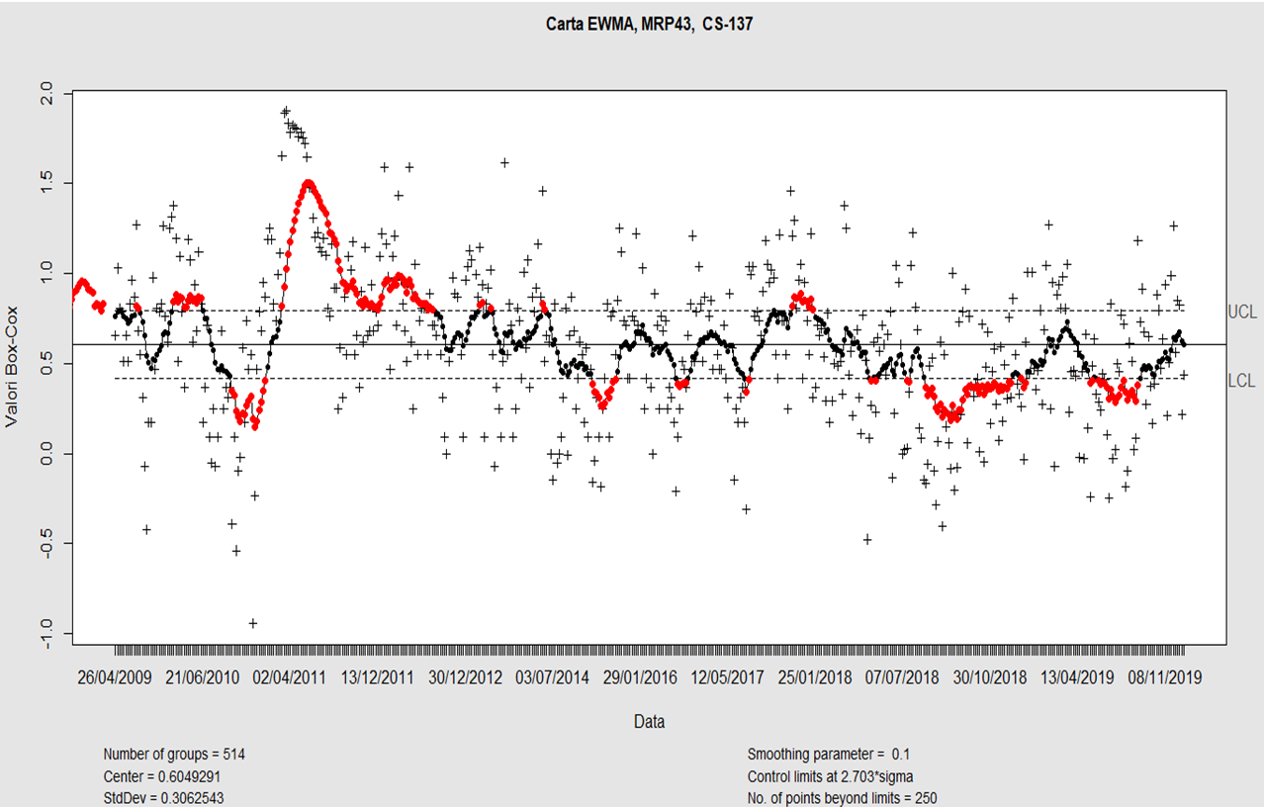
Statistical study of the Cs-137 detections at RN43 station
M. M. Mounja¹, C. Sanguigni²; A. Rizzo²; g. Ottaviano²
¹Mauritania National Authority of Radiation, Safety and Nuclear Security (ARSN), Nouakchott, Mauritania
²Italian National Agency for New Technologies, Energy and Sustainable Economic Development (ENEA), Italy]
O2.4-406
Fukushima events
EWMA Control Chart
applied to the measurements of Cs-137 at RN43 (2008-2019)
RESULTS

Slide 14
Statistical study of the Cs-137 detections at RN43 station
M. M. Mounja¹, C. Sanguigni²; A. Rizzo²; g. Ottaviano²
¹Mauritania National Authority of Radiation, Safety and Nuclear Security (ARSN), Nouakchott, Mauritania
²Italian National Agency for New Technologies, Energy and Sustainable Economic Development (ENEA), Italy]
O2.4-406
We have studied some statistical approach to the measuremnt we saw in our IMS radionuclide station located in Nouakchott.
We have also applied process control charts to the dataset and it was clear that the control charts could help to highlight deviation from the normal statistic of the measurements
We have noticed some coincidence with the appearance of Cs-137 and augmented aerosol loading on Noaukchott in spring 2007, 2008 and 2010
New dataset on atmospheric aerosol loading will be searched for
Further studies to investigate correlations will be done in the future, thanks to the collaboration between Mauritania NDC adn Italian NDC
CONCLUSION

