Slide 1
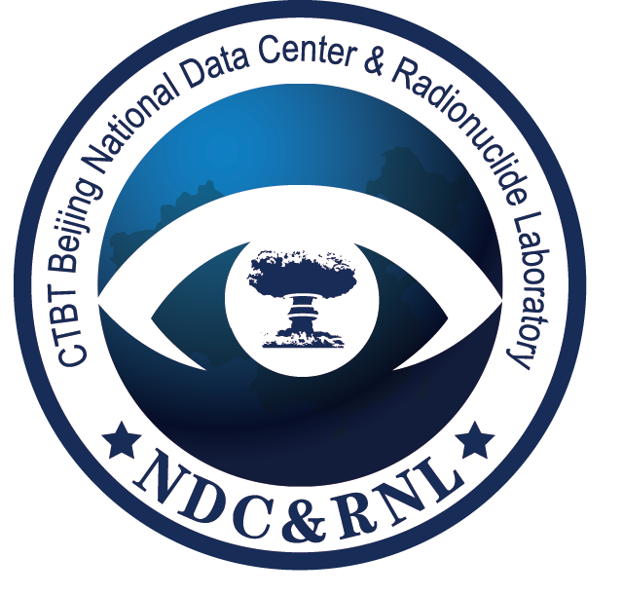
NPE19 Source Term Reconstruction
based on Radionuclide Monitoring Result
Yungang ZHAO^{a,b} , Shilian WANGª,Qi LIª,Xiaoming WANGª,Xinjun ZHANGª,Yuanqing FANª,Huaimao JIAª, Jian LIª , Yuanyuan LIU^{b} , Jianping CHENG^{b}
ª CTBT Beijing National Data Centre and Beijing Radionuclide Laboratory
^{b}Key Laboratory of Beam Technology of Ministry of Education, College of Nuclear Science and Technology, Beijing Normal University
T2.4-360

Slide 2
NPE19 Source Term Reconstruction based on Radionuclide Monitoring Result
Yungang ZHAO, Shilian WANG,Qi LI,Xiaoming WANG,Xinjun ZHANG,Yuanqing FAN,Huaimao JIA,
Jian LI , Yuanyuan LIU,Jianping CHENG
T2.4-360
NDC Preparedness Exercises(NPE) are regularly performed to practice the verification procedures for the detections of nuclear explosions in the framework of CTBT monitoring. In the event of NPE2019, a fictitious state RAETIA announced that a reactor had an accident and some radionuclides were released into the atmosphere. Based on the monitoring results, we analyzed the detections data, did ATM simulation in backward and forward mode by flexpart. Our results demonstrated that the source was not a nuclear explosion and the amount of ¹³⁴Cs and ¹³³Xe were given.
ABSTRACT

Slide 3
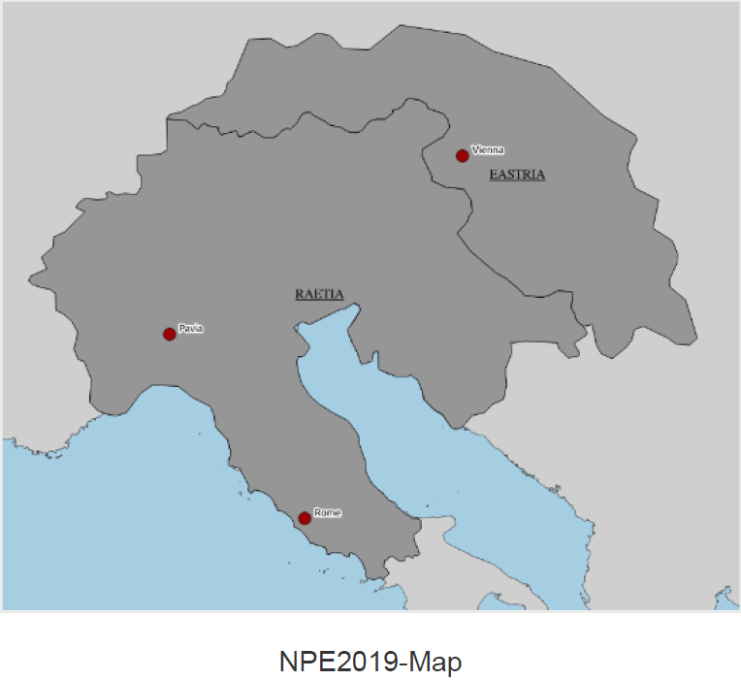
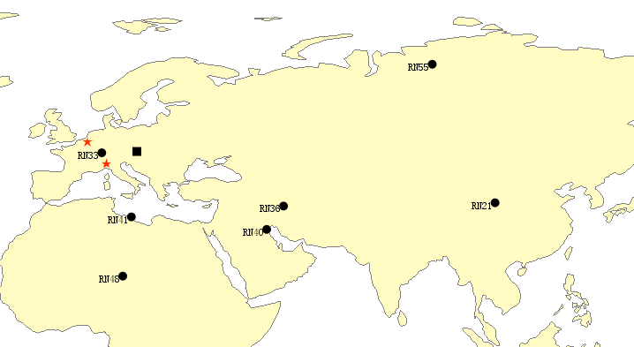
NPE19 Source Term Reconstruction based on Radionuclide Monitoring Result
Yungang ZHAO, Shilian WANG,Qi LI,Xiaoming WANG,Xinjun ZHANG,Yuanqing FAN,Huaimao JIA,
Jian LI , Yuanyuan LIU,Jianping CHENG
T2.4-360
On July 30, 2019, RAETIA announced that the TRIGA reactor in Pavia had an accident and a small amount of radionuclides had been released.
Subsequently, ¹⁴⁰Ba, ¹⁴⁰La, ¹³⁴Cs, ¹³⁷Cs and various xenon isotopes were monitored at multiple stations.
Aim: Assess the compliance of RAETIA state to the CTBT
INTRODUCTION

Slide 4
NPE19 Source Term Reconstruction based on Radionuclide Monitoring Result
Yungang ZHAO, Shilian WANG,Qi LI,Xiaoming WANG,Xinjun ZHANG,Yuanqing FAN,Huaimao JIA,
Jian LI , Yuanyuan LIU,Jianping CHENG
T2.4-360
Data Analysis
Analysis of historical monitoring data:
regional normal release or an abnormal event.
Ratio of nuclides:
One source or more
Reactor or nuclear explosion
ATM
Backward mode:
The possible source region.
Forward mode:
Quantitative the amount of radionuclides
METHODS

Slide 5
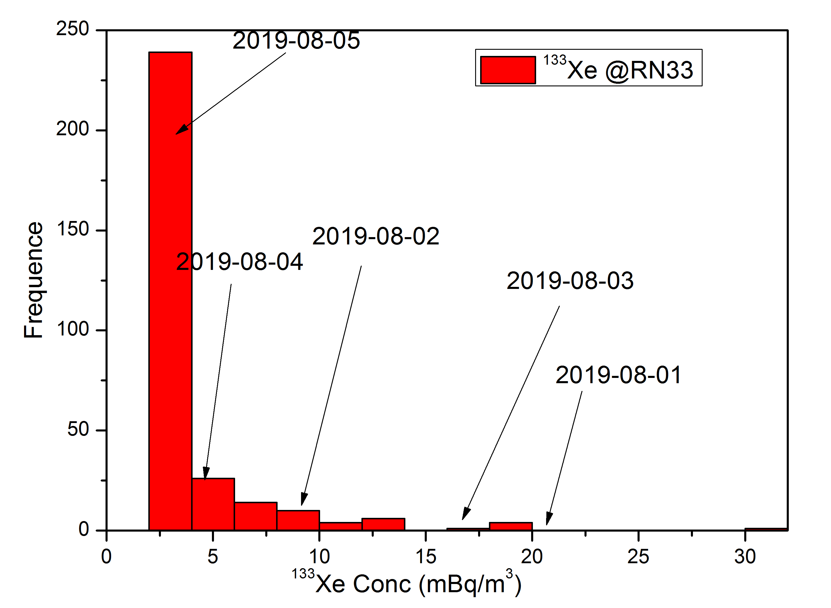
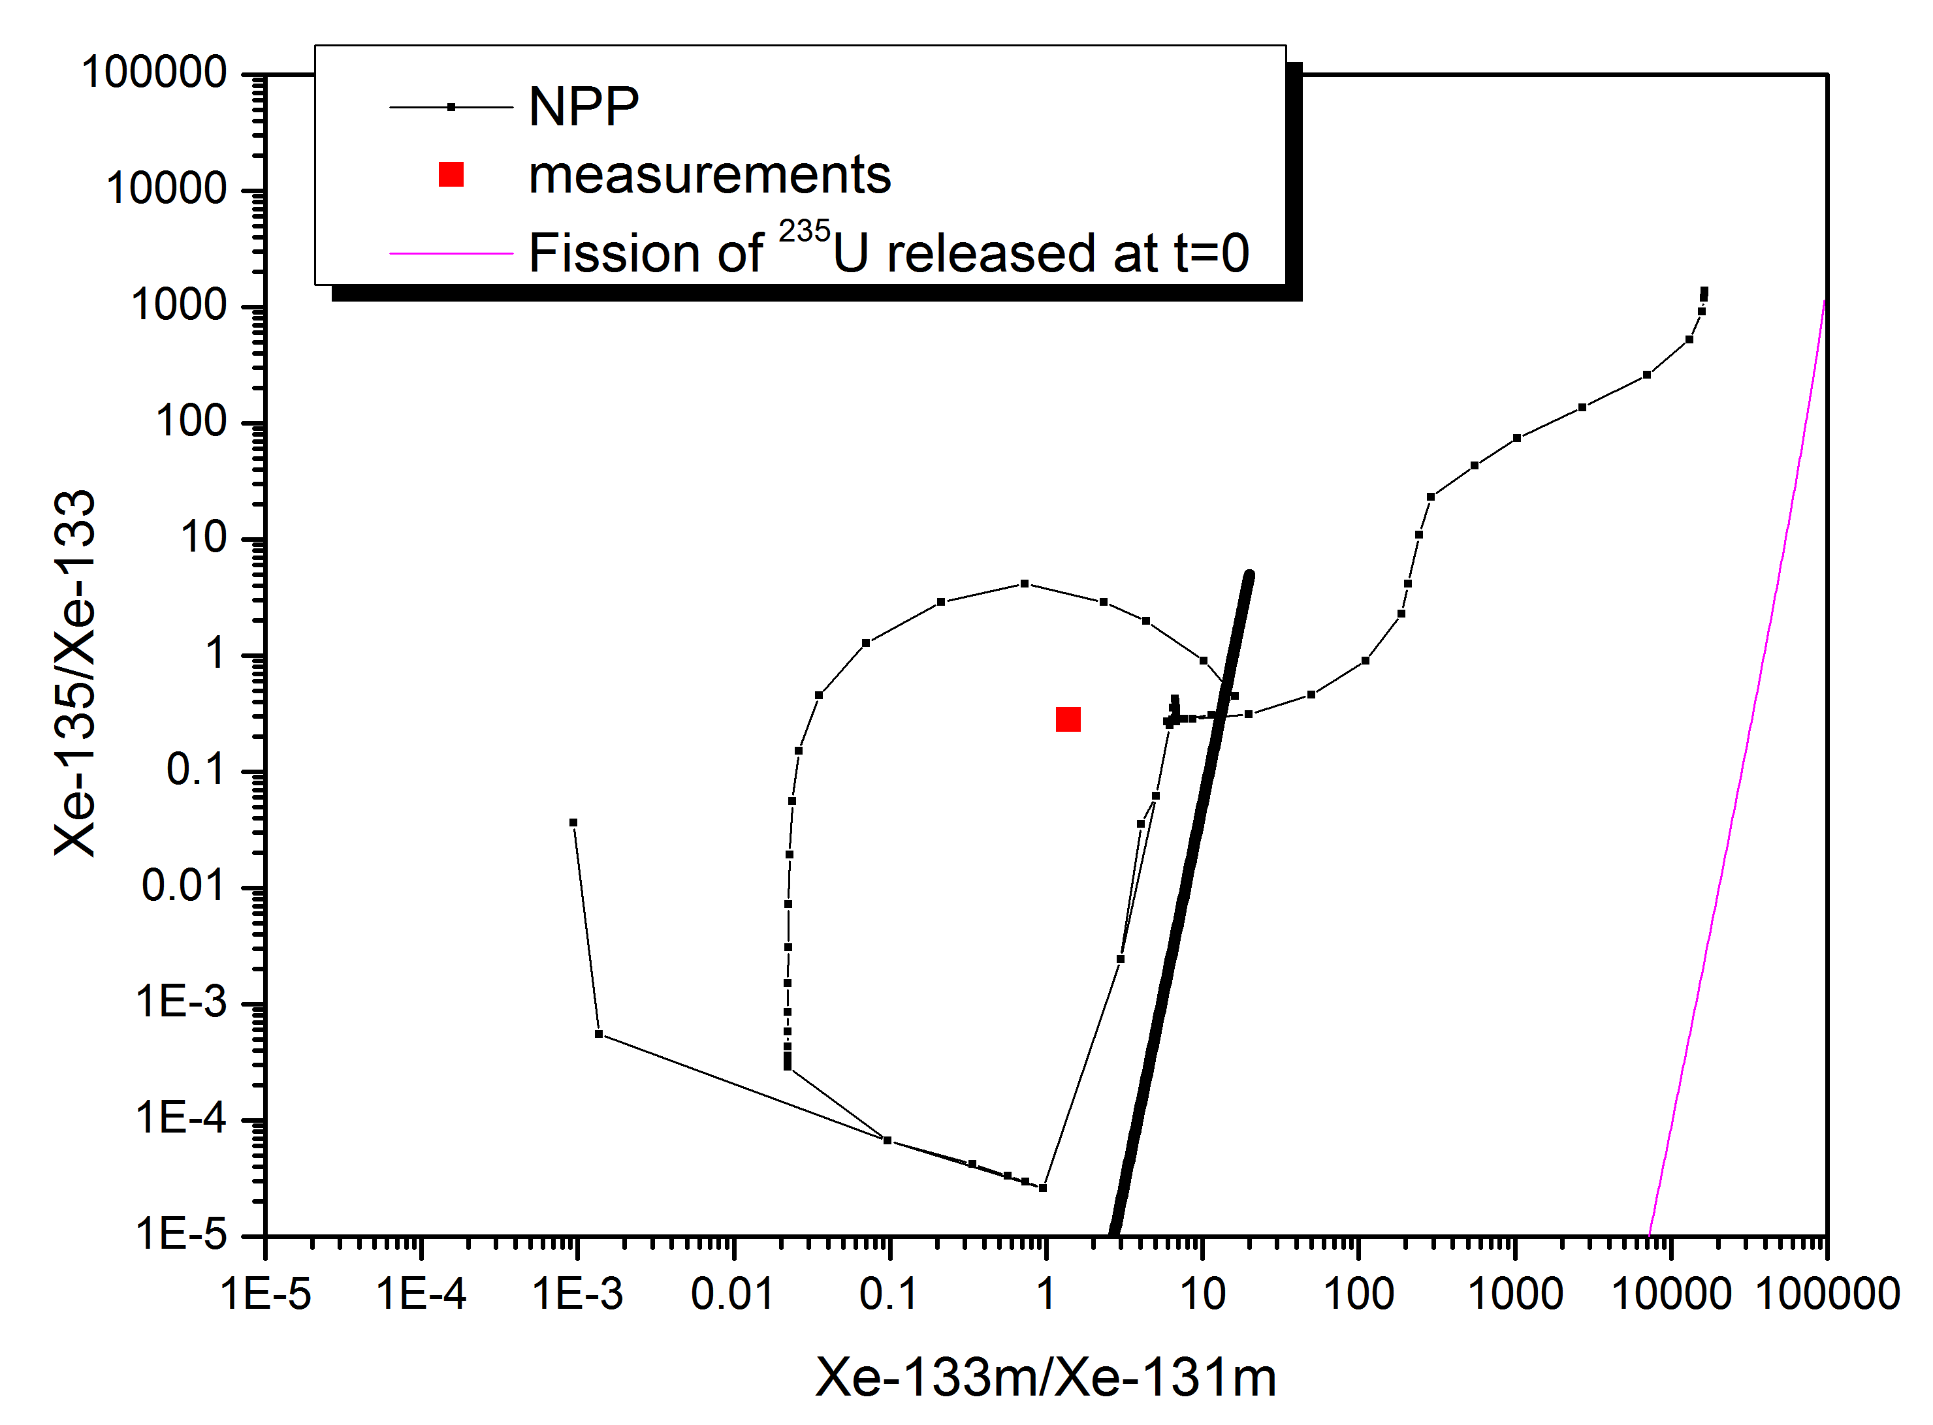
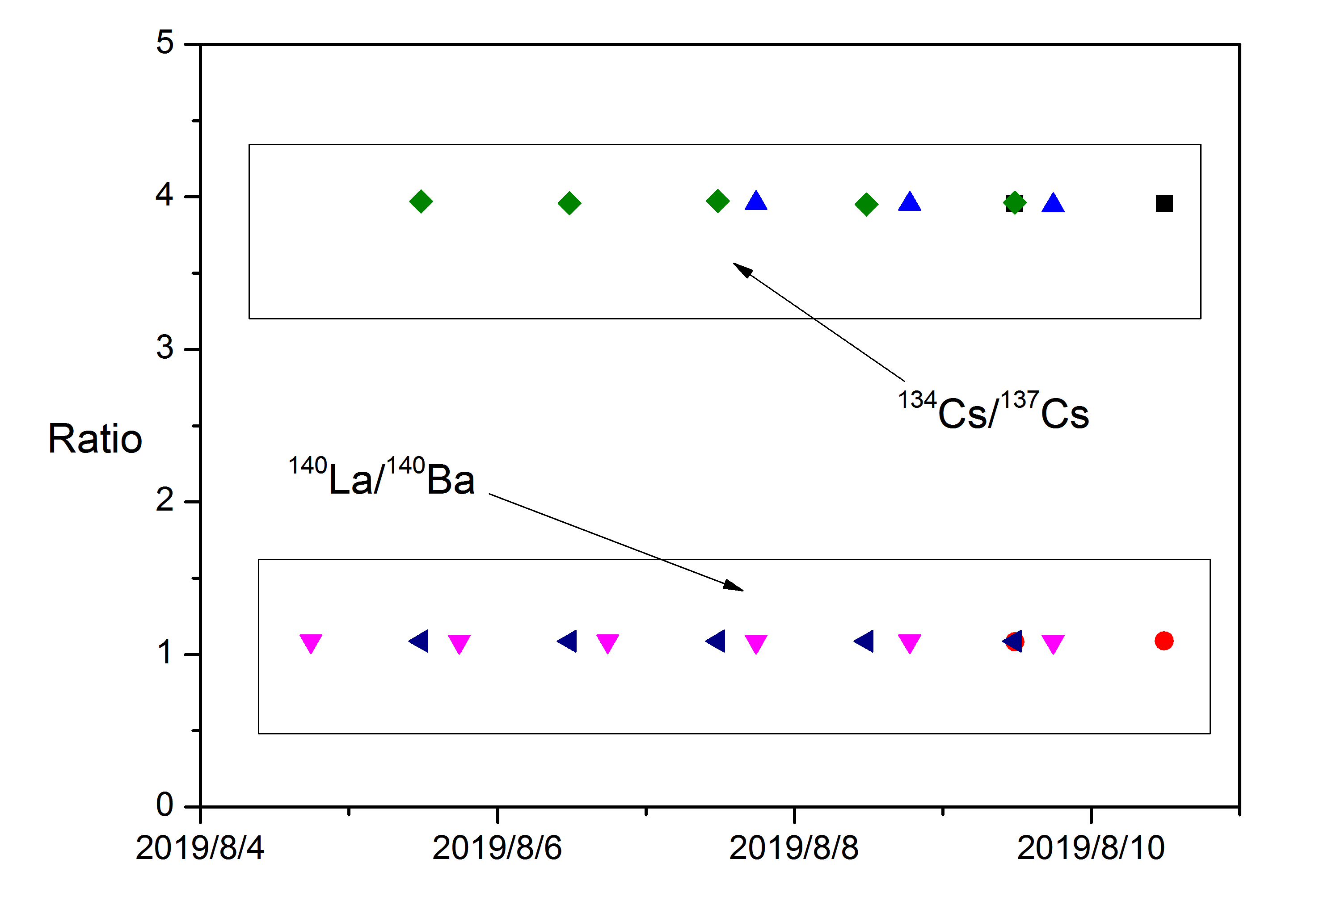
NPE19 Source Term Reconstruction based on Radionuclide Monitoring Result
Yungang ZHAO, Shilian WANG,Qi LI,Xiaoming WANG,Xinjun ZHANG,Yuanqing FAN,Huaimao JIA,
Jian LI , Yuanyuan LIU,Jianping CHENG
T2.4-360
Data Analysis
Noble gas
Historical monitoring data:
Not a normal emission.
Xenon ratio:
Not NE.
Particulate
Ba-La ratio:
Equilibrium.
Cs ratio:
Not NE.
One source.
RESULTS
¹³³Xe historical monitoring statistics at RN33
Case | ¹³⁴Cs/¹³⁷Cs
NE | ~0.01
NPP(Fukushima) | ~1
NPE19 | ~4
Nuclide ratios at radionuclide stations

Slide 6
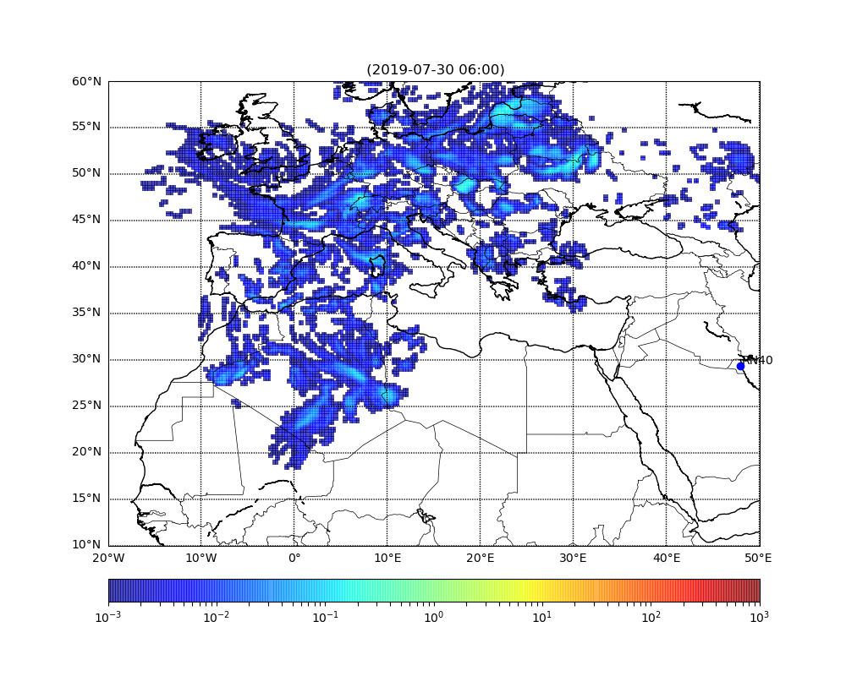
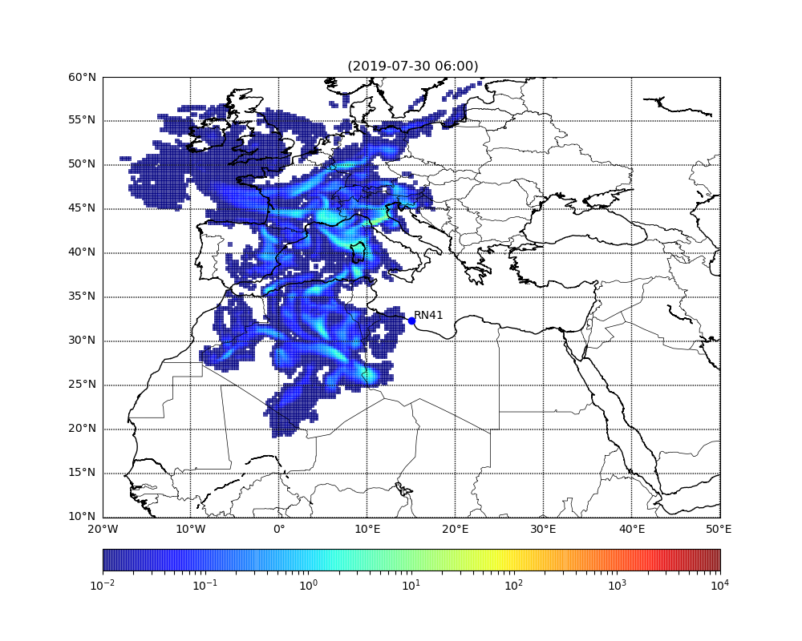
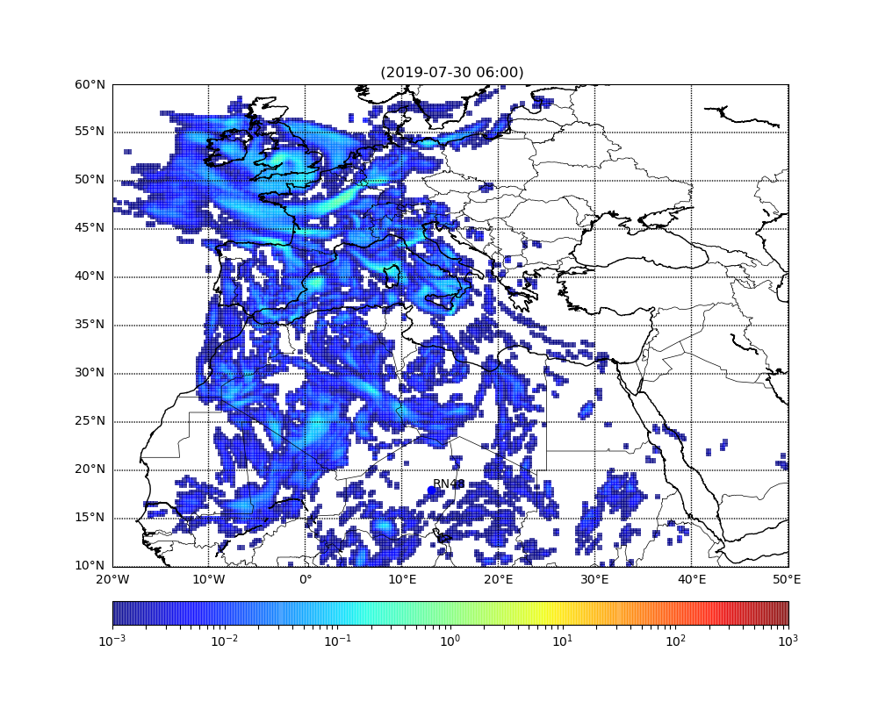
NPE19 Source Term Reconstruction based on Radionuclide Monitoring Result
Yungang ZHAO, Shilian WANG,Qi LI,Xiaoming WANG,Xinjun ZHANG,Yuanqing FAN,Huaimao JIA,
Jian LI , Yuanyuan LIU,Jianping CHENG
T2.4-360
ATM：Backward mode
RESULTS
RN40
RN41
RN48

Slide 7
NPE19 Source Term Reconstruction based on Radionuclide Monitoring Result
Yungang ZHAO, Shilian WANG,Qi LI,Xiaoming WANG,Xinjun ZHANG,Yuanqing FAN,Huaimao JIA,
Jian LI , Yuanyuan LIU,Jianping CHENG
T2.4-360
ATM：Forward mode Location: Pavia, IRE Release Time:2019-07-30~07-31
RESULTS
Noble Gas
Particulate

Slide 8
NPE19 Source Term Reconstruction based on Radionuclide Monitoring Result
Yungang ZHAO, Shilian WANG,Qi LI,Xiaoming WANG,Xinjun ZHANG,Yuanqing FAN,Huaimao JIA,
Jian LI , Yuanyuan LIU,Jianping CHENG
T2.4-360
Source characteristics:
Not a nuclear explosion.
From one source.
probably the accident of the TRIGA reactor.
Source amount:
¹³⁴Cs ~ 10¹² Bq.
¹³³Xe ~ 10¹⁴ Bq.
CONCLUSIONS

