Slide 1




Shielding of radiation from atmospheric dispersion resulting from a radiological accident
Authors:
Rodrigo Carneiro Curzio; Carlos Eduardo Bonfim; Rudnei Karam Morales; Sergio Gavazza; Domingos D’Oliveira Cardoso
T2.4 e-poster session / P2.4-274

Slide 2
Shielding of radiation from atmospheric dispersion resulting from a radiological accident
P2.4-274
This study describes the determination of the shielding against ionizing radiation from atmospheric dispersion arising from a radiological accident in a small nuclear reactor (SMR). Among the radionuclides from the inventory of this reactor, the contribution of Cs-137 was considered for simulation in HotSpot (analytical modeling) and ANSYS (numerical modeling), of the concentration and total effective doses (TEDE) received, both depending on the distance of the event. The analytical solution, based on the hypotheses of the Gaussian approach, aims to validate the numerical solution brought by the CFD techniques, in a simplified computational scenario, taking into account the set of partial differential equations that govern the physical phenomenon of the transport of this material radioactive. Additionally, for the analysis of shielding, Taylor’s formulations were used to perform simple shielding calculations, considering only shelters, based on ordinary concrete, possibly existing in the contaminated area, and Broder, in multilaminated cases, with adding a layer of lead to the front of the wall. The relevance of this investigation shows the importance of planning responses in an emergency situation, considering the data assumed in the simulations..
ABSTRACT

Slide 3
Shielding of radiation from atmospheric dispersion resulting from a radiological accident
P2.4-274
Radiological Accident
Source Term
Atmospheric Dispersion
Meterological conditions
INTRODUCTION
Equivalent Doses
Health damage
Protective Actions
SHELTER
Protection actions linked to the initial phase of the radiological event

Slide 4
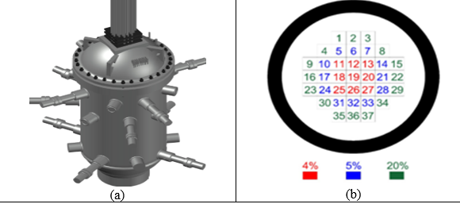
Shielding of radiation from atmospheric dispersion resulting from a radiological accident
P2.4-274
Source term of atmospheric dispersion:
Tab. 1: SMR radionuclide inventory (SCALE, 2020).
Radionulide | Activity | Mass (g) | Percentage
Ba140 | 9,228E+16 | 3,41E+01 | 1,52E-02
Cs137 | 4,295E+15 | 1,34E+03 | 5,98E-01
I131 | 4,746E+16 | 1,03E+01 | 4,62E-03
I135 | 9,744E+16 | 7,45E-01 | 3,33E-04
Kr85 | 6,153E+14 | 4,25E+01 | 1,90E-02
Kr85m | 1,735E+16 | 5,70E-02 | 2,55E-05
Rn218 | 2,811E+04 | 5,14E-19 | 2,30E-22
Rn219 | 7,766E+03 | 1,61E-17 | 7,21E-21
Rn220 | 2,334E+07 | 6,84E-13 | 3,06E-16
Rn222 | 7,553E+01 | 1,33E-14 | 5,93E-18
Sr89 | 6,185E+16 | 5,76E+01 | 2,57E-02
Sr90 | 3,739E+15 | 7,32E+02 | 3,28E-01
Te132 | 6,911E+16 | 6,05E+00 | 2,71E-03
Xe133 | 1,000E+17 | 1,44E+01 | 6,45E-03
Xe133m | 1,210E+15 | 7,29E-02 | 3,26E-05
Xe135 | 4,697E+16 | 5,00E-01 | 2,24E-04
Xe135m | 1,383E+16 | 4,10E-03 | 1,83E-06
TOTAL | 5,561E+17 | 2,24E+03 | 100%
INTRODUCTION
Fig. 1: SMR with 4%, 5% e 20% enrichment (SCALE).
Fig. 2: Figura ilustrativa da dispersão atmosférica
(STOKIE, 2015)

Slide 5
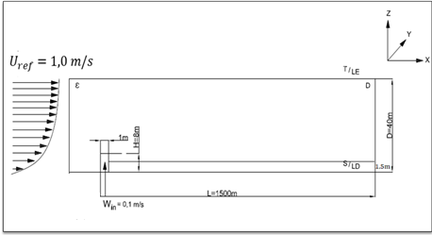
Shielding of radiation from atmospheric dispersion resulting from a radiological accident
P2.4-274
Descrition of computacional scenario:
# General information about Accident:
    SRM chimney height: 8 m;
    Pasquill-Gifford’s Class: F (moderately stable)
    The Accident has occurred daytime;
    No rain at moment of accident in SMR;
    Flat terrain, not very rough and without natural obstacles downstream;
    Diameter of the Cs-137 particle: dp = 1μm
    Airbone fraction: 100%;
    Respirable fraction: 100%
METHODS
Fig. 2: Illustrative scheme of the dispersion scenario.
Fig. 2: Figura ilustrativa da dispersão atmosférica
(STOKIE, 2015)

Slide 6
Shielding of radiation from atmospheric dispersion resulting from a radiological accident
P2.4-274
Radiological Aciddent in a SMR Reactor
#Computational Fluid Dynamics:
RANS Model:
      Continuity Equation;
      Moviment Equation;
      Advection-diffusion Equation.
k-ε Turbulence Model
Multiphase flow
(atmospheric air + Cs-137 particulate)
Atmospheric Dispersion
Computational Modeling
# Gaussian Approach:
  Advection-diffusion equation
METHODS
HotSpot Health Physics
ANSYS 2021 R1
Cs-137 Concentration (Bq/m³)
Equivalent Dose, TEDE, (Sv)
Conversion factors (concentration to dose)
# Federal Guidance Report 11
Notes:
Em todos os cenários envolvendo modelagem computacional, partimos da coleta de informações, modelamos o cenário, e estimamos os resultados para assim assessorar de forma mais completa a tomada de decisões

Slide 7




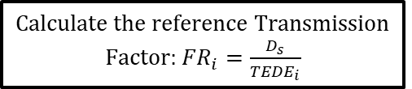

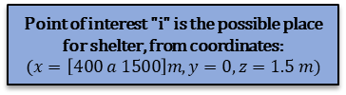

Shielding of radiation from atmospheric dispersion resulting from a radiological accident
P2.4-274
Point of interest "i" is the possible place for shelter, from coordinates:
$$(x=\left[400 a 1500\right]m, y=0, z=1.5 m)$$
Dose at a point of interest (i):${TEDE}_{i}$
ANSYS (CFD);
HotSpot (Gaussian Approach).
Calculate the reference Transmission Factor: ${FR}_{i}=\frac{D_{s}}{{TEDE}_{i}}$
$D_{s}$= 10 mSv (Shelter)
METHODS
Calculate the Transmission Factor of the shelter (${FT}_{s} )$
(Taylor’$s$ $Buildup$)
(Broder’$s$ $Buildup$)
Yes
No
Add a layer of lead to the front of the Shelter wall.
${FT}_{s} >{FR}_{i}$?
Shielding is effective for protection against Cs-137.

Slide 8
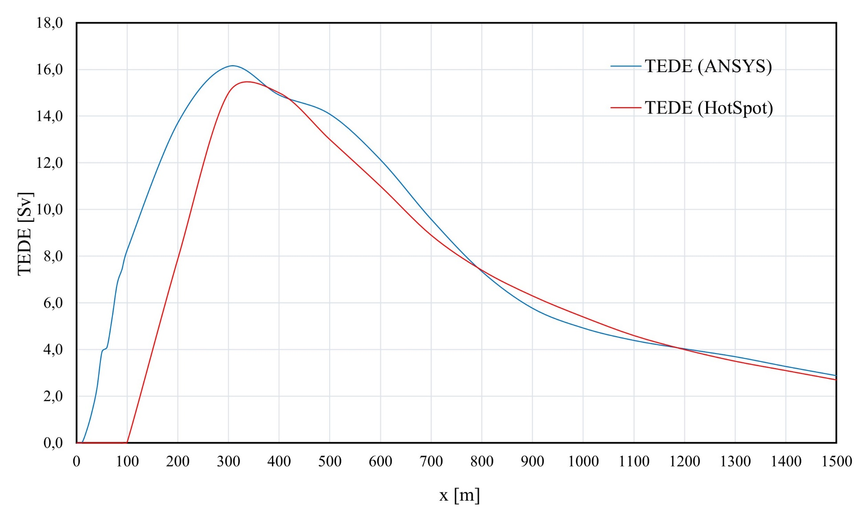
Shielding of radiation from atmospheric dispersion resulting from a radiological accident
P2.4-274
Intercomparison of computational models (ANSYS and HotSot):
RESULTS
Fig. 3: Results obtained in analytical and numerical simulations
76

Slide 9
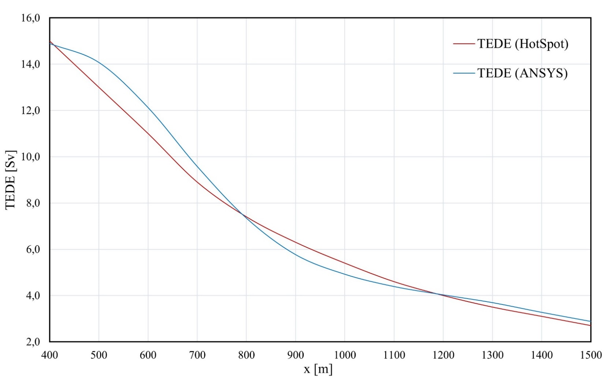
Shielding of radiation from atmospheric dispersion resulting from a radiological accident
P2.4-274
Intercomparison of computational models (ANSYS and HotSot):
RESULTS
Fig. 4: Results obtained in the analytical and numerical simulations (from 400 m).
Average percentage error between results: 5%
It is possible to use both methodologies for shielding analysis
76

Slide 10
Shielding of radiation from atmospheric dispersion resulting from a radiological accident
P2.4-274
Shelter Transmission Factor Results (${FR}_{i}$):
Tab. 2: Reference Transmission Factor Values${ (FR}_{i})$.
Distance (m) | Reference Transmission Factor
 | HotSpot | ANSYS
400 | 6,67E-04 | 6,71E-04
500 | 7,69E-04 | 7,10E-04
600 | 9,09E-04 | 8,25E-04
700 | 1,12E-03 | 1,04E-03
800 | 1,35E-03 | 1,36E-03
900 | 1,59E-03 | 1,73E-03
1000 | 1,85E-03 | 2,03E-03
1100 | 2,17E-03 | 2,28E-03
1200 | 2,50E-03 | 2,48E-03
1300 | 2,86E-03 | 2,70E-03
1400 | 3,23E-03 | 3,05E-03
1500 | 3,70E-03 | 3,47E-03
RESULTS
Addition of lead to wall of the shelter

Slide 11
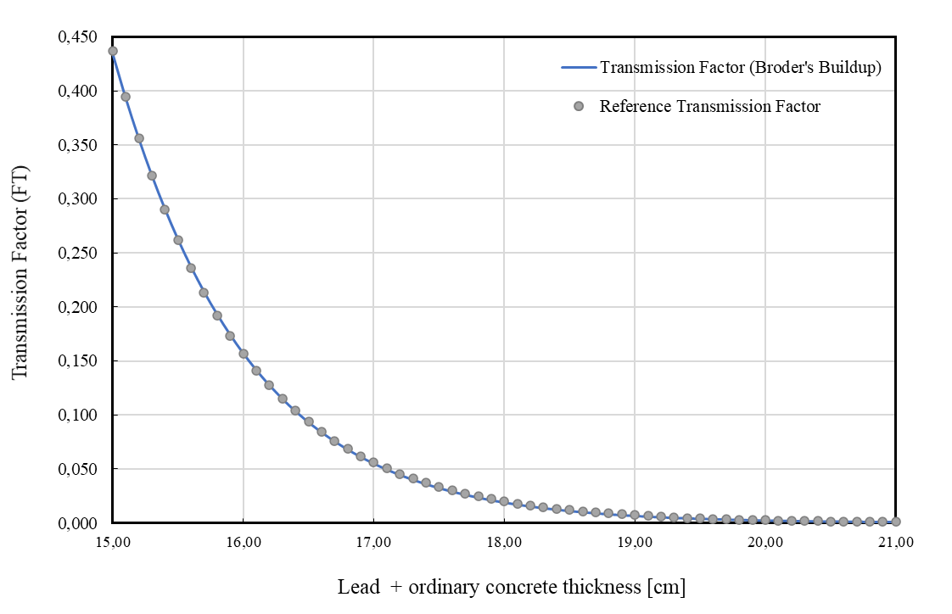

Shielding of radiation from atmospheric dispersion resulting from a radiological accident
P2.4-274
Bilaminar Transmission Factor Curve and Adjustment Equation:
RESULTS
$${ x}_{1}^{j}=\frac{1}{1,17}ln\left(\frac{1,71E+07}{{FR}_{i}}\right)−15$$
Fig. 5: Curve obtained for the Broder Transmission Factor.

Slide 12
Shielding of radiation from atmospheric dispersion resulting from a radiological accident
P2.4-274
Shelter thickness analysis (x=[400 a 1.500]; y=0; z=1,5):
Tab. 3: Shelter thickness.
 | HotSpot | ANSYS
Distance [m] | Thickness [cm] of the shelter | Thickness [cm] of the shelter
400 | 20,56 | 20,55
500 | 20,43 | 20,50
600 | 20,29 | 20,37
700 | 20,11 | 20,17
800 | 19,95 | 19,95
900 | 19,81 | 19,76
1000 | 19,68 | 19,63
1100 | 19,54 | 19,53
1200 | 19,42 | 19,43
1300 | 19,31 | 19,32
1400 | 19,20 | 19,21
1500 | 19,09 | 19,10
Greater thickness
RESULTS
Decreasing behavior
Smaller thickness

Slide 13
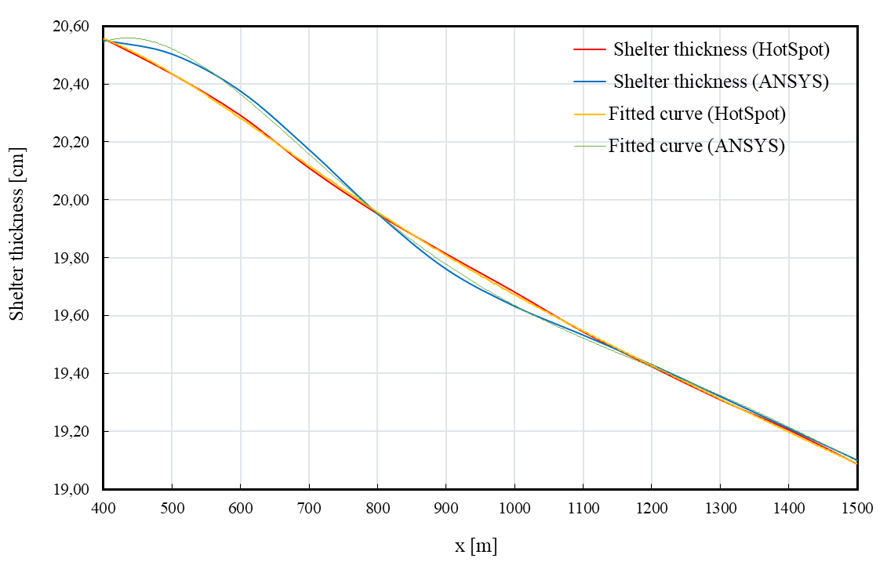
Shielding of radiation from atmospheric dispersion resulting from a radiological accident
P2.4-274
Shelter thickness analysis (x=[400 a 1.500]; y=0; z=1,5):
*
*
*
*
RESULTS
Fig. 6: Fitted curves to the results obtained in the numerical and analytical simulations.
*
5th degree polynomial
*

Slide 14
IME
Shielding of radiation from atmospheric dispersion resulting from a radiological accident
P2.4-274
Final considerations:
Atmospheric Dispersion
Characterization of the source term
Dipersion scenario
CONCLUSIONS
Compliance with normative aspects regarding the planning of responses in emergency situations.

Slide 15

Shielding of radiation from atmospheric dispersion resulting from a radiological accident
P2.4-088
P2.4-274
Obrigado!
Thank you
Capitain Curzio, M.Sc.
Brazilian Army Officer
+ 55 21 2410-6329
curzio.carneiro@eb.mil.br

