Slide 1




Applications in CFD in nuclear emergency response decisions
C.E.S.Bonfim, T. Brum, J.A.V. Da Silva, F.B. Ougano, R.C. Curzio
P2.4-088

Slide 2
Applications in CFD in nuclear emergency response decisions
Carlos Eduardo Santos Bonfim, bonfim.carlos@eb.mil.br, Brazilian Army/IDQBRN; Tércio Brum, brum.tercio@eb.mil.br, Brazilian Army/EME; José Alberto Valle da Silva, alberto.valle@eb.mil.br, Brazilian Army/MD, Felipe Barbosa Ougano, ougano.felipe@eb.mil.br, Brazilian Army/IME, Rodrigo Carneiro Curzio, curzio.carneiro@eb.mil.br, Brazilian Army/IDQBRN
P2.4-088
The atmospheric dispersion modeling of radionuclides is used to obtain responses to emergencies by estimating radiation effects, associated with the atmospheric release of radioactive materials. Nowadays, the almost all of software, used for such purpose, is based on the Gaussian model, which provides fast and conservative means that consider regions free of obstructions and simple weather conditions. However, when it comes to calculate radiological impacts from radionuclide transport to recover the affected area in complex regions close to the event, considering the physical or physico-chemical phenomena of the flow, the radioactive-cloud spreading time, the concentration and effective dose levels, and both time and environmental impact on the reached area, we need to use more robust tools to assist us in decision making. Hence, this work aims to address the use of computational fluid dynamics as a differentiated and complementary tool to support decisions related to nuclear emergencies, involving the atmospheric dispersion of radionuclides, and to analyze a possible underground nuclear explosion, based on the calculation of radioxenon surface flow regarding yields, detonation depths and distinct permeabilities.
ABSTRACT

Slide 3
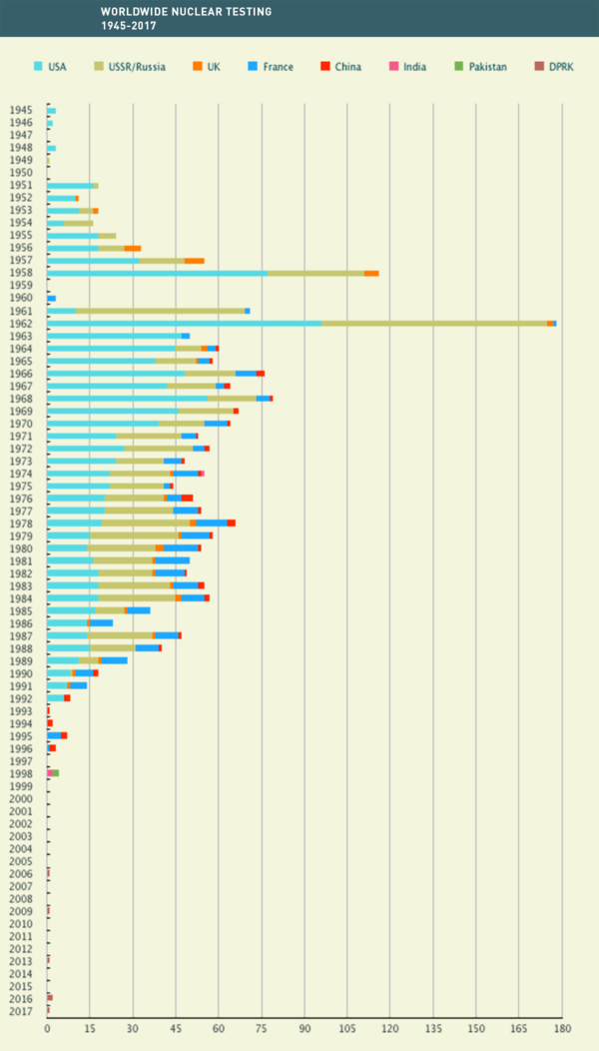
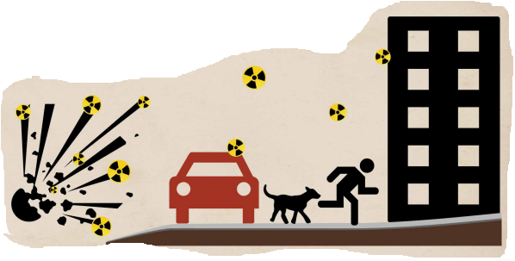
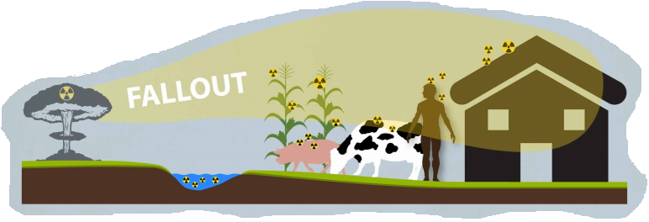
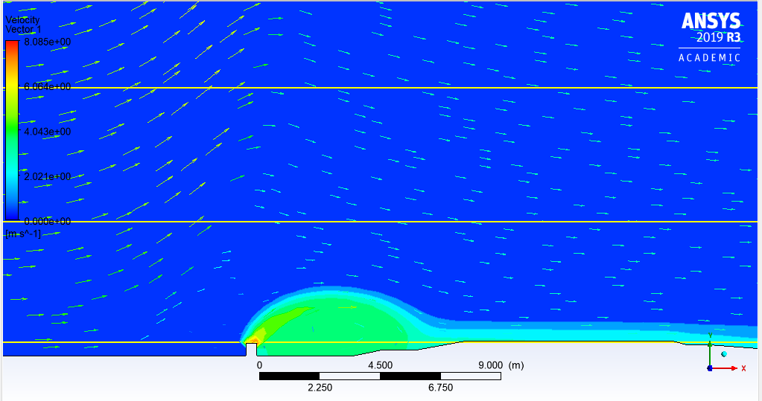
Applications in CFD in nuclear emergency response decisions
Carlos Eduardo Santos Bonfim, bonfim.carlos@eb.mil.br, Brazilian Army/IDQBRN; Tércio Brum, brum.tercio@eb.mil.br, Brazilian Army/EME; José Alberto Valle da Silva, alberto.valle@eb.mil.br, Brazilian Army/MD, Felipe Barbosa Ougano, ougano.felipe@eb.mil.br, Brazilian Army/IME, Rodrigo Carneiro Curzio, curzio.carneiro@eb.mil.br, Brazilian Army/IDQBRN
P2.4-088
When we think about emergency response, involving atmospheric dispersion of radionuclides, the main associated events are nuclear tests, nuclear accidents and RDD, where we need to obtain through estimation the radiation effects associated with the atmospheric release of radioactive materials.
Nuclear Tests from 1945 to Today
Major Nuclear Accidents
RDDs
WindScale and Kyshtym (Ozyorsk)
Bohunice NPP
Fukushima
Yucca Flat
Three Mile Island NPP
Chernobyl
Cesiun-137 (Brazil)
Sevrsk, Tomsk-7
Tokaimura
INTRODUCTION
1957
1970
1977
1979
1986
1993
1987
1999
2011
CFD Simulation
Environmental Impact

Slide 4
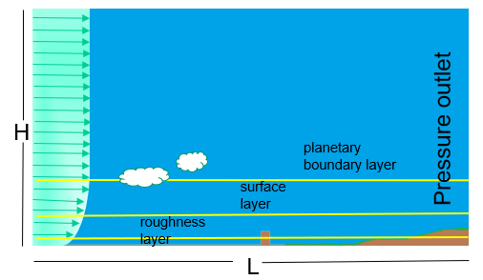
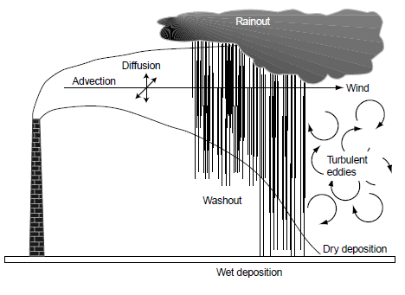
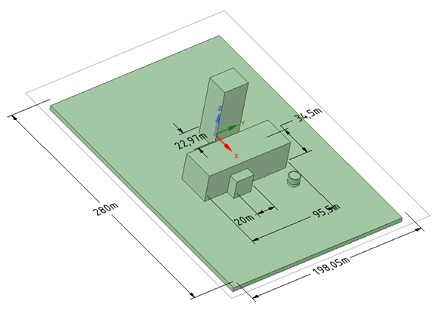
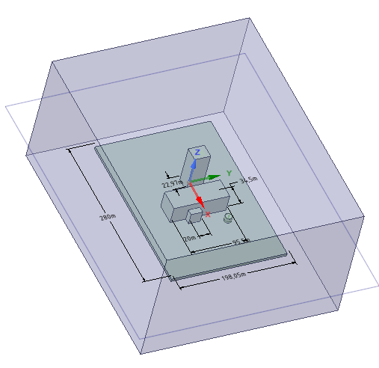
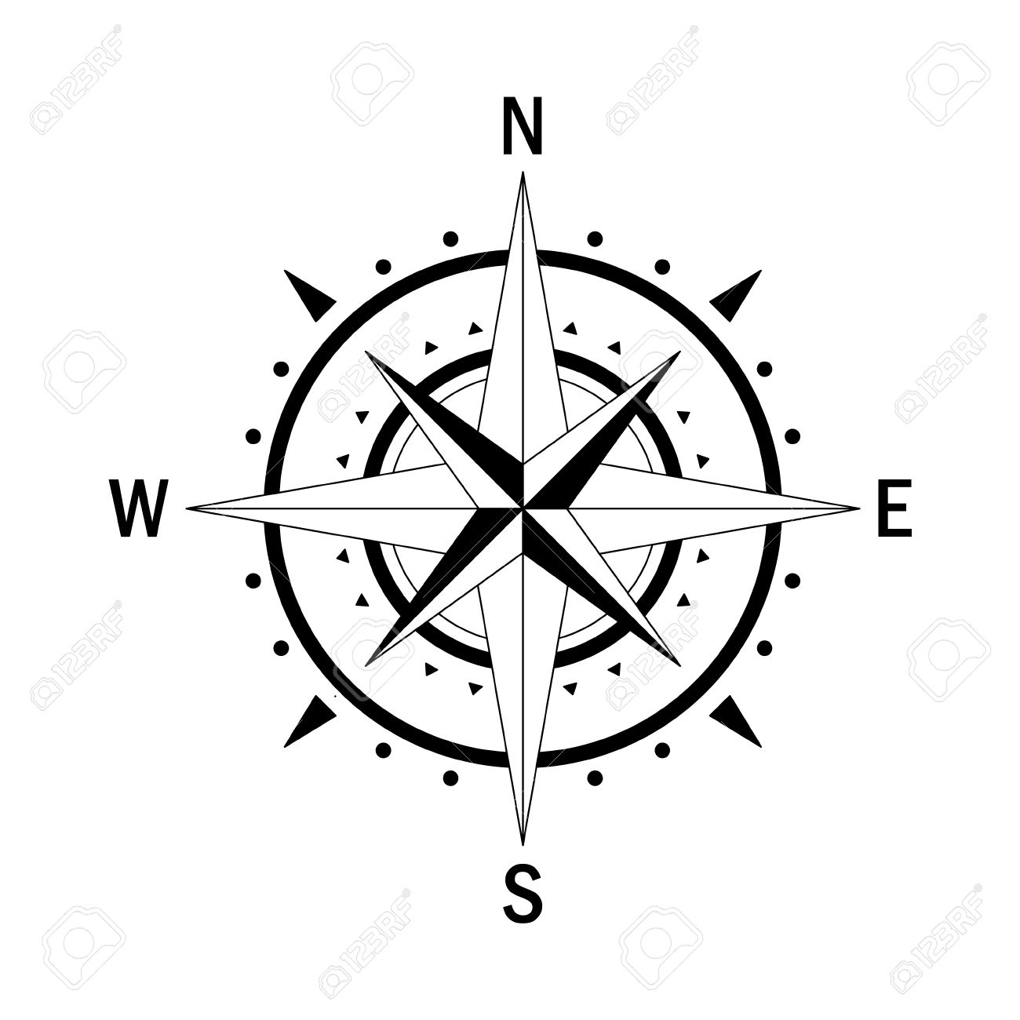
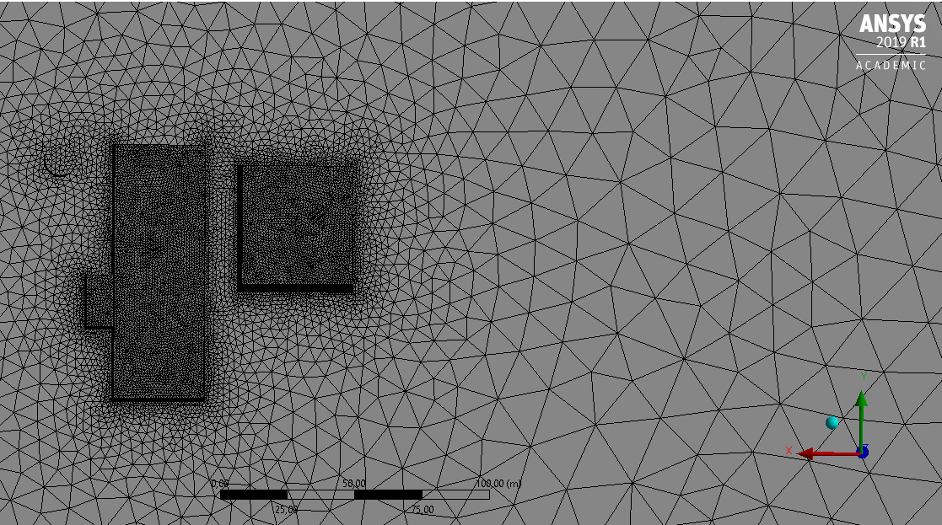
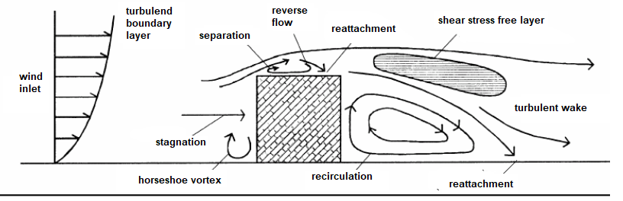
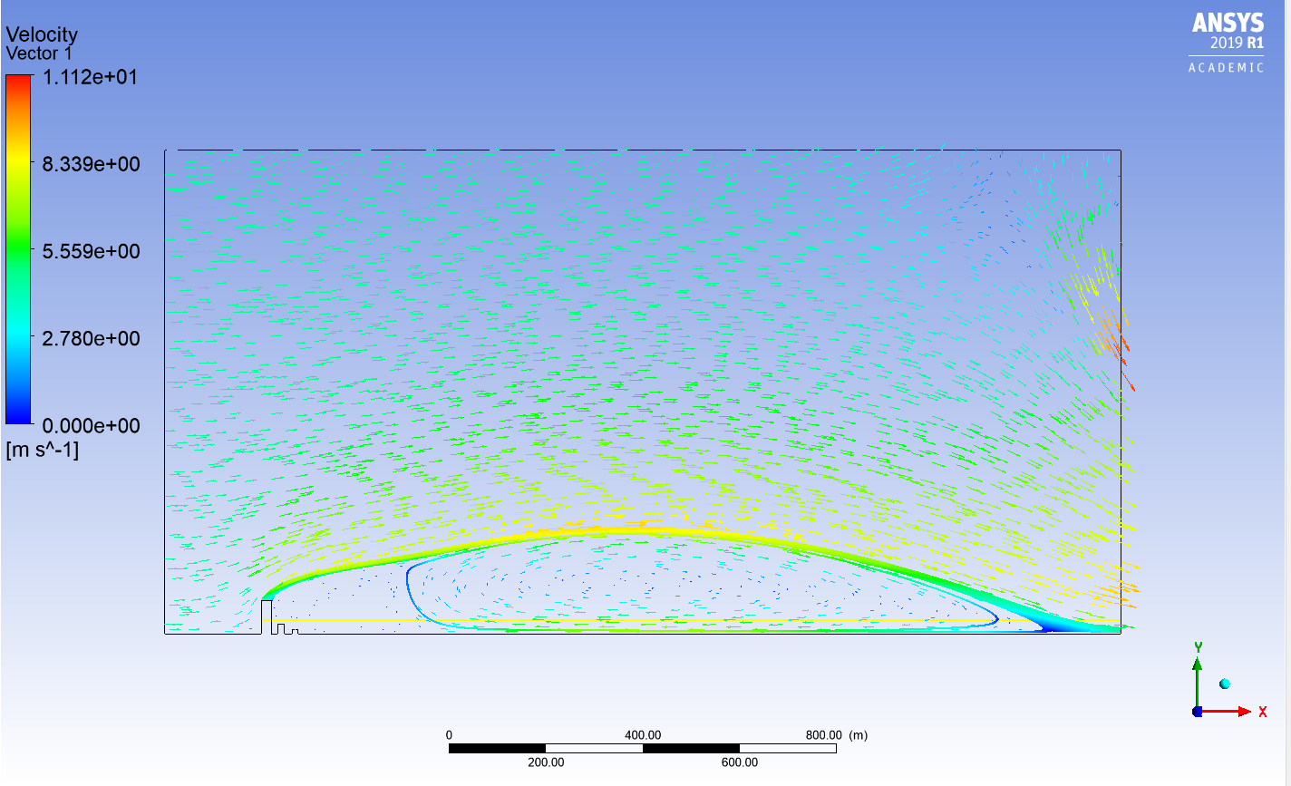
Applications in CFD in nuclear emergency response decisions
Carlos Eduardo Santos Bonfim, bonfim.carlos@eb.mil.br, Brazilian Army/IDQBRN; Tércio Brum, brum.tercio@eb.mil.br, Brazilian Army/EME; José Alberto Valle da Silva, alberto.valle@eb.mil.br, Brazilian Army/MD, Felipe Barbosa Ougano, ougano.felipe@eb.mil.br, Brazilian Army/IME, Rodrigo Carneiro Curzio, curzio.carneiro@eb.mil.br, Brazilian Army/IDQBRN
P2.4-088
CFD methododology
Environmental Impact
METHODS
Figure 9 – The most important processes affecting the transport of radionuclides released to the
atmosphere.
Fonte: IAEA (2001).
Infographic on dirty bombs or Radiological Dispersal Devices (RDDs)pdf icon
Figure 11 – Schematic representation of the flow around a cubic building - view from the central plane.
Fonte: adptade of Murakami (1993).

Slide 5
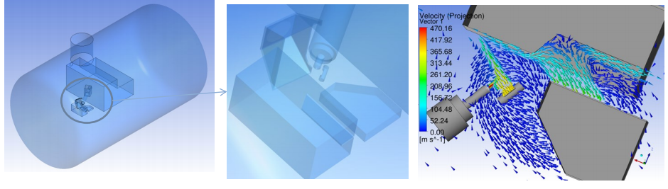
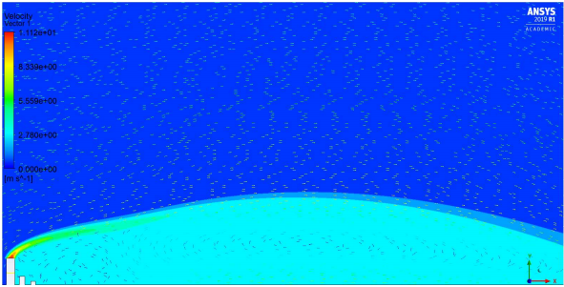
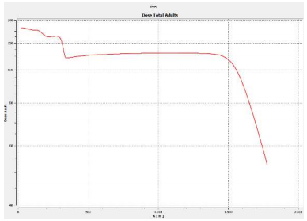
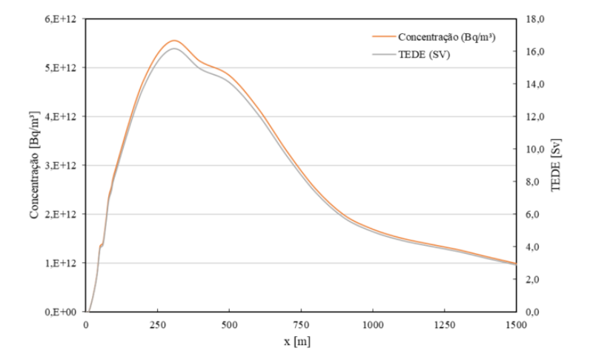
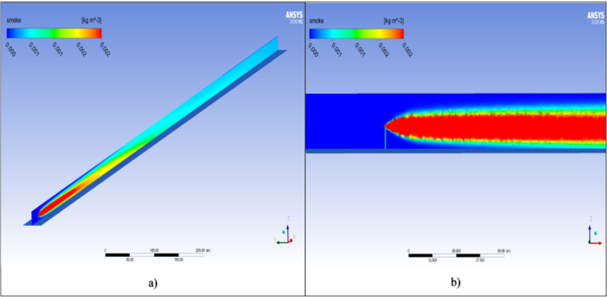
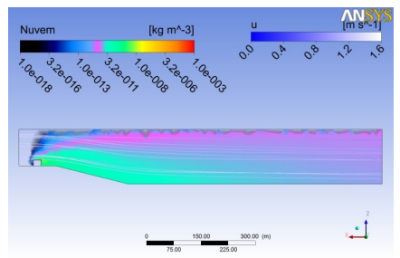
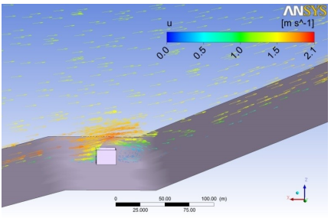
Applications in CFD in nuclear emergency response decisions
Carlos Eduardo Santos Bonfim, bonfim.carlos@eb.mil.br, Brazilian Army/IDQBRN; Tércio Brum, brum.tercio@eb.mil.br, Brazilian Army/EME; José Alberto Valle da Silva, alberto.valle@eb.mil.br, Brazilian Army/MD, Felipe Barbosa Ougano, ougano.felipe@eb.mil.br, Brazilian Army/IME, Rodrigo Carneiro Curzio, curzio.carneiro@eb.mil.br, Brazilian Army/IDQBRN
P2.4-088
Development and validation of an agglomeration model for CFD simulations of aerosol dispersion in the frame of Fukushima fuel debris retrieval.
https://doi.org/10.1080/00223131.2020.1862717
Use of CFD by IDQBRN for Radiological Defense Using CTBTO Radionuclide Measurements.
https://iopscience.iop.org/article/10.1088/1742-6596/1826/1/012060
RESULTS
Determination of the shield for protection against radiation arising from atmospheric dispersion caused by radiological event
Atmospheric radionuclide dispersion and dose calculation due to the fall of low and medium level radiation packages
https://inis.iaea.org/collection/NCLCollectionStore/_Public/49/107/49107756.pdf

Slide 6
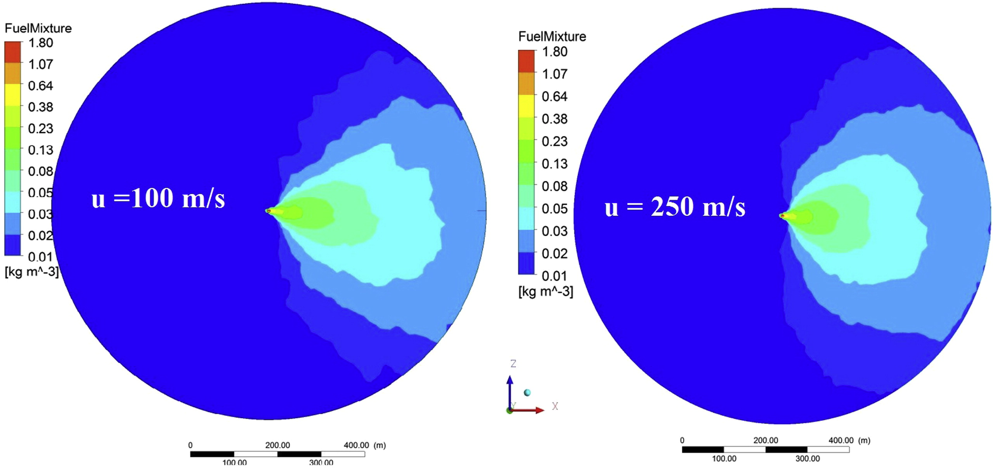
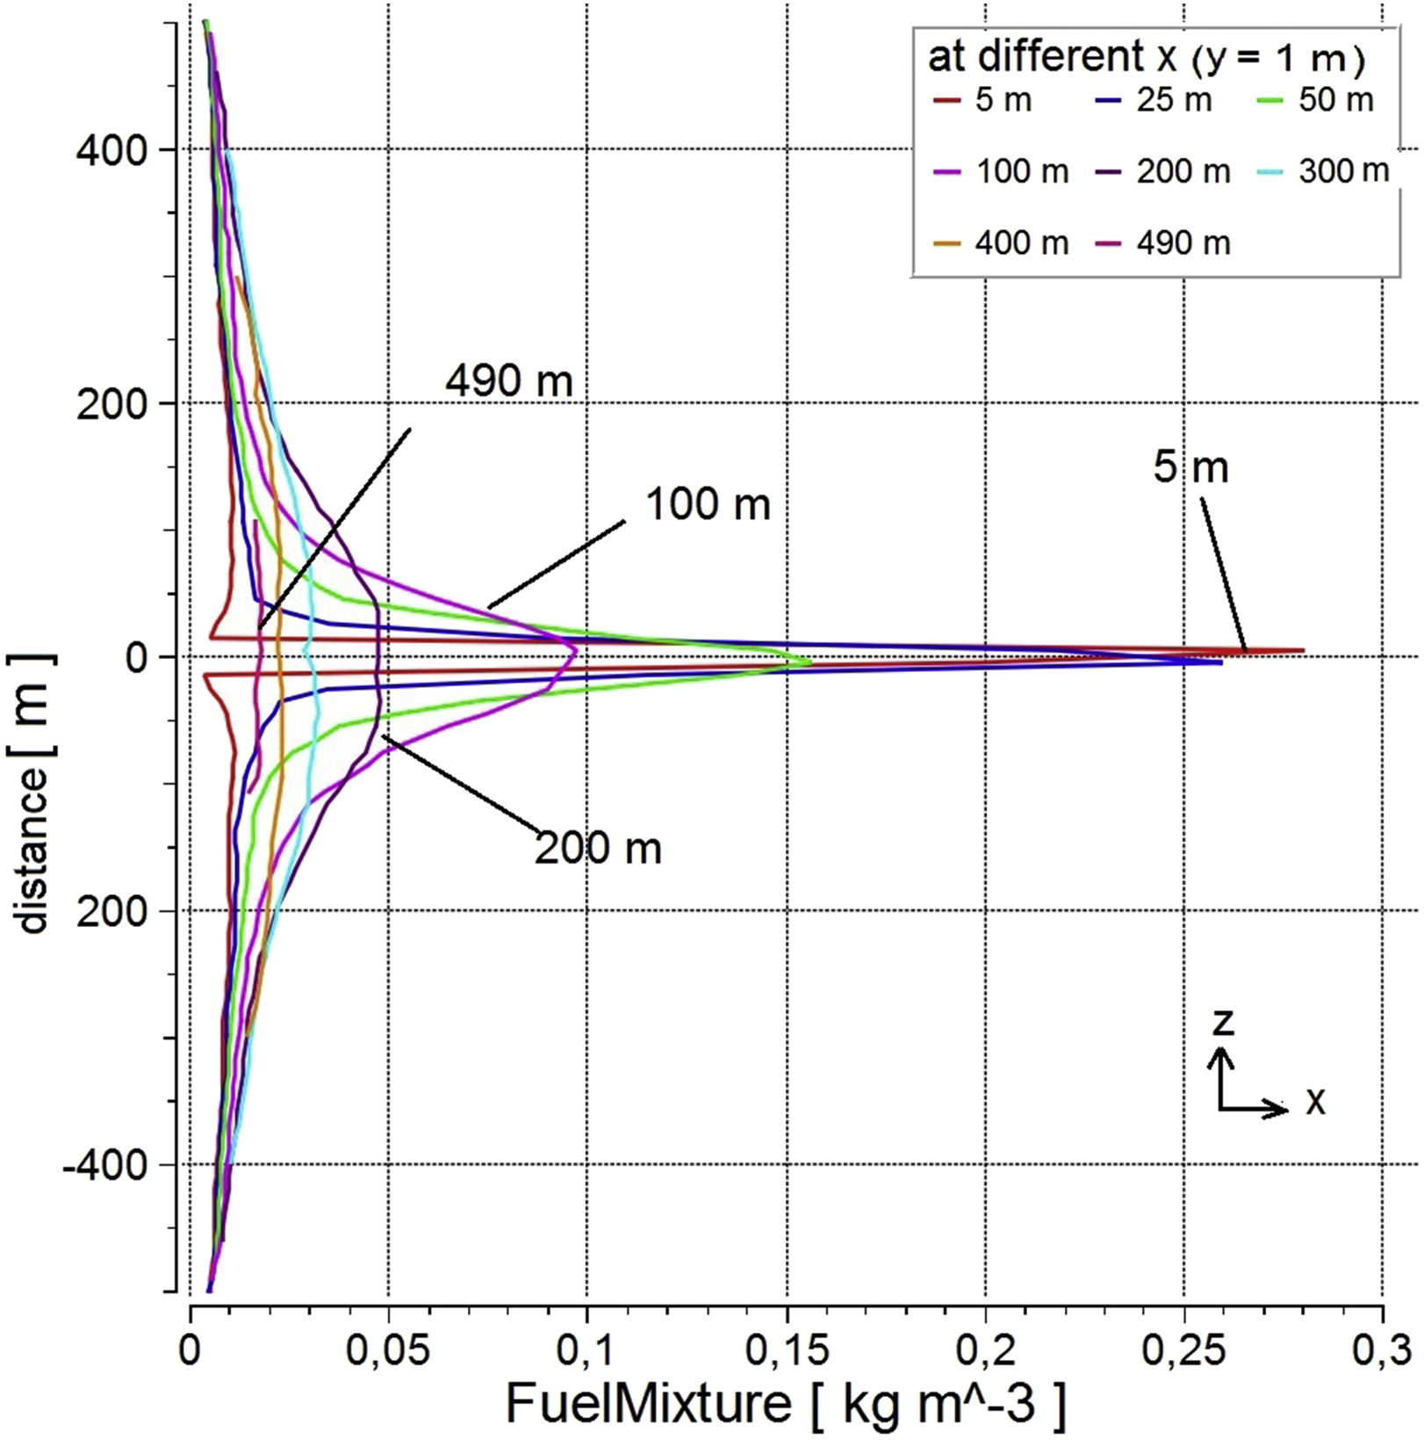
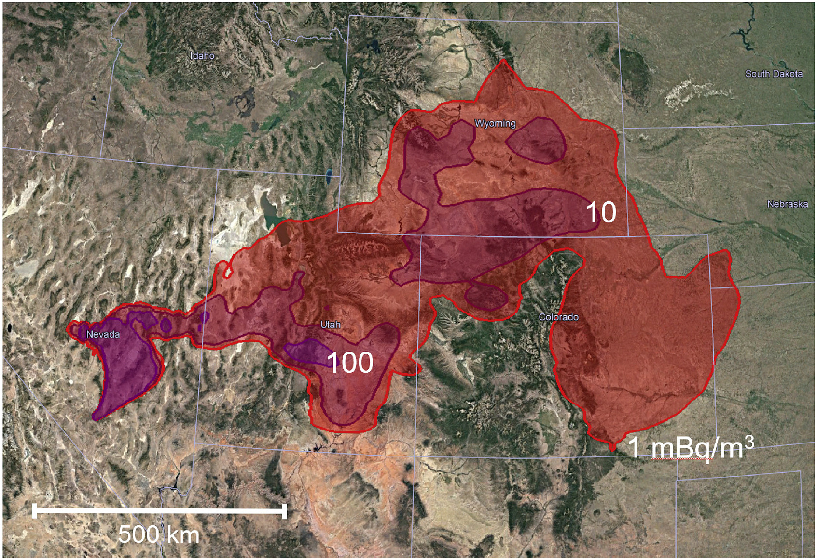
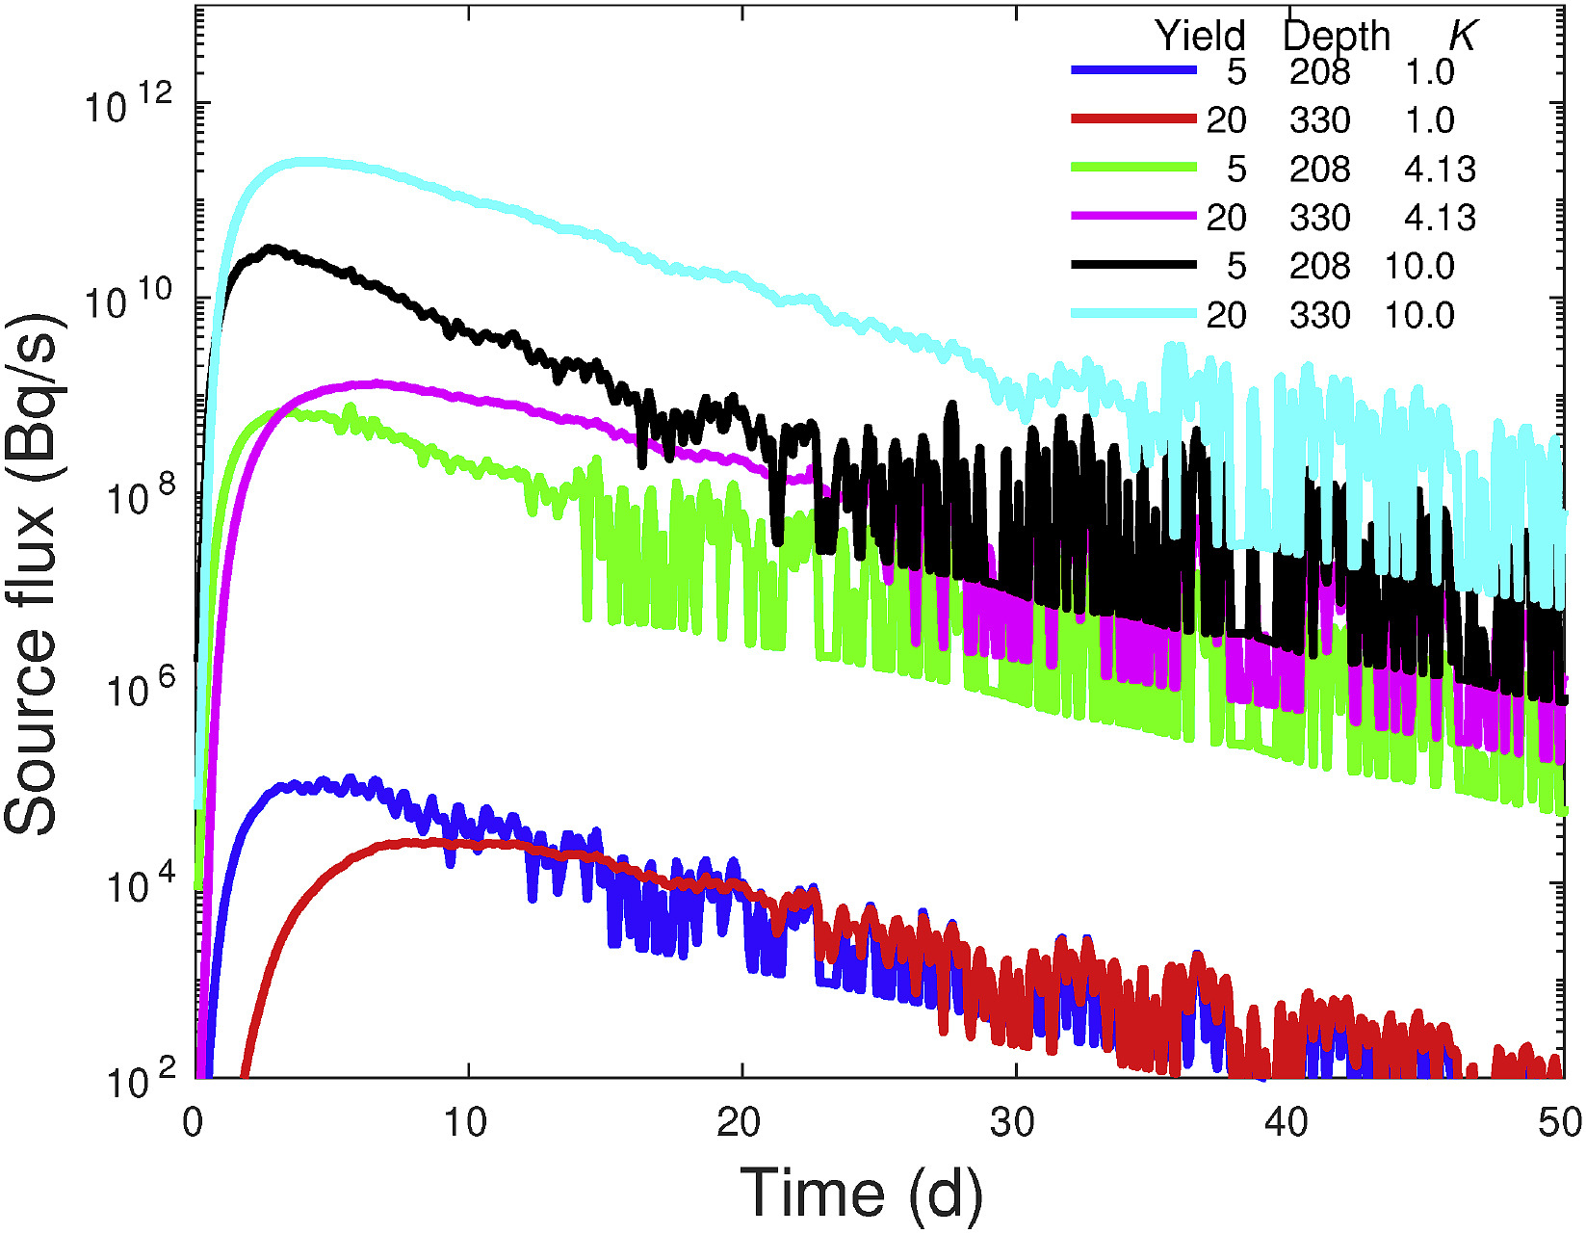
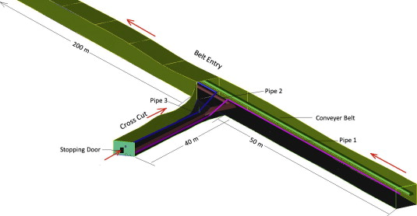
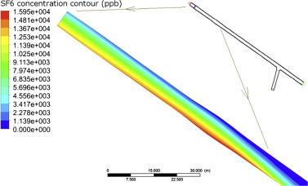
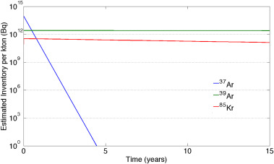
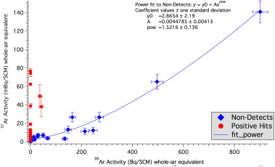
Applications in CFD in nuclear emergency response decisions
Carlos Eduardo Santos Bonfim, bonfim.carlos@eb.mil.br, Brazilian Army/IDQBRN; Tércio Brum, brum.tercio@eb.mil.br, Brazilian Army/EME; José Alberto Valle da Silva, alberto.valle@eb.mil.br, Brazilian Army/MD, Felipe Barbosa Ougano, ougano.felipe@eb.mil.br, Brazilian Army/IME, Rodrigo Carneiro Curzio, curzio.carneiro@eb.mil.br, Brazilian Army/IDQBRN
P2.4-088
Underground gas pipeline explosion and fire: CFD based assessment of foreseeability.
https://doi.org/10.1016/j.jngse.2015.04.010
The characteristic release of noble gases from an underground nuclear explosion.
https://doi.org/10.1016/j.jenvrad.2018.10.015
CONCLUSIONS
Remote characterization of ventilation systems using tracer gas and CFD in an underground mine.
https://doi.org/10.1016/j.ssci.2015.01.004
Measurements of Argon-39 at the U20az underground nuclear explosion site.
https://doi.org/10.1016/j.jenvrad.2017.07.013

Slide 7
Applications in CFD in nuclear emergency response decisions
Carlos Eduardo Santos Bonfim, bonfim.carlos@eb.mil.br, Brazilian Army/IDQBRN; Tércio Brum, brum.tercio@eb.mil.br, Brazilian Army/EME; José Alberto Valle da Silva, alberto.valle@eb.mil.br, Brazilian Army/MD, Felipe Barbosa Ougano, ougano.felipe@eb.mil.br, Brazilian Army/IME, Rodrigo Carneiro Curzio, curzio.carneiro@eb.mil.br, Brazilian Army/IDQBRN
P2.4-088
Most of the models traditionally used in the study of radionuclide scattering are the Gaussian Plume models, which do not involve solving flow equations. Its success in the mesoscale range (2–2000 km) depends on the use of well-tuned parameters that are selected according to predefined weather conditions. However, because they do not model flow directly, they are not suited to dealing with turbulence that is generated locally from the interaction of wind with buildings, terrain, and the convective forces of the released material flow;
In cases of underground detonation, the use of computational fluid dynamics (CFD) to calculate atmospheric dispersion is a tool that allows, when well adjusted, to calculate the mass flow in relation to yields, detonation depths, and different permeabilities;
In conjunction with laboratory experiments, on-site experiments, CFD studies can be performed to examine the methodology using tracer gas to remotely analyze underground nuclear explosion systems, based on radioxenon surface calculation.
CONCLUSIONS

Slide 8
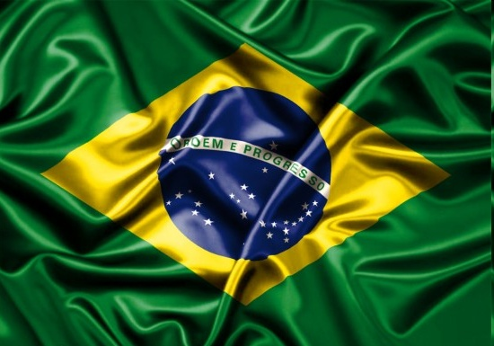
P2.4-088
Obrigado!
Thank you
Cap Bonfim
IDQBRN Army Officer
+ 55 21 2410-6301/6302
bonfim.carlos@eb.mil.br

