Slide 1


Characterization of radioxenon global background between 2015 and 2020
Sayed A. Mekhaimer and M. Elbahrawy
P2.4-421
National Data Center – Egypt
National Research Institute For Astronomy And Geophysics

Slide 2
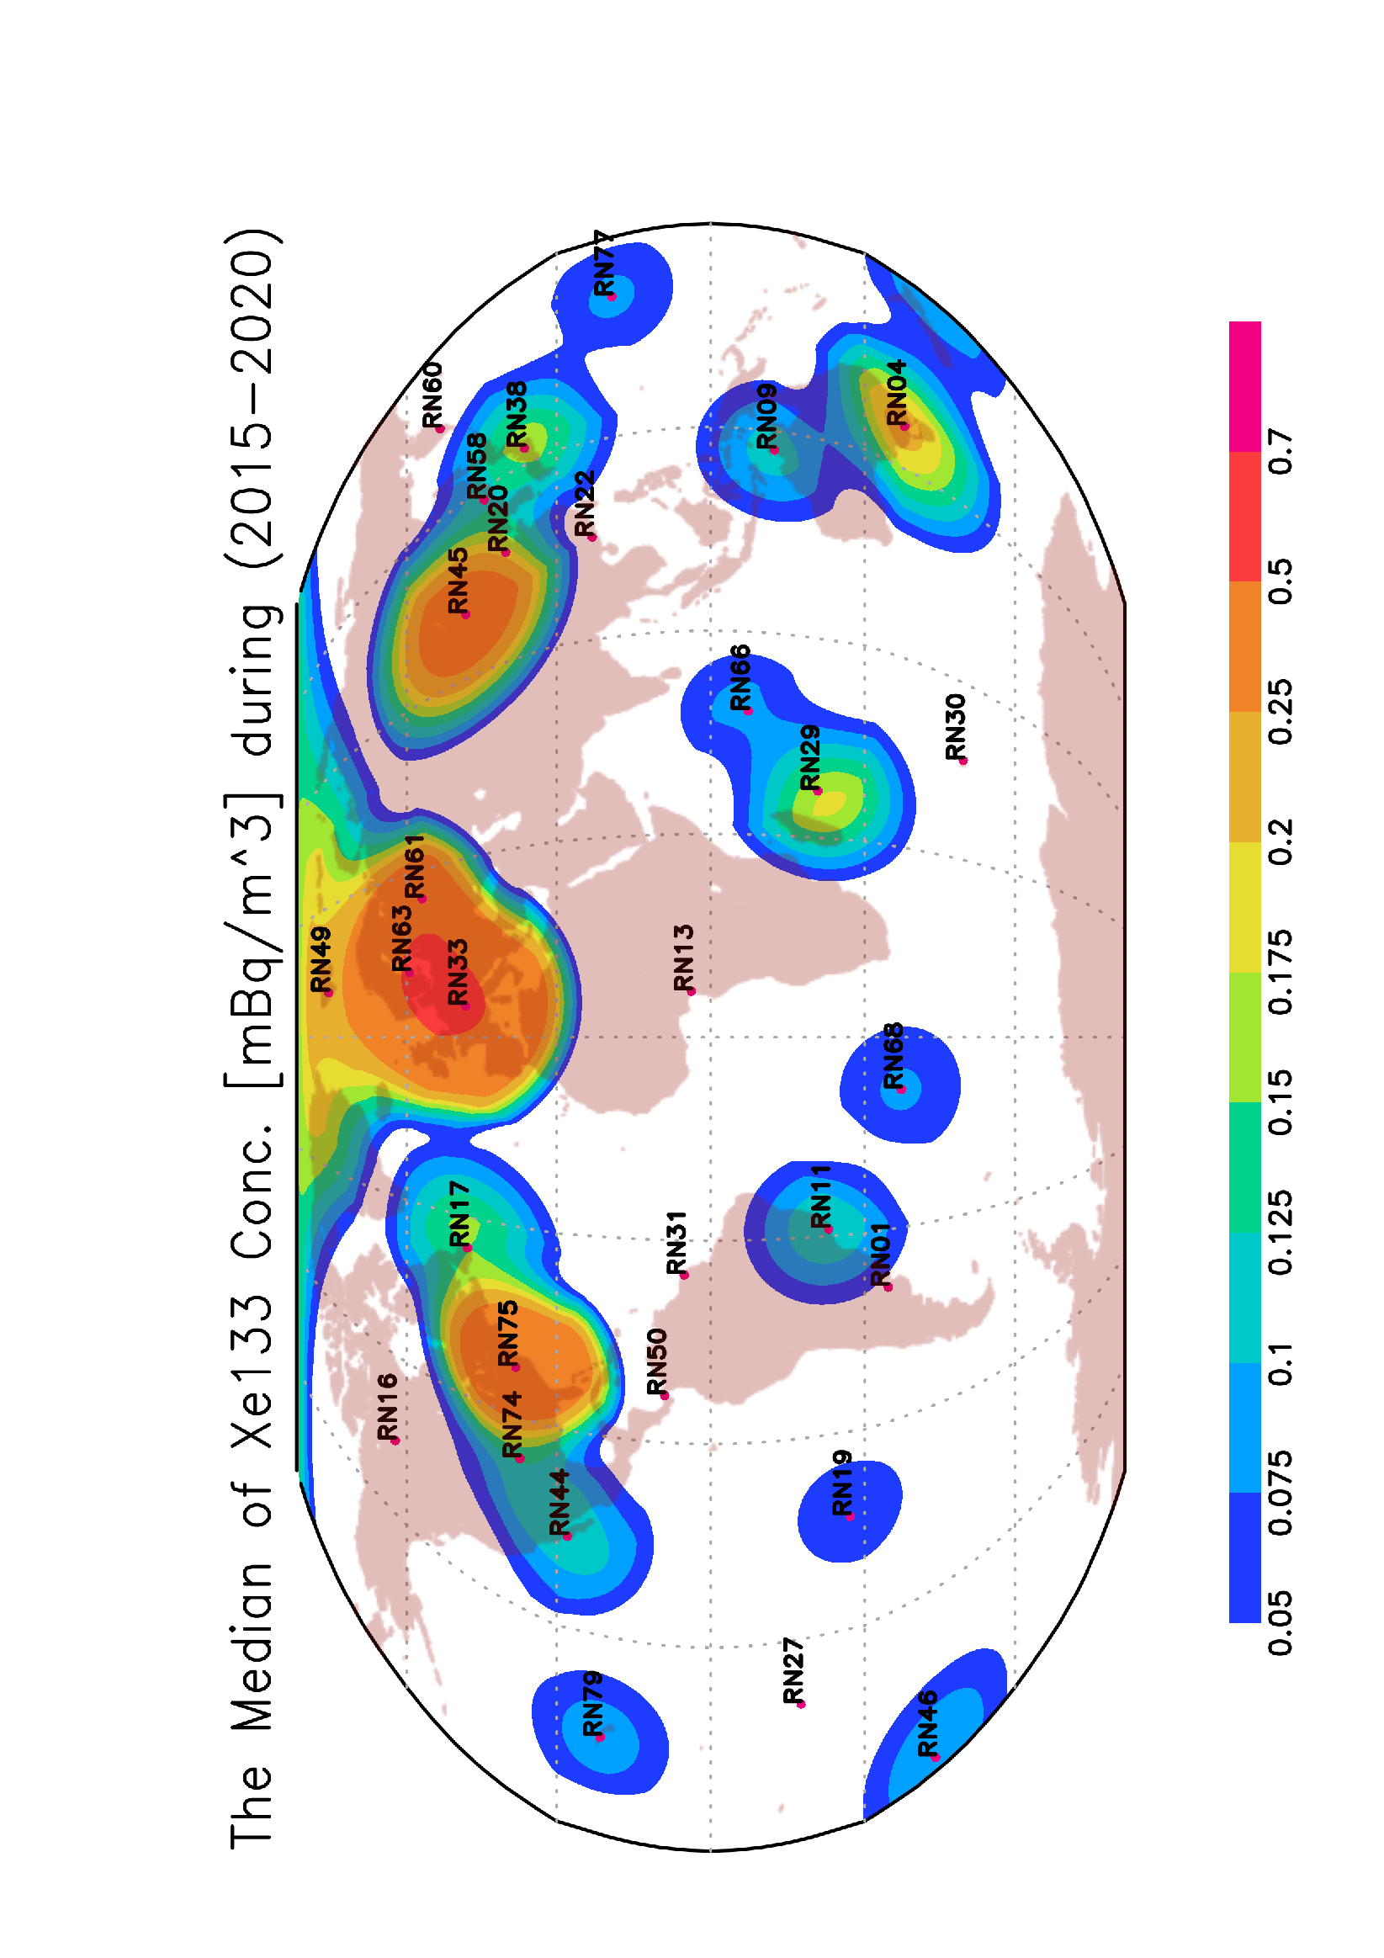
Characterization of radioxenon global background between 2015 and 2020
Sayed A. Mekhaimr and M. Elbahrawy
National Data Center, National Research Institute For Astronomy And Geophysics, Cairo, Egypt.
P2.4-421
Four Xe isotopes measuring frequency from 2015 to 2020
The categories of the four Xe isotopes from 2015 to 2020
Samples | Xe | Multi Xe
11629 | 5455 (46.9%) | 1231 (10.6%)
13368 | 6246 (46.7%) | 1417 (10.6%)
13397 | 6428 (48%) | 1732 (12.9%)
13520 | 6289 (46.5%) | 1597 (11.8%)
13592 | 6077 (44.7%) | 1770 (13%)
12701 | 4954 (39%) | 1323 (10.4%)
78207 | 35449 (45.3%) | 9070 (11.6%)
133, 131m, 133m, 135 | 133, 131m, 135 | 131m, 133m, 135 | 133,131m, 133m | 133, 133m,135
8 | 21 | 26 | 90 | 19
6 | 20 | 21 | 89 | 23
13 | 33 | 25 | 160 | 35
11 | 28 | 37 | 138 | 14
115 | 55 | 34 | 184 | 50
93 | 53 | 39 | 87 | 71
246 | 210 | 182 | 748 | 212
2015
2016
2017
2018
2019
2020
Total
 | 2015 | 2016 | 2017 | 2018 | 2019 | 2020 | Total
Total | 3325 (28.6%) | 3702 (27.7%) | 3568 (26.6%) | 3372 (24.9%) | 3398 (25%) | 3112 (24.5%) | 20477 (26.2%)
B | 3007 | 3280 | 3083 | 2889 | 3009 | 2830 | 18098
C | 318 | 422 | 485 | 483 | 389 | 282 | 2379
Total | 1563 (13.4%) | 1854 (13.9%) | 2336 (17.3%) | 2140 (15.8%) | 2059 (15.2%) | 1241 (9.8%) | 11193 (14.1%)
B | 1523 | 1817 | 2211 | 2063 | 1933 | 1159 | 10706
C | 40 | 37 | 125 | 77 | 126 | 82 | 487
Total | 1251 (10.8%) | 1452 (10.7%) | 1562 (11.7%) | 1660 (12.3%) | 1763 (13%) | 1203 (9.5%) | 8891 (13.6%)
B | 1201 | 1388 | 1494 | 1571 | 1631 | 1127 | 8412
C | 50 | 64 | 68 | 89 | 132 | 76 | 479
Total | 719 (6.2%) | 820 (6.1%) | 973 (7.3%) | 953 (7%) | 1180 (8.7%) | 1157 (9.1%) | 5802 (8.9%)
B | 709 | 814 | 955 | 940 | 1142 | 1129 | 5689
C | 10 | 6 | 18 | 13 | 38 | 28 | 113
Xe133
2015
2016
Xe131m
2017
2018
Xe133m
2019
2020
Xe135
Total
Xe-133 concentration during 2015 - 2020
Geographical distribution of the median value of Xe-133 during 2015 – 2020
Disclaimer: The contributing authors are members of National Research Institute of Astronomy and Geophysics (NRIAG). The opinions expressed here are their own and are not necessarily representative of the views of NRIAG, or any other party. Individual posts are not edited or moderated in advance by anyone but the individual authors.

Slide 3
Characterization of radioxenon global background between 2015 and 2020
Sayed A. Mekhaimr and M. Elbahrawy
National Data Center, National Research Institute For Astronomy And Geophysics, Cairo, Egypt.
P2.4-421
Abstract
Worldwide monitoring of radioxenon is a necessary component of the International Monitoring System (IMS) of the Comprehensive Nuclear-Test-Ban Treaty (CTBT). The current IMS design foresees 40 radioxenon stations around the world to provide a 90 % detectability of a 1 kt nuclear explosions within 14 days. Radioxenon stations have the capability to measure four radioxenon isotopes; 131mXe, 133Xe, 133mXe, and 135Xe. The discrimination between radioxenon emission from civil sources and xenon released from a nuclear explosion is achieved by analyzing different ratios between the four xenon isotopes. In the present work, we systematically study the development of the four Xe isotopes background between 2015 and 2020, and its geographical distribution according to the IMS stations.
ABSTRACT
Disclaimer: The contributing authors are members of National Research Institute of Astronomy and Geophysics (NRIAG). The opinions expressed here are their own and are not necessarily representative of the views of NRIAG, or any other party. Individual posts are not edited or moderated in advance by anyone but the individual authors.

Slide 4
Characterization of radioxenon global background between 2015 and 2020
Sayed A. Mekhaimr and M. Elbahrawy
National Data Center, National Research Institute For Astronomy And Geophysics, Cairo, Egypt.
P2.4-421
Four of the xenon isotopes are of interest for CTBT verification; ^{131m}Xe, ^{133m}Xe, ¹³³Xe and ¹³⁵Xe.
In a nuclear explosion, the four isotopes are produced in sufficient quantities and have half‐live times long enough to allow an appreciable amount to travel and reach IMS radioxenon stations.
Monitoring of nuclear explosions can be affected by man-made background of radioxenon created from NPP and MIPF.
INTRODUCTION
IMS noble gas stations: unique network to measure and understand global Xenon background.
Disclaimer: The contributing authors are members of National Research Institute of Astronomy and Geophysics (NRIAG). The opinions expressed here are their own and are not necessarily representative of the views of NRIAG, or any other party. Individual posts are not edited or moderated in advance by anyone but the individual authors.

Slide 5
Characterization of radioxenon global background between 2015 and 2020
Sayed A. Mekhaimr and M. Elbahrawy
National Data Center, National Research Institute For Astronomy And Geophysics, Cairo, Egypt.
P2.4-421
The development of the activity and the geographical distribution of the four Xe isotopes is studied depending on data collected by the international monitoring system (IMS) from 2015 to 2020
Four Xe isotopes measuring frequency and the simultaneous measurement of different Xe isotopes from 2015 to 2020
Total Number of samples: 78207
Total Number of samples with at least one Xe isotope: 35449
METHODS
Samples | Xe | Multi Xe
11629 | 5455 (46.9%) | 1231 (10.6%)
13368 | 6246 (46.7%) | 1417 (10.6%)
13397 | 6428 (48%) | 1732 (12.9%)
13520 | 6289 (46.5%) | 1597 (11.8%)
13592 | 6077 (44.7%) | 1770 (13%)
12701 | 4954 (39%) | 1323 (10.4%)
78207 | 35449 (45.3%) | 9070 (11.6%)
2015
2016
2017
2018
2019
2020
Total
Disclaimer: The contributing authors are members of National Research Institute of Astronomy and Geophysics (NRIAG). The opinions expressed here are their own and are not necessarily representative of the views of NRIAG, or any other party. Individual posts are not edited or moderated in advance by anyone but the individual authors.

Slide 6
Characterization of radioxenon global background between 2015 and 2020
Sayed A. Mekhaimr and M. Elbahrawy
National Data Center, National Research Institute For Astronomy And Geophysics, Cairo, Egypt.
P2.4-421
2015 – 2020
The Simultaneous measurement of:
3 or 4 isotopes: 1598 samples
133,131,133m: 748 samples.
133m,131m,135: 182 samples.
RESULTS
Samples | Xe | Multi Xe
11629 | 5455 (46.9%) | 1231 (10.6%)
13368 | 6246 (46.7%) | 1417 (10.6%)
13397 | 6428 (48%) | 1732 (12.9%)
13520 | 6289 (46.5%) | 1597 (11.8%)
13592 | 6077 (44.7%) | 1770 (13%)
12701 | 4954 (39%) | 1323 (10.4%)
78207 | 35449 (45.3%) | 9070 (11.6%)
133, 131m, 133m, 135 | 133, 131m, 135 | 131m, 133m, 135 | 133,131, 133m | 133, 133m,135
8 | 21 | 26 | 90 | 19
6 | 20 | 21 | 89 | 23
13 | 33 | 25 | 160 | 35
11 | 28 | 37 | 138 | 14
115 | 55 | 34 | 184 | 50
93 | 53 | 39 | 87 | 71
246 | 210 | 182 | 748 | 212
2015
2016
2017
2018
2019
2020
Total
Disclaimer: The contributing authors are members of National Research Institute of Astronomy and Geophysics (NRIAG). The opinions expressed here are their own and are not necessarily representative of the views of NRIAG, or any other party. Individual posts are not edited or moderated in advance by anyone but the individual authors.

Slide 7
Characterization of radioxenon global background between 2015 and 2020
Sayed A. Mekhaimr and M. Elbahrawy
National Data Center, National Research Institute For Astronomy And Geophysics, Cairo, Egypt.
P2.4-421
The categories of the four Xe isotopes from 2015 to 2020
2015
2016
2017
2018
2019
2020
Total
 | 2015 | 2016 | 2017 | 2018 | 2019 | 2020 | Total
Total | 3325 (28.6%) | 3702 (27.7%) | 3568 (26.6%) | 3372 (24.9%) | 3398 (25%) | 3112 (24.5%) | 20477 (26.2%)
B | 3007 | 3280 | 3083 | 2889 | 3009 | 2830 | 18098
C | 318 | 422 | 485 | 483 | 389 | 282 | 2379
Total | 1563 (13.4%) | 1854 (13.9%) | 2336 (17.3%) | 2140 (15.8%) | 2059 (15.2%) | 1241 (9.8%) | 11193 (14.1%)
B | 1523 | 1817 | 2211 | 2063 | 1933 | 1159 | 10706
C | 40 | 37 | 125 | 77 | 126 | 82 | 487
Total | 1251 (10.8%) | 1452 (10.7%) | 1562 (11.7%) | 1660 (12.3%) | 1763 (13%) | 1203 (9.5%) | 8891 (13.6%)
B | 1201 | 1388 | 1494 | 1571 | 1631 | 1127 | 8412
C | 50 | 64 | 68 | 89 | 132 | 76 | 479
Total | 719 (6.2%) | 820 (6.1%) | 973 (7.3%) | 953 (7%) | 1180 (8.7%) | 1157 (9.1%) | 5802 (8.9%)
B | 709 | 814 | 955 | 940 | 1142 | 1129 | 5689
C | 10 | 6 | 18 | 13 | 38 | 28 | 113
Xe133
RESULTS
Xe131m
Xe133m
Xe135
Disclaimer: The contributing authors are members of National Research Institute of Astronomy and Geophysics (NRIAG). The opinions expressed here are their own and are not necessarily representative of the views of NRIAG, or any other party. Individual posts are not edited or moderated in advance by anyone but the individual authors.

Slide 8
Characterization of radioxenon global background between 2015 and 2020
Sayed A. Mekhaimr and M. Elbahrawy
National Data Center, National Research Institute For Astronomy And Geophysics, Cairo, Egypt.
P2.4-421
Xe-133 concentration during 2015 - 2020
Most of the stations have lognormal distribution.
The geographical distribution of the median values of Xe-133 concentration is consistence with the distribution of nuclear facilities (nuclear power plants, and medical isotopes facilities).
RESULTS
Disclaimer: The contributing authors are members of National Research Institute of Astronomy and Geophysics (NRIAG). The opinions expressed here are their own and are not necessarily representative of the views of NRIAG, or any other party. Individual posts are not edited or moderated in advance by anyone but the individual authors.

Slide 9
Characterization of radioxenon global background between 2015 and 2020
Sayed A. Mekhaimr and M. Elbahrawy
National Data Center, National Research Institute For Astronomy And Geophysics, Cairo, Egypt.
P2.4-421
2015 – 2020:
IMS noble gas stations: 78207 samples 35449 (45%) samples with at least one Xe isotope.
Xe-133 is the most detected Xe isotope and Xe-135 is the least detected Xe-isotope.
9070 (11.6%) samples with multi Xe isotope detection.
Only 1598 (2%) samples with 3 or 4 Xe isotopes.
The geographical distribution of Xe-133 concentration distribution of nuclear facilities.
IMS noble gas stations: unique network to measure and understand global Xenon background.
CONCLUSIONS
Disclaimer: The contributing authors are members of National Research Institute of Astronomy and Geophysics (NRIAG). The opinions expressed here are their own and are not necessarily representative of the views of NRIAG, or any other party. Individual posts are not edited or moderated in advance by anyone but the individual authors.

