Slide 1
Preliminary analysis results of ongoing temporary radioxenon background
measurement campaign in Japan
Jonathan BARÉ, Jana MEREŠOVÁ, Abdelhakim GHEDDOU, Martin KALINOWSKI
[P2.4 - 552]

Slide 2
Preliminary analysis results of ongoing temporary radioxenon background measurement campaign in Japan
Jonathan BARÉ, Jana MEREŠOVÁ, Abdelhakim GHEDDOU, Martin KALINOWSKI
P2.4-552
In 2017, the Government of Japan has decided to make a voluntary contribution to the CTBTO, with the objective of further enhancing its capabilities to detect nuclear explosions anywhere on the planet through scientific projects.
In that context, two transportable noble gas TXL-SAUNA systems were deployed in Japan:
Horonobe, Hokkaidō island,
Mutsu, Honshū island.
The systems started operating in February 2018 and March 2018, respectively.
Continued operation of the two systems is now financially supported with funding from European Union Council Decisions (EU-CD VII and EU-CD VIII).
Together with other regional IMS stations (e.g. the JPX38 station in Takasaki, Japan), this forms a temporary high-density configuration network enabling observation of the same event release at different locations (at distances of about 500 km from each other).
About 4500 samples were collected and measured during the campaign, and this number is still increasing daily. Resulting spectra are automatically sent to the IDC and processed in a non-operational database. They are routinely reviewed, and the concentrations of ^{131m}Xe, ^{133m}Xe, ¹³³Xe and ¹³⁵Xe are calculated. These data are made available for scientific studies.
ABSTRACT

Slide 3
Preliminary analysis results of ongoing temporary radioxenon background measurement campaign in Japan
Jonathan BARÉ, Jana MEREŠOVÁ, Abdelhakim GHEDDOU, Martin KALINOWSKI
P2.4-552
Xenon is a noble gas. Due to its low chemical reactivity and volatile nature, it is more likely to escape an underground nuclear test cavity than particulate matter. Its radioactive isotopes are therefore best signatures of underground nuclear explosions.
The Commission is carrying out radioxenon measurements with very sensitive systems as part of the International Monitoring System (IMS), to verify compliance with the Comprehensive Nuclear-Test-Ban Treaty (CTBT). Focus is given to four isotopes: ^{131m}Xe, ^{133m}Xe, ¹³³Xe and ¹³⁵Xe.
In routine operation, more than 500 nuclear facilities around the globe (nuclear power plants, research reactors, medical isotope production facilities, etc.) regularly release radioactive xenon. Radioxenon isotopes are then frequently observed in the IMS network.
The ability to detect nuclear explosions through noble gas (NG) measurements depends on the understanding and characterization of the dynamic atmospheric background of radioxenon (including regional patterns, variations, influences, concentrations, etc.) originating from other sources.
Without appropriate characterization of interfering background sources (including their isotopic signatures), discriminating potential of Treaty violations from civil radioxenon emissions is challenging. Field measurement campaigns are an important and pragmatic way to advance methods for the noble gas component of the IMS.
Two transportable noble gas TXL-SAUNA systems were installed in Horonobe (JPX81) and Mutsu (MUX88) in Japan and started operation in early 2018.
INTRODUCTION

Slide 4
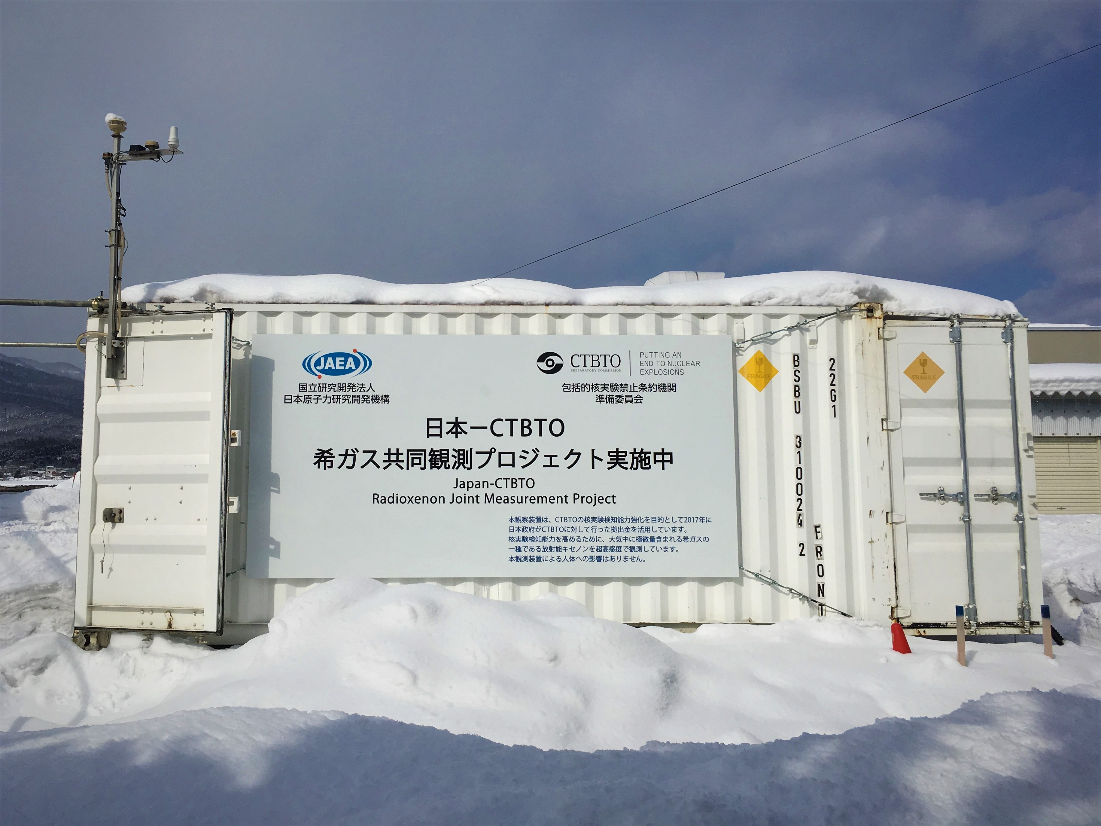
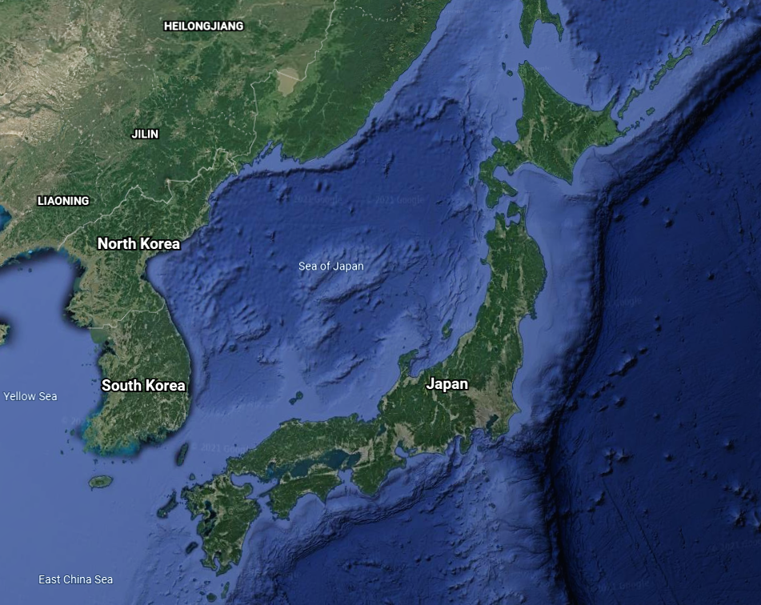
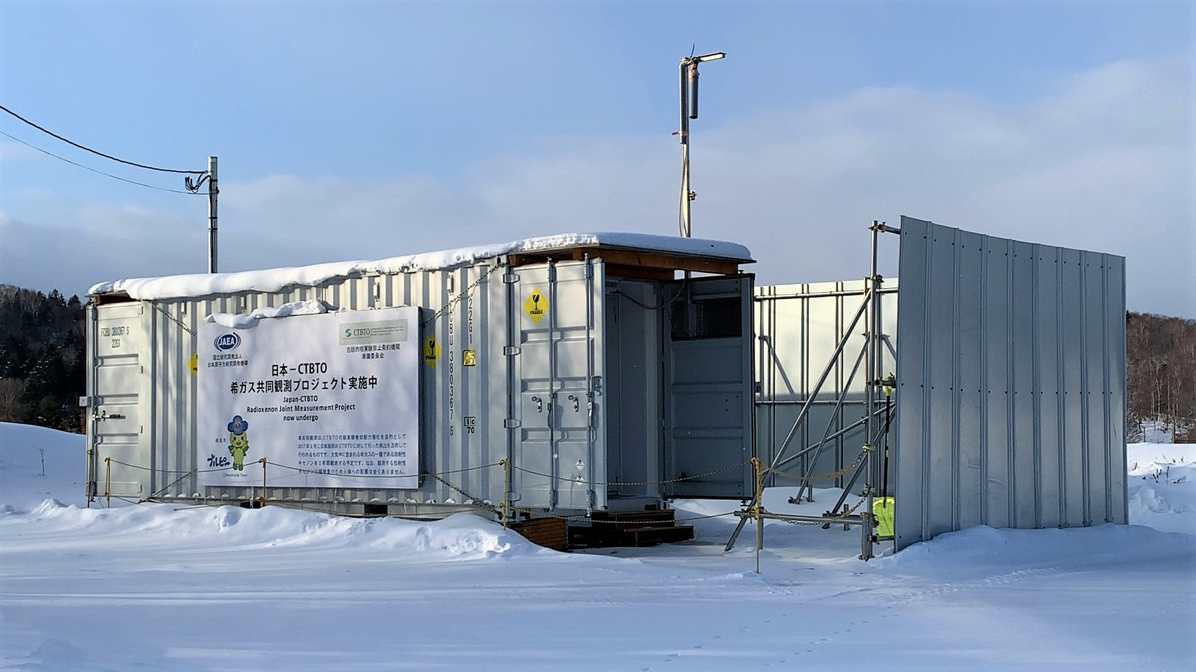
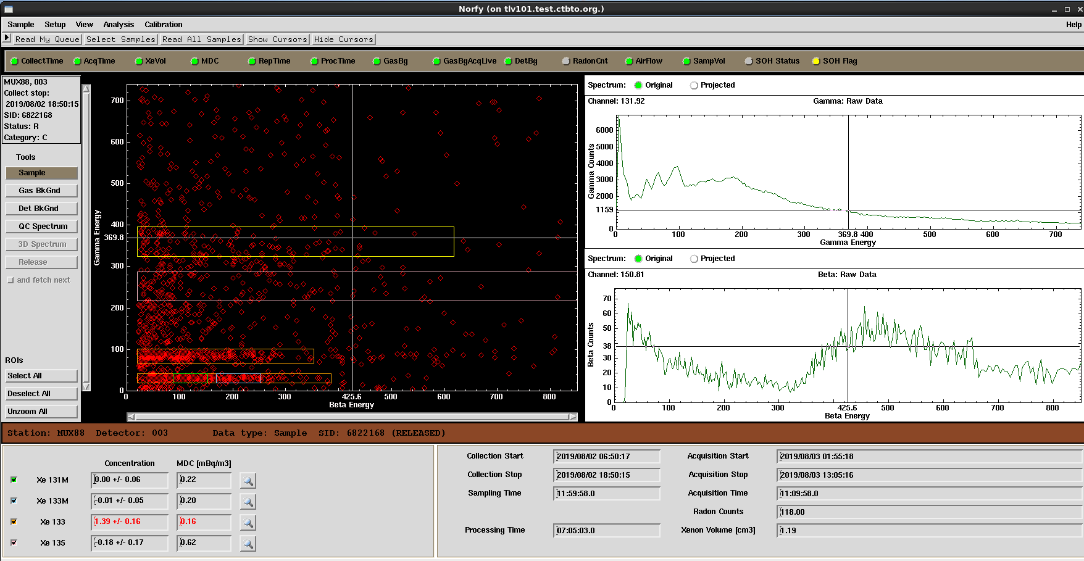
Preliminary analysis results of ongoing temporary radioxenon background measurement campaign in Japan
Jonathan BARÉ, Jana MEREŠOVÁ, Abdelhakim GHEDDOU, Martin KALINOWSKI
P2.4-552
The transportable NG measurement systems
                gtr
Horonobe
Mutsu
METHODS
MUX88, Mutsu
Data transmission started Feb. 2018
As of 31 May 2021:
1997 spectra received and processed in the IDC non-operational database
JPX81, Horonobe
Data transmission started Mar. 2018
As of 31 May 2021:
2434 spectra received, processed in the IDC non-operational database

Slide 5
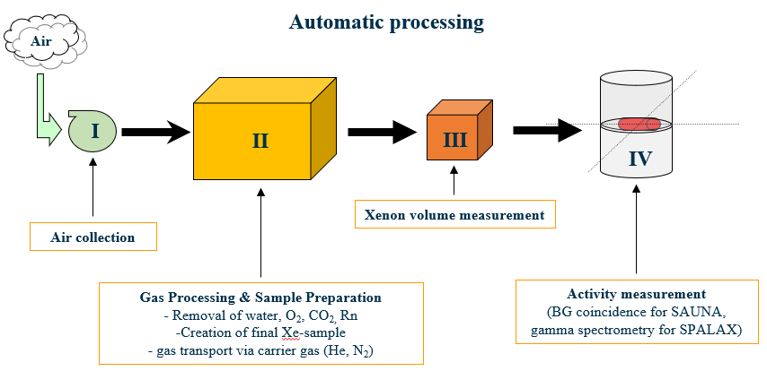
Preliminary analysis results of ongoing temporary radioxenon background measurement campaign in Japan
Jonathan BARÉ, Jana MEREŠOVÁ, Abdelhakim GHEDDOU, Martin KALINOWSKI
P2.4-552
Transportable NG measurement systems
Are based on the two currently certified IMS NG technologies,
Have identical specifications as IMS systems and meet the same minimum requirements,
Are integrated within standard ISO containers for transportation purpose,
Have auxiliary generator and UPS integrated to provide power autonomy if needed,
Provide near real-time data transmission by email.
The basic operating principle from air collection to activity measurement is as follows:
Mutsu
METHODS

Slide 6
Preliminary analysis results of ongoing temporary radioxenon background measurement campaign in Japan
Jonathan BARÉ, Jana MEREŠOVÁ, Abdelhakim GHEDDOU, Martin KALINOWSKI
P2.4-552
Basic overview of the data sets (based on sub-sets of quality-controlled data; measurements below LC were not considered)
Comments:
All 3 systems have frequent detections of ¹³³Xe and rare detections of other isotopes.
The statistics and other plots for Mutsu are limited to data with Cstop > 25 Aug. 2019. Earlier data need to be resubmitted with corrected xenon volume (which has been underestimated by 15%). The PTS is coordinating actions to have spectra files affected by this issue resubmitted to the IDC. A rough correction factor has been applied to produce the time series for MUX88.
Location | Radioisotope | Max. conc. (mBq/m³) | Mean conc. (mBq/m³) | Median conc. (mBq/m³) | Mean LC (mBq/m³) | Measurements < LC (%)
Horonobe (JPX81) | ^{131m}Xe | 0.41 | 0.06 | 0.05 | 0.05 | 79.1
 | ^{133m}Xe | 0.48 | 0.07 | 0.05 | 0.04 | 82.8
 | ¹³³Xe | 2.84 | 0.23 | 0.20 | 0.08 | 36.4
 | ¹³⁵Xe | 7.14 | 0.47 | 0.38 | 0.30 | 84.6
Mutsu (MUX88) | ^{131m}Xe | 0.26 | 0.09 | 0.07 | 0.05 | 72.3
 | ^{133m}Xe | 0.23 | 0.07 | 0.06 | 0.05 | 74.9
 | ¹³³Xe | 1.39 | 0.28 | 0.21 | 0.08 | 16.4
 | ¹³⁵Xe | 2.37 | 0.47 | 0.43 | 0.31 | 64.1
Takasaki (IMS) (JPX38) | ^{131m}Xe | 0.40 | 0.07 | 0.07 | 0.06 | 77.0
 | ^{133m}Xe | 0.24 | 0.05 | 0.06 | 0.05 | 84.1
 | ¹³³Xe | 3.11 | 0.24 | 0.17 | 0.08 | 42.6
 | ¹³⁵Xe | 1.11 | 0.48 | 0.43 | 0.38 | 94.7
RESULTS

Slide 7
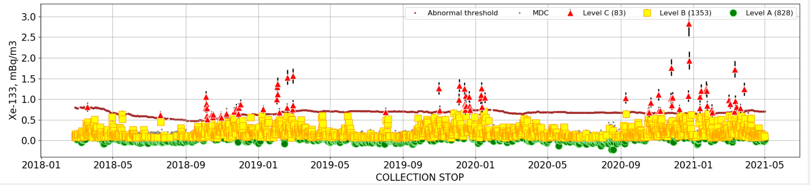
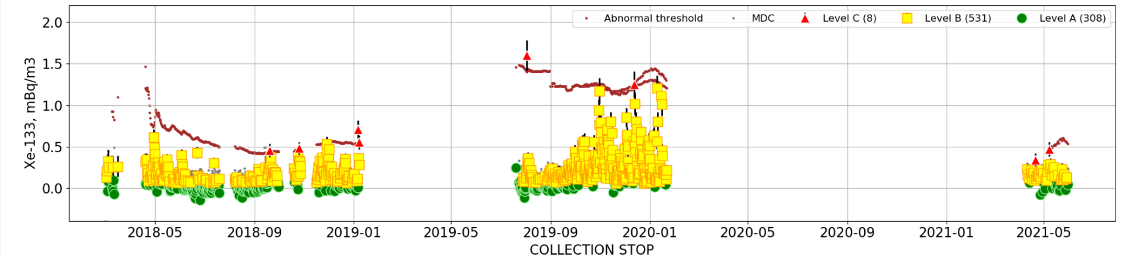
Preliminary analysis results of ongoing temporary radioxenon background measurement campaign in Japan
Jonathan BARÉ, Jana MEREŠOVÁ, Abdelhakim GHEDDOU, Martin KALINOWSKI
P2.4-552
Time series of ¹³³Xe @ JPX81
RESULTS
Time series of ¹³³Xe @ MUX88
Station down due to technical issues
Station down due to technical issues

Slide 8
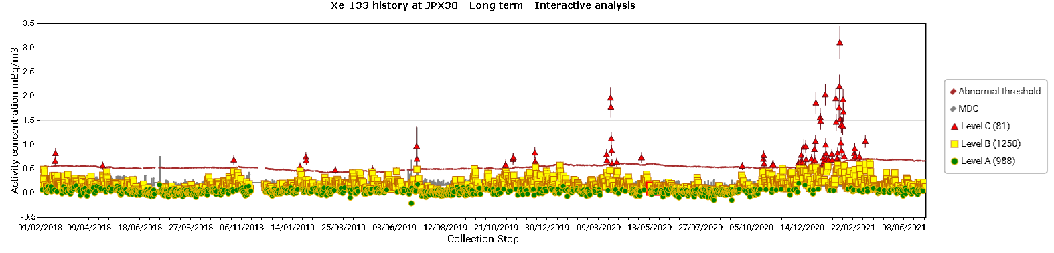
Preliminary analysis results of ongoing temporary radioxenon background measurement campaign in Japan
Jonathan BARÉ, Jana MEREŠOVÁ, Abdelhakim GHEDDOU, Martin KALINOWSKI
P2.4-552
RESULTS
Note: Time series were produced using the online RN Tool kit (https://rntoolkit.ctbto.org). This tool is available on CTBTO web portal and allows to plot data over determined periods of time for operating stations.

Slide 9
Preliminary analysis results of ongoing temporary radioxenon background measurement campaign in Japan
Jonathan BARÉ, Jana MEREŠOVÁ, Abdelhakim GHEDDOU, Martin KALINOWSKI
P2.4-552
Box and Whisker plots of the ¹³³Xe activity concentrations at Horonobe, Mutsu and Takasaki
Mutsu and Horonobe background profiles are very similar as illustrated by the median (0.20 mBq/m³ in Horonobe vs. 0.21 mBq/m³ in Mutsu) and the IQR (0.20 mBq/m³ @ Horonobe vs. 0.22 mBq/m³ @ Mutsu), even if the values are slightly shifted to the higher concentrations in Mutsu. Both the median and the IQR are smaller in Takasaki (0.17 mBq/m³ and 0.14 mBq/m³, respectively).
The background profiles in Horonobe and Takasaki are more affected by clear outliers, with detections up to 2.84 mBq/m³ in Horonobe and 3.11 mBq/m³ in Takasaki (vs. 1.39 mBq/m³ in Mutsu).
RESULTS

Slide 10
Preliminary analysis results of ongoing temporary radioxenon background measurement campaign in Japan
Jonathan BARÉ, Jana MEREŠOVÁ, Abdelhakim GHEDDOU, Martin KALINOWSKI
P2.4-552
4-isotopes (direct) ratio plots for JPX81 (red cross) / MUX88 (blue cross) / JPX38 (green cross)
The majority of detections are located in the nuclear reactor domain (left side of the plot)
Both clusters are very similar, though detections in Horonobe appear to be more sparse than in Mutsu or Takasaki
Few detections are located at the right side of the discrimination line, i.e. in the nuclear explosion domain
Graph explanation
The separation line is given in grey dashed line, dividing the plot in two specific regions: the left side for the reactor domain, and the right side for the nuclear explosion domain. In the right side of the plot, the trajectories of isotopic activity ratios as they develop with time as a result of three nuclear explosion scenarios are shown. These are fission induced by fission energy neutrons of pure ²³⁵U (red) and ²³⁹Pu (green) as well as fission by high energy neutrons of pure ²³⁸U (blue). The isotopic activity ratios at t = 0 are indicated by diamonds. The evolution of the fission products, starting at t = 0, are shown for the two extreme scenarios of continuous in-growth from the full decay chain (continuous lines) and of full fractionation, i.e. xenon gases being instantaneously separated from all pre-cursors at time t=0 (dashed lines). The typical simulation trajectories for a nuclear power plant (LWR-type) are also given (continuous purple line).
RESULTS
Kalinowski et al., “Discrimination of nuclear explosions against civilian sources based on atmospheric xenon isotopic activity ratios”. Pure and Applied Geophysics, Volume 167/4-5, pp. 517-539 (2010).

Slide 11
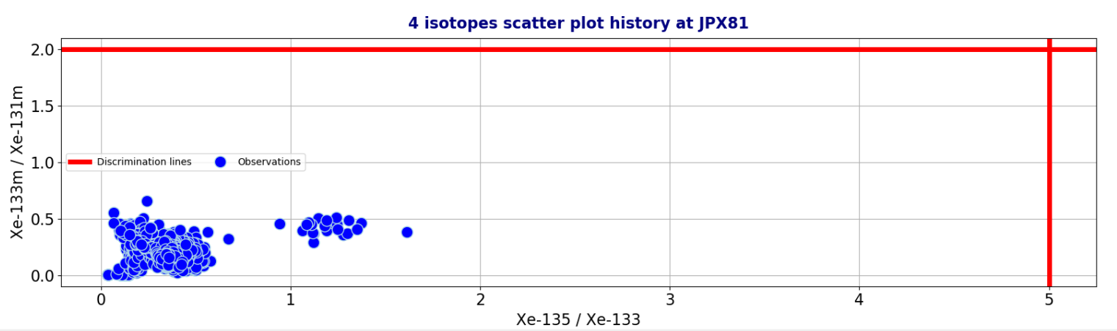
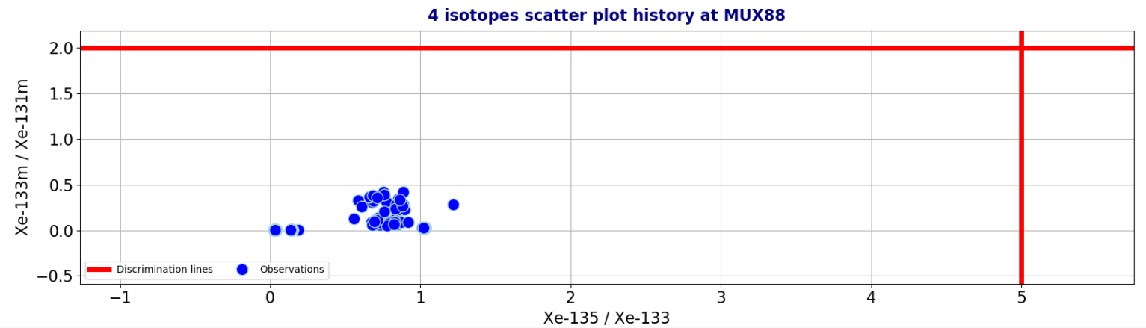
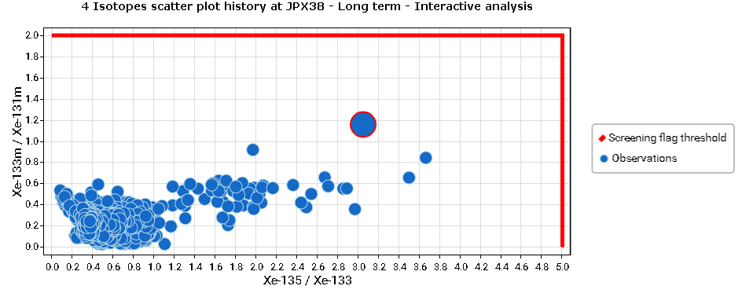
Preliminary analysis results of ongoing temporary radioxenon background measurement campaign in Japan
Jonathan BARÉ, Jana MEREŠOVÁ, Abdelhakim GHEDDOU, Martin KALINOWSKI
P2.4-552
4-isotopes (Bayesian) ratio plots for JPX81 / MUX88 / JPX38
All detections are in the nuclear reactor domain
RESULTS
Zähringer and Kirchner, “ Nuclide ratios and source identification from high-resolution gamma-ray spectra with Bayesian decision methods”. Nuclear Instruments and Methods in Physics Research Section A, Volume 594, pp. 400-406 (2008)

Slide 12
Preliminary analysis results of ongoing temporary radioxenon background measurement campaign in Japan
Jonathan BARÉ, Jana MEREŠOVÁ, Abdelhakim GHEDDOU, Martin KALINOWSKI
P2.4-552
Two transportable NG systems of the SAUNA type are currently operating in Horonobe and Mutsu, Japan. As of 31 May 2021, about 4500 samples were collected and processed in the non-operational IDC database.
Preliminary analysis of results (basic statistical overview of the quality-controlled data sets, Box-and-Whisker plots) show a very similar radioxenon background profile at both locations.
Over the studied period, ¹³³Xe has been detected more regularly in Mutsu, than in Horonobe and in Takasaki. Other radioxenon isotopes were rarely detected at all 3 stations.
The 4-isotopes Bayesian plots for all locations show that all detections are in the nuclear reactor domain.
On the direct ratio plots, few points are located in the nuclear explosion domain. Further work and investigation is needed to better understand these preliminary findings.
Further investigation is needed on the data sets – this is work in progress. This includes identifying periods of time during which the same plume was detected at all 3 locations.
CONCLUSIONS

Slide 13
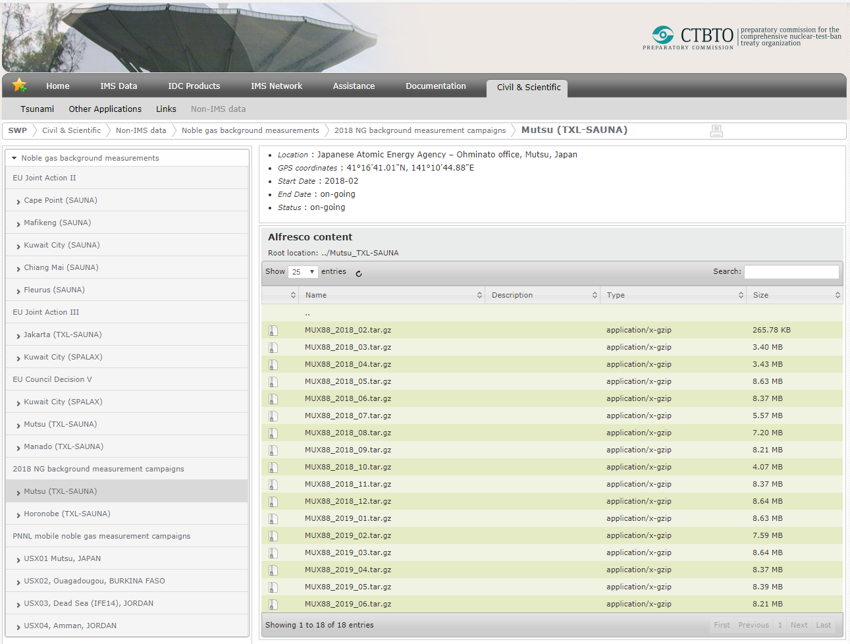
Preliminary analysis results of ongoing temporary radioxenon background measurement campaign in Japan
Jonathan BARÉ, Jana MEREŠOVÁ, Abdelhakim GHEDDOU, Martin KALINOWSKI
P2.4-552
Information about the transportable NG systems / projects is made available to authorized users of State Signatories on the CTBTO Secure Web Portal (SWP). This includes the plans, status, raw data, analysis results and conclusions (for current and past measurement campaigns)
https://swp.ctbto.org/web/swp/2018-ng-background-measurement-campaigns,
Access to this information may also be requested by the scientific
community via the CTBTO vDEC platform
http://www.ctbto.org/specials/vdec
Contact: vdec@ctbto.org
CONCLUSIONS

