Slide 1
Search for small temporal modulations of half-lives
of radionuclides in the IMS Quality Control data
Gabor David, SNARE david@bnl.gov
D. Javorsek II, United States Air Force daniel.javorsek@us.af.mil
Shaun Little, General Dynamics Shaun.Little@gd-ms.com
J. Thomas Gruenwald, SNARE Tom.Gruenwald@snareinc.com
This research was developed with funding from the Defense Advanced Research Projects Agency (DARPA).
PUTTING AN END TO NUCLEAR EXPLOSIONS
CTBTO.ORG

Slide 2



Search for small temporal modulations of half-lives of radionuclides in the IMS Quality Control data
Gabor David, SNARE david@bnl.gov
Poster No.:
T2.4-169
Abstract
Half-lives of radioisotopes have long been thought as absolute constants of Nature. However, since the 1980s several experiments indicated that small - percent or sub-percent level – temporal modulations may exist, that can be correlated to variations of the solar neutrino flux. The issue has been hotly debated by the nuclear theory community, since it would imply some new mechanism influencing weak decays, and as such, of fundamental importance for nuclear physics. One problem is that high quality data collected over extensive period of time are scarce.
As regular part of their operation, the IMS monitoring stations take so-called quality control data daily, measuring a source of known isotopes for 30 minutes. The stations are at diverse geographic locations and using standardized equipment and sources. Such data are in principle ideal to investigate long-term, small modulations of the
half-lives due to a penetrating external influence, like solar neutrinos.
We obtained and analyzed 15 years worth of quality control data from 11 IMS stations for annual and higher frequency modulations. We will present the results of this analysis, including an upper limit of the amplitude of the modulations and suggestions for the design of a future high-sensitivity experiment, dedicated to settle the issue
of temporal modulations of half-lives due to solar influence.
ABSTRACT
Disclaimer: The views, opinions and/or findings expressed are those of the author and should not be interpreted as representing the official views or policies of the Department of Defense or the U.S. Government.
Disclaimer: The views expressed on this poster are those of the author and do not necessarily reflect the view of the CTBTO

Slide 3
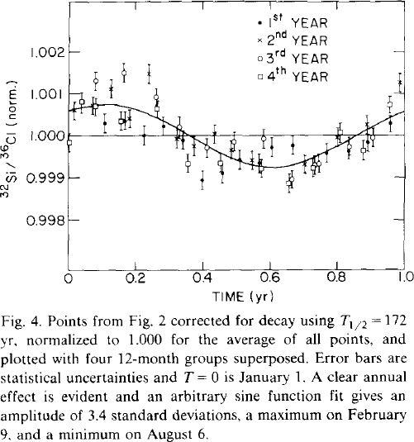
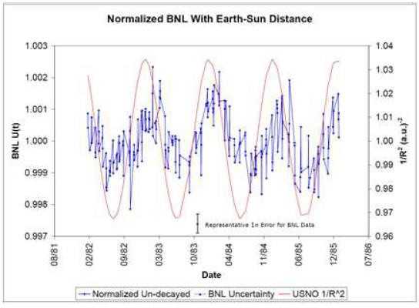
Search for small temporal modulations of half-lives of radionuclides in the IMS Quality Control data
Gabor David, SNARE david@bnl.gov
Poster No.:
T2.4-169
INTRODUCTION
Are half-lives really constant?
The issue: are half-lives of radionuclides really constant, or do at least some of them exhibit small temporal variations due to external effects?
Theoretically: several mechanisms suggested, like influence of solar neutrinos (flux changes with time!), but mostly they are phenomenological models, not ab initio calculations (yet).
Experimentally: since the first observation of a very small annual modulation in 1986,
a large number of measurements were made, some confirming, some rejecting the claim. Even where a signal is claimed, the modulation is in the 10⁻² – 10⁻⁴ range.
For a review, see arXiv:2012.00153
The same BNL data plotted with absolute dates. The superimposed red curve is the variation of the inverse square distance from the Sun. The amplitude of the modulation is 10⁻³.
Annual modulation from Alburger et al.
Earth and Planetary Sci. Lett. 78 (1986) 168-176
Disclaimer: The views, opinions and/or findings expressed are those of the author and should not be interpreted as representing the official views or policies of the Department of Defense or the U.S. Government.
Disclaimer: The views expressed on this poster are those of the author and do not necessarily reflect the view of the CTBTO

Slide 4
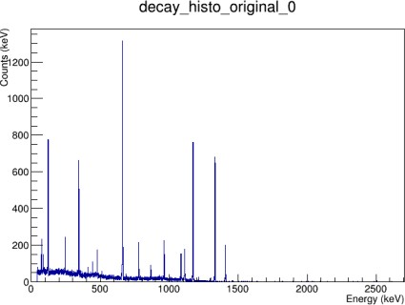
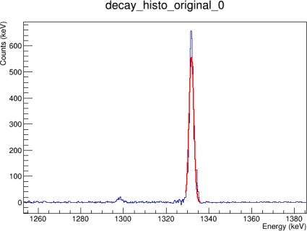
Search for small temporal modulations of half-lives of radionuclides in the IMS Quality Control data
Gabor David, SNARE david@bnl.gov
Poster No.:
T2.4-169
INTRODUCTION
An opportunity: study IMS QC data!
To study small, annual variations of half-lives long measurements are needed with very well-controlled equipment. For a search of effects from solar neutrinos multiple devices at various positions on Earth are optimal.
The QC data from select IMS stations fulfill the above conditions, so they appeared
to be a promising candidate for an opportunistic study.
Typical daily 30 minutes spectrum taken with the Quality Control (QC) source, before background subtraction
IMS mission: to identify airborne nuclides with intensity above normal background. Therefore, equipment at monitoring stations is optimized for stable gain, perfect energy measurement. Stable efficiency is less important, since spurious samples will then be analyzed in a dedicated lab, with different equipment.
To control gain-variations, each day a reference source (⁶⁰Co, ¹³⁷Cs, ¹⁵²Eu) is moved
in and measured for 30 minutes, providing very clean peaks at well-kown energies.
However, the position of the reference source is not perfectly reproduced day-to-day. This is irrelevant for the IMS mission, but it is a serious problem for our purposes.
Small variations of the source position do not affect measured line energies, but slightly change the measured daily rates (efficiency).
Region around the 1333 keV line of ⁶⁰Co
after background subtraction
Disclaimer: The views, opinions and/or findings expressed are those of the author and should not be interpreted as representing the official views or policies of the Department of Defense or the U.S. Government.
Disclaimer: The views expressed on this poster are those of the author and do not necessarily reflect the view of the CTBTO

Slide 5
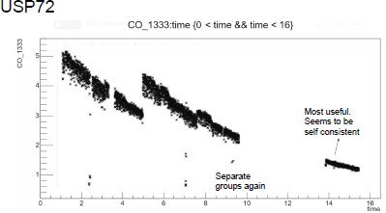
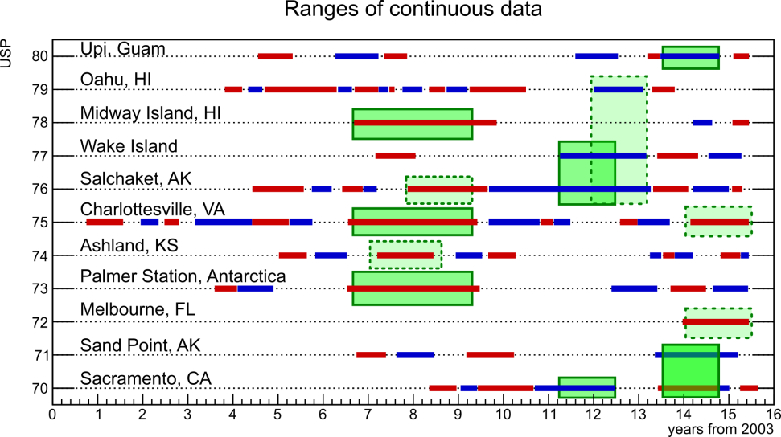
Search for small temporal modulations of half-lives of radionuclides in the IMS Quality Control data
Gabor David, SNARE david@bnl.gov
Poster No.:
T2.4-169
Geographic locations and analyzable time intervals
METHODS
Daily decay rates for the 1333 keV ⁶⁰Co line. Horizontal scale: elapsed years since Jan. 1, 2003. Even on this compressed scale one can see sudden shifts in the data, short-term variations exceeding statistical fluctuations, and downward skewed distributions (see later).
Data passing our quality assurance criteria, mostly based on ⁶⁰Co lines. Alternating red and blue indicate periods where reasonable residuals can be obtained with one single exponential fit.
Disclaimer: The views, opinions and/or findings expressed are those of the author and should not be interpreted as representing the official views or policies of the Department of Defense or the U.S. Government.
Disclaimer: The views expressed on this poster are those of the author and do not necessarily reflect the view of the CTBTO

Slide 6
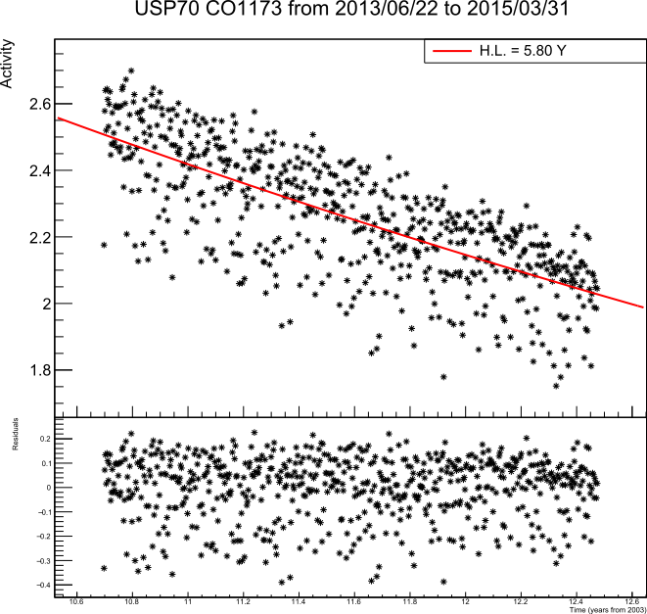
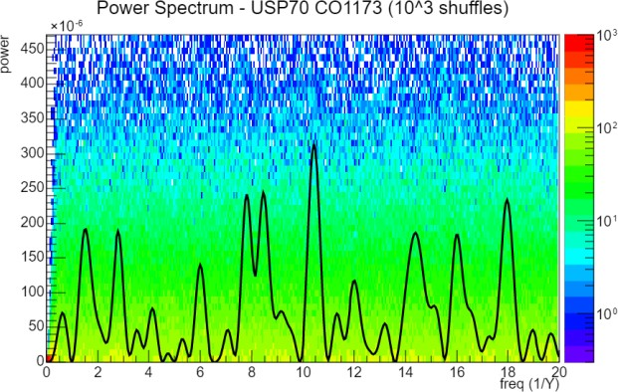
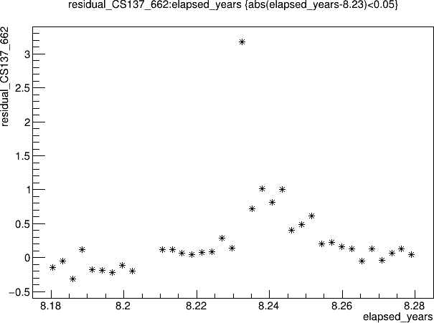
Search for small temporal modulations of half-lives of radionuclides in the IMS Quality Control data
Gabor David, SNARE david@bnl.gov
Poster No.:
T2.4-169
Decay rates, residuals, power spectra… and the Fukushima event in the QC data
METHODS
One of the isotopes in the IMS QC source is ¹³⁷Cs. This plot shows the residuals
for the 662 keV line for the days around March 11, 2011, when the Fukushima accident happened. Note the huge excess from contaminated air (USP71 station).
Daily decay rates (top) and residuals from the 1173 keV line of ⁶⁰Co at USP70. Note the sizeable downward fluctuations (residuals are a skewed, non-Gaussian distribution)
Power spectrum for the residuals of the 1173 keV line of ⁶⁰Co at USP70.
Disclaimer: The views, opinions and/or findings expressed are those of the author and should not be interpreted as representing the official views or policies of the Department of Defense or the U.S. Government.
Disclaimer: The views expressed on this poster are those of the author and do not necessarily reflect the view of the CTBTO

Slide 7
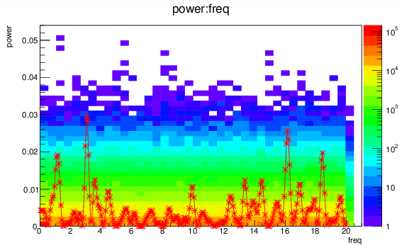
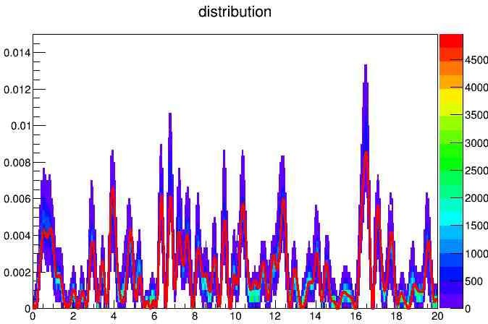
Search for small temporal modulations of half-lives of radionuclides in the IMS Quality Control data
Gabor David, SNARE david@bnl.gov
Poster No.:
T2.4-169
Spurious frequencies and powers (using real data)
METHODS
Power spectrum of an original time series (red graph) and from 10,000 shufflings (2D background, log z scale) For a given power, any frequency is produced with equal probability in shuffling (horizontal stripe structure)
Power spectrum of an original time series of residuals (red graph) and with each residual randomized with its
own statistical error, repeated 1,000 times. For a given time series, statistical fluctuations change the power, but do not introduce or make disappear spurious frequencies
Disclaimer: The views, opinions and/or findings expressed are those of the author and should not be interpreted as representing the official views or policies of the Department of Defense or the U.S. Government.
Disclaimer: The views expressed on this poster are those of the author and do not necessarily reflect the view of the CTBTO

Slide 8
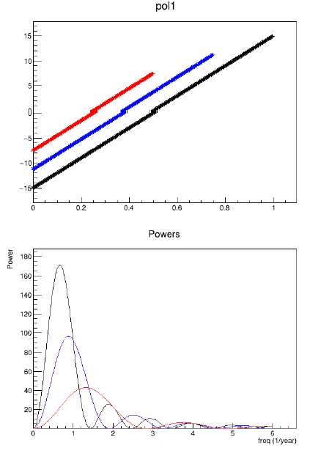
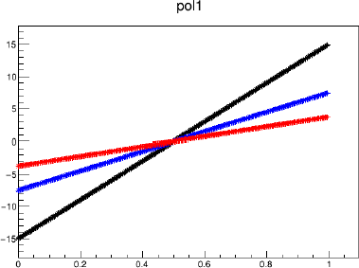
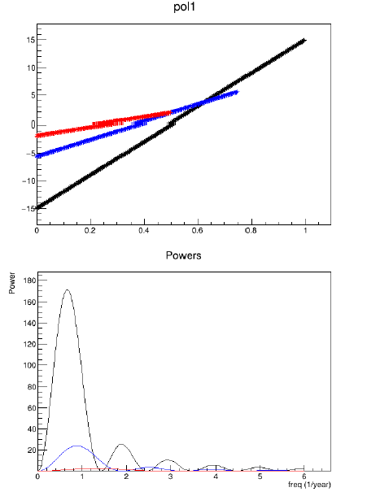
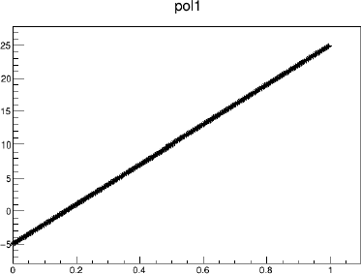
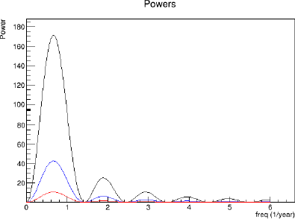
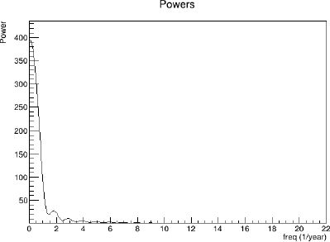
Search for small temporal modulations of half-lives of radionuclides in the IMS Quality Control data
Gabor David, SNARE david@bnl.gov
Poster No.:
T2.4-169
Simulation of the effect of small variations in detector response
METHODS
Detector drift; same slope different time interval introduces spurious frequencies inversely proportional to the length of time
Detector drift; same interval different slopes introduce
the same spurious frequencies with different power, inversely proportional to the slope
Detector drift; different intervals and slopes: the effect of the two variables factorizes.
Detector drift with a net offset (mean of residuals non-zero, which can happen for skewed distributions): a strong peak appears at zero frequency.
Disclaimer: The views, opinions and/or findings expressed are those of the author and should not be interpreted as representing the official views or policies of the Department of Defense or the U.S. Government.
Disclaimer: The views expressed on this poster are those of the author and do not necessarily reflect the view of the CTBTO

Slide 9
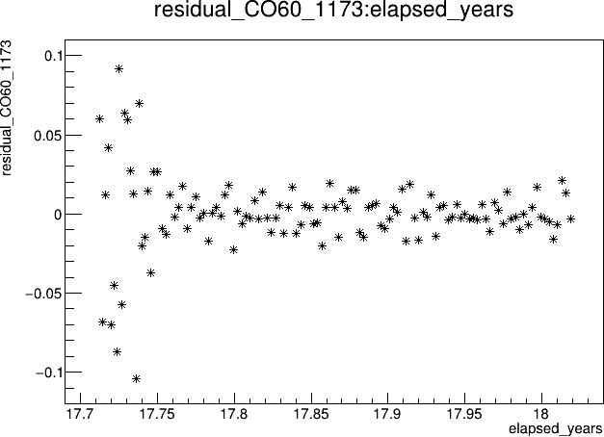
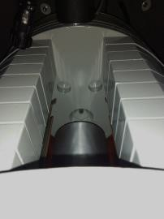
Search for small temporal modulations of half-lives of radionuclides in the IMS Quality Control data
Gabor David, SNARE david@bnl.gov
Poster No.:
T2.4-169
Detector study: a control experiment (TVD01)
Control experiment: TVD01 (thanks to General Dynamics MS!) 4 months of data taking with IMS QC source
First two weeks: the source is regularly moved in and out
Rest of the time: the source is left in place
QC source is behind the collimator, moved vertically in and out
METHODS
Residuals for the 1173 keV ⁶⁰Co line at TVD01. In the first two weeks the source was moved in and out daily, then left in a stable position for the rest of the time → the day-to-day fluctuations become almost purely statistical.
HPGe detector assembly
Cartoon: imperfect positioning changes the detector acceptance (measured rates!)
Disclaimer: The views, opinions and/or findings expressed are those of the author and should not be interpreted as representing the official views or policies of the Department of Defense or the U.S. Government.
Disclaimer: The views expressed on this poster are those of the author and do not necessarily reflect the view of the CTBTO

Slide 10
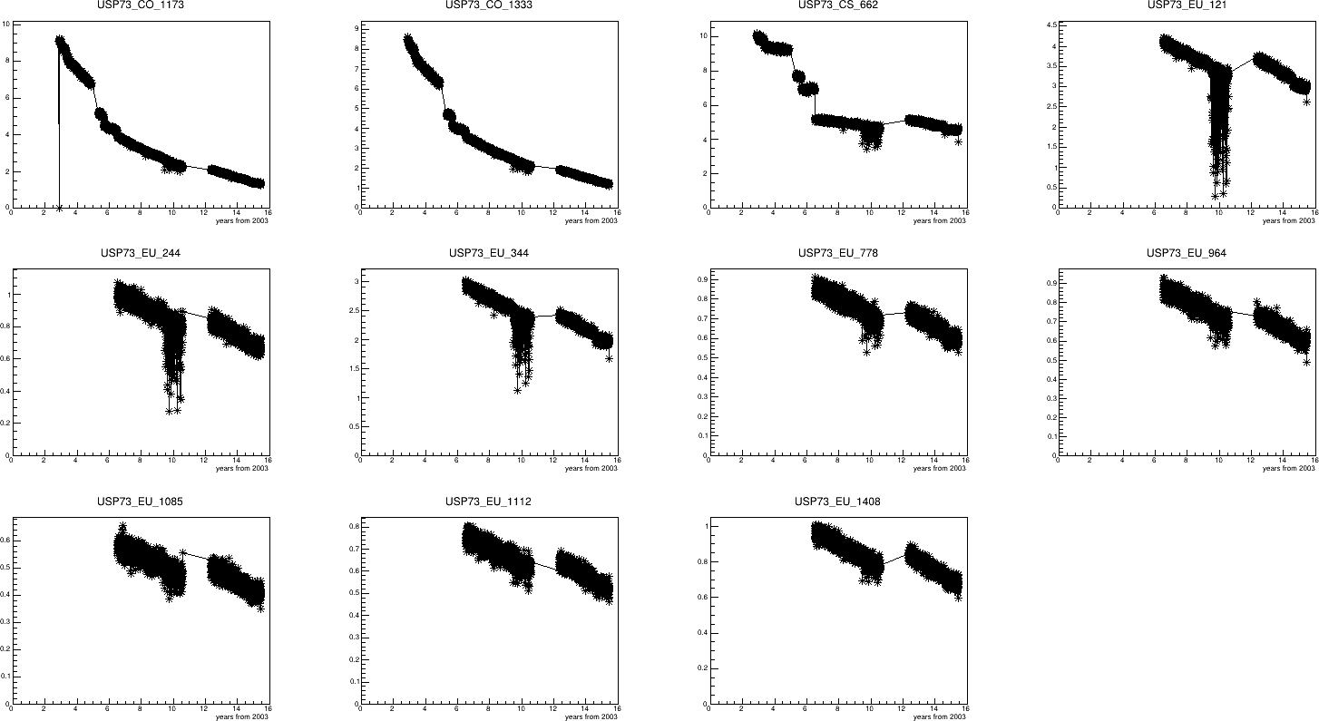
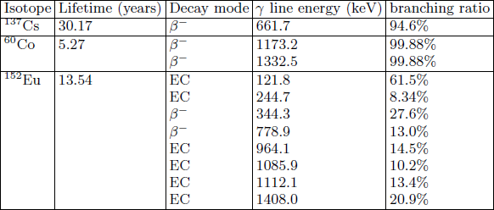
Search for small temporal modulations of half-lives of radionuclides in the IMS Quality Control data
Gabor David, SNARE david@bnl.gov
Poster No.:
T2.4-169
The most stable dataset: USP73 (Palmer Station, Antarctica)
RESULTS
Sudden jumps in the data often come from changing the QC source, the detector or the high voltage, but not all changes could be explained.
The steep downward excursions in the 121, 244 and 344 keV ¹⁵²Eu lines
are so far not understood.
Composition of the IMS QC source
Decay rates for all isotopes in the QC source (gamma lines). Horizontal scale: elapsed years since Jan. 1, 2003
Disclaimer: The views, opinions and/or findings expressed are those of the author and should not be interpreted as representing the official views or policies of the Department of Defense or the U.S. Government.
Disclaimer: The views expressed on this poster are those of the author and do not necessarily reflect the view of the CTBTO

Slide 11
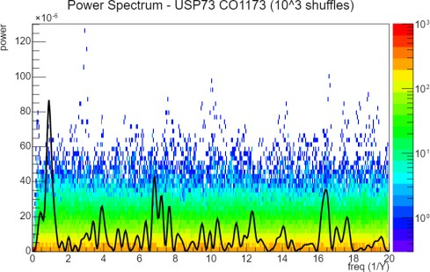
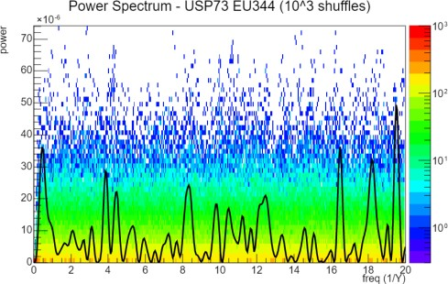
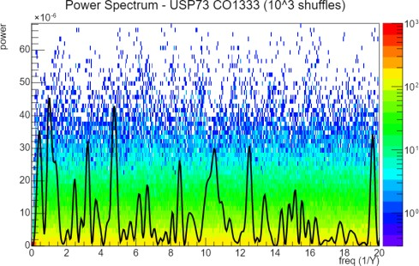
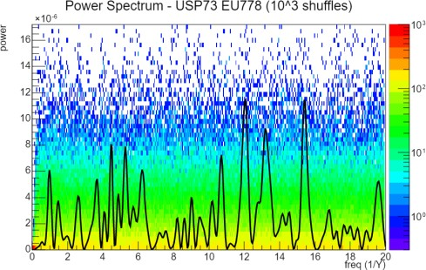
Search for small temporal modulations of half-lives of radionuclides in the IMS Quality Control data
Gabor David, SNARE david@bnl.gov
Poster No.:
T2.4-169
The most stable dataset: USP73 (Palmer Station, Antarctica)
RESULTS
Power spectra for ⁶⁰Co 1173 keV line (top) and 1333 keV line (bottom) with the powers from 1000 shufflings as background.
Power spectra for ¹⁵²Eu 344 keV line (top) and 778 keV line (bottom)
with the powers from 1000 shufflings as background.
These two lines come from the same decay chain, should be completely correlated and the respective power spectra should be nearly identical.
Both lines come from
b⁻ decay, the respective power spectra should be similar.
Clearly they are not, indicating randomness due to detector effects.
Clearly they are not, indicating randomness due to detector effects.
Disclaimer: The views, opinions and/or findings expressed are those of the author and should not be interpreted as representing the official views or policies of the Department of Defense or the U.S. Government.
Disclaimer: The views expressed on this poster are those of the author and do not necessarily reflect the view of the CTBTO

Slide 12
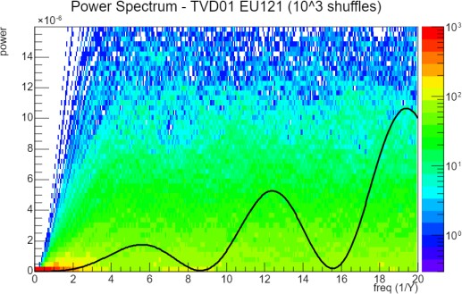
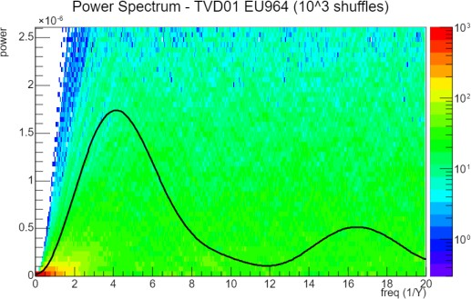
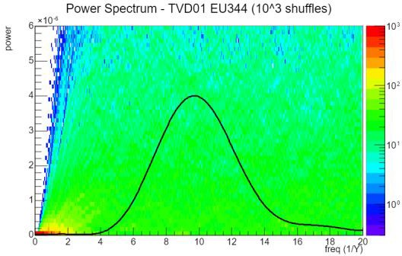
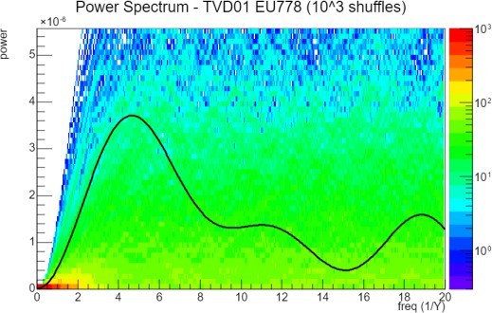
Search for small temporal modulations of half-lives of radionuclides in the IMS Quality Control data
Gabor David, SNARE david@bnl.gov
Poster No.:
T2.4-169
Some results from TVD01 -- ¹⁵²Eu, b⁻ decay and EC (electron capture)
RESULTS
Power spectra, EC lines:
121 keV (left), 964 keV (right) Different pattern, and all powers buried deep in the random shuffled background
Power spectra, b⁻ lines:
344 keV (left), 778 keV (right) Different pattern, and all powers buried deep in the random shuffled background
Note that this is a very short measurement, only 3.5 months with stable source!
Disclaimer: The views, opinions and/or findings expressed are those of the author and should not be interpreted as representing the official views or policies of the Department of Defense or the U.S. Government.
Disclaimer: The views expressed on this poster are those of the author and do not necessarily reflect the view of the CTBTO

Slide 13
Search for small temporal modulations of half-lives of radionuclides in the IMS Quality Control data
Gabor David, SNARE david@bnl.gov
Poster No.:
T2.4-169
CONCLUSIONS
Summary and outlook
The IMS QC data are perfect for the IMS mission, but inadequate for the study of temporal modulation of the decay rates at the percent level or below (where some experiments claim to have found it).
The principal reason is low statistics and day-to-day variations in the positioning of the QC source.
In certain short (1-3 years) intervals and certain stations we found hints of an 0.01 amplitude annual modulations, but no convincing evidence.
Detailed results of these studies will be published soon.
Simulations have shown that the signal/noise ratio (from statistical error and any detector instabilities) should be at least S/N>1/3, preferably even higher. This puts a lower limit on count-rates in a future precision experiment.
Based on our studies and the lessons learned from the TVD01 control experiment, we are working on a proposal for a new precision experiment, largely based on existing IMS (GDMS) hardware.
Disclaimer: The views, opinions and/or findings expressed are those of the author and should not be interpreted as representing the official views or policies of the Department of Defense or the U.S. Government.
Disclaimer: The views expressed on this poster are those of the author and do not necessarily reflect the view of the CTBTO

