Slide 1




STAX Project – Data analysis and interactive data access
M. Auer, S. Hellman, M. Rizescu
matthiasauer@isti.com
P2.4-211

Slide 2
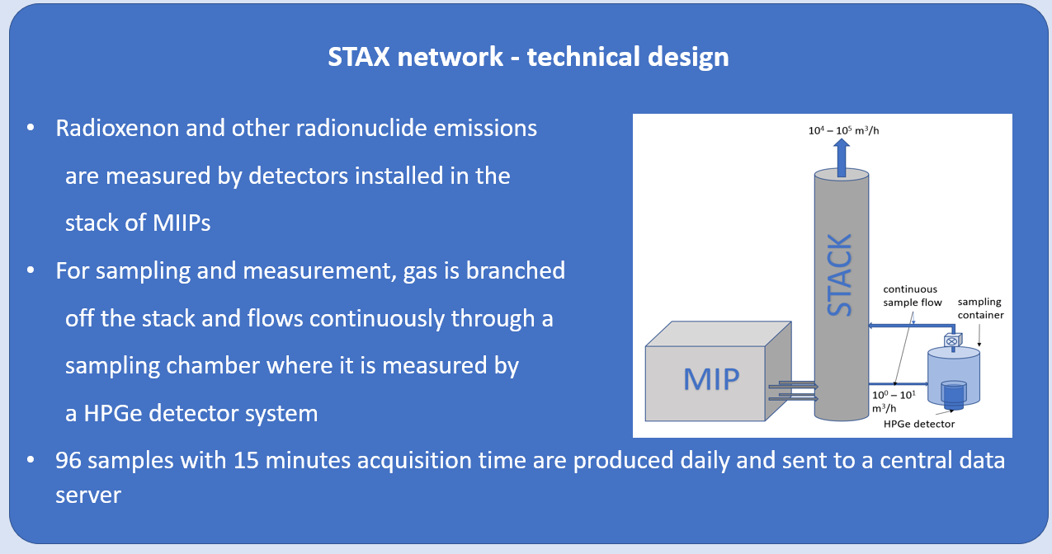
Source Term Analysis of Xenon – The STAX project
P2.4-211
Emissions of Xenon isotopes from nuclear fission based medical isotope production is the main source of background in the IMS noble gas network. The global emissions of radioxenon from the major MIPs are about 10 higher than the emissions from all NPPs worldwide (Achim et al 2016, Gueibe et al 2017). The STAX project (Source Term Analysis of Xenon) aims at the characterization of the origin of the Xenon measured at IMS sites.
STAX is an experimental network of sensors to detect and quantify emissions of xenon isotopes from Medical Isotope Production (MIP) facilities and other nuclear facilities. Using results from atmospheric transport modelling, the impact on the measured concentrations at IMS sites can be estimated based on the measured emissions.

Slide 3
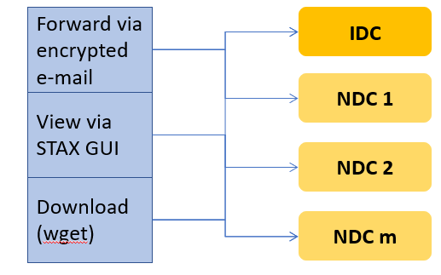
Data access, control and data security
P2.4-211
Data messages from the monitoring facilities to the data server are sent via authenticated and encrypted e-mail messages.
MIP operators can set delay times for sending of messages, in order to allow for time for data review, before data are distributed further to authorized users.
Data are only accessible to authorized users and access is approved for each individual facility separately, so that a given user only has access to the specifically assigned facilities.
Data are accessible via email, download or can be viewed through the STAX GUI
Data Types
15 minutes emission values are reported once per day in a time series file in json format
System specific State-of-Health data are transmitted every two hours
Optional, spectra (phd) messages in text file format (STAX1.0) are sent every 15 minutes
Alert messages are sent, triggered by user defined events
Except for the time series format, the format of the data messages is similar to IMS2.0 format conventions.

Slide 4
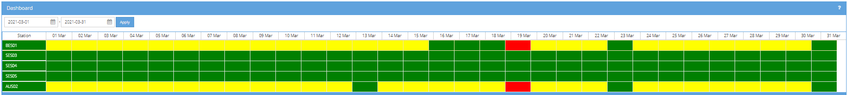
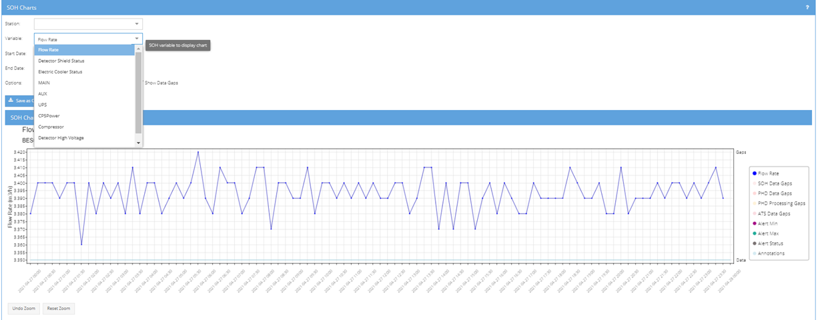
Data viewing (I)
P2.4-211
Authorized users can view data via the web based STAX user interface, currently located at stax.isti.com, but will shortly be moved to www.staxdata.net. The STAX user interface provides data viewing tools to display emission data as well as data on the operational network status.
A dashboard view provides an overview on the overall operational status of the network
For viewing details on the State-of-Health data of indivdiual STAX systems, such as air flow rate, power status or detector temperature, measurement system data can be viewed via the SOH chart interface:

Slide 5
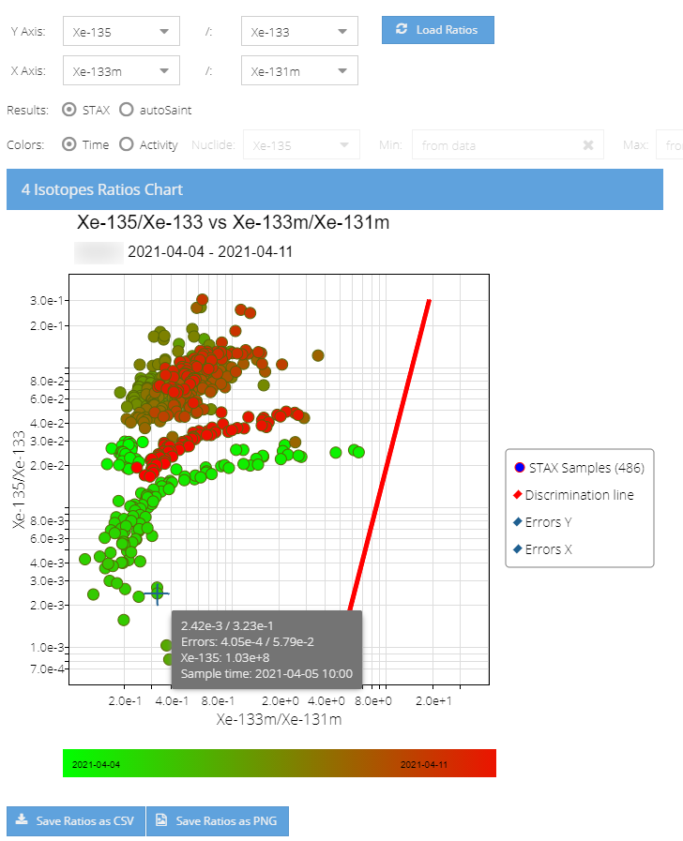
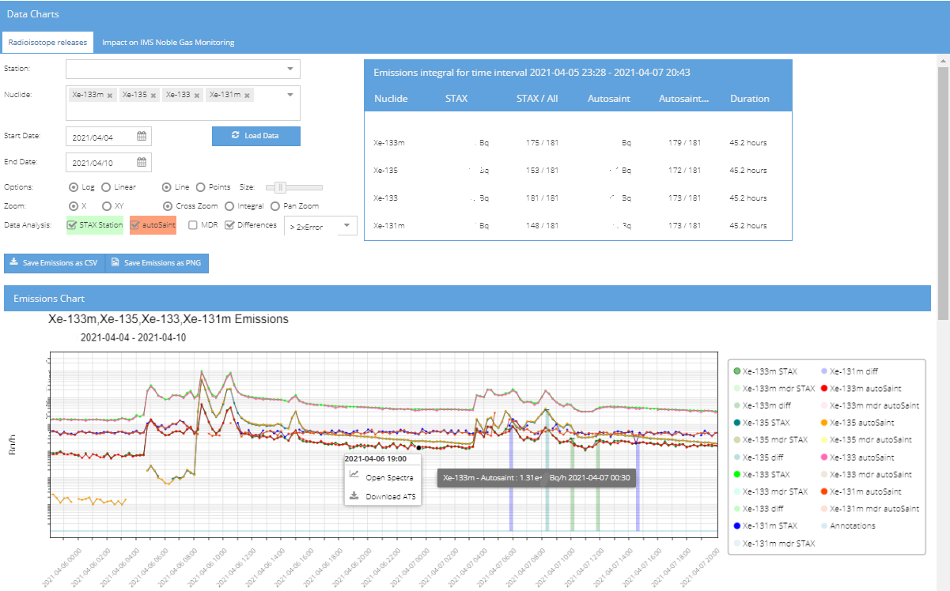
Data viewing (II)
P2.4-211
Emission data
An emission chart interface allows to view time series of emissions for all detected isotopes:
Each data point on the chart can be interactively accessed to retrieve its data and value, but also to access the corresponding spectrum chart and to download the associated time series data file.
Isotope Ratios Chart interface
Any combination of the isotopes detected during the selected time period can be viewed via the Isotope Ratio Chart
The temporal sequence of ratios can be visualized by a color scheme
Alternatively, to illustrate the temporal sequence, the activity of a selected isotope can be indicated by color
Data of individual data point as well as error bars can be viewed by mouse interaction

Slide 6
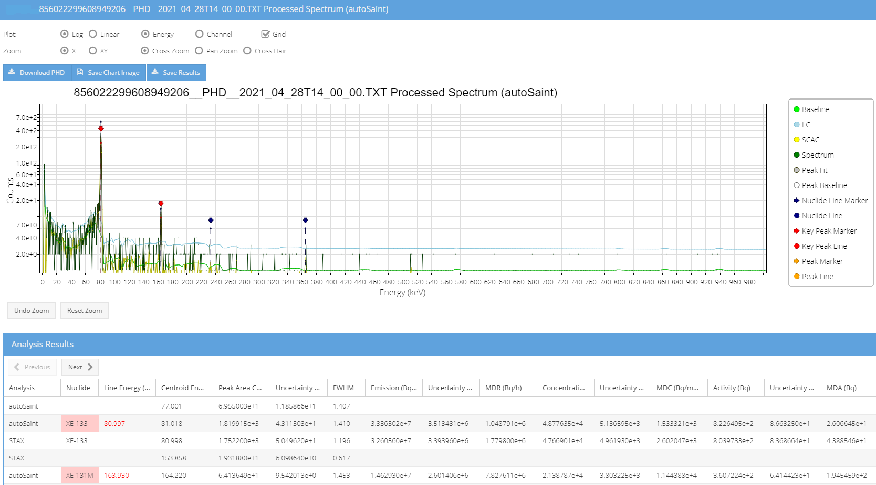
Parallel data analysis
P2.4-211
A total of 96 spectra is produced daily per STAX facility, therefore data analysis is fully automated and no regular manual review of data is performed
To increase the confidence in data quality, samples are analyzed twice in case raw spectra are transmitted to the STAX data server
Initial data analysis is done at the emitter facility using the STAX measurement systems proprietary software
Reanalysis is performed using the autosaint algorithm
Results of both analyses and their differences can be viewed on the emission data chart as well as on the Spectrum viewing interface
References:
Achim, P., Generoso, S., Morin, M., Gross, P., Le Petit, G., Moulin, C.: Characterization of Xe-133 global atmospheric background: implications for the international monitoring system of the comprehensive nuclear-test-ban treaty; J. Geophys Res-Atmos 121, 2016
Gueibe, C., Kalinowski, M. B., Bare, J., Gheddou, A., Krysta, M., Kusmierczyk-Michulec, J.: Setting the baseline for estimated background observations at IMS systems of four radioxenon isotopes in 2014; J. Env. Rad., 178-179 (2017)

